Slide 1
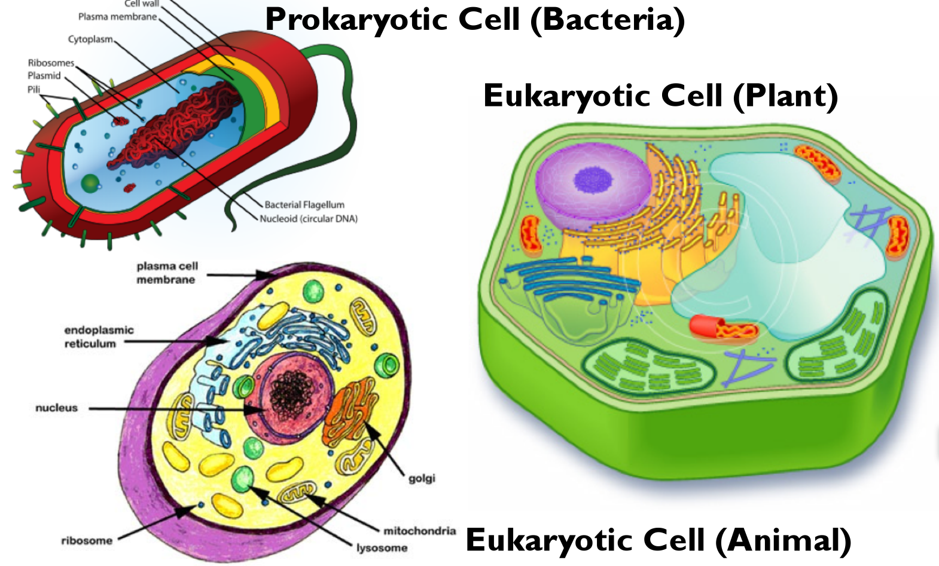
PROKARYOTES AND EUKARYOTES

Slide 3
PROKARYOTES
They are the oldest living beings in our world having simpler cells, structures and reproduction types. They are so small that they can not be seen without the usage of a microscope. There are billions of microorganisms in our surroundings. In a pinch of garden soil, approximately 2 billions of microorganisms are found. Microorganisms are usually associated with plants; some are beneficial and some are harmful. Some microorganisms provide various ecological benefits.

Slide 5
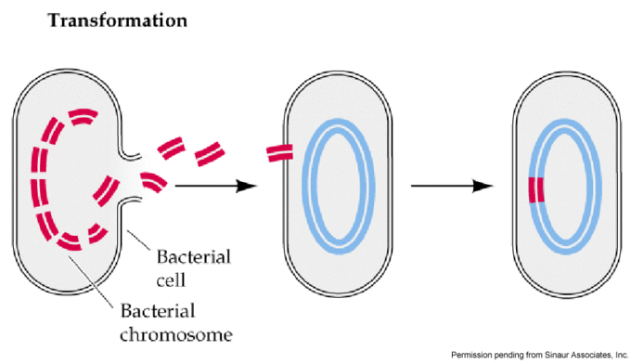
Prokaryotes are described as organisms with simple cell structures. Prokaryotic cells do not contain nucleus and organelles contrary to eukaryotes. Sexual reproduction is not present in prokaryotes; however they can change their genetic material by other methods: transformation, transduction, conjugation
Prokaryotes can obtain DNA fragments from their environment – this process is called transformation and is beneficial in genetic engineering.

Slide 6
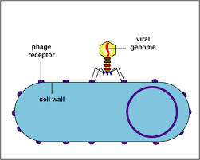
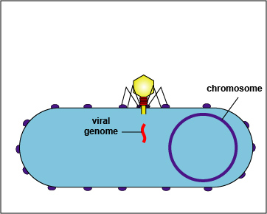
Prokaryotes may also gain DNA with virus infections – this process is called transduction.

Slide 7
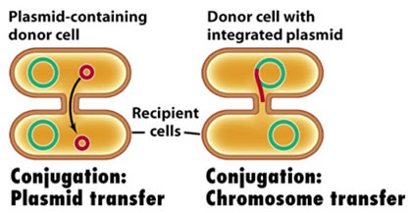
Another DNA transfer method among prokaryotes is conjugation. Bacteria performing conjugation are tied to each other with thin tubes called pilus and DNA is transferred to a bacterium from another one by passing through these tubes.

Slide 8
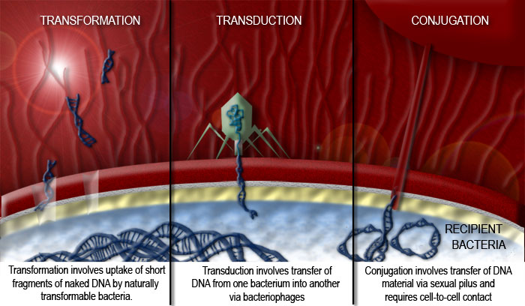

Slide 9
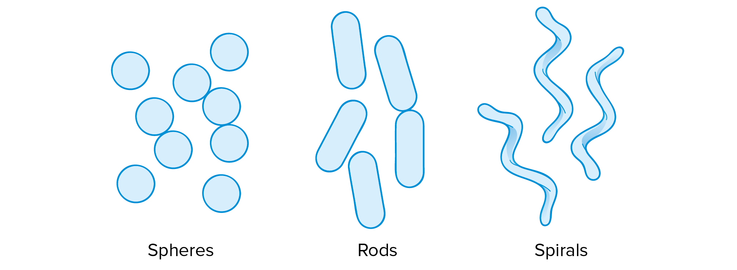
Description of prokaryotes is mostly performed by examining some of their DNA regions. In addition, some biochemical tests and examination of their structures and reproduction types also serve for the purpose of identification.
Prokaryote cells are usually round (coccus), cylindrical rod (basil) or like a cork puller (spiral).

Slide 10
Prokaryotes may be single celled or they may form small clusters called colony or may be linearly arranged (filament).

Slide 11
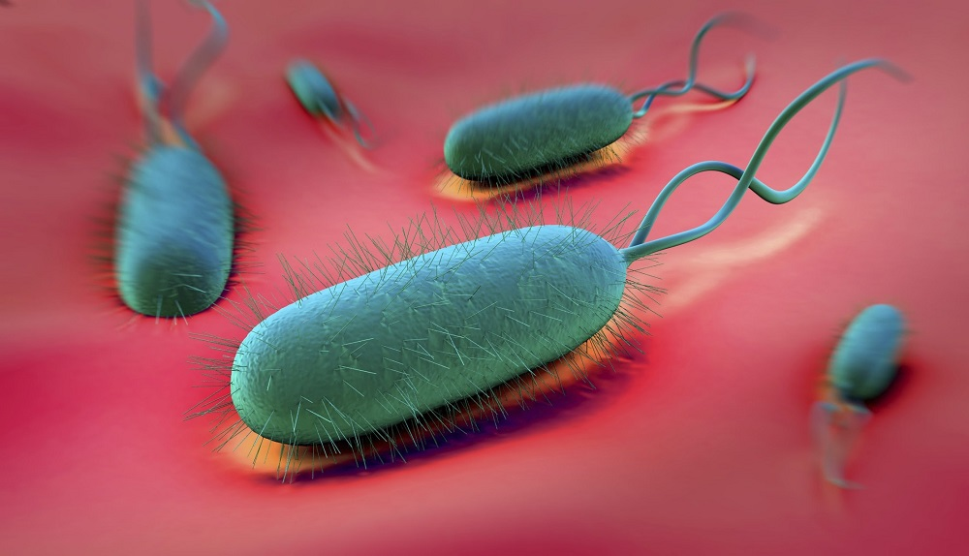
Prokaryotes have one or more flagella. These are thread-like extensions that enable them to swim in fluid environment. In another words, it is a whip-like structure that allows a cell to move.
They are found in all three domains of the living world: bacteria, archaea and eukaryota. While all three types of flagella are used for locomotion, they are structurally very different.

Slide 12
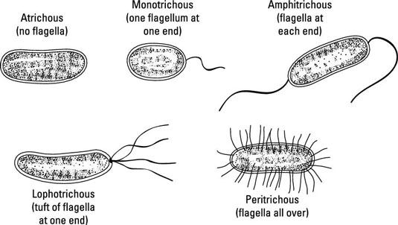

Slide 13
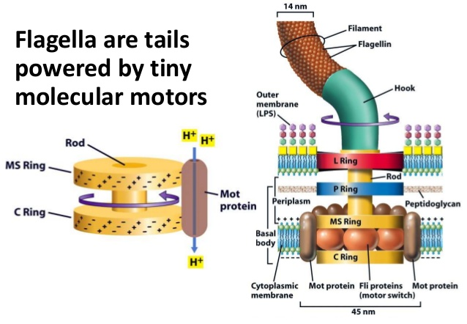

Slide 14
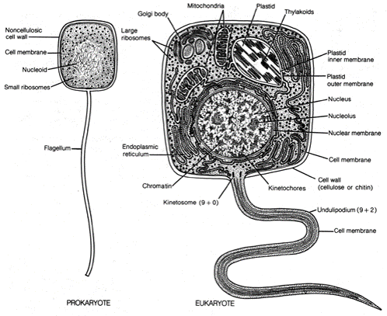
Prokaryote flagella is simple compared to eukaryote flagella and it enables swimming via a different mechanism: They turn like a fan, however eukaryote flagellae undulate. They move as a response to different stimuli like light, food or magnetic field.

Slide 15
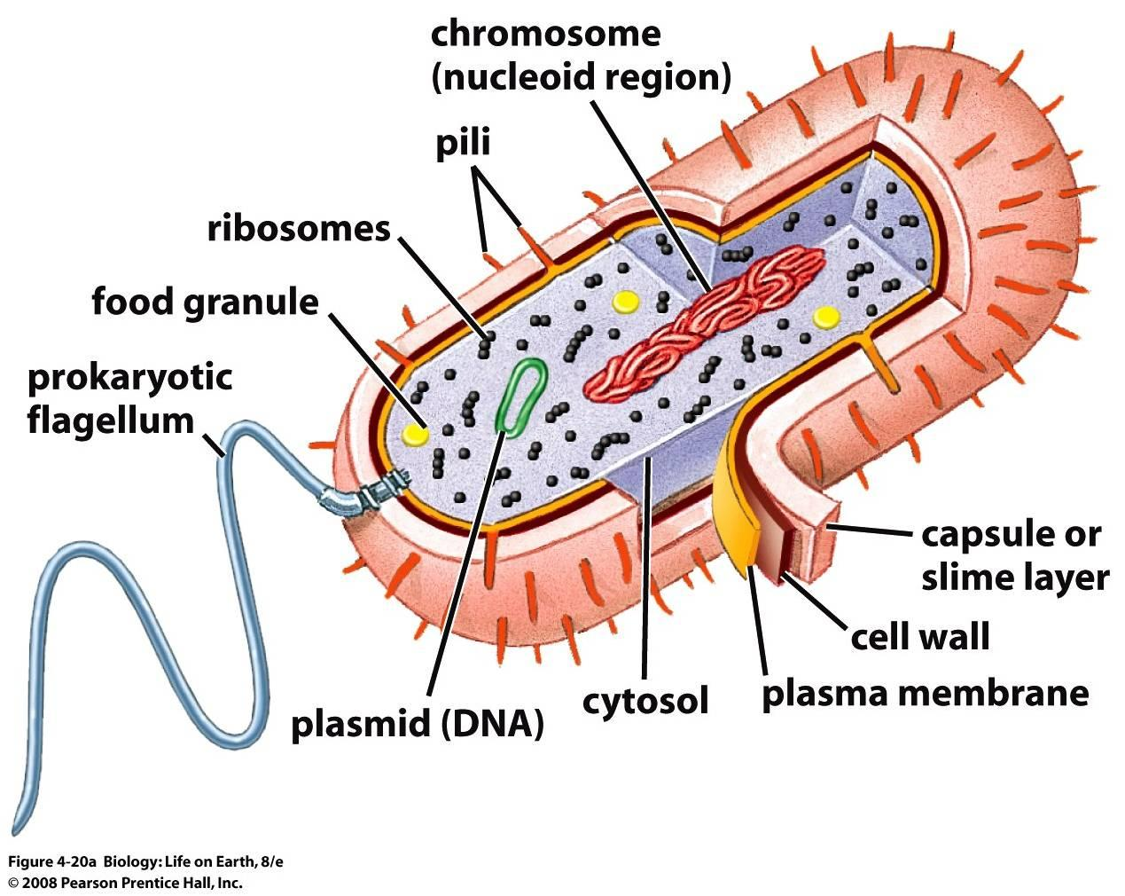
Most of the prokaryotes produce polysaccharides that cover their surfaces forming cell coat. These cell coats maybe named as a capsule, mucilaginous envelope or adhesive coat.

Slide 16
This capsule layer prevents the type of bacteria from being recognized and be killed by the defense systems of the host. Prokaryotes may also adhere to other surfaces of other living beings with the help of their mucilaginous envelopes. The layer that bacteria adhering to the surface form with their mucilaginous secretions is called a biofilm.

Slide 17
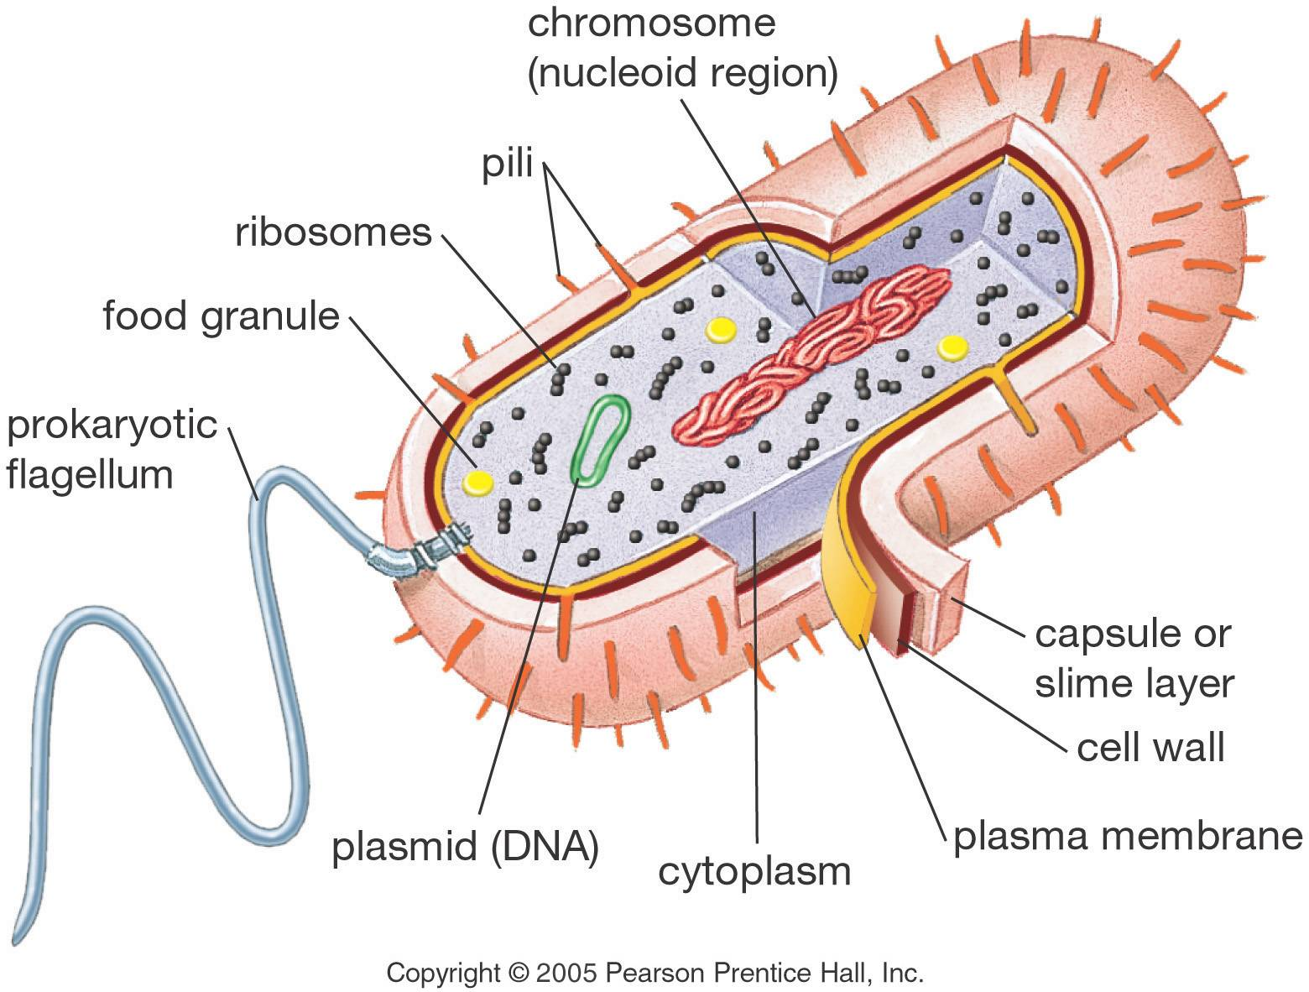
All prokaryotes (with a few exceptions) have a hard and durable cell wall that surrounds their cell membrane and the cytoplasm within. This cell wall is found inside the capsule if present. Cell wall prevents the explosion of the cell when extracellular water is intense. It also prevents viral infections. However some viruses may leave their contagious genetic material through the cell wall.

Slide 18
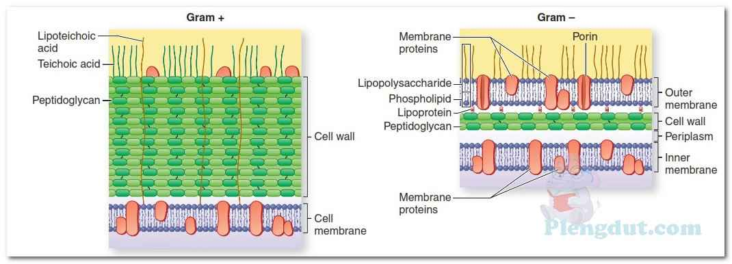
Peptidoglycan is found in cell walls of bacteria at least to a small extent. This substance is a mixture of protein and carbohydrate and is important in respect to the biology of bacteria and also in respect to medicine since the quantity of this substance determines the antibiotic susceptibility. Penicillin and some other antibiotics show activity by preventing peptidoglycan synthesis of bacteria. These antibiotics do not effect eukaryotic cells (except for those having antibiotic allergy).

Slide 19
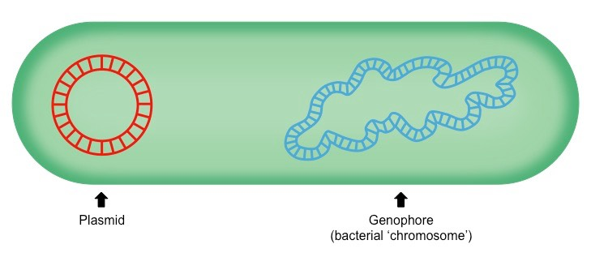
Main components of prokaryotic cell is nucleic acids (DNA and RNA), enzymes, other proteins, ribosomes and inner membrane.
DNA molecules of prokaryotes are found as a couple of DNA rings. Prokaryote DNA is called genophore or chromosome. Genophore is a long double strand of DNA, usually in one large circle. It includes most of the genetic material of the organism. They also contains plasmids (small continuous loops of DNA)

Slide 20
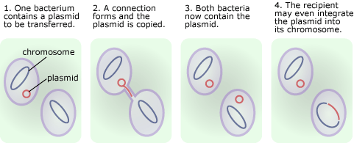
Plasmids produce toxins or carry genes that lead to antibiotic or heavy metal resistivity. Bacteria may transfer their plasmids to each other, and by this way various genes are distributed within a bacterial population in a short time. This is important in respect to the development of antibiotic resistance.

Slide 21
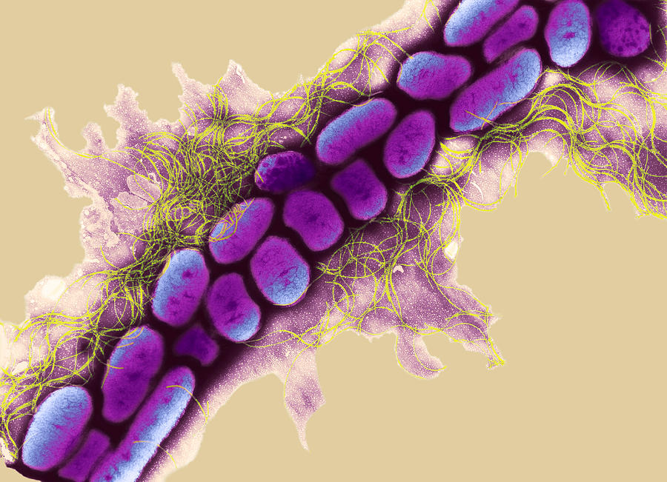
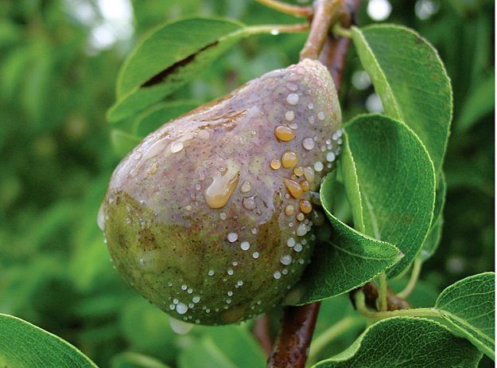
For example, fire blight disease is caused by Erwinia species on fruit trees. Farmers administer streptomycin to control the disease, however the plasmid that carries the streptomycin resistance gene is distributed and thus the disease can not be controlled.

Slide 22
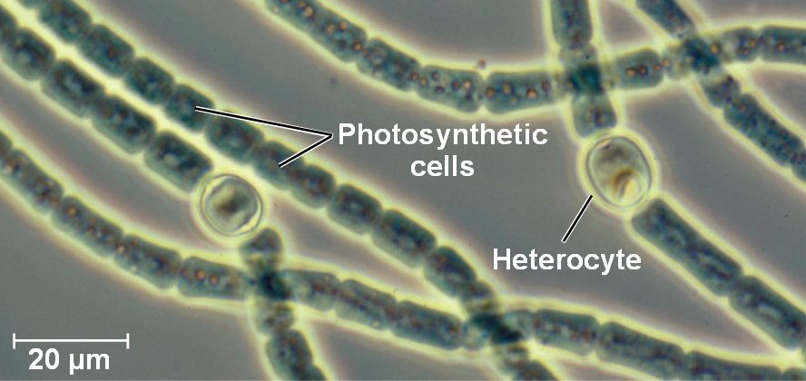
Prokaryote enzymes determine the metabolism type of the cell. For example, Anabaena (a cynanobacterium) cells have the necessary enzymes that enable them to perform photosynthesis. However Erwinia sp. does not have enzymes that enable them to perform photosynthesis

Slide 23
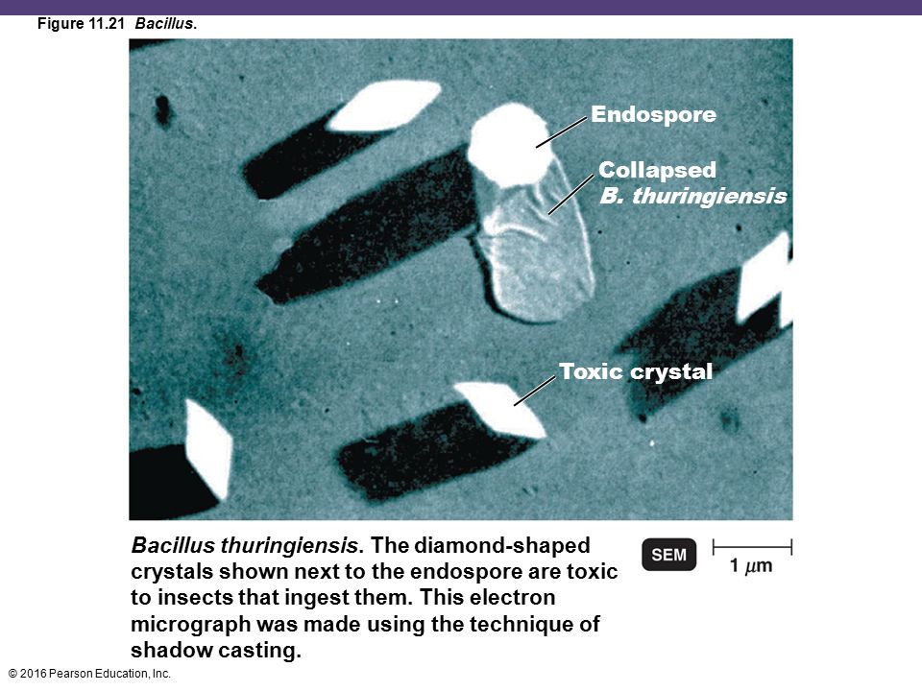
Other components that are present in prokaryote cells depend on the organism. For example, Anabaena and other cyanobacteria have thylakoids in their cells; Bacillus sp. produce a toxic protein crystal.

Slide 24
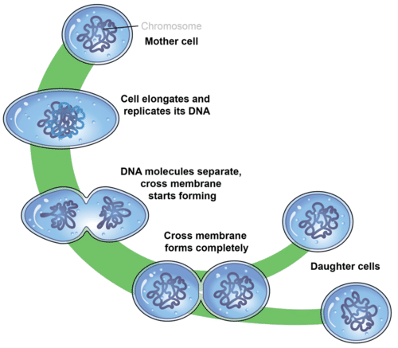
Prokaryotes reproduce by binary fission which is a simpler procedure compared to eukaryotes.

Slide 25
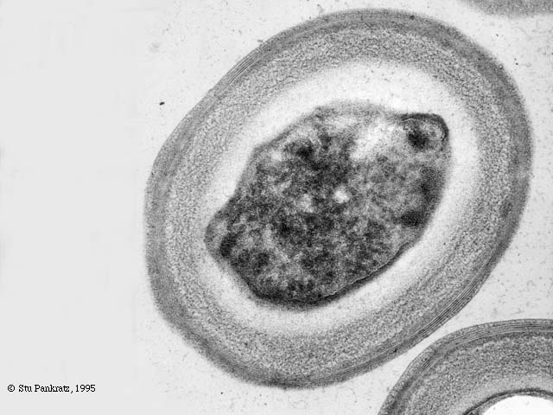
Most prokaryotes can produce thick walled cells that are called spores. These are especially produced when these organisms are under environmental pressure (stress) like lack of food or low temperature. They can survive in dormant state for a long time and when the conditions become favorable again, they germinate and turn into typical cells again.
Bacillus stearothermophilus
endospore

Slide 26
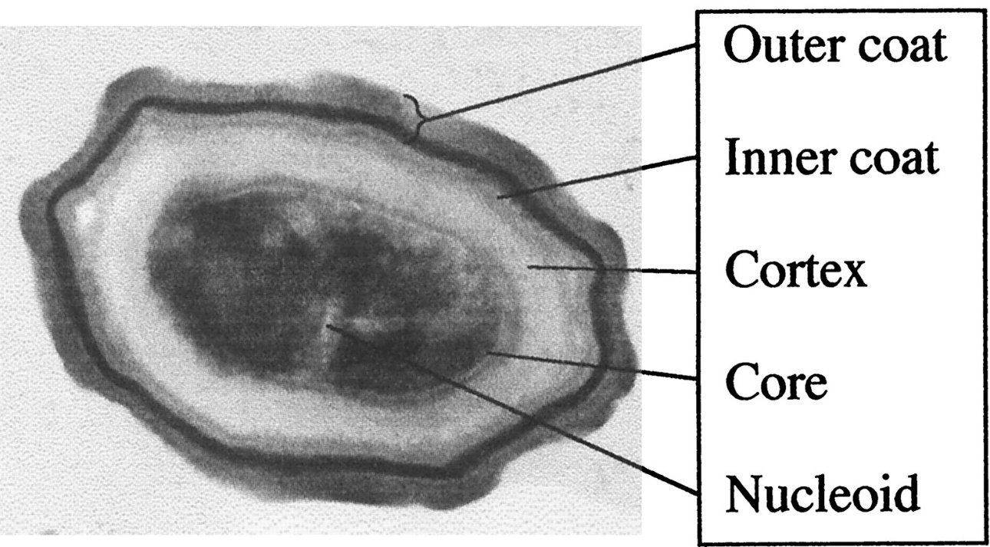
Endospore is another cell type that tolerates pressure (stress). Endospores are produced within the bacterium cell and passes into the environment after the cells in which they are produced die. The main reason for widespread bacterial infections and bacterium originated food contamination is these endospores.

Slide 27
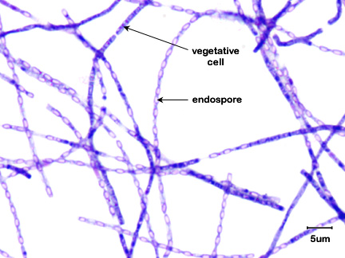
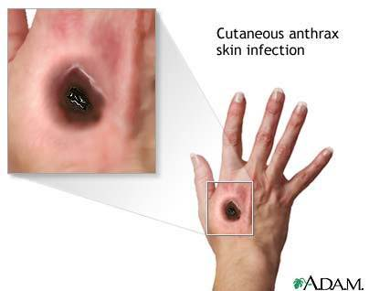
For example, Bacillus anthracis bacterium that produces endospores lead to anthrax (charbon) disease that is generally the subject of bioterrorism. This bacterium has gained attention as a potential biological war agent. Spores of this bacterium enter into human body through wounds, and lead to skin infections that can be easily treated with antibiotics.

Slide 28
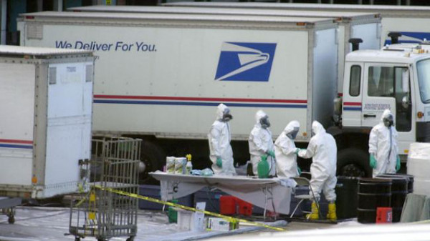
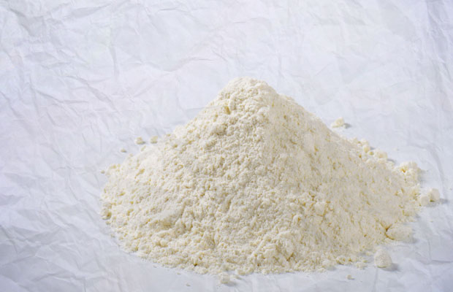
However, sometimes bacterium spores may reach the lungs via respiratory system; may reach the gastrointestinal system via consumption of infected and unbaked meat and result in lung or gastrointestinal infections. These type of internal infections are hard to treat since the toxins that Bacillus anthracis produces continue to harm the internal organs even after the bacteria are killed by the antibodies.

Slide 29
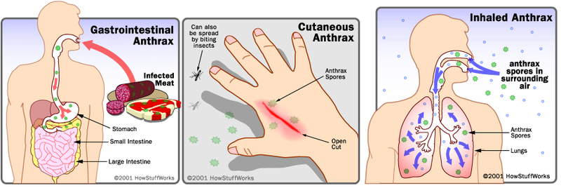
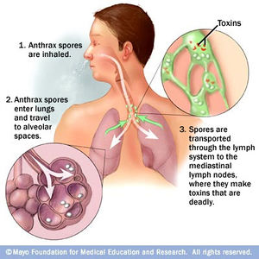

Slide 30
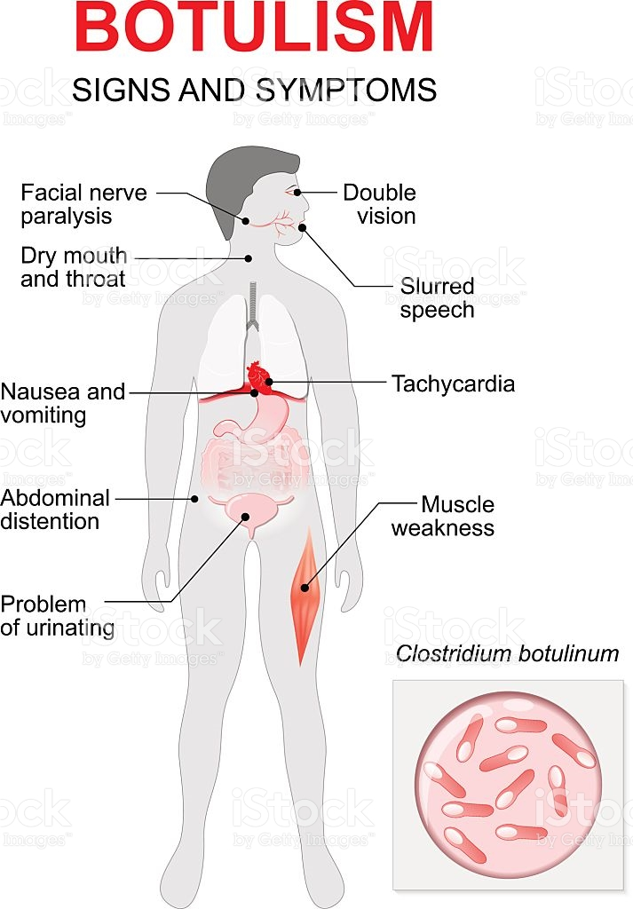
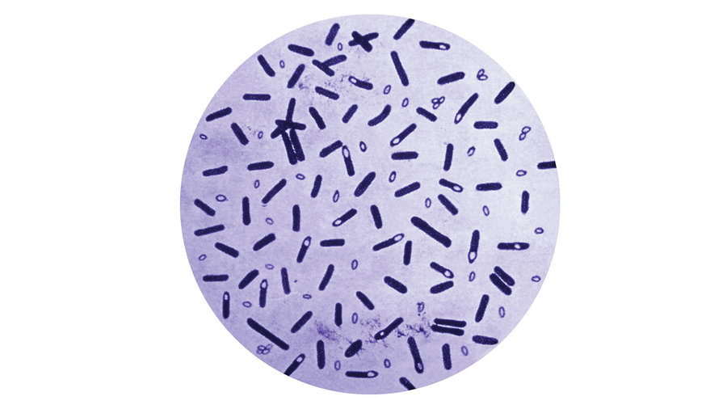
Another bacterium that contaminates food is Clostridium botulinum. This bacterium produces spores can resist pasteurization temperatures (10 min. At 80⁰C. Spores germinate following pasteurization, become typical cells and start to produce neurotoxins (nerve toxins). The neurotoxins that the bacteria produce lead to a type of paralysis called botulism.

Slide 31
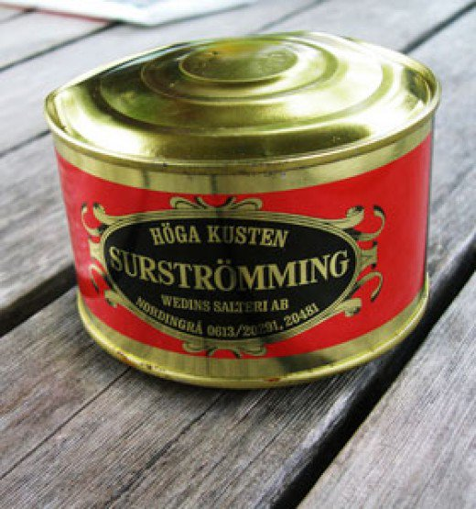
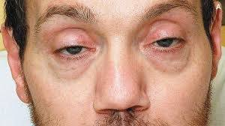
Consumers and people making their own canned foods at home are warned not to eat canned foods having swelled caps. The gas that leads to this swelling indicated that Clostridium botulinum may have proliferated inside the can.

Slide 32
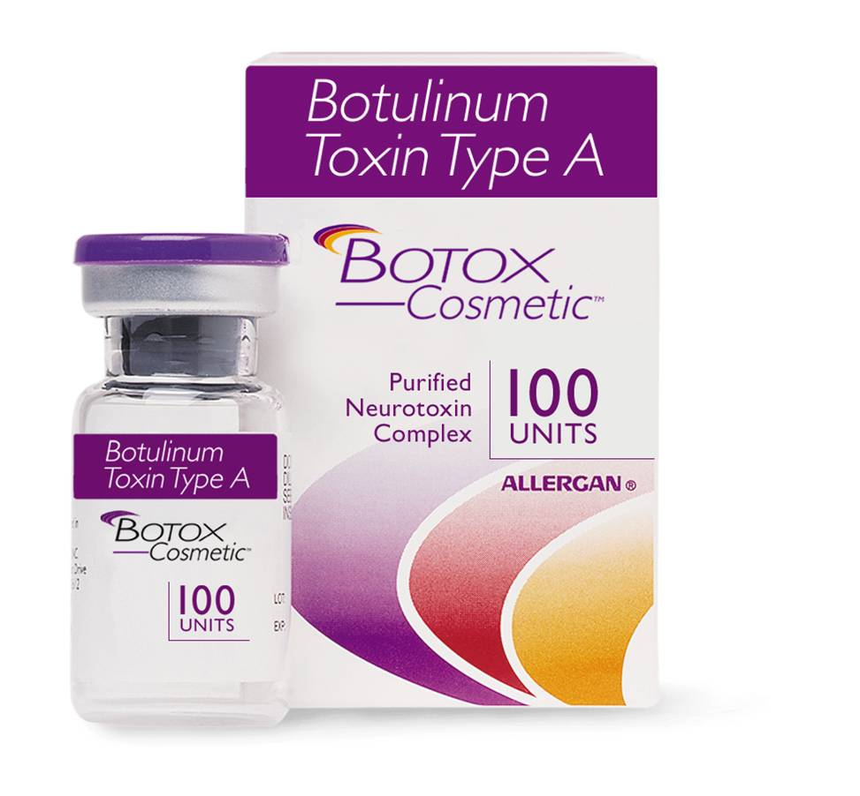
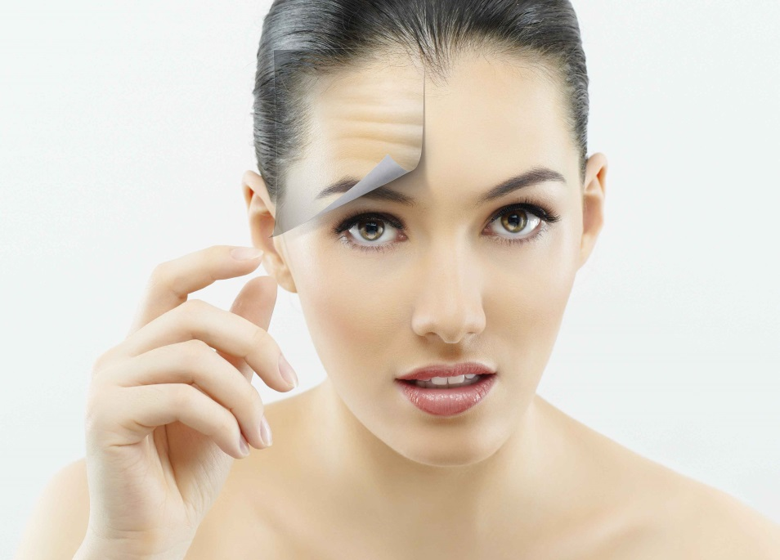
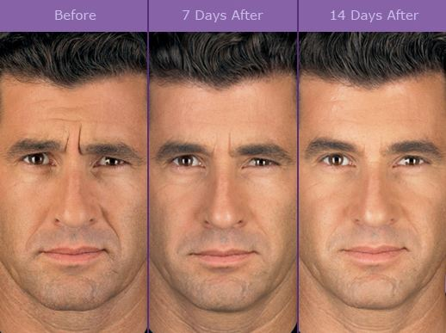

Slide 34
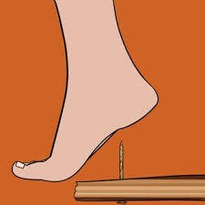
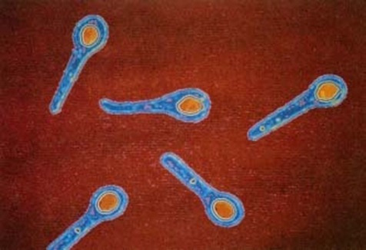
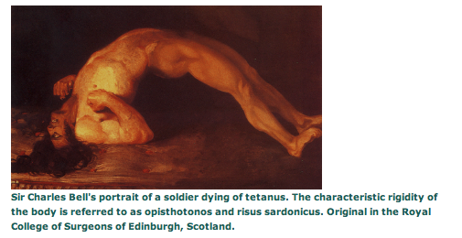
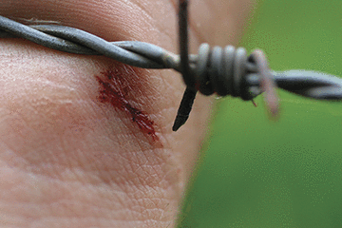
Another Clostridium species called C. tetani leads to the formation of tetanus. This bacterium is usually found in the soil and when its spores enter into the body through cuts and wounds, tetanus infection starts.

Slide 35
EUKARYOTES
Eukaryote cells have some similarities with prokaryote cells, however they have many differences. Eukaryote cells are defined as cells containing a nucleus, organelles (other intracellular components surrounded by a membrane). For example mitochondria and chloroplasts are organelles. Plant cells are eukaryote cells; they have nuclei, mitochondria and chloroplasts.
Though prokaryotes lack nucleus and other organelles, they still have some similarities.

Slide 36
All prokaryote and eukaryote cells have cell membrane consisting of bilayer of phospholipids. Integral membrane proteins are found within this bilayer structure. Cell membranes are described as semipermeable. Only very small molecules like oxygen, carbon dioxide, nitrogen, water and some other molecules can pass freely. Big molecules and ions can not enter the cell membrane without their specific integral membrane proteins.

Slide 38
Integral membrane proteins facing the inner and outer parts of the cell are slightly protruded. They are also called transmembrane proteins. Some integral membrane proteins carry the nutrients in to the cell from the outside and some of them carry the metabolism products or waste products outside the cell. Some other integral membrane proteins function as the receptors of external communication signals.

Slide 39
Some cell membrane proteins perceive the environmental information. Receptors are found in their membranes and when these receptors bind to the chemical messenger molecule, the signal is perceived. The signal that is perceived at the surface is transmitted to towards the cytoplasm and responses form. These receptors enable cells to perceive their chemical environments and react accordingly.

Slide 40
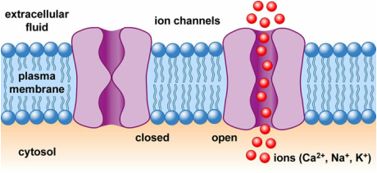
While these carrier proteins enable passing of molecules and information that is appropriate to be inside the cell, they limit passing of unnecessary and harmful substances.
eg. Root cells of plants use ion channels to get minerals. Some of these channels are specialized in phosphate uptake. Phosphate is found within the structure of phospholipids, ATP and DNA. Nitrate and ammonium (ions that plants use for the production of amino acids and proteins) are taken inside the cell with ion carrying proteins that are found in the membranes of root cells.

Slide 41
Osmosis results from the semipermeable property of the cell membrane. Cell wall is developed by nearly all prokaryotes, most of the Protista, fungi and plants as a evolutionary response. Cell wall is a limiting structure against expansion of the cell volume.
Animal cells do not require cell wall against bursting of the cell since the salt concentration of the body fluids that the cells are found within is the same with the salt concentration of the cell itself. Thus salt is important in the diet of animals.

Slide 42
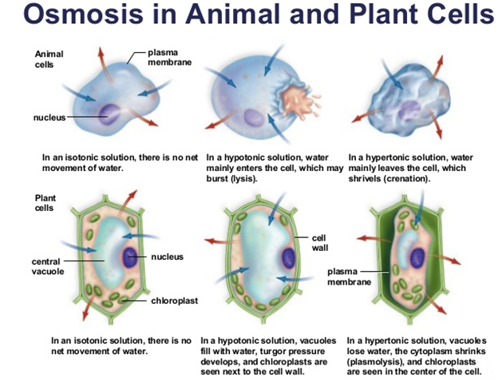

Slide 43
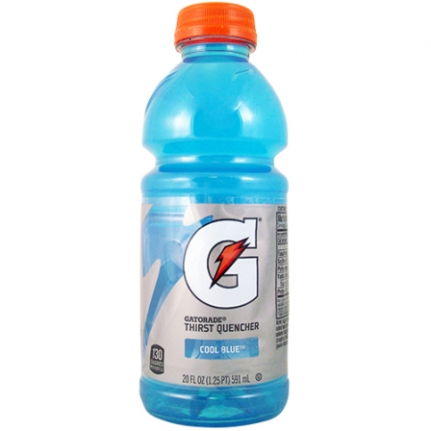
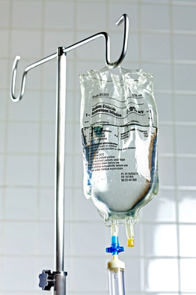
Sportsmen and sportswomen drink special drinks enhanced with soluble substances to compensate for the fluid that they lose by sweating. And seriously dehydrated patients are given salt and sugar instead of pure water due to this phenomenon.

Slide 44
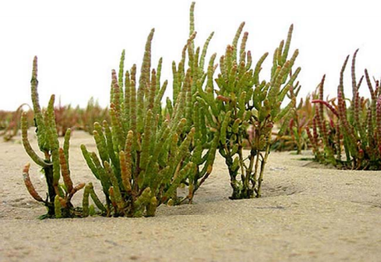
Normally hypertonic solutions like salty water damage plants cells. If pot flowers are given salt water, they get damaged. In animal cells, ion channels are present to prevent the accumulation of excess ions in cytoplasm (absent in plant cells).
Some plants may adapt to salty environment (e.g. deserts, salty swamps). These plants are termed as halophytes (salt loving plants).

Slide 45
Halophytes have developed some adaptation mechanisms to avoid osmosis damage to the cell. Most of these cells accumulate inorganic salts like NaCl in their vacuoles and organic solutes in their cytoplasms. By this way, plants try to balance the concentration of solutes inside and outside the cell. Some other halophytes empty the excessive salts to the outside.

Slide 46
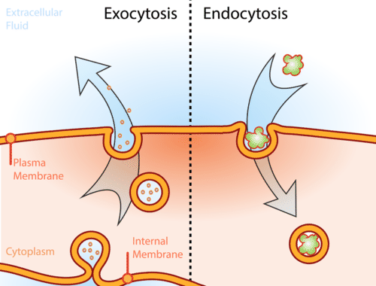
Endocytosis and exocytosis are methods of substance transfer via cell membrane. Cells use other methods to take in or empty the substances that can not pass through the carrier proteins that are found in their membranes. Transfer of these big substances are performed by endocytosis and exocytosis. However prokaryotes do not perform endocytosis and exocytosis.

Slide 47
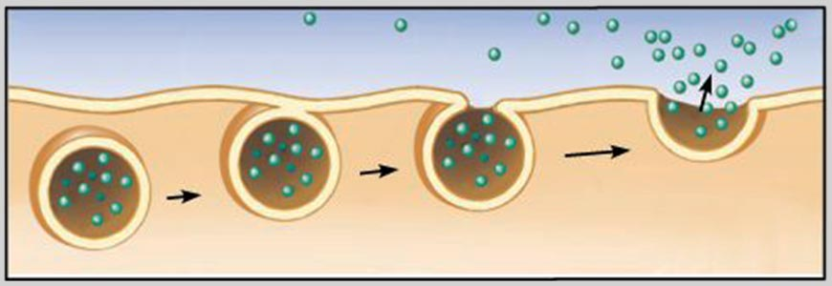
Substances that would be expelled from the cell via exocytosis are primarily packaged in vesicles that have the structure of a phospholipid membrane. These balloon like vesicles move towards the cell membrane, and when they reach the cell membrane they fuse with the membrane and the substances that they contain are disposed of.

Slide 48
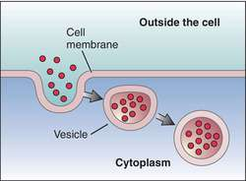
Endocytosis starts with the accumulation of particles or other materials that are found outside the cell with a pocket formed by the cell membrane. The membrane turns into a vesicle with the gathering of the pocket opening. Then the vesicle detaches from the cell membrane and becomes a free vesicle within the cytoplasm.

Slide 49
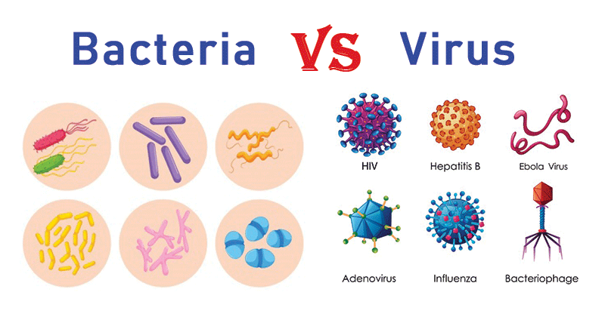
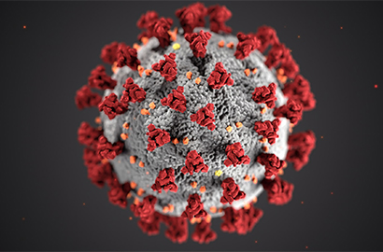
Corona virus
Covid-19

