Slide 1

The exocrıne Pancreas
-2020-
-Internal Medıcıne I-
Prof. Dr. Ebubekir Ceylan

Slide 2
GENERAL CONSIDERATIONS
The pancreas is located in the cranial abdomen, with the left limb positioned between the transverse colon and the greater curvature of the stomach and the right limb running alongside the proximal duodenum.
The major function of the exocrine pancreas is to secrete digestive enzymes, bicarbonate, and intrinsic factor (IF) into the proximal duodenum. Pancreatic enzymes are responsible for the initial digestion of larger food molecules and require an alkaline pH to function (hence the concurrent bicarbonate secretion by pancreatic duct cells).
The pancreas is the only significant source of lipase, and hence steatorrhea (fatty feces) is a prominent sign of exocrine pancreatic insufficiency (EPI).
Pancreatitis is the most common disease of the exocrine pancreas in both cats and dogs; EPI, although less common, is also recognized frequently. Uncommon diseases of the pancreas include pancreatic abscess, pseudocyst, and neoplasia.

Slide 3
PANCREATITIS
Pancreatitis may be acute or chronic. As with acute and chronic hepatitis, the difference is histological and not necessarily clinical, and there is some clinical overlap between the two.
The causes of acute and chronic pancreatitis may be different, but there may also be some overlap between them.

Slide 4
ACUTE PANCREATITIS
In recent years with the discovery of hereditary mutations of trypsin, which predispose to pancreatitis; the pathophysiology of this disease is believed to be similar in dogs and cats. The final common pathway in all cases is the inappropriate early activation of trypsinogen within the pancreas as a result of increased autoactivation and/or reduced autolysis.
It can be seen in fatty animals or those who eat too much fatty food.

Slide 5
Causes of Acute Pancreatitis

Slide 6
Clinical Features
Acute pancreatitis typically affects middle-aged dogs and cats, although very young and very old individuals may also be affected.
It is likely that the disease is multifactorial with a genetic tendency and superimposed triggering factors. For example, eating a high-fat meal may be a trigger for a susceptible terrier. Some studies suggest a slight increase in risk in female dogs, whereas others show no sex predisposition.
Obesity has been suggested as a predisposing factor in dogs, but it is unclear whether this is a cause or whether it is co-segregating with disease. (i.e., breeds at high risk for acute pancreatitis may coincidentally also be breeds with a high risk for obesity).
Concurrent endocrine diseases such as hypothyroidism, hyperadrenocorticism, or diabetes mellitus (DM) increase the risk of severe fatal pancreatitis in dogs; therefore it is important to identify these in the history. In cats the history may include features of concurrent cholangiohepatitis, inflammatory bowel disease, or hepatic lipidosis.

Slide 7
In mild cases, we observe lack of appetite, depression, and abdominal pain whereas in severe conditions, acute vomitting, hemorrhagic diarrhea, shock and death can be observed.
In complete blood count tests, dehydration and leukocytosis; if there is diffuse intravascular coagulation (DIC), thrombocytopenia can be seen.
Plasma color can also be indicative; it is lipemic and sometimes icteric.

Slide 8
Azotemia, which is an elevation of blood urea nitrogen, can be seen in blood serum because of dehydration.
ALP level rises 2-12 times, ALT level is normal, or may increase eight times.
Mild versions of hyperglisemia, hypoalbuminemia, hypocalcemia and hyperbilirubinemia can be observed.
Amilase level, which increase in the beginnig, decrease gradually.

Slide 9
Diagnosis
Routine Clinical Pathology
Routine laboratory analysis (i.e., complete blood count [CBC], serum biochemical profile, and urinalysis) typically does not help in arriving at a specific diagnosis, but it is very
important to perform these in all but the mildest cases because they give important prognostic information and aid in effective treatment,
Dog exhibiting evidence of cranial abdominal pain by
assuming the "position of relief." (Courtesy Dr. William E.
Hornbuckle, Cornell University, College of Veterinary
Medicine.)

Slide 10
Carefully palpating a Cocker Spaniel for cranial abdominal pain. A , The clinician should
palpate craniodorsally under the rib cage for evidence of focal pancreatic pain (as shown
in this dog by turning of the head). B, With deep-chested dogs it helps to ask an assistant
to elevate the head of the dog to displace the pancreas caudally

Slide 11
More Specific Pancreatic Enzyme Assays
More specific laboratory tests for the pancreas are the catalytic assays amylase and lipase and the immunoassays trypsinlike immunoreactivity (TLI) and pancreatic lipase immunoreactivity (PLI).
Immunoassays, however, use an antibody against a part of the enzyme molecule distant from the active site and thus will also measure inactive precursors (e.g., trypsinogen) and tend to be organ and species specific.
Overall, PLI has the highest sensitivity and likely the highest specificity in both species and is the only reliable test for pancreatitis currently available in cats.

Slide 12
Diagnostic Imaging
The most sensitive way to image the canine and feline pancreas noninvasively is by ultrasonography. Abdominal radiographs in patients with pancreatitis usually show mild or no changes, even in those with severe disease.
Occasionally, a "mass" effect may be seen in the region of the pancreas, usually the result of fat necrosis. Pancreatic tumors by contrast are usually small, but it is impossible to differentiate fat necrosis from neoplasia using imaging alone. Abdominal radiographs appear normal in many dogs and cats with acute or chronic pancreatitis.
Histopathology
Definitive diagnosis of acute pancreatitis can be achieved only via histopathology of a pancreatic biopsy, but this is invasive and not indicated in most cases.
The pancreas usually appears grossly inflamed and may have a masslike appearance. The latter is usually due to fat necrosis and/or fibrosis and not neoplasia; therefore no animal should be euthanized on the basis of a tumorlike appearance in the pancreas without supportive cytology or pathology because
most large masses in the pancreas are not tumors.

Slide 13
Treatment
Intravenous Fluids and Electrolytes
Intravenous fluid therapy is very important in all but the mildest cases of pancreatitis to reverse dehydration, address electrolyte imbalances associated with vomiting and fluid pooling in the hypomotile gastrointestinal tract, and maintain adequate pancreatic circulation. It is vital to prevent pancreatic ischemia associated with reduced perfusion because it contributes to necrosis.
Analgesia
In practice, analgesia is indicated in almost all patients with pancreatitis and should be given routinely to cats with pancreatitis because pain is difficult to assess in this species. Morphine agonists or partial agonists are often used, particularly buprenorphine. Morphine, meperidine, and fentanyl (intravenous or patches) can also be used.

Slide 14
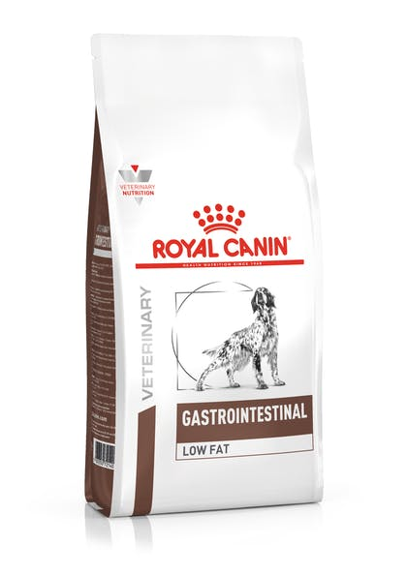
Nutrition
Initially, it was believed that early enteral nutrition was contraindicated because it was likely to result in cholecystokinin and secretin release, with consequent release of pancreatic enzymes and worsening
of pancreatitis and associated pain.
Total parenteral nutrition (TPN) seemed a more logical route early in the disease process, with jejunal tube feeding later in the disease aiming to bypass the areas of pancreatic enzyme stimulation.
The more severe the disease, the more important it is to feed early. In severe cases this is best achieved with jejunostomy tube feeding by continuous infusion of an elemental diet, although frequent small-volume feeds of a low-fat food via a gastrostomy tube is also well tolerated in most dogs and cats with moderate pancreatitis.
A good initial choice is baby rice mixed with water followed by a low-fat proprietary veterinary diet (such as Eukanuba Intestinal Formula; Hill’s i/d; Royal-Canin-Waltham Digestive low fat or Purina E N -formula)
Altunyurt, Umay ‘’Royal Canin Gastrointestinal Low Fat Dry’’, October,2020.

Slide 15
Antiemetics
Antiemetics are often necessary to manage acute vomiting in dogs and cats with pancreatitis. Metoclopramide has been used successfully i n dogs with pancreatitis (0.5 to 1 mg/kg,
administered intramuscularly, subcutaneously, or orally three times a day, or 1 to 2 mg/kg, administered intravenously over 24 hours as a slow infusion)
A phenothiazine antiemetic such as chlorpromazine may be more effective in
some patients.
Gastroprotectans
Patients with acute pancreatitis have an increased risk of gastroduodenal ulceration caused by local peritonitis and treated as necessary with sucralfate and acid secretory inhibitors ( H 2 blockers such as cimetidine, famotidine, ranitidine, or nizatidine or the proton pump inhibitor omeprazole).
Antibiotics
Fluroquinolones are effective against only aerobes, so combination with another antibiotic with action against anaerobes, such as metronidazole or amoxicillin, may be necessary.

Slide 16
CHRONIC PANCREATITIS
Chronic pancreatitis is defined as "a continuing inflammatory disease characterized by the destruction of pancreatic parenchyma leading to progressive or permanent impairment of exocrine or endocrine function or both.«
The gold standard for diagnosis is histology, but this is rarely indicated or performed in dogs or cats. Noninvasive diagnosis is difficult with the currently available diagnostic imaging, and blood tests have a lower sensitivity than for acute disease.
Chronic pancreatitis has been considered a rare and not particularly important disease in dogs, whereas it is recognized as the most common form of pancreatitis in cats. However, it was noted that a high proportion of cases of EPI( Exocrine Pancreas Insufficiency) in dogs were caused by chronic pancreatitis and also that it might be responsible for up to 30% or more of cases of diabetes mellitus (DM).

Slide 17
Clinical Features
Dogs with chronic pancreatitis, regardless of the cause, most commonly present with mild intermittent gastrointestinal signs;
*Anorexia,
*Occasional vomiting,
*Mild hematochezia, and obvious postprandial pain, which often goes on for months to years before a veterinarian is consulted.
In cats the clinical signs of chronic pancreatitis are usually very mild and nonspecific. This is not surprising considering that cats display mild clinical signs, even in association with
acute necrotizing pancreatitis.
Chronic pancreatitis is the most common cause of extrahepatic biliary obstruction in dogs, and dogs and cats with acute-on-chronic pancreatitis frequently develop jaundice.

Slide 18
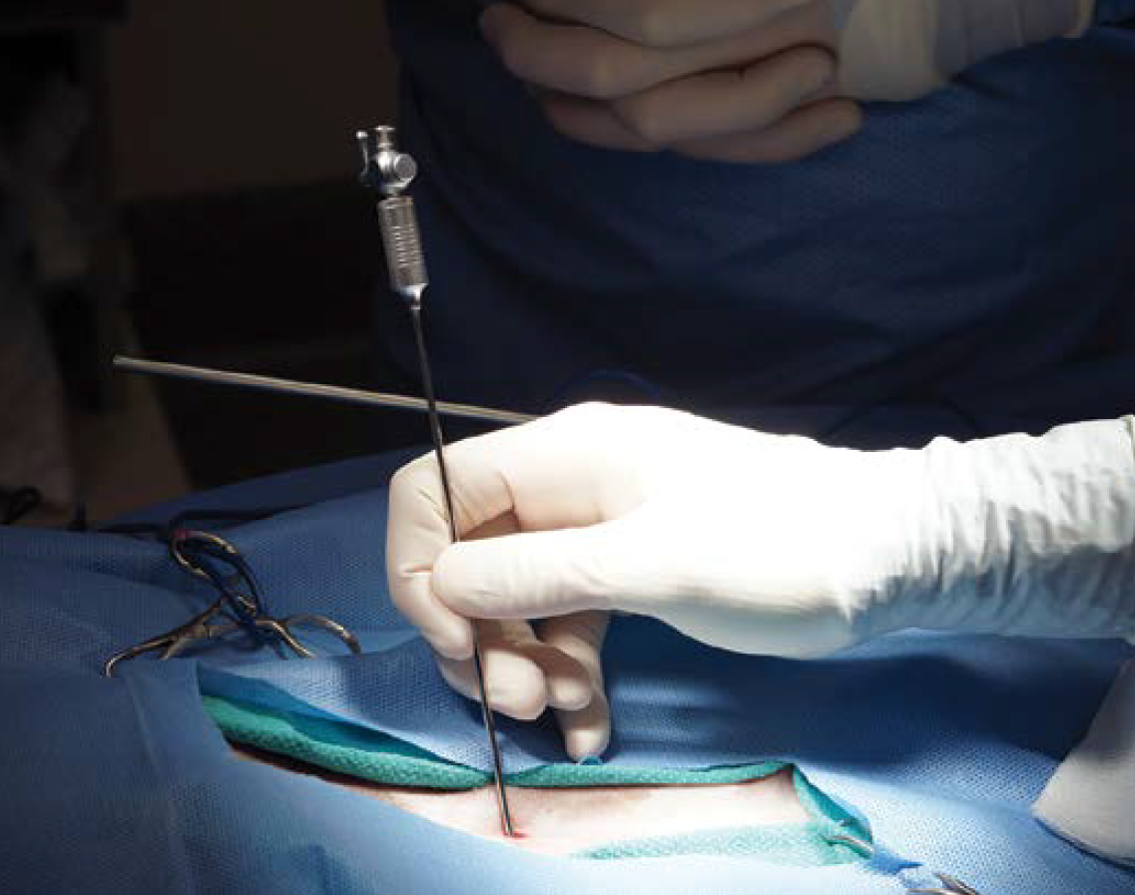
Diagnosis
Noninvasive Diagnosis
In the absence of a biopsy, which is the gold standard, the clinician must rely on a combination of clinical history, ultrasonography, and clinical pathology.
Ultrasonography has a lower sensitivity in dogs and cats with chronic disease because there is less edema than in those with acute disease. A variety of ultrasonographic changes may be seen in patients with chronic pancreatitis, including a normal pancreas, a mass lesion, a mixed hyperechoic and hypoechoic appearance to the pancreas, and sometimes an appearance resembling that of classical acute pancreatitis with a hypoechoic pancreas and a bright surrounding mesentery.
Biopsy
Establishing a definitive diagnosis relies on obtaining a pancreatic biopsy. However, this will not be indicated in most cases until there are effective treatments because a biopsy is a relatively invasive procedure, the results of which do not alter treatment or
outcome.

Slide 19
Treatment
In the milder cases symptomatic treatment can make a real difference in the animal's quality of life. Changing to a low-fat diet (such as Hill's ID, Royal-Canin-Waltham Digestive low fat, or Eukanuba Intestinal) apparently reduces postprandial pain and acute flare-ups i n many cases.
-short courses of metronidazole (10 mg/kg, PO ql2h)
-serum B12 concentration should be measured regularly, and cobalamin should be supplemented parenterally as necessary (0.02 mg/kg, administered intramuscularly 2 to 4 weeks until serum concentration normalizes)

Slide 20
EXOCRINE PANCREATIC INSUFFICIENCY
EPI is a functional diagnosis that results from a lack of pancreatic enzymes. As such, unlike pancreatitis, it is diagnosed on the basis of clinical signs and pancreatic function tests.
The pancreas is the only significant source of lipase, so fat maldigestion with fatty feces (steatorrhea) and weight loss are the predominant signs of EPI.
Pancreatic acinar atrophy (PAA) is believed to be the predominant cause of EPI in dogs, but recent work has shown that end-stage chronic pancreatitis is also important in this
species.
PAA has not been recognized in cats; end-stage pancreatitis is the most common cause of feline EPI. The development of clinical EPI requires approximately a 90% reduction i n lipase production and thus extensive loss of pancreatic acini.
In contrast, many dogs with end-stage chronic pancreatitis also develop D M either before or after EPI as a result of concurrent islet cell destruction.

Slide 21
PAA has not been recognized in cats; end-stage pancreatitis is the most common cause of feline EPI. The development of clinical EPI requires approximately a 90% reduction i n lipase production and thus extensive loss of pancreatic acini.
A middle-aged Persian cat with end-stage chronic pancreatitis and exocrine pancreatic insufficiency. Note matting of coat with feces and poor body condition.

Slide 22

Other causes of EPI in dogs and cats are pancreatic tumors, hyperacidity of the duodenum inactivating lipase, and isolated enzyme (particularly lipase) deficiency. These are all rare causes.

Slide 23
Clinical Features
Most dogs and cats with EPI present because of chronic diarrhea and emaciation in tandem with a ravenous appetite.
The diarrhea tends to be fatty (steatorrhea) because of prominent fat maldigestion but is variable from day to day and among individuals.
If EPI is due to chronic pancreatitis, the diagnosis may be complicated by concurrent
ongoing pancreatitis that may cause intermittent anorexia and vomiting. Animals with end-stage chronic pancreatitis may also develop D M either before or months to years after the development of EPI.

Slide 24
Diagnosis
Routine Clinical Pathology
CBCs and serum biochemistry profiles are often normal in dogs and cats with EPI. In very cachectic animals there may be subtle nonspecific changes consistent with malnutrition, negative nitrogen balance, and breakdown of body muscle such as low albumin and globulin concentrations, mildly increased liver enzyme activities, low cholesterol and triglyceride concentrations, and lymphopenia.
Pancreatic Enzymes
The diagnosis of EPI in dogs and cats relies on demonstrating reduced pancreatic enzyme output. The most sensitive and specific way of doing this is by measuring reduced circulating enzyme activity.
Measurement of reduced TLI(Trypsin-like immunoreactivity) in the blood has a high sensitivity and specificity for the diagnosis of EPI.

Slide 25
Treatment
All dogs and cats with clinical EPI require enzyme supplementation
for life. In most cases this is provided as a powder or in the form of a capsule, which is opened and then sprinkled on the food.
Fresh raw pancreas (which can be frozen in aliquots) may be used as an alternative and can be very effective, but there is also the potential for acquiring gastrointestinal infections (such as Salmonella and Campylobacter).
Dogs and cats with EPI and concurrent SIBO(Small Intestinal Bacterial Overgrowth) require courses of appropriate antibiotics (oxytetracycline, tylosin, or metronidazole).
Dogs and cats with documented hypocobalaminemia will require parenteral vitamin B 1 2 injections (0.02 mg/kg, administered intrumuscularly every 2 to 4 weeks until serum concentration normalizes).

Slide 26
PANCREATIC ABSCESSES, CYSTS, AND PSEUDOCYSTS
Pancreatic abscesses, cysts, and pseudocysts are uncommonly reported in dogs and cats and are usually a complication or sequela of pancreatitis.
Pancreatic cysts may be congenital (e.g., as part of the polycystic renal disease i n Persian cats) or secondary to cystic neoplasia, but the most common are pseudocysts secondary to pancreatitis.
A pancreatic pseudocyst is a collection of fluid containing pancreatic enzymes
and debris in a nonepithelialized sac.
A true pancreatic abscess is a collection of septic exudate that results from secondary infection of necrotic pancreatic tissue or a pancreatic pseudocyst.
Treatment of pancreatic pseudocysts can be surgical or medical. Medical treatment by ultrasound-guided cyst aspiration has had a reasonable success rate. Pancreatic abscesses should be treated surgically with omentalization or open peritoneal drainage. Both carry a high mortality rate, but a recent study suggested that omentalization may be preferable.

Slide 27
REFERENCES
-Small animal internal medicine / [edited by] Richard W. Nelson, C. Guillermo Couto.—4th ed.

