Slide 1
The NERVOUS SYSTEM
-2020-
-Internal Medıcıne I-
Prof. Dr. Ebubekir Ceylan

Slide 2
DIAGNOSTIC APPROACH TO ANIMALS
WITH INTRACRANIAL DISEASE
Intracranial disorders that commonly cause abnormalities of mentation include external trauma, vascular disorders (e.g., hemorrhage and infarction), anomalies (e.g., hydrocephalus, lissencephaly), thiamine deficiency, inflammatory diseases (e.g., encephalitis), degenerative disorders, and primary or
metastatic brain tumors.
Physical and neurological examination as well as an ophthalmologic examination should be evaluated.
If the cause of disorder is not apperant, clinicopathologic tests, thoracic and abdominal radiographs, and abdominal ultrasound must be screened.
Degenerative disorders are suspected if all test results are normal.

Slide 3
1. Perform a complete history, physical examination, and
neurological assessment.
Focal or asymmetrical deficits suggest intracranial
disease
2. Rule out metabolic encephalopathies.
Hematology, serum chemistry profile, urinalysis
Blood glucose: fasting, symptomatic, postprandial
Liver function test
3. Evaluate for systemic inflammatory or neoplastic
disease.
Complete ophthalmic examination
Thoracic and abdominal radiographs
Aspirates of lymph nodes (+/- spleen, liver, bone
marrow)
Serology when appropriate
4. Perform an intracranial examination.
Neuroimaging (computed tomography, magnetic
resonance imaging)
Cerebrospinal fluid collection and analysis

Slide 4
INTRACRANIAL DISORDERS
HEAD TRAUMA
Common causes of head injuries in dogs and cats include motor vehicle
accidents and kicks and bites from larger animals. The initial trauma to the brain parenchyma is followed by secondary damage resulting from hemorrhage, ischemia, and edema.As brain volume increases with edema or hemorrhage, intracranial pressure will be high that leads to decreased
cerebral perfusion and further brain damage.
To manage brain injury;
treat systemic injuries and maintain adequate circulation and respiration.
Systemic hypotension further decreases cerebral perfusion, so fluids should be administered to maintain blood volume
Synthetic colloids (hetastarch, dextrans) help blood volume.

Slide 5
Intubation and ventilation may be required, ıf animal is unconscious.
If seizures are evident, aggressive anticonvulsant therapy
should be initiated as for status epilepticus. because seizure activity greatly increases intracranial pressure.

Slide 6
VASCULAR ACCIDENTS
Spontaneous infarction and hemorrhage occasionally occur in the central nervous systems of dogs and cats. Intracranial hemorrhage and infarction may also occur secondary to septic emboli, neoplasia, thrombocytopenia, coagulopathies, heartworm disease, or vasculitis.
Also, systemic blood pressure should be measured and an ocular exam performed to search for hypertension-related hemorrhage or retinal detachment.
MRI is the most effective means of making an antemortem diagnosis.
Short-term
aggressive therapy to lower intracranial pressure as described
for head trauma.
Most mildly or moderately affected animals
show dramatic improvement during the first 3 to 10 days after the onset of signs, although some never return to a normal functional status.

Slide 7
FELINE ISCHEMIC ENCEPHALOPATHY
Feline ischemic encephalopathy (FIE) is a syndrome of acute cerebral cortical dysfunction caused by cerebral infarction in young and middle-aged cats of any breed and either gender.
The portion of the cortex supplied by the middle cerebral artery is most commonly affected.
Diagnosis:
Most cases of FIE are diagnosed during the summer months, and the prevalence of this disorder is highest in cats living in the northeastern
United States with access to the outdoors.
Ophthalmologic examination, clinicopathologic evaluation, and skull radiography findings are also normal. CSF is normal cytologically, with a normal or only slightly increased protein content, making inflammatory disease unlikely. MRI is the best method of documenting the infarcted region.

Slide 8
SYMPTOMS:
peracute onset of asymmetric neurologic abnormalities
delirium,
aggression,
circling to the side of the lesion,
ataxia,
seizures
loss of proprioception and hyperactive reflexes ( U M N signs) in the
limbs opposite the side of the lesion,
the cat may be blind but have normal pupillary light reflexes (cortical blindness) on the side opposite the lesion.
HISTOLOGICAL CHANGES:
Extensive acute necrosis
Edema of the cerebral cortex, resulting from acute infarction of the middle cerebral artery.
Many cats show histopathologic features compatible with aberrant migration of Cuterebra fly larvae.

Slide 9
TREATMENT:
Acutely, mannitol and furosemide can be administered intravenously
to decrease the edema associated with the vascular lesion.
If seizures occur, anticonvulsants should be administered.
Treatment of parasite is with diphenhydramine (4 mg/kg, administered intramuscularly), followed 2 hours later with dexamethasone (0.1 mg/kg, administered intravenously) and ivermectin (400 μg/kg, administered subcutaneously). This treatment is repeated 48 hours later. Most cats show marked improvement in 2 to 7 days whether or not the ivermectin treatment is initiated. Complete recovery occurs in approximately 50% of cats.

Slide 10
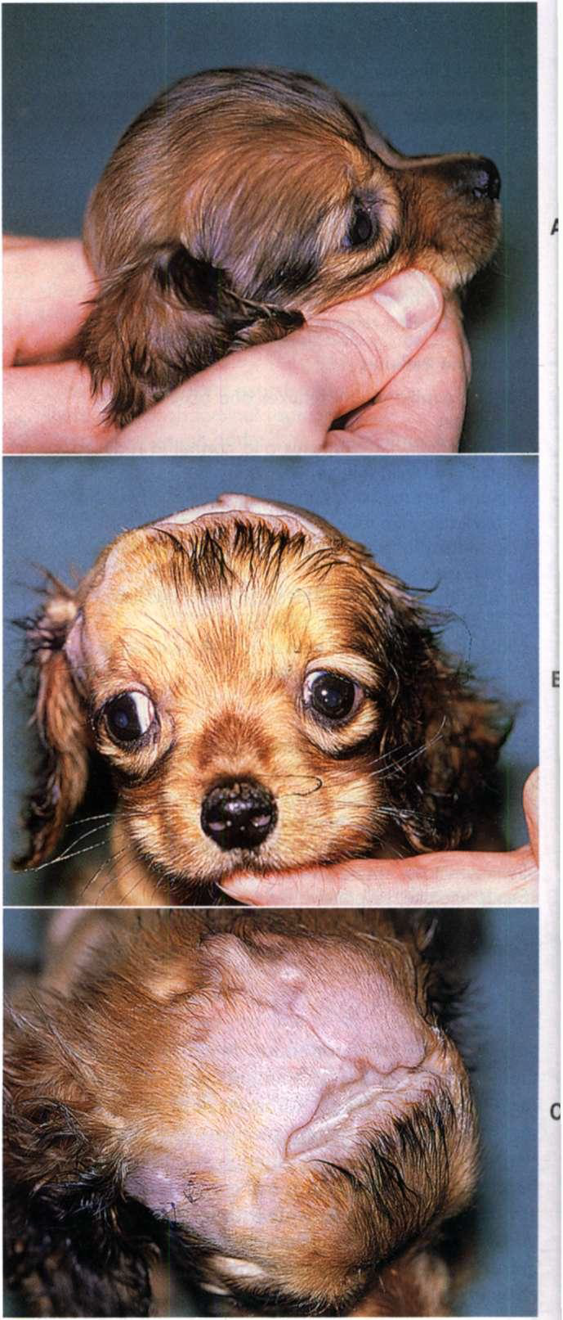
HYDROCEPHALUS
Hydrocephalus is a condition in which the cerebral ventricular system is enlarged secondary to an increased amount of CSF, with secondary compression or atrophy of the surrounding neurologic tissue. Most cases are congenital.
Animals with symptomatic hydrocephalus are slow learners and may be difficult to housetrain.
Dull or depressed.
Episodic or constant abnormal behavior,
Delirium,
Cortical blindness
Seizures may occur
Severely affected animals may exhibit tetraparesis and slow postural reactions.
Some animals will develop a ventrolateral
Strabismus
are seen in hydrocephalus

Slide 11
TREATMENT:
Glucocorticoids are administered to decrease CSF production (prednisone, 0.5 mg/kg, administered orally daily, tapered weekly until 0.1 mg/kg q48h).
Seizures may be controlled with anticonvulsant therapy, as described for epilepsy.
LISSENCEPHALY
Sulci and gyri developmental failure , resulting in a smooth cerebral cortex. Cerebellar hypoplasia may be seen in association with this malformation.
Behavioral abnormalities and visual deficits are common. These animals are also very difficult to train and may not be housebroken. If seizures occur, they often are not prominent until the end of the first year of life.

Slide 12
THIAMINE DEFICIENCY
Thiamine (vitamin B1) deficiency may occur i n anorexic cats or cats fed uncooked all-fish diets that contain thiaminase.Thiamine deficiency is almost never seen clinically in dogs, except in racing sled dogs fed a diet high in raw fish.
Results in abnormal glucose metabolism in the brain, encephalopathy, and hemorrhage of brainstem nuclei.
Clinical signs;
Lethargy
Ataxia followed by bilateral vestibular ataxia
Ventroflexion of the head and neck
Blindness,
Dementia,
Head tilt,
Nystagmus, and seizures may be seen

Slide 13
INFLAMMATORY DISEASES
(ENCEPHALITIS)
Granulomatous meningoencephalitis (GME), a common noninfectious inflammatory disease in dogs, commonly affects the forebrain, brainstem, or cerebellum to cause a wide range of neurologic abnormalitis.
INHERITED DEGENERATIVE DISORDERS
Metabolic storage diseases are fatal neurodegenerative disorders resulting from an inherited deficiency of enzymes within the cells of the nervous system.
Clinical Signs:
Seizures and severe alterations in consciousness may develop.
No treatment

Slide 14
GERIATRIC CANINE COGNITIVE DYSFUNCTION
Older dogs with degenerative brain disorders similar to human Alzheimer's disease may develop chronic progressive behavioral abnormalities, including loss of housebreaking, forgetting learned behaviors, altered sleep-wake cycles, and failure to recognize or interact with their owners.
NEOPLASIA
Brain tumors cause signs by destroying adjacent tissue, increasing intracranial pressure, or causing hemorrhage or obstructive hydrocephalus.Seizures are the most common reason for presentation. Circling, ataxia, and head tilt are less common. As intracranial tumors enlarge, they may cause an increase in intracranial pressure with progressive loss of consciousness and altered mentation.
Compulsive circling toward the side of the lesion and abnormal postural reactions and vision on the side opposite the lesion are common with forebrain lesions.

Slide 15
HYPERMETRIA
A hypermetric gait, with each limb raised excessively during protraction and then returned more forcefully than normal to weight bearing, suggests that there has been a loss of the normal cerebellar regulation of the rate, range, and force of movement. Affected animals are unable to judge distances.
CONGENITAL MALFORMATIONS
CEREBELLAR CORTICAL DEGENERATION (ABIOTROPHY)
Cerebellar abiotrophy is a syndrome of premature degeneration of cells within the cerebellum. Cells develop normally but later degenerate because of an intrinsic cellular defect.
No treatment is effective.

Slide 16
NEUROAXONAL DYSTROPHY
Neuroaxonal dystrophy is a slowly progressive degenerative disorder affecting nerve cell bodies within gray matter throughout much of the central nervous system, with most severe lesions within the spinocerebellar tracts and the Purkinje cells.
Affected dogs develop an intention tremor, a constant fine tremor, nystagmus, and menace deficits.
BRAIN CYSTS
Epidermoid, dermoid, and arachnoid cysts occasionally compress the cerebellum.

Slide 17
PAPILLEDEMA
Papilledema Edema of the optic disk usually indicates that there is increased intracranial pressure caused by a cerebral tumor or inflammatory mass lesion. This is seen as an enlarged optic disk with indistinct or fluffy margins and kinking of blood vessels as they pass over the disk.
Papilledema may be difficult to distinguish on fundoscopic evaluation from optic neuritis, although patients with a significant forebrain lesion causing papilledema should have clinical evidence of forebrain disease, including abnormal mentation, behavior change, and seizures. Despite reports that papilledema does not affect vision, most patients with papilledema caused by increased intracranial pressure are cortically blind.

Slide 18
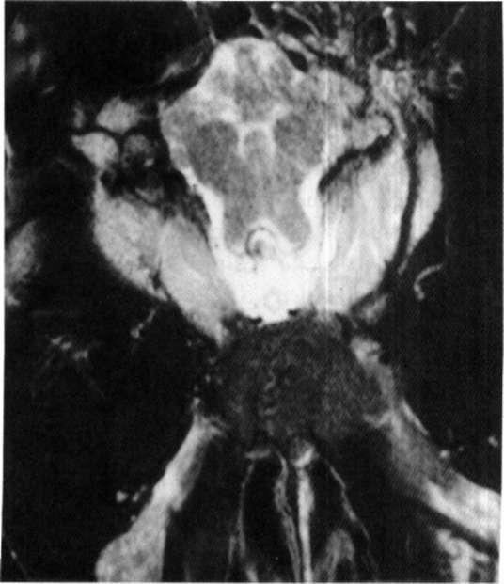
LESIONS OF THE OPTIC CHIASM
LESION OF OPTIC CHASM
Lesions of the optic chiasm result in a failure of transmission of the visual image and the light stimulus, causing blindness, normal fundic examination, normal ERG , bilateral mydriasis, and loss of the direct and consensual PLRs in both eyes.
Neoplasia and other space-occupying masses can occur at this location, especially lymphoma (cats), pituitary macroadenomas, meningiomas, and primary nasal tumors extending into the brain. Vascular lesions such as hemorrhage and infarction, infectious inflammatory granulomas, and granulomatous meningoencephalitis can also affect the optic chiasm.
Evaluation should include a search for evidence of extraneural infectious or neoplastic disease followed by MRI, CSF collection and analysis, and endocrinologic testing as warranted.
Neoplasm of the optic chiasm identified with magnetic resonance imaging in a 7-year-old Doberman Pinscher with an acute onset of bilateral blindness, loss of pupillary light reflexes, a n d no other neurologic deficits.

Slide 19
LESIONS CAUDAL TO THE OPTIC CHIASM
Lesions in the lateral geniculate nucleus, optic radiations, or visual cortex prevent interpretation of the image, resulting in a normal fundic examination, normal ERG, normal PLRs (direct and consensual), and blindness in the eye opposite the side of the lesion. With unilateral lesions of the optic tracts or optic radiations the visual deficits are most com- plete in the lateral visual field of the contralateral eye and the medial visual field of the ipsilateral eye.

Slide 20
Other clinical signs of forebrain disease, such as seizures, circling, and decreased consciousness, are expected with forebrain lesions severe enough to cause visual deficits. Causes of intracranial blindness (i.e., central or cortical blindness) include traumainduced hemorrhage and edema, vascular infarcts, GME , infectious encephalitis, central nervous system neoplasia, congenital disorders (e.g., hydrocephalus, lissencephaly), and degenerative disorders (lysosomal storage diseases). Animals with functional disturbances of the forebrain caused by metabolic encephalopathies, lead intoxication, hypoxia, or postictal depression may also present with cortical blindness.
Diagnostic evaluation for intracranial blindness should follow guidelines outlined i n Chapter 65 and should include thorough physical, ophthalmologic, and neurologic examinations; a laboratory database; screening thoracic and abdominal radiographs; CSF analysis; and CT or MR I evaluation.

Slide 21
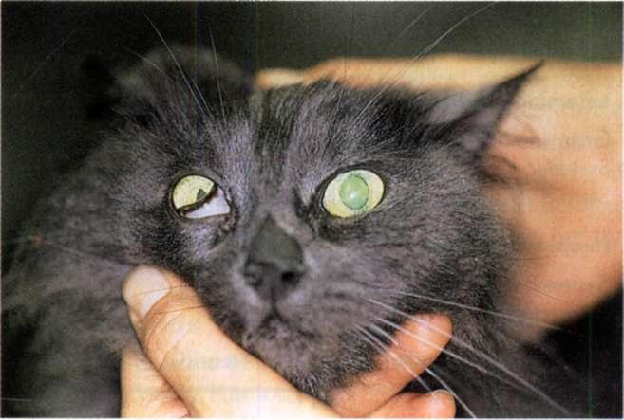
HORNER'S SYNDROME
HORNER’S SYDROME
Lesions affecting the sympathetic innervation to the eye result in Horner's syndrome. This condition causes miosis (constriction of the affected pupil), drooping of the upper eyelid (ptosis), and an inward sinking of the eyeball (enoph¬ thalmos). The third eyelid (nictitating membrane) is often partially protruded
Horner's syndrome can result from injury to the sympathetic innervation to the eye anywhere along its pathway .Lesions are classified as first order (central), second order (preganglionic), or third order (postganglionic) according to the level of the lesion along the sympathetic pathway

Slide 22
Most dogs and cats with Horner's syndrome have postganglionic lesions. The postganglionic (third order) axons for ocular sympathetic innervation course rostrally through the tympanooccipital fissure into the middle ear and enter the cranial cavity with the glossopharyngeal nerve (CN9), leaving the cranial cavity via the orbital fissure for distribution to the smooth muscle of the orbit, the upper and lower eyelids, the third eyelid, and the iris muscles
Third order Horner's syndrome is common in patients with otitis media or neoplasia within the middle ear, often accompanied by evidence of peripheral vestibular (CN8) disturbance and sometimes facial nerve (CN7) paralysis. Rarely, retrobulbar injury, neoplasia, or abscessation will result in a third order Horner's syndrome.

Slide 23
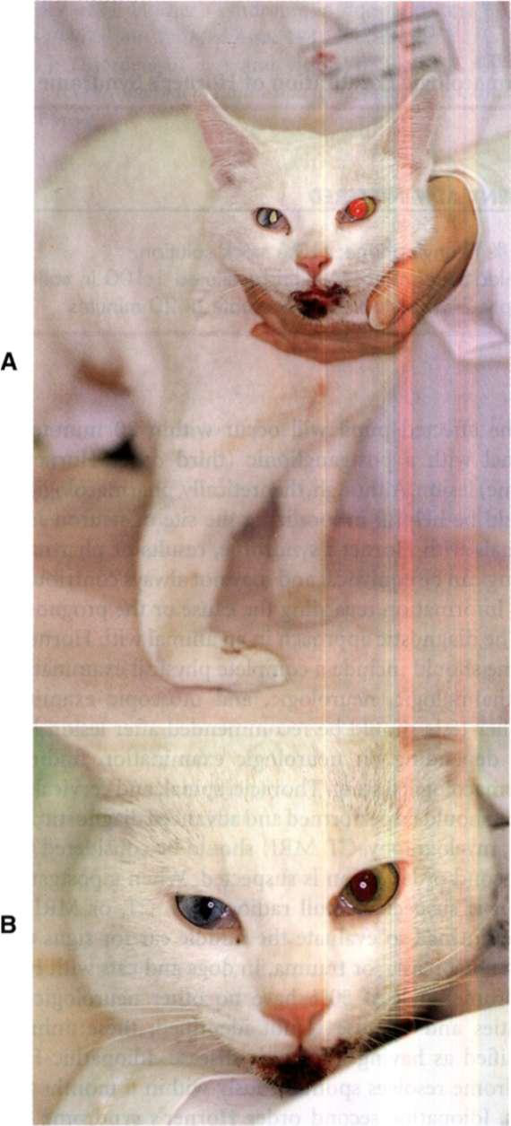
Common Causes of Horner's Syndrome
First Order (Central) Causes (Rare)
Intracranial neoplasia, trauma, infarct
Cervical spinal cord lesion
Intervertebral disk protrusion
Neoplasm
Fibrocartilaginous embolism
Trauma
Second Order (Preganglionic) Causes
Spinal cord lesion T1-T3 (trauma, neoplasia, fibrocartilaginous
embolism)
Brachial plexus avulsion
Thoracic spinal nerve root tumor
Cranial mediastinal mass
Cervical soft-tissue neoplasia, trauma
Skull base trauma
Third Order (Postganglionic) Causes
Otitis media/interna
N e o p l a s i a in middle ear
Retrobulbar injury, neoplasia
Unknown Causes
Idiopathic

Slide 24
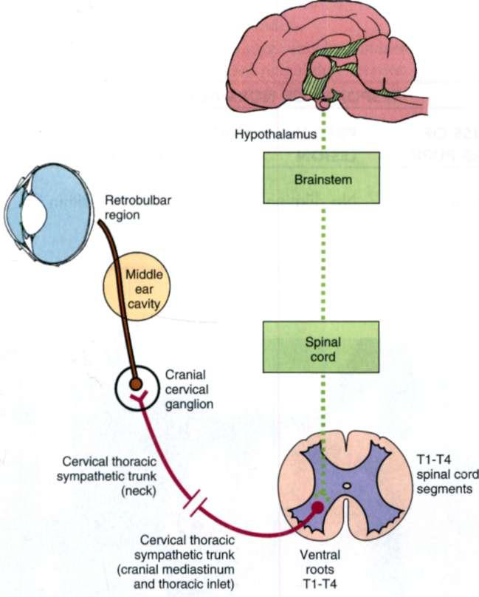
Sympathetic innervation to the eye. A n injury anywhere along this pathway will result in Horner's syndrome.

Slide 25
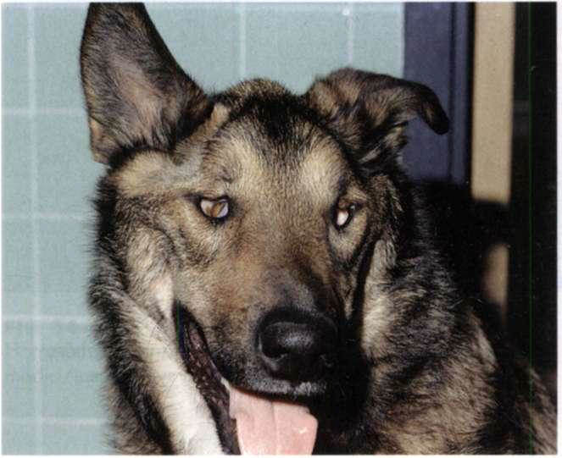
ProtPROTRUSION OF THE THIRD EYELID
PROTRUSION OF THIRD EYELID
In dogs and cats the third eyelid may protrude over the corneal surface in the presence of corneal or conjunctival irritation or space-occupying retroorbital disease. This may also occur if the animal experiences a decrease in periorbital mass as a result of dehydration, a loss of retrobulbar fat or muscle , or a loss of volume within the eye (i.e., microphthalmos, phthisis bulbi).

Slide 26
SEIZURES Seizure: the clinical manifestation of excessive or hyper- synchronous abnormal electrical activity in the cerebral cortex.
The clinical features of seizures can be separated into four components:
1-The prodrome is the period of time before the seizure begins, when the owner may report unusual behavior such as hiding, attention seeking, whining, or agita­tion.
2-The aura is the initial manifestation of the seizure, when animals exhibit stereotypical sensory or motor activity (pacing, licking, swallowing), autonomic pat­terns (salivation, vomiting, urination) or abnormal behavior (barking, attention seeking) for seconds to minutes before seizure onset.

Slide 27
3-The ictal period is the seizure itself, when the animal exhibits a variety of signs that may include loss or derangement of consciousness, altered muscle tone, jaw chomping, salivation,and involuntary urination and defeca­tion. This phase usually lasts only seconds to minutes.
4-The postictal period immediately follows the seizure and can last from a few seconds to several hours, during which time the animal may exhibit abnormal behavior, disorientation, altered thirst or appetite, somnolence, or blindness as well as defined sensory and motor neurological deficits.

Slide 28
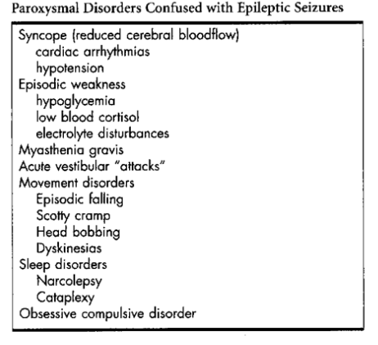
Animals are usually unconscious during these seizures, although their eyes may remain open.

Slide 29
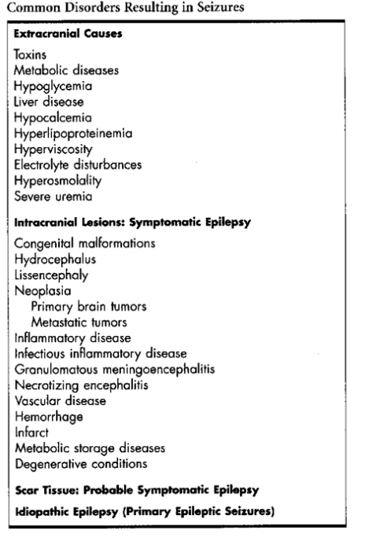
SEIZURE CLASSIFICATION AND LOCALIZATION
Seizure disorders are classified according to their cause :
idiopathic,
intracranial
extracranial
Approximately 35% of dogs with seizures and most cats with seizures have an identifiable structural intracranial lesion (e.g., anomaly, inflammation, neoplasia, trauma) that is causing seizures, and these animals are said to have symptomatic epilepsy

Slide 30
Seizure activity always indicates a functional or structural abnormality of the forebrain, particularly of the frontal or temporal lobes of the cerebrum.
Metabolic and toxic disor­ders cause seizures through functional alterations of the balance between inhibitory and excitatory neurotrans­mitters.
Idiopathic epilepsy is a condition wherein the seizure threshold is decreased. This can be caused by intrinsic neu­rotransmitter imbalances, genetic mutations affecting ion channels, or other functional abnormalities.
Differential Diagnosis: The differential diagnosis for a patient with seizures includes idiopathic epilepsy, intracranial disease (symptomatic epi­lepsy), probable symptomatic epilepsy, and extracranial disease.

Slide 31
Idiopathic Epilepsy
- Idiopathic epilepsy is diagnosed in approximately 25% to 30% of dogs having seizures but is uncommon in cats.
- Animals with idiopathic epilepsy have no identifiable extracranial or intracranial cause for their seizures and no concurrent neurologic abnormalities, and their seizures are presumed to be genetically based.
- Idiopathic epilepsy is inherited in German Shepherd Dogs, Belgian Tervurens, Keeshonds, Beagles, and Dachshunds. It is seen sporadically in almost all breeds, mixed-breed dogs, and cats.
- The initial onset of seizures usually occurs between 6 months and 3 years of age, although seizures are not observed until 5 years of age in some dogs.
Findings from a complete physical, neurologic, and ophthalmologic evalu­ation and results of routine clinicopathologic tests are normal. Intracranial evaluation, when performed, is normal

Slide 32
Intracranial Disease
Symptomatic epilepsy is a direct result of intracranial disease localized in the forebrain. Congenital and infectious inflam­matory conditions are most often seen in young animals, whereas neoplasia is the most common cause in dogs and cats older than 6 years of age.
Probable Symptomatic Epilepsy
- Scar tissue-related acquired epilepsy can occur after an inflammatory, traumatic, toxic, metabolic, or vascular insult. If a history of significant trauma or infection can be ascer­tained, the event usually precedes the onset of the seizure disorder by 6 months to 3 years
It is not usually possible to detect a structural abnormality using MRI , and even necropsy will not reliably demonstrate a lesion
Extracranial Disease
- Hypoglycemia, hepatic encephalopathy, hypocalcemia, and primary hyperlipoproteinemia may cause seizures in dogs and cats. Other metabolic alterations, severe electrolyte disturbances, hyperosmo­larity , heatstroke, and pro­longed severe uremia, also occasionally cause seizures

Slide 33
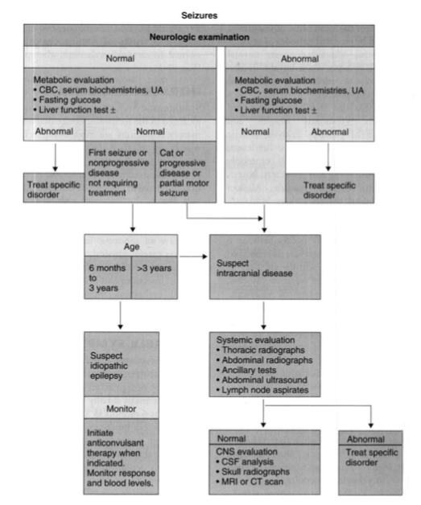

Slide 34
Management of dogs and cats with seizures can be attempted using anticonvulsant therapy.
Anticonvulsant Drugs
Phenobarbital
Potassium Bromide
Diazepam
Clorazepate
Felbamate
Gabapentine
Zonisamide
Levitiracetam
Alternative Therapies

Slide 35
Head Tilt: Head tilt is a common neurologic abnormality in dogs and cats. It indicates a lesion of the vestibular system, which consists of central and peripheral parts.
Abnormalities involving the central or peripheral vestibular system typically cause head tilt, circling, ataxia, rolling, and nystagmus.
Nystagmus is defined as an involuntary rhythmic oscilla­tion of the eyeballs. In the jerk nystagmus typical of vestibu­ lar disease the eye movements have a slow phase in one direction and a rapid recovery in the opposite direction
Jerk nystagmus direction is defined as the direction of the fast phase. Less common than jerk nystagmus is pendular nys­tagmus, a slight oscillatory movement of the eyeballs with no slow or fast phase; this condition is most often seen in Siamese, Birman, and Himalayan cats because of a congenital abnormality of the visual pathway.

Slide 36
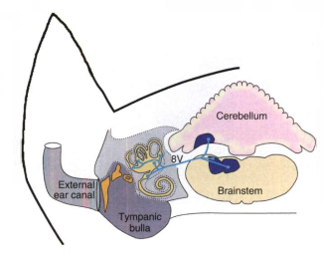
PERIPHERAL AND CENTRAL VESTIBULAR DISEASE
The head tilt (ear pointed toward the ground) is typically on the same side as the lesion, and tight circling toward that side is common. Vomiting, salivation, and other signs of motion sickness are often apparent.
Nystagmus observed when the head is held motionless is called spontaneous nystagmus or resting nystagmus. Nystag­mus that develops only when the head is held in an unusual position is called positional nystagmus.

Slide 37
Peripheral Vestibular Disease
Animals with peripheral vestibular disease should have normal mentation and consciousness. They have normal strength and postural reactions, although these tests may be difficult to assess because affected animals have impaired balance and a tendency to fall and roll.
Spontaneous and positional nystagmus is horizontal or rotary or alternates between the two and will not change fast-phase direction when the animal is held in multiple positions or examined repeatedly during the day.
Central Vestibular Disease
Early in the course of disease, animals with central vestibular dysfunction may not have clinical features that readily dis­tinguish them from animals with peripheral vestibular dys­function. With time and progression, however, they usually develop additional signs indicating brainstem involvement.
Paradoxical Vestibular Syndrome
Vestibular signs can be seen with lesions affecting the caudal cerebellar peduncle or the flocculonodular lobe of the cer­ebellum. This syndrome is called paradoxical vestibular syn­drome because affected animals have a head tilt and circling away from the lesion and a fast phase nystagmus directed toward the lesion.

Slide 38
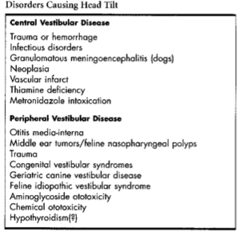

Slide 39
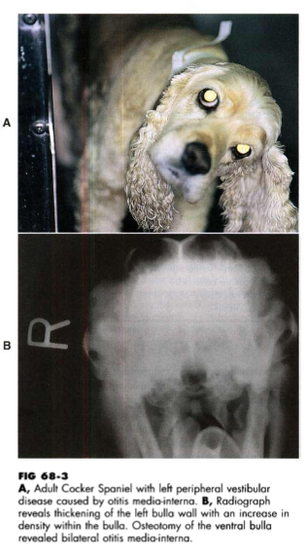
Peripheral Vestibular Disease
Peripheral vestibular disease is much more common in dogs and cats than central disease and generally carries a better prognosis.
The most common disorders causing peripheral vestibular signs are infection, polyps, or neoplasia affecting the middle and inner ear and transient idiopathic vestibular syndromes.
DISORDERS CAUSING PERIPHERAL VESTIBULAR SIGNS
Otitis Media-lnterna Otitis media-interna (OM-OI) is one of the most common causes of peripheral vestibular signs in dogs and cats.
Most animals with OM-OI have obvious otitis externa, and many have a tympanic membrane that appears abnormal or ruptured. Occasionally, the otoscopic examination is normal.

Slide 40
Geriatric Canine Vestibular Disease
Geriatric canine vestibular disease (i.e., old dog vestibular disease), an idiopathic syndrome, is the most common cause of acute unilateral peripheral vestibular dysfunction in old dogs, with a mean age of onset of 12.5 years. The disorder is characterized by the very sudden onset of head tilt, loss of balance, and ataxia with a horizontal or rotatory nystagmus
The prognosis for recovery is excellent; no therapy is rec­ommended.
Feline Idiopathic Vestibular Syndrome
Feline idiopathic vestibular syndrome is an acute, nonpro­gressive disorder similar to the idiopathic geriatric vestibular syndrome that occurs in dogs. It is a common disorder affecting cats of any age. This syn­drome is characterized by the peracute onset of peripheral vestibular signs, such as severe loss of balance, disorienta­tion, falling and rolling, a head tilt, and spontaneous nystag­mus, with no abnormalities of proprioception or in other cranial nerves.

Slide 41
Neoplasia
Tumors involving the inner and middle ear may damage peripheral vestibular structures and result in peripheral ves­ tibular dysfunction. Tumors can arise from regional soft tissues or from the osseous bulla. Tumors originating within the external ear canal may also invade past the tympanic membrane to involve the middle and inner ear.
Nasopharyngeal Polyps
Nasopharyngeal inflammatory polyps originate at the base of the eustachian tube in kittens and young adult cats and grow passively into the nasopharynx, nose, or middle ear. Most affected cats exhibit stertorous breathing or nasal dis­ charge as a result of respiratory obstruction by these polyps, but cats with polyps in the middle and inner ear are pre­ sented with peripheral vestibular signs and sometimes Horner's syndrome and facial nerve paralysis
Trauma
Trauma to the middle and inner ear will result in peripheral vestibular signs and commonly concurrent Horner's syn­ drome and facial nerve paralysis.

Slide 42
Congenital Vestibular Syndromes
Purebred dogs and cats that show peripheral vestibular signs before 3 months of age are likely to have a congenital ves­tibular disorder. Congenital unilateral peripheral vestibular syndromes have been recognized in the German Shepherd Dog, Doberman Pinscher, Akita, English Cocker Spaniel, Beagle, Smooth Fox Terrier, and Tibetan Terrier as well as in Siamese, Burmese, and Tonkinese cats.
Aminoglycoside Ototoxicity
Chemical Ototoxicity
Hypothyroidism
BILATERAL PERIPHERAL VESTIBULAR DISEASE
Most animals with bilateral peripheral vestibular disease have no discernible head tilt. Affected animals have a definite balance problem, and they fall or circle to either side. No spontaneous or positional nystagmus is observed; in most cases normal vestibular eye movements are also lost.

Slide 43
CENTRAL VESTIBULAR DISEASE
Central vestibular disease is much less common in dogs and cats than peripheral vestibular disease and generally carries a poor prognosis. Central vestibular disease can be caused by any inflammatory, neoplastic, vascular, or traumatic dis­ orders affecting the brainstem. In particular, granulomatous meningoencephalitis (dogs), Rocky Moun­ tain spotted fever (dogs), and feline infectious peritonitis (cats) seem to have a predilection for this region of the brain
METRONIDAZOLE TOXICITY
Central vestibular signs have been reported in dogs after administration of metronidazole
ACUTE VESTIBULAR ATTACKS
A peracute onset of loss of balance, nystagmus, and severe ataxia that lasts only minutes is occasionally seen in dogs. Head tilt may be mild or absent. Neurologic examination during an episode is usually most consistent with peripheral disease, with no postural reaction deficits or cranial nerve abnormalities, but a few dogs have had vertical nystagmus, localizing to central vestibular disease.

Slide 44
NECK PAIN
NON-INFECTIOUS INFLAMMATORY DISORDERS
INFECTIOUS INFLAMMATORY DISORDERS
Encephalitis, Myelitis, and Meningitis

Slide 45
REFERENCES
-Small animal internal medicine / [edited by] Richard W. Nelson, C. Guillermo Couto.—4th ed.

