Slide 1
BASIC GENETIC TERMS-I
Asist. Prof. Nüket BİLGEN
A. U. Vet. Med. Department of Genetics

Slide 2
Why we should study Genetics?
What is gene?
What is Genetics?
What is inheritance?
What is stability?
What is variation?
What is environment?
….. ?!?!

Slide 3
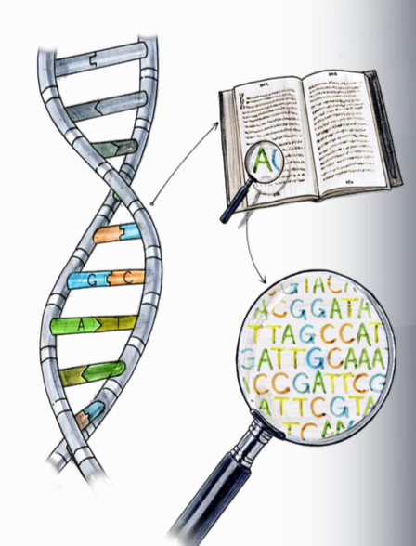
In this class;
Answers of the “What” questions,
Definition of the genetic and genetic related terms,
History of genetics

Slide 4
Basic reasons for studying genetics…
Genetics is the center of all biological subjects
Plants, animals, human, bacteria, virus
In daily life we come across with genetics because genetics is everywhere!
Examples?

Slide 5
Homework
When was the last time you heard or read about genetics or a genetic term?
To complete this homework write one paragraph about it.
Homework is due till next Monday.
Either use “ekampus” or send an email (nbilgen@ankara.edu.tr)

