Slide 1
MEDICAL STUDENT AND LIFELONG LEARNING
Dr. İpek Gönüllü

Slide 2
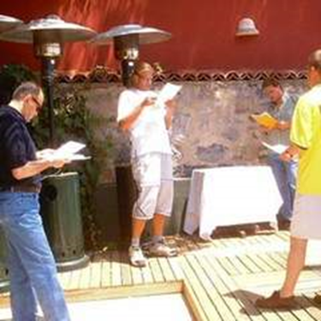
What is Lifelong Learning?

Slide 3
LIFELONG LEARNING
Lifelong education was defined as a process improving and strengthening the knowledge, values, skills and senses that individuals obtain throughout their lives and a process of putting all these into practice during the whole life cycle.
Candy (1994)
It is best described as being voluntary with the purpose of achieving personal fulfillment. The means to achieve this could result in informal or formal education.

Slide 4
Traditional Learning | Lifelong Learning
Teacher is the source of knowledge. | Teacher is a guide for sources of information.
Learners get the information from the teacher. | People learn by doing.
Learners work on their own. | People learn from each other in groups.
Students are not allowed to access to the next learning stage untill the range of skills are completely finished by passing the exams. | Assessment is done to guide learning strategies and to identify future learning paths.
All learners do the same things. | Teacher develops individualized learning plans.
Teachers receive an initial training first then in-service training is added. | Teacher is a lifelong learner. Initial education and continuing professional expertise are linked.
“Good” learners are noticed and given opportunities for further education. | People have access to lifelong learning opportunities.

Slide 5
Key checklist for lifelong learning:
Voluntary
Self-motivated or self-initiated
Doesn’t always require a cost
Often informal
Self-taught or instruction that is sought
Motivation is out of personal interest or
personal development

Slide 6
Knowing the learner
(self-awareness)
Evaluating learning
( self-monitoring)
Lifelong learner
Planing for learning
(self-managment)
Understanding how to learn
(meta-learning)

