Slide 1
SURGICAL ATTIRE

Slide 2
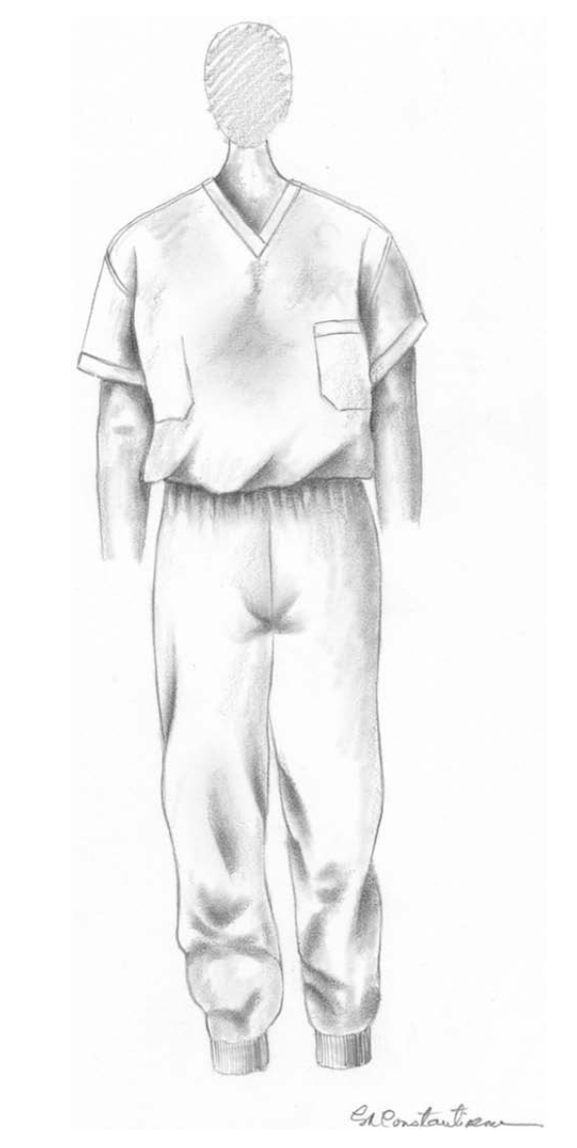
Surgical scrub suit.
The shirt should be tucked into the pants.

Slide 3
A cap and mask should be donned immediately prior to entering the operating theater.
The cap is put on first.
Once the cap is in place, there should be no hair showing.
That is, no hair should be extending from the borders of the cap.
After the cap is in place, the mask is positioned such that the bottom tie is tied behind the neck and the top tie is tied behind the head.

Slide 4
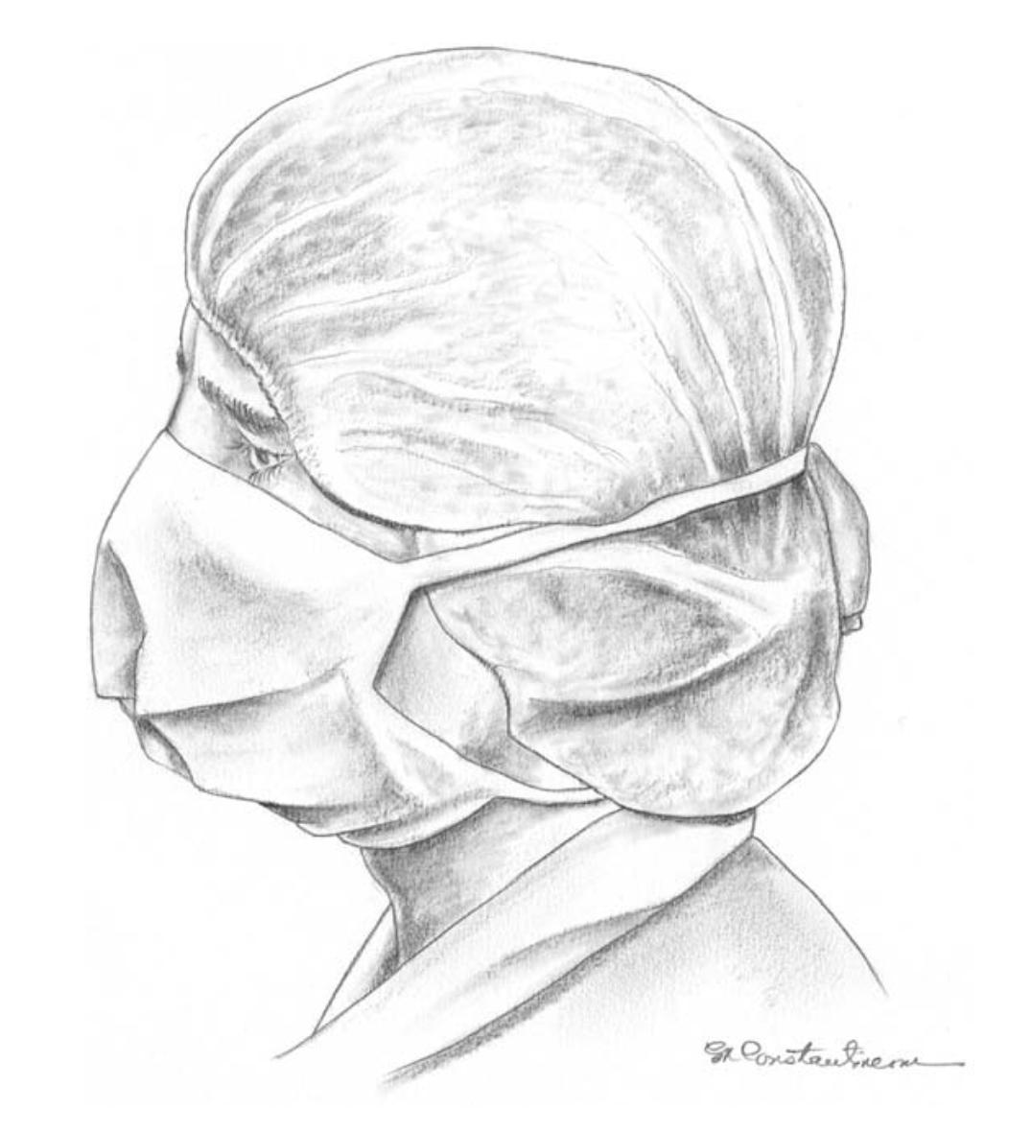
Bouffant surgical cap and standard surgical mask.
Ears should be covered by this type of surgical cap.
Both mask ties are tied behind the head. The method of crossing the mask ties and tying the bottom tie on the top of the head is inappropriate.

Slide 5
Coughing can force air out the sides of a properly donned mask !
As such, a person scrubbed for surgery should not turn his/her head to cough or else droplets could be directed toward the sterile field.

Slide 6
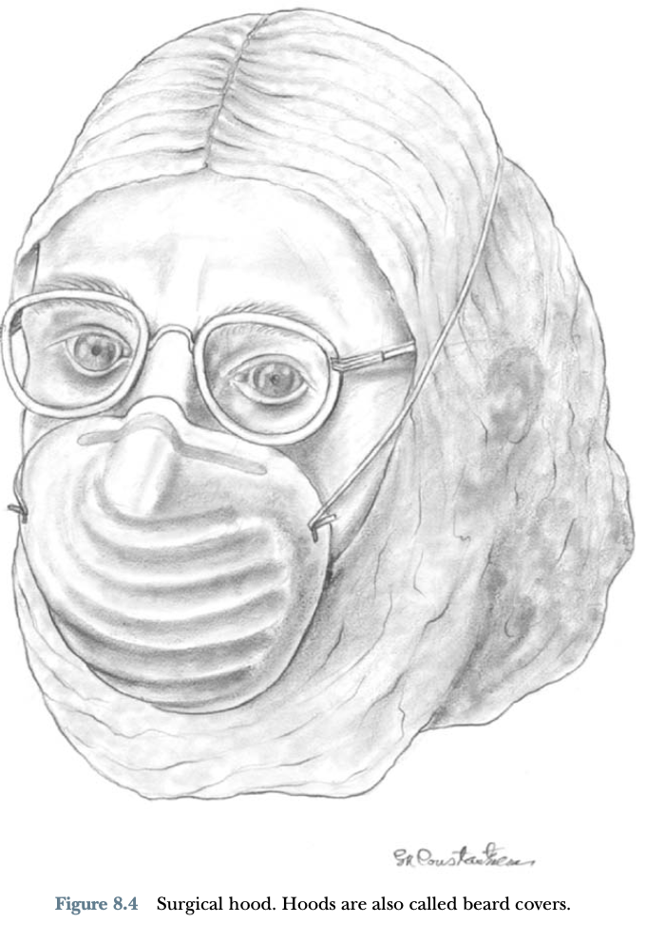

Slide 7
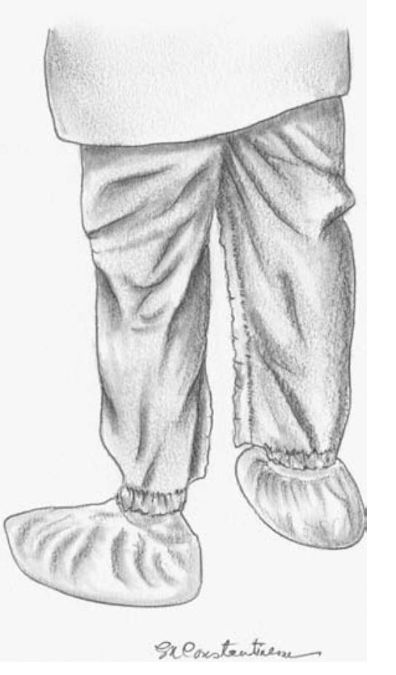
Shoe covers.
If used, shoe covers should be donned immediately before entering the operating theater.
They should not be worn outside of the operating theater !
The laboratory coat illustrated in this figure would be removed immediately before entering the operating theater.

Slide 8
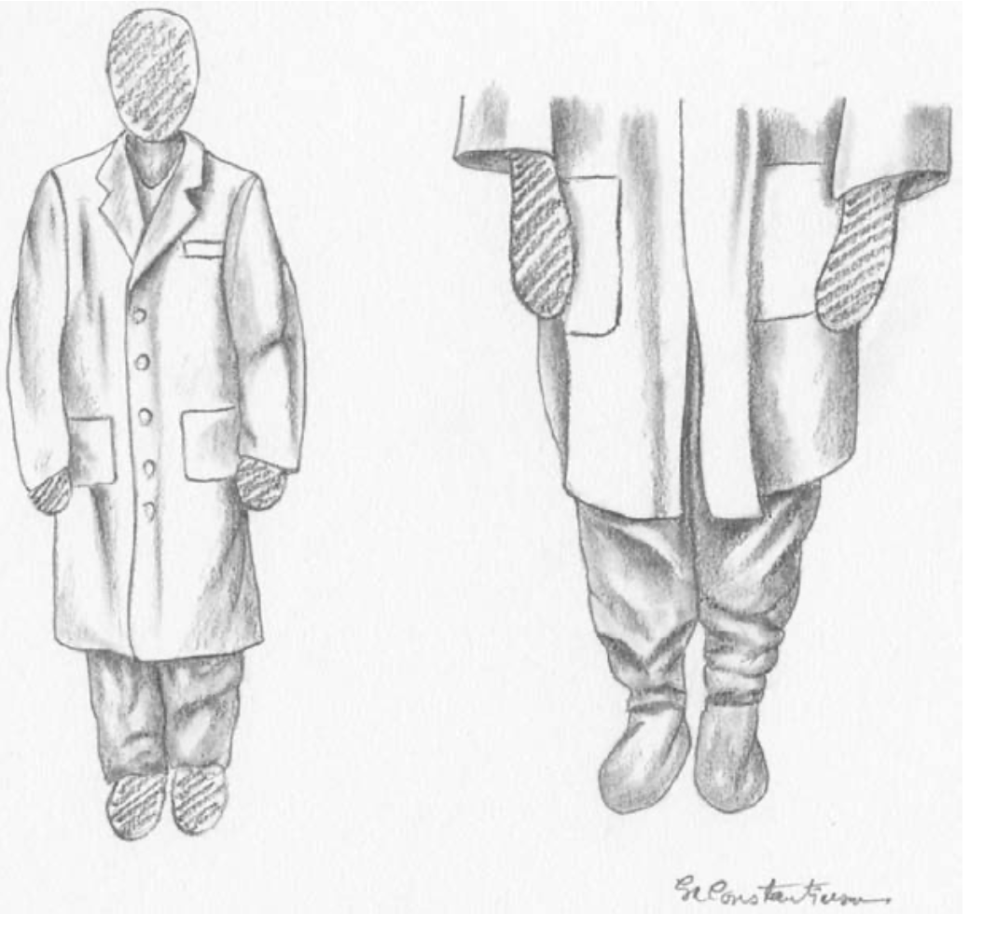
Laboratory coat.
The laboratory coat should always cover the scrub suit outside of the operating rooms and should never be worn in the operating theater. !!!!

Slide 9
SCRUBBING, GOWNING, AND GLOVING

Slide 10
Surgical scrubbing is performed to remove as many microorganisms as possible from finger nails, hands, and forearms by mechanical washing and chemical antisepsis before participating in a surgical procedure.
Commonly available scrub antiseptics include chlorhexidine glu- conate, chlorhexidine diacetate, iodophors, triclosan, and chloroxylenol.
Scrubbing is typically performed for five minutes.
Scrub time is shorter for brushless rubs compared with traditional agents.

Slide 11
Gowning is performed to build a barrier between the skin and the clothes of the surgical team member and the sterile surgical field.
Likewise, gloving is performed to build a barrier between the hands of the surgical team member and the patient because hands cannot be sterilized.

Slide 12
Before surgical scrubbing, rings, watches, and jewelry should be removed, and gown and gloves need to be aseptically opened in the surgery area
Surgical scrubbing should begin with a brief, general hand and forearm wash to remove surface debris. Then, the subungual areas of both hands are cleaned under run- ning water using a nail pick
The next step is to apply the antimicrobial agent to wet fingers, hands, and forearms, using a brush and soft sponge. A brush is applied to the fin- gernails

Slide 13
Each finger is divided into four sides and a soft sponge is applied as ten up and down strokes to each of the four surfaces from the tip of the finger to the palm.
Then, the palm, back, and sides of the hand are scrubbed as ten up and down strokes.
The forearm is divided into four planes and a soft sponge is applied to the four planes from the wrist to the elbow.
This process is repeated for the opposite fingers, hand, and forearm

Slide 14
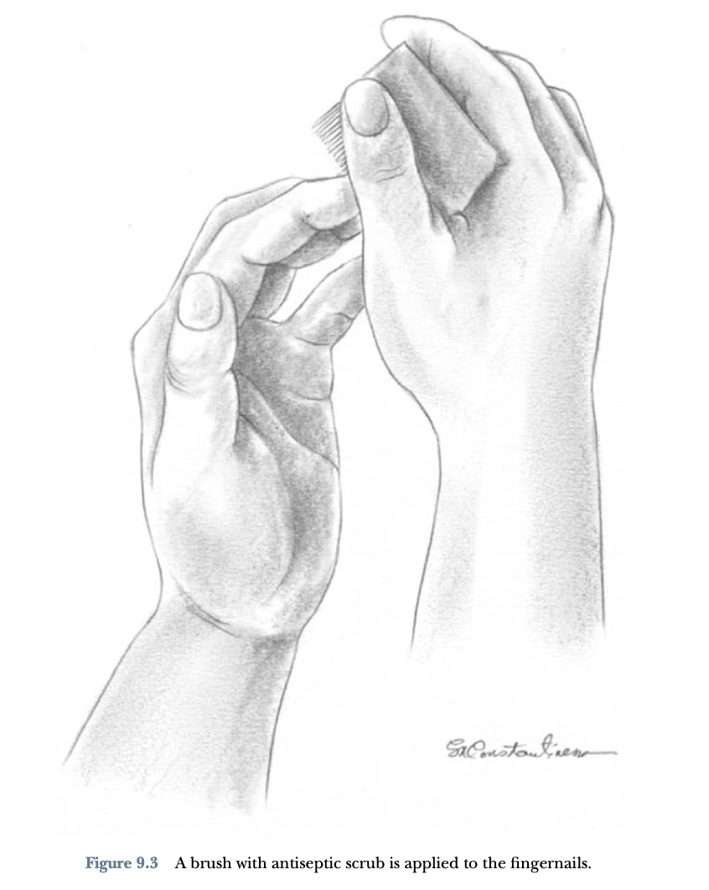

Slide 15
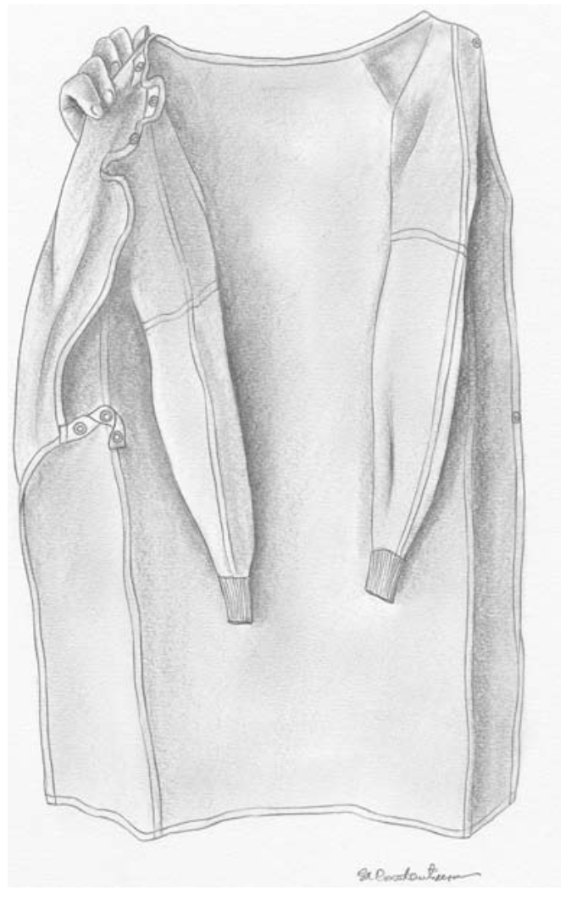
The neckline of the sterile surgical gown is identified and held while the armholes are found.

Slide 16
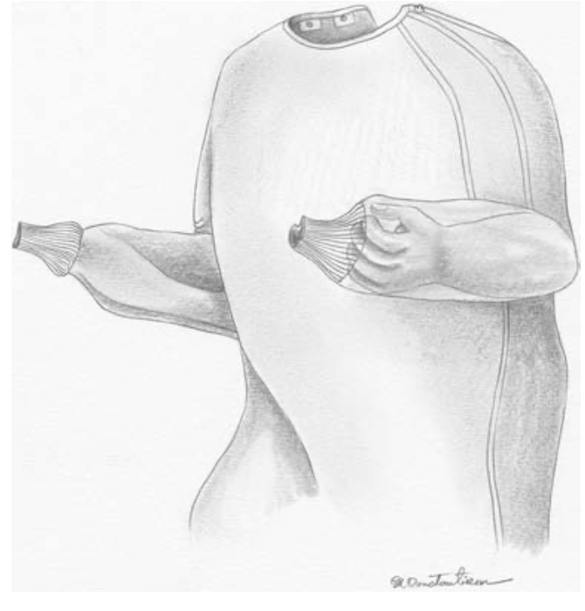
Both arms are advanced into the gown sleeves simultaneously, but the hands are not allowed to pass all the way through the cuffs in order to allow for closed gloving.

Slide 17
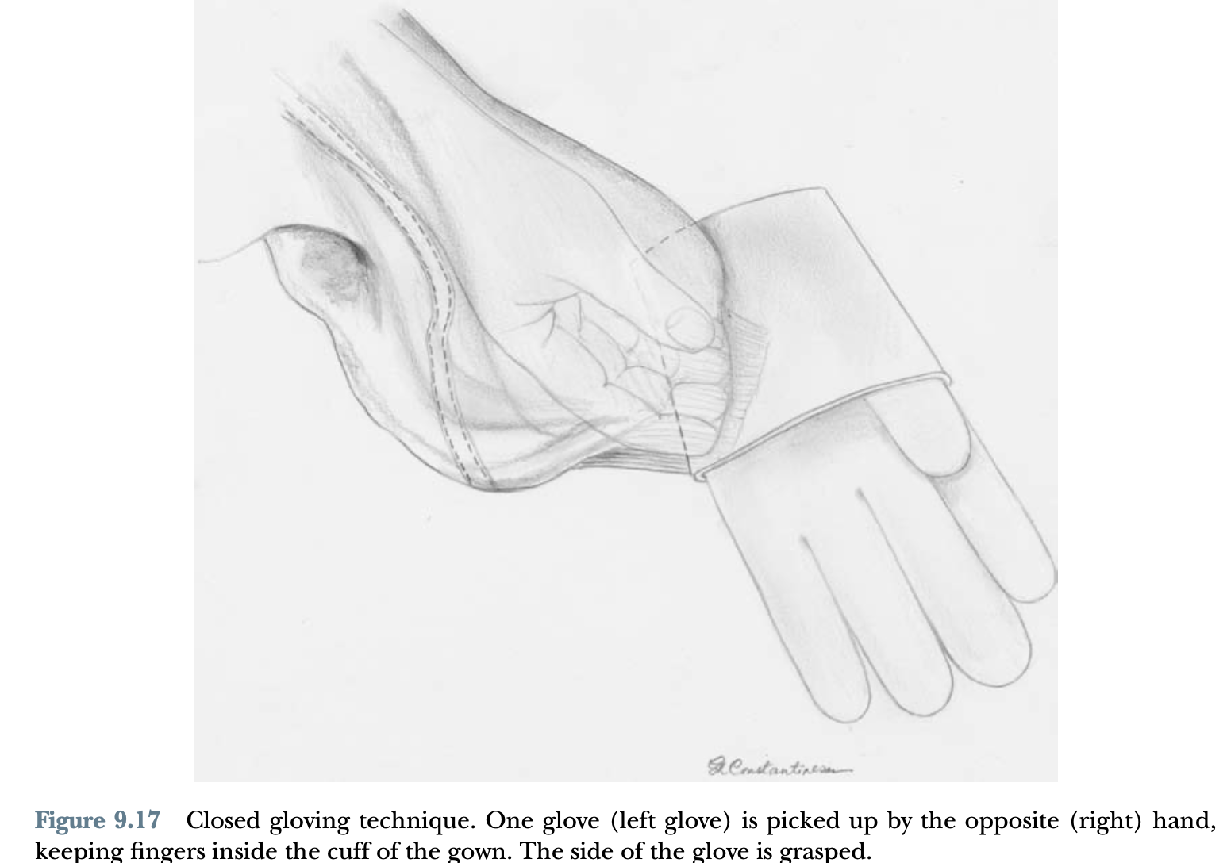

Slide 18
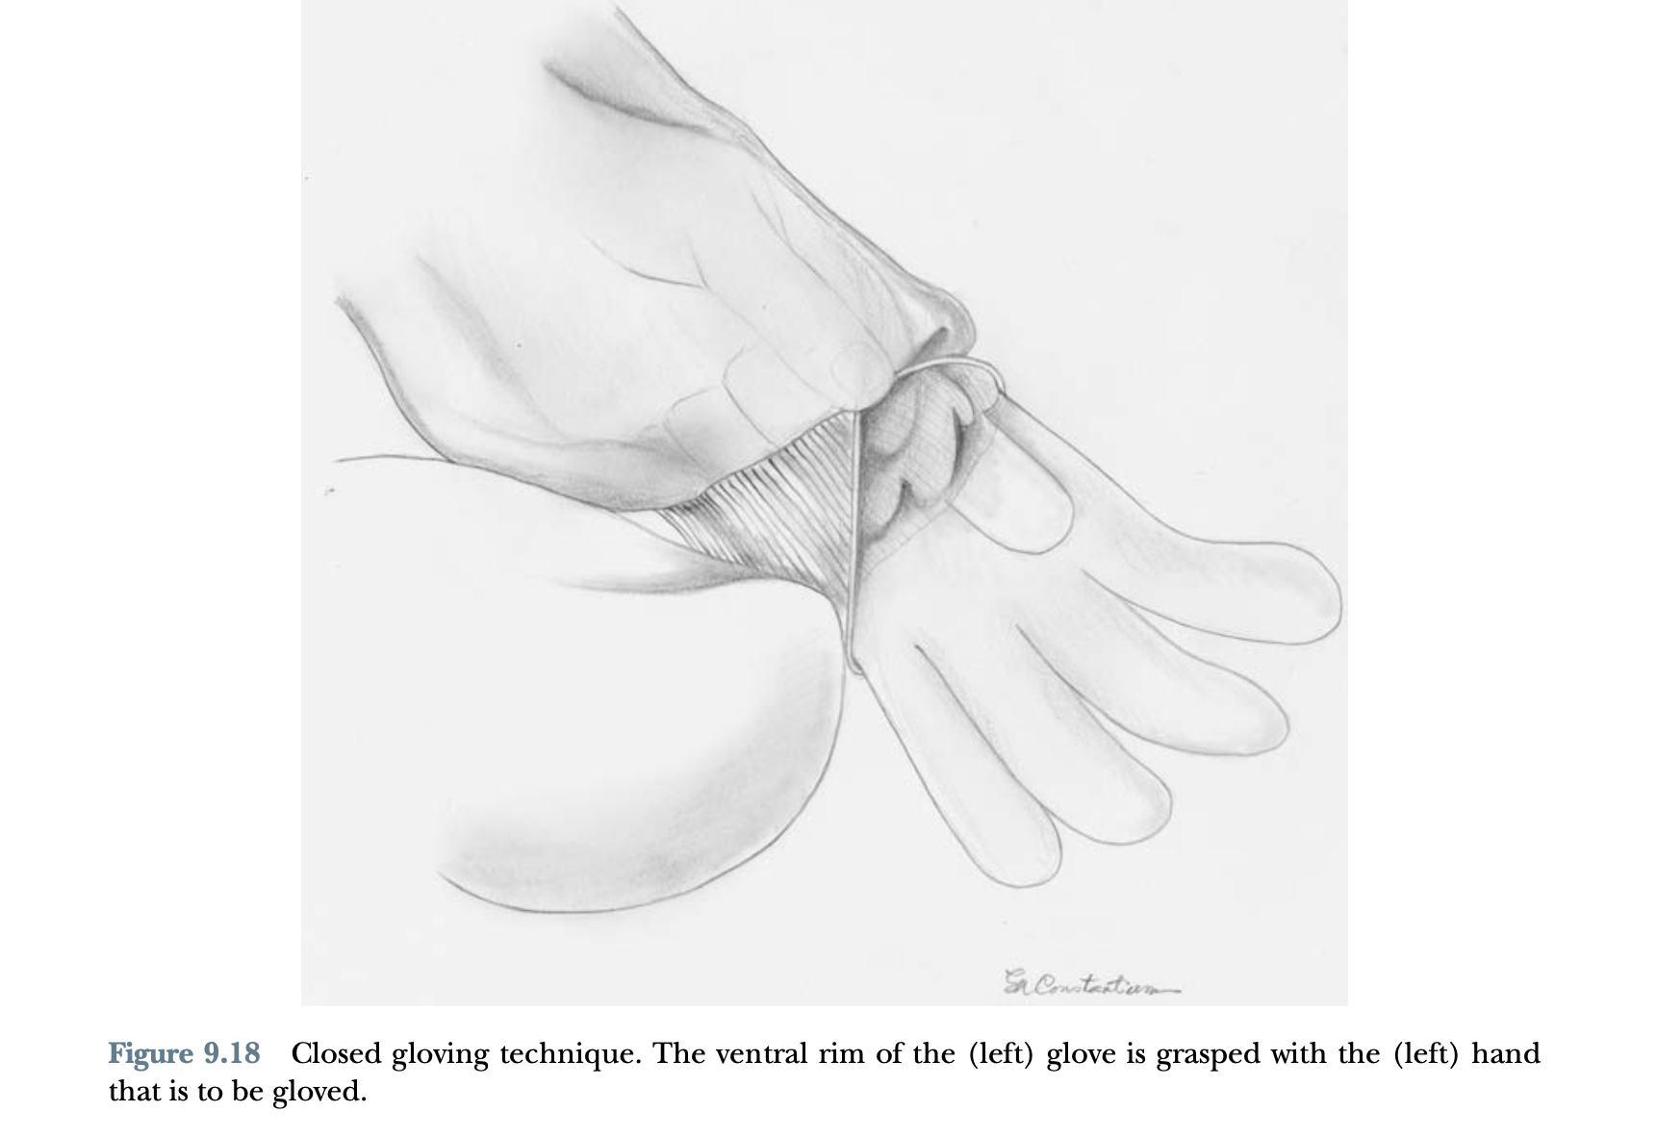

Slide 19
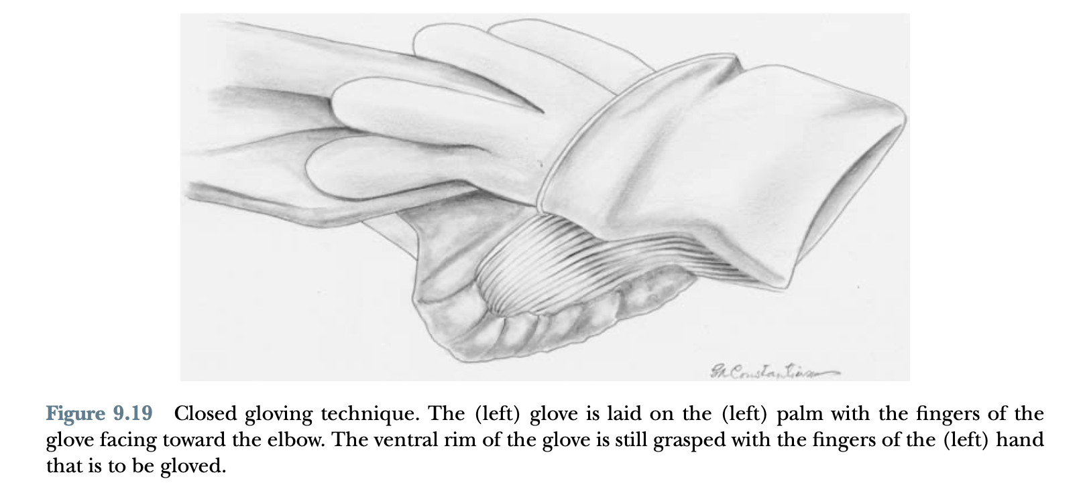

Slide 20
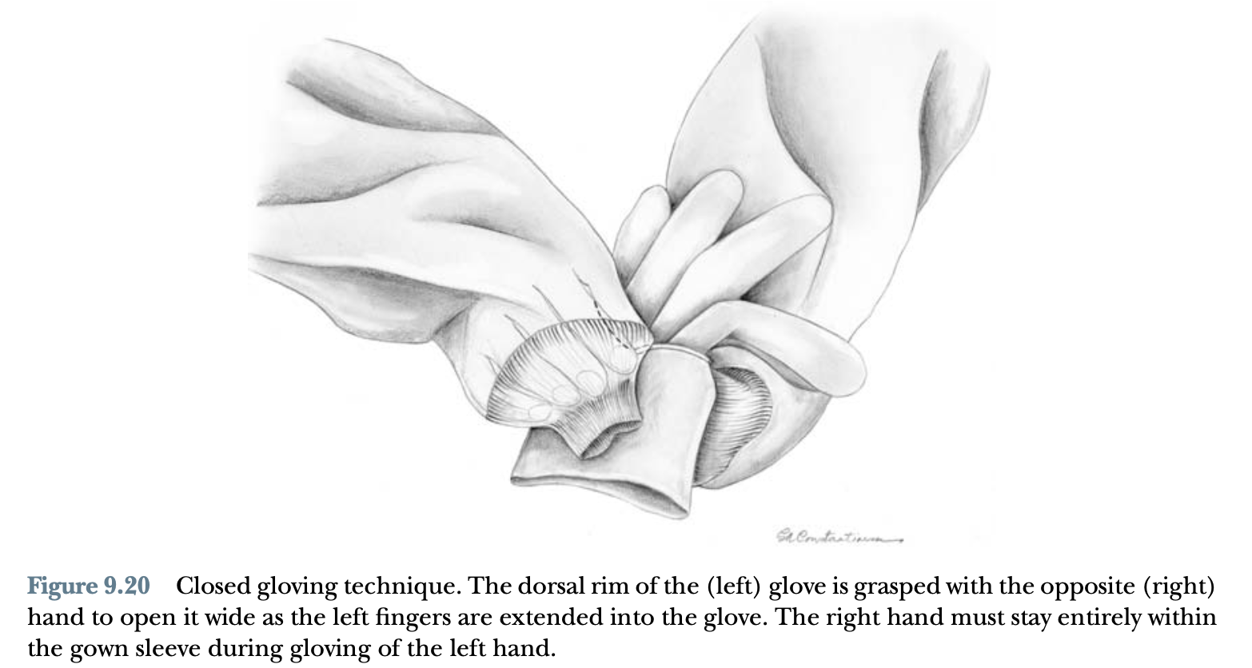

Slide 21
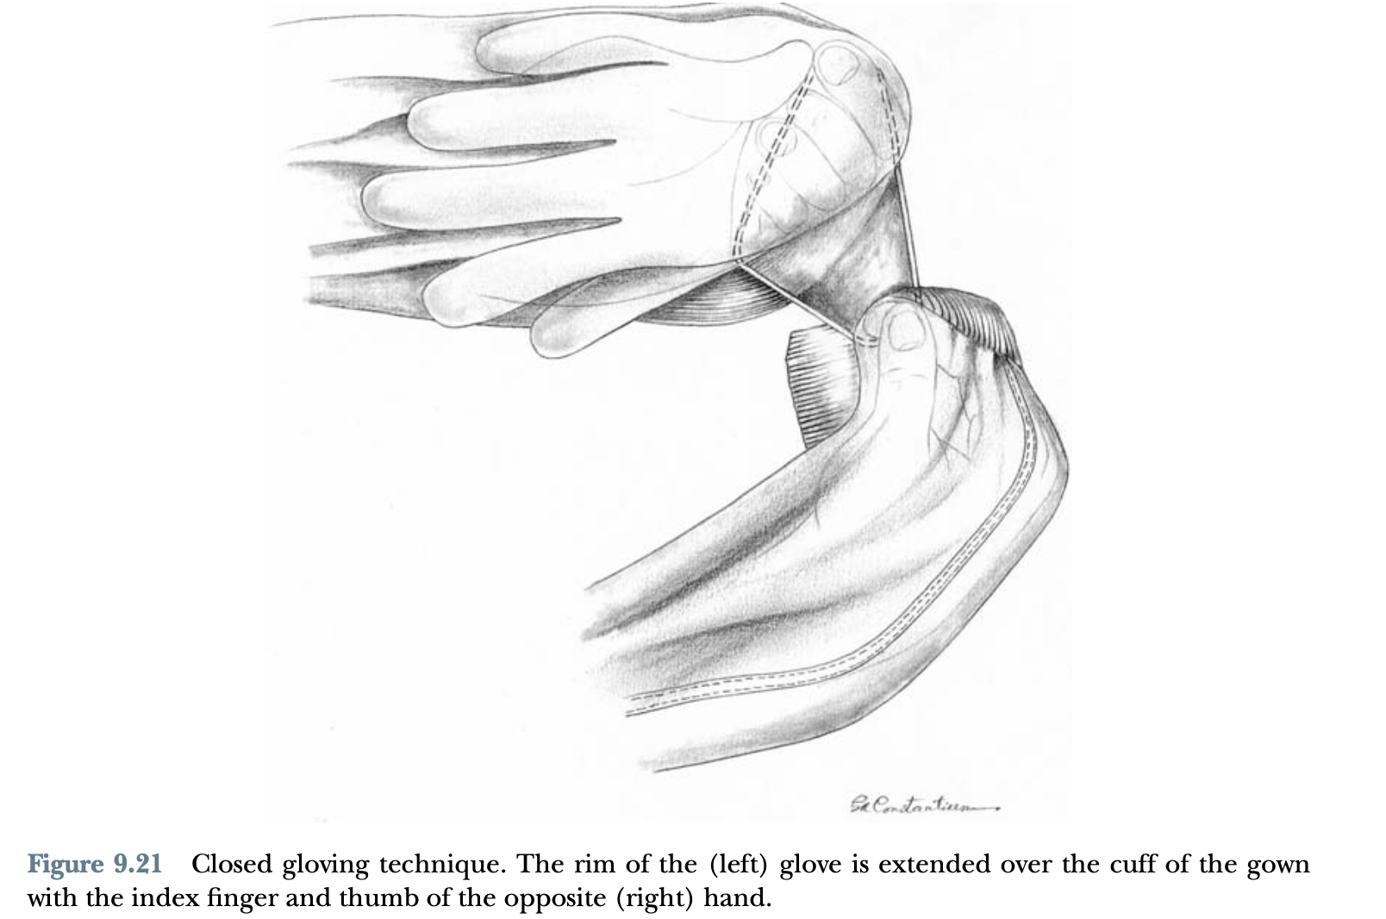

Slide 22
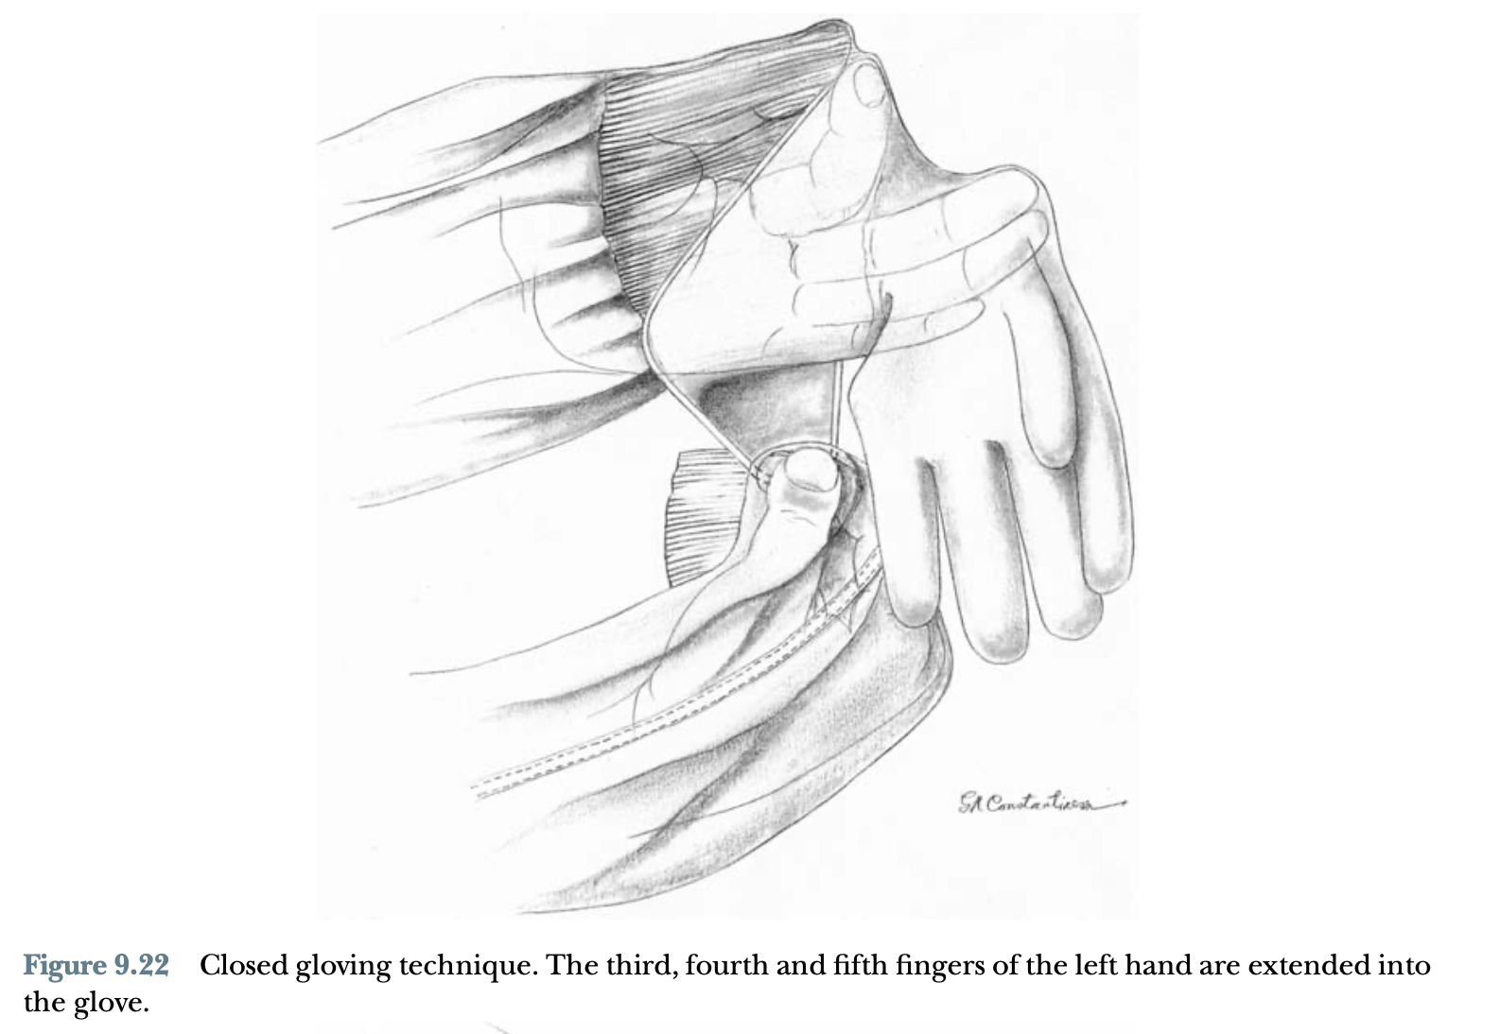

Slide 23
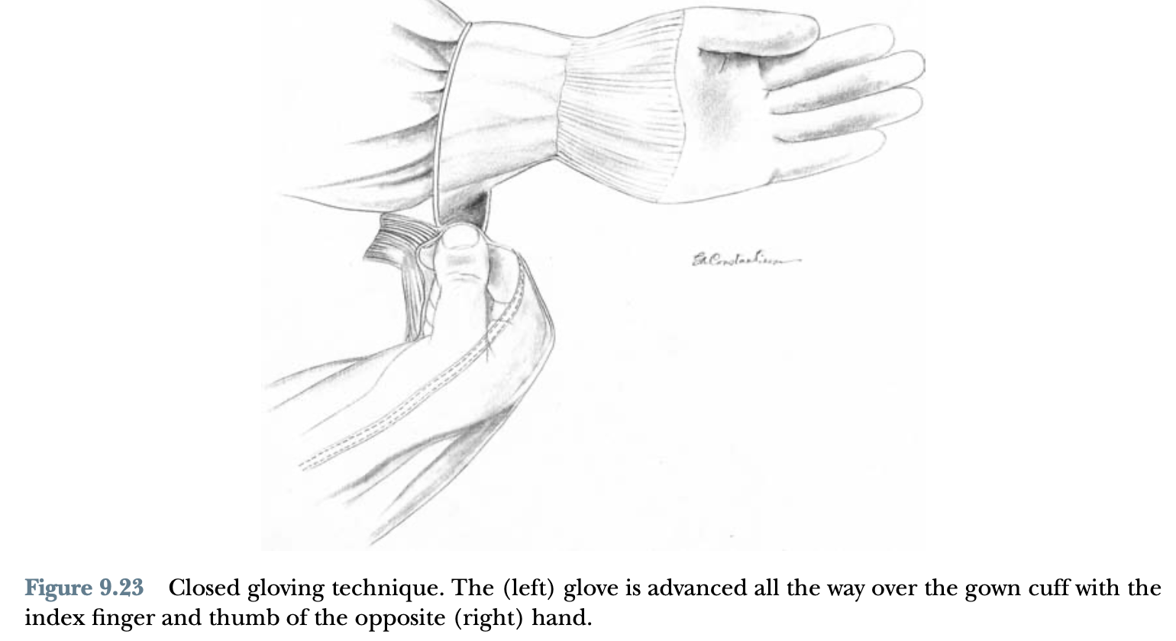

Slide 24
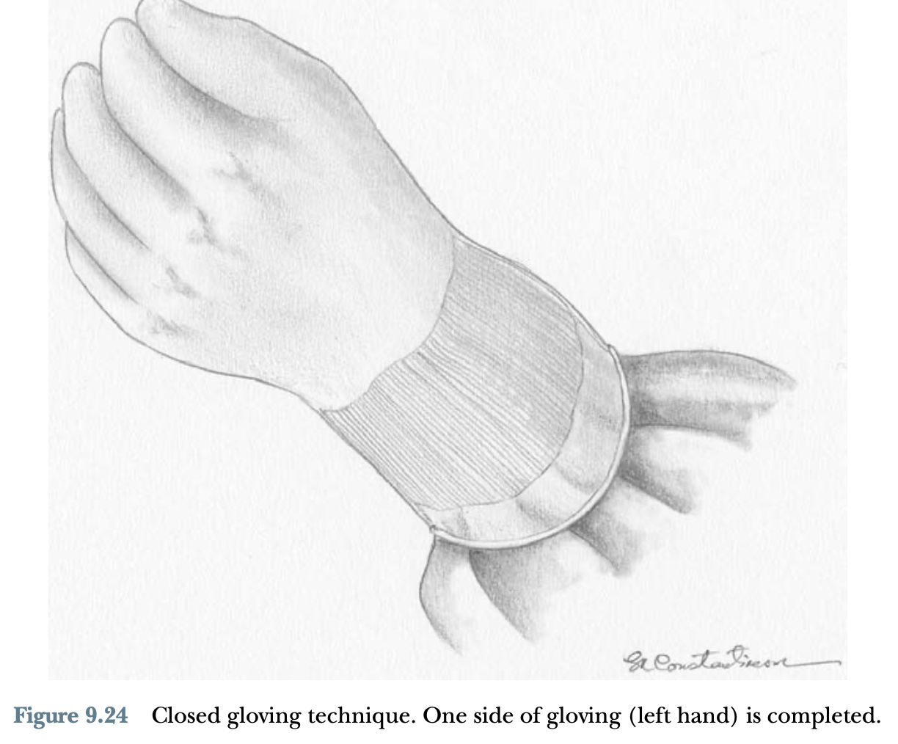

Slide 25
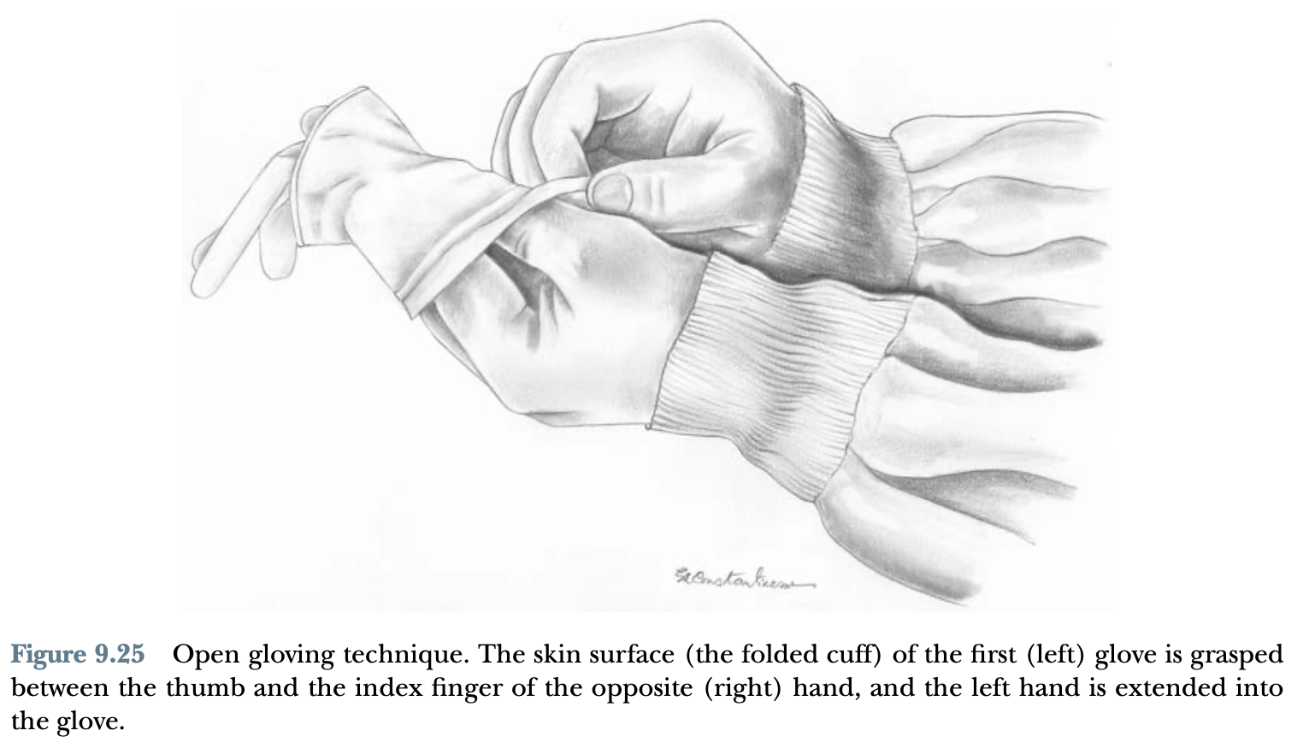

Slide 26
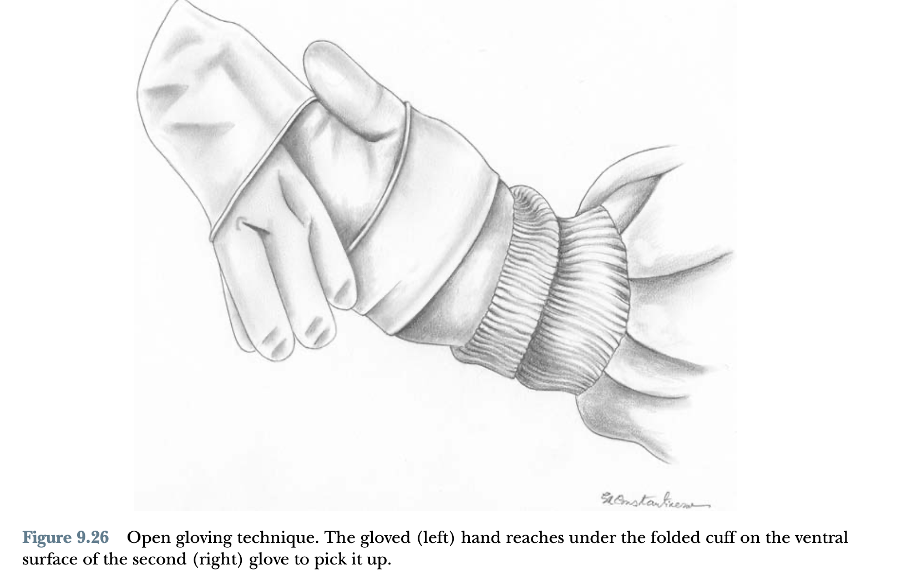

Slide 27
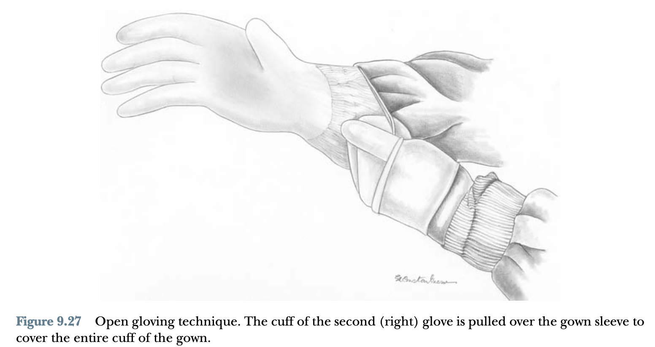

Slide 28
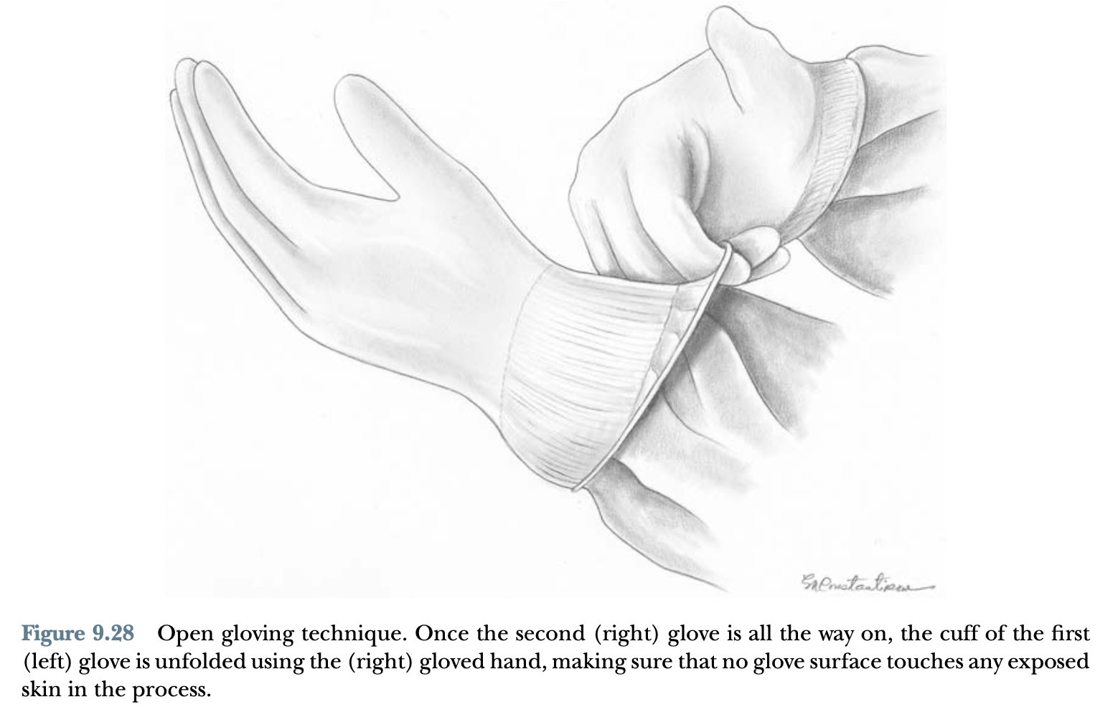

Slide 29
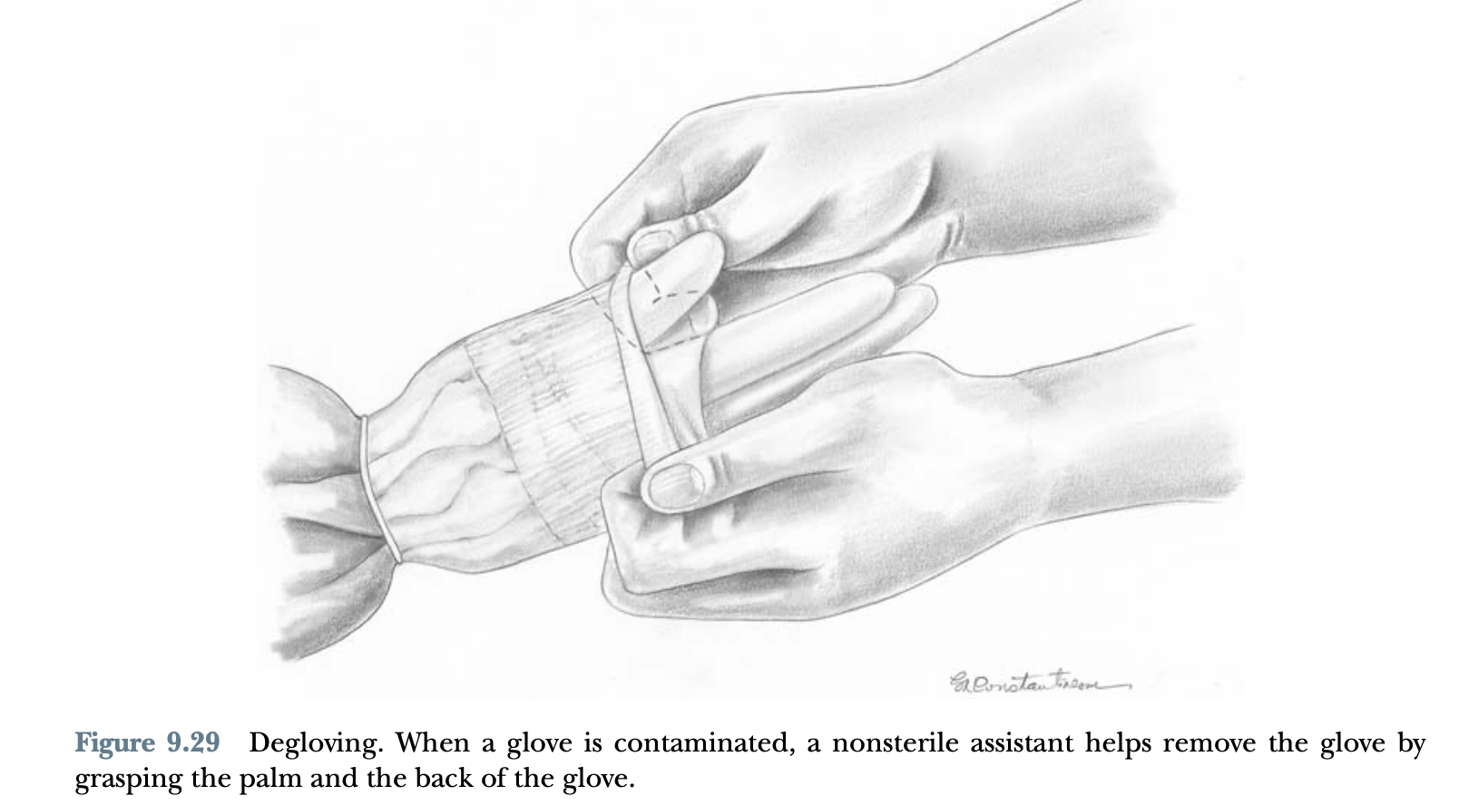

Slide 30
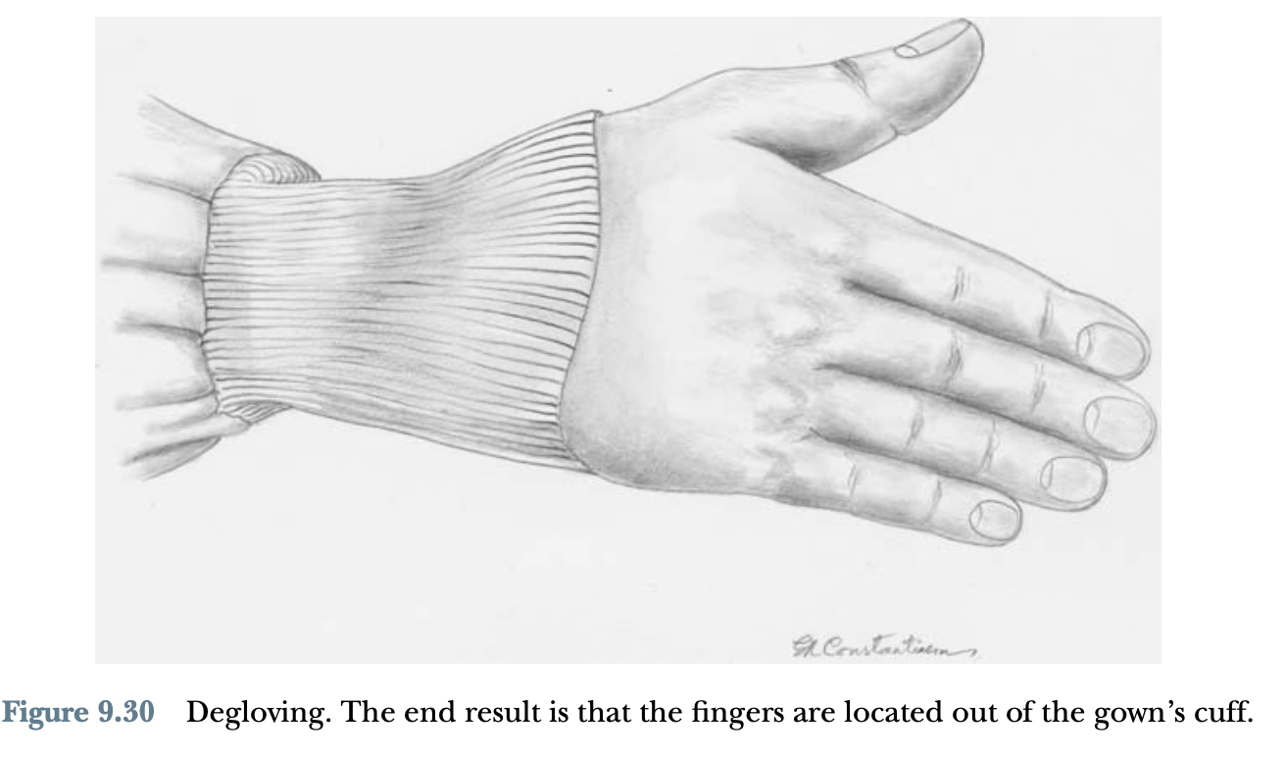

Slide 31
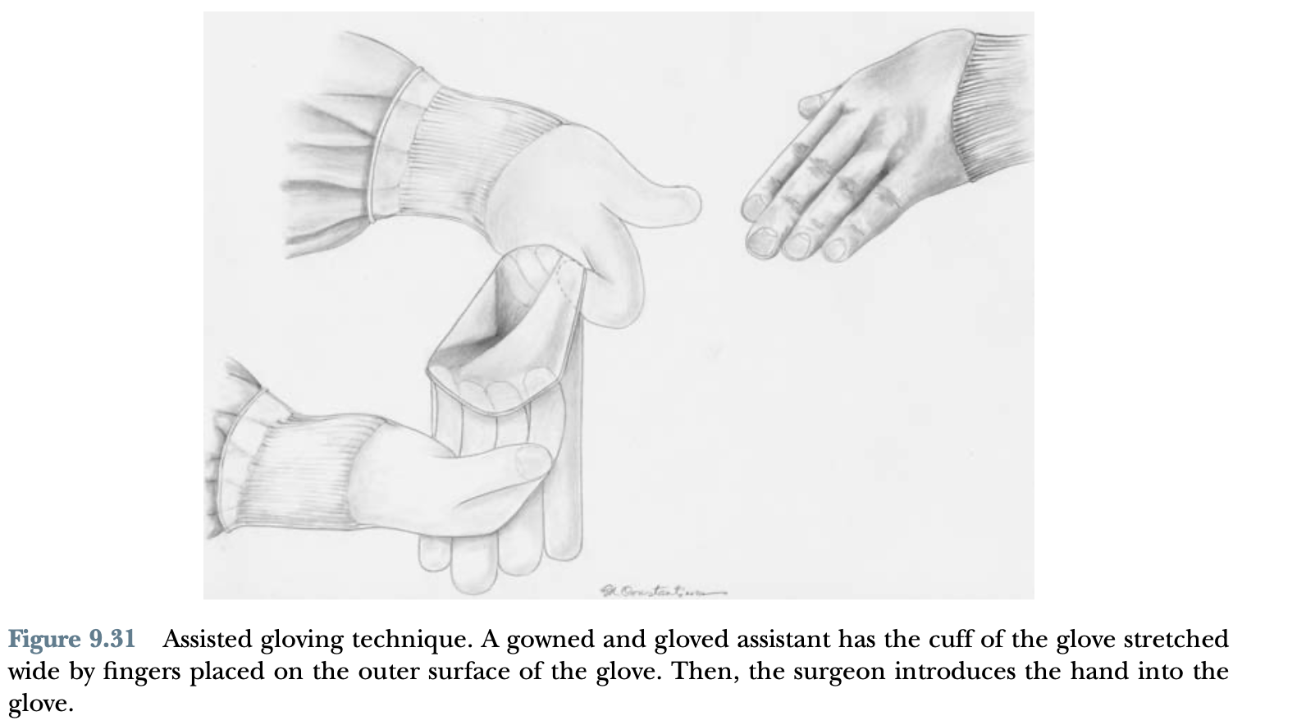

Slide 32
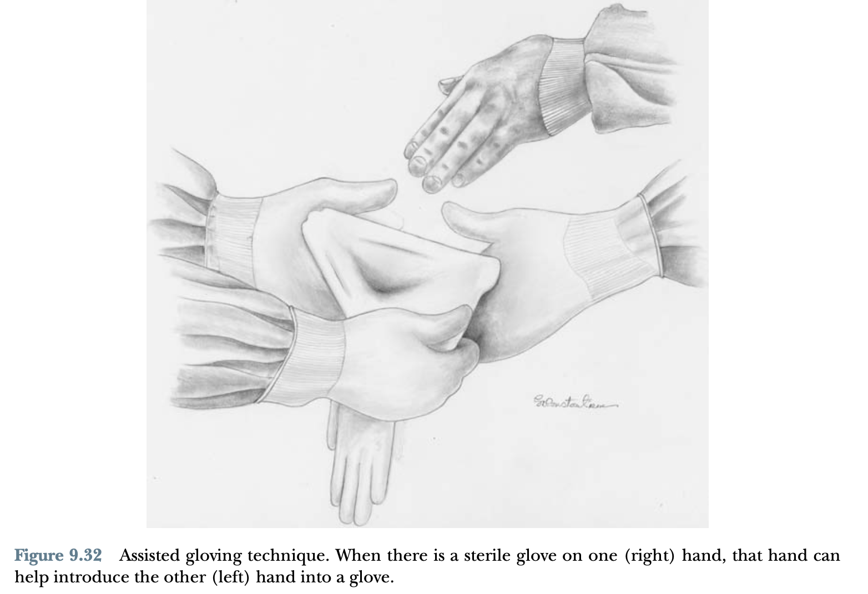

Slide 33
SURGICAL PREPARATION AND ANIMAL POSITIONING

Slide 34
Surgical preparation is subdivided into initial preparation (nonsterile) and final preparation (sterile).
Initial preparation includes hair clipping, urinary bladder expression, prepuce flushing, limb gloving and taping (for limb procedures), and rough scrubbing.
Before initial preparation, ophthalmic antibiotic ointments or lubricants are placed on the cornea and con- junctiva.
Once an animal has been stabilized under anesthesia, clipping begins.
The clipper should be held using a standard “pencil grip” and initial clipping may be done along the hair growth pattern

Slide 35
A general guide- line is to clip at least 4 cm on each side of the incision; however, clipping area depends on the size of the animal and the procedures
After hair removal is completed, loose hair is removed with a vacuum.
For limb procedures, the hair is removed from the surgical site and well beyond it.
If exposure of the paw is unnecessary, the hair can be left on the paw

Slide 36
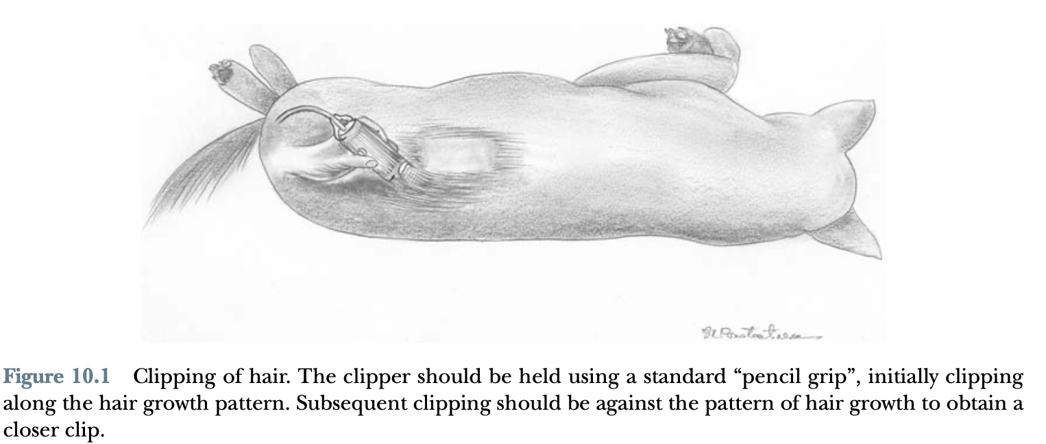

Slide 37
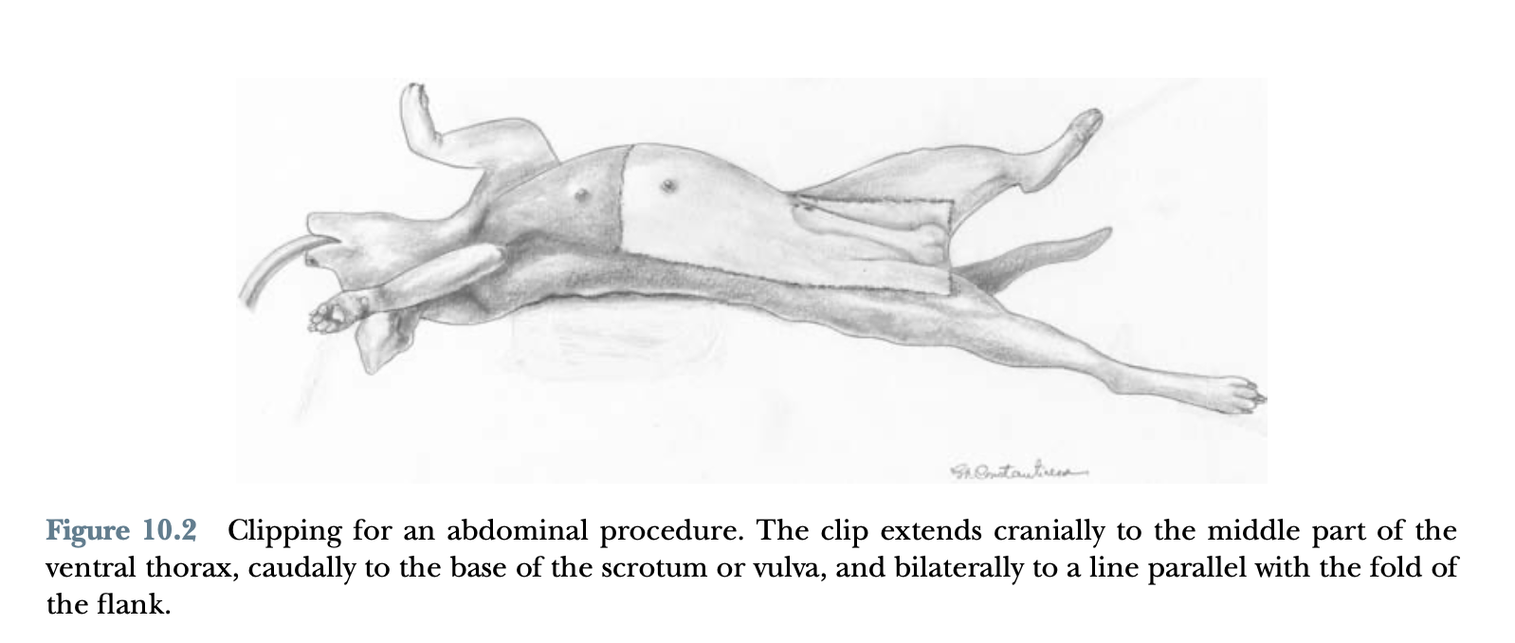

Slide 38
The animal’s urinary bladder should be expressed to avoid inadvertent cystotomy when entering the abdominal cavity and to avoid urine soiling from urination during any surgical procedure.
Expression of the urinary bladder may be contraindicated, or care should be taken to express the urinary bladder, if the abdomen has been traumatized.

Slide 39
The animal is positioned in dorsal recumbence (thoracoabdominal positioner can be used) for abdominal procedures, ventral cervical procedures, and median sternotomies.
Lateral recumbence positioning is used for lateral thoracic approaches, auricular procedures, some oral procedures, and most ophthalmic procedures.
Ventral recumbence positioning is used for dorsal spinal procedures and some ophthalmic procedures.

Slide 40
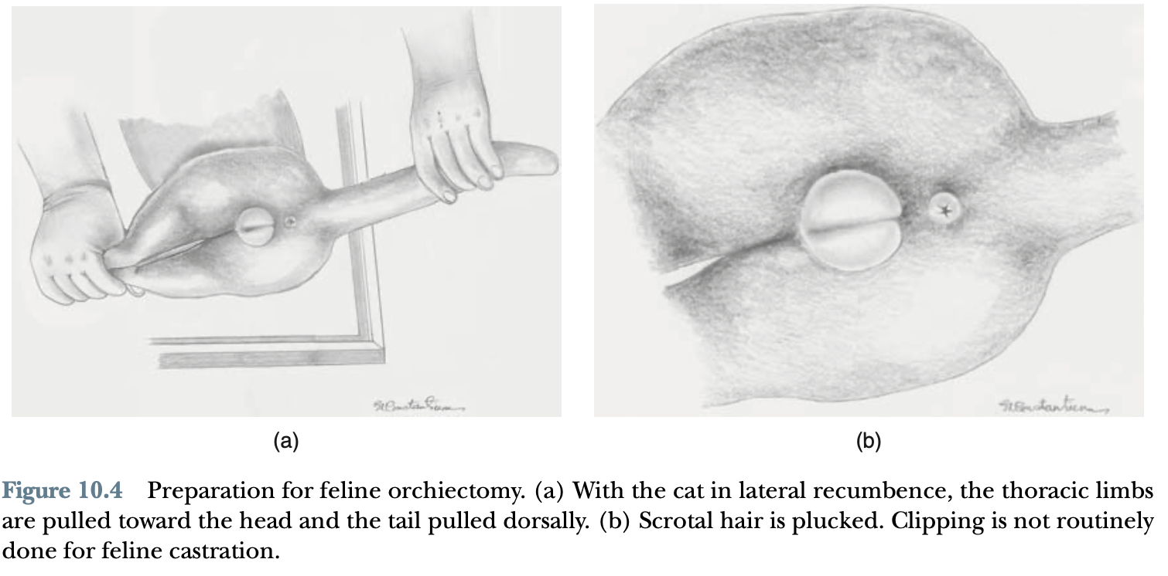

Slide 41
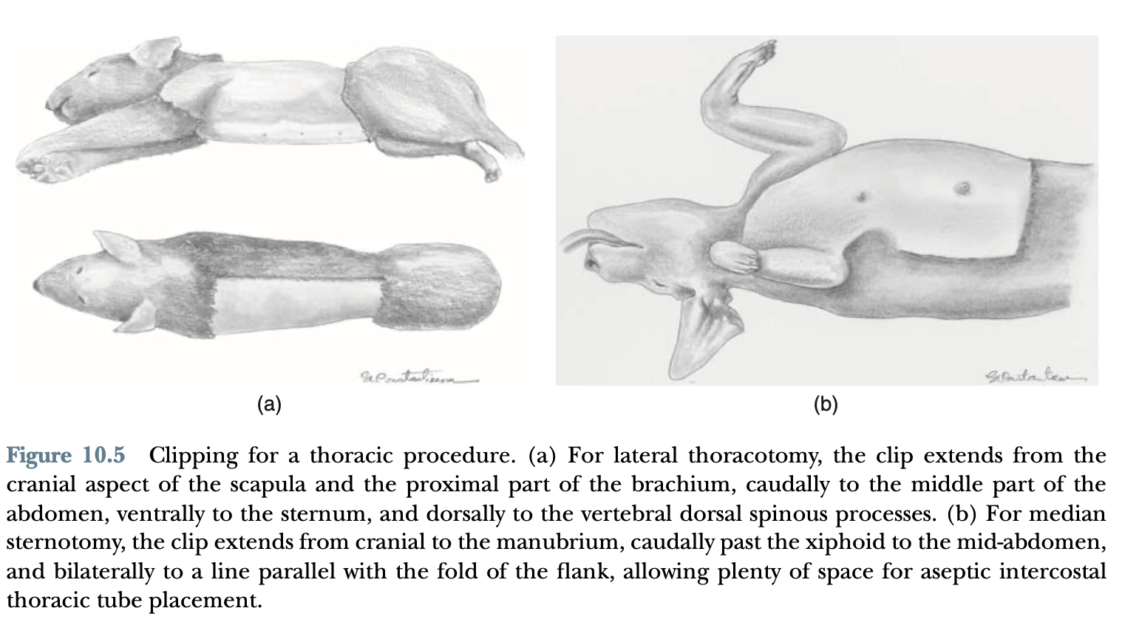

Slide 42
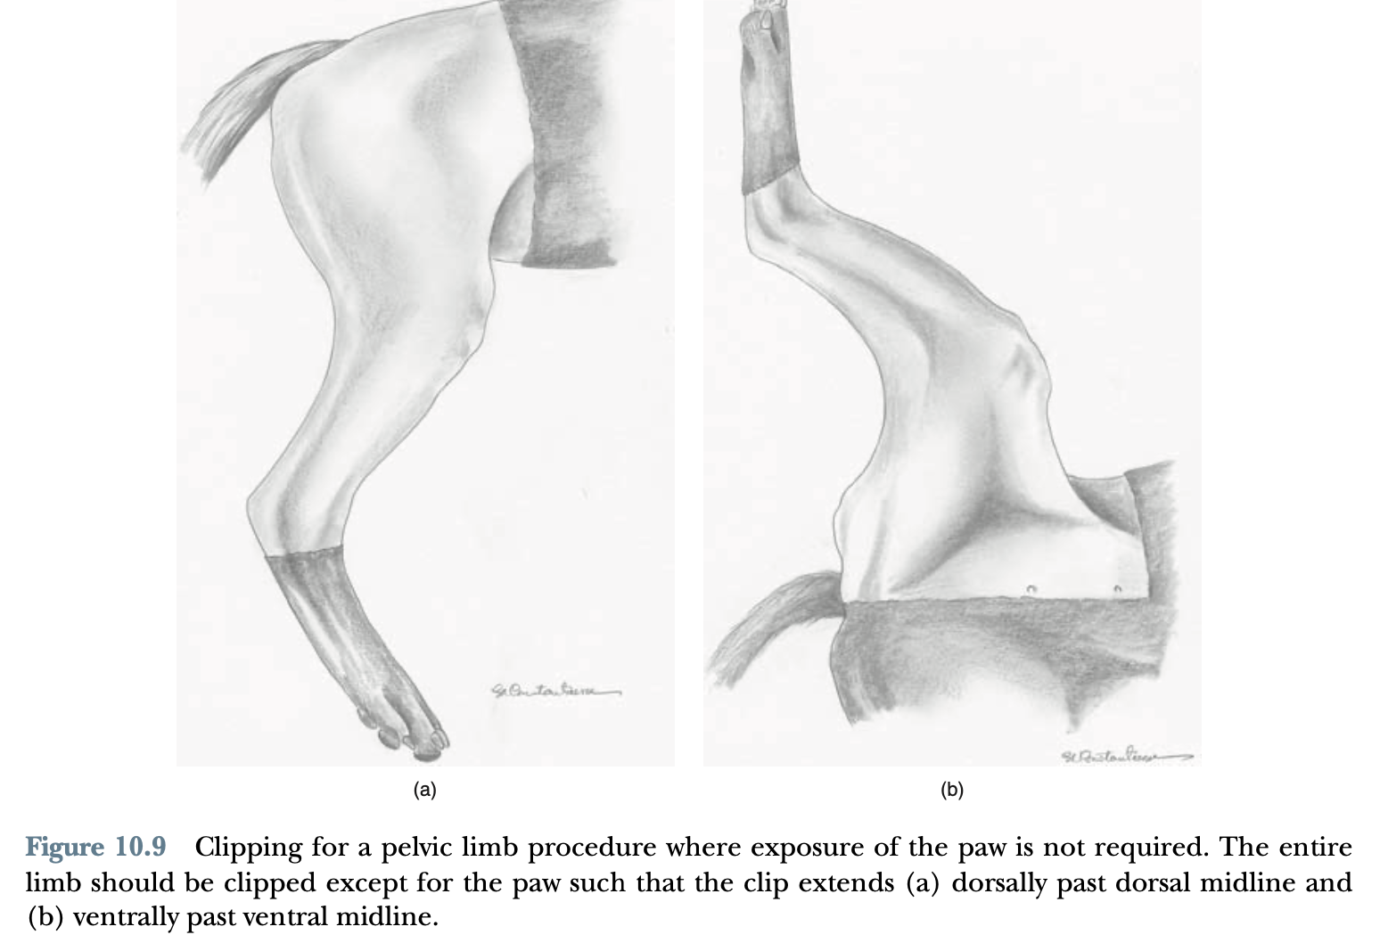

Slide 43
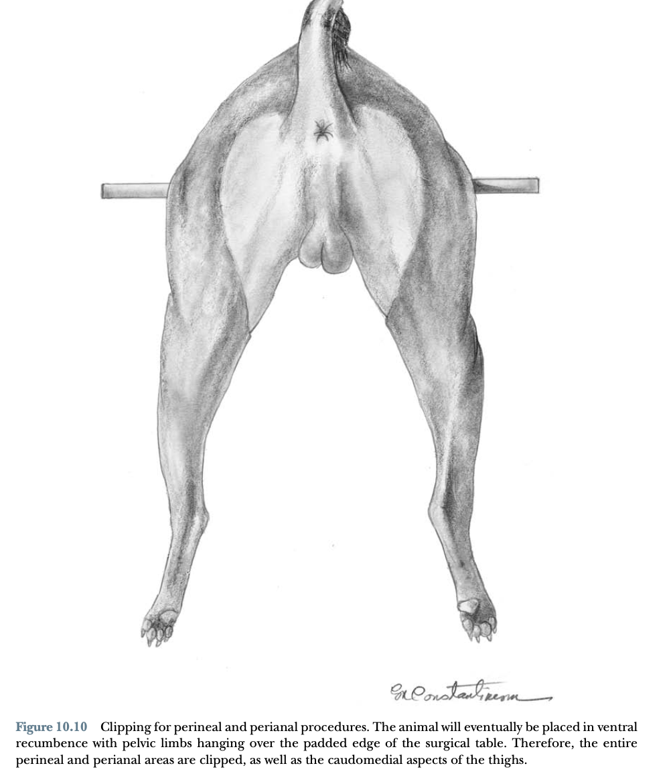

Slide 44
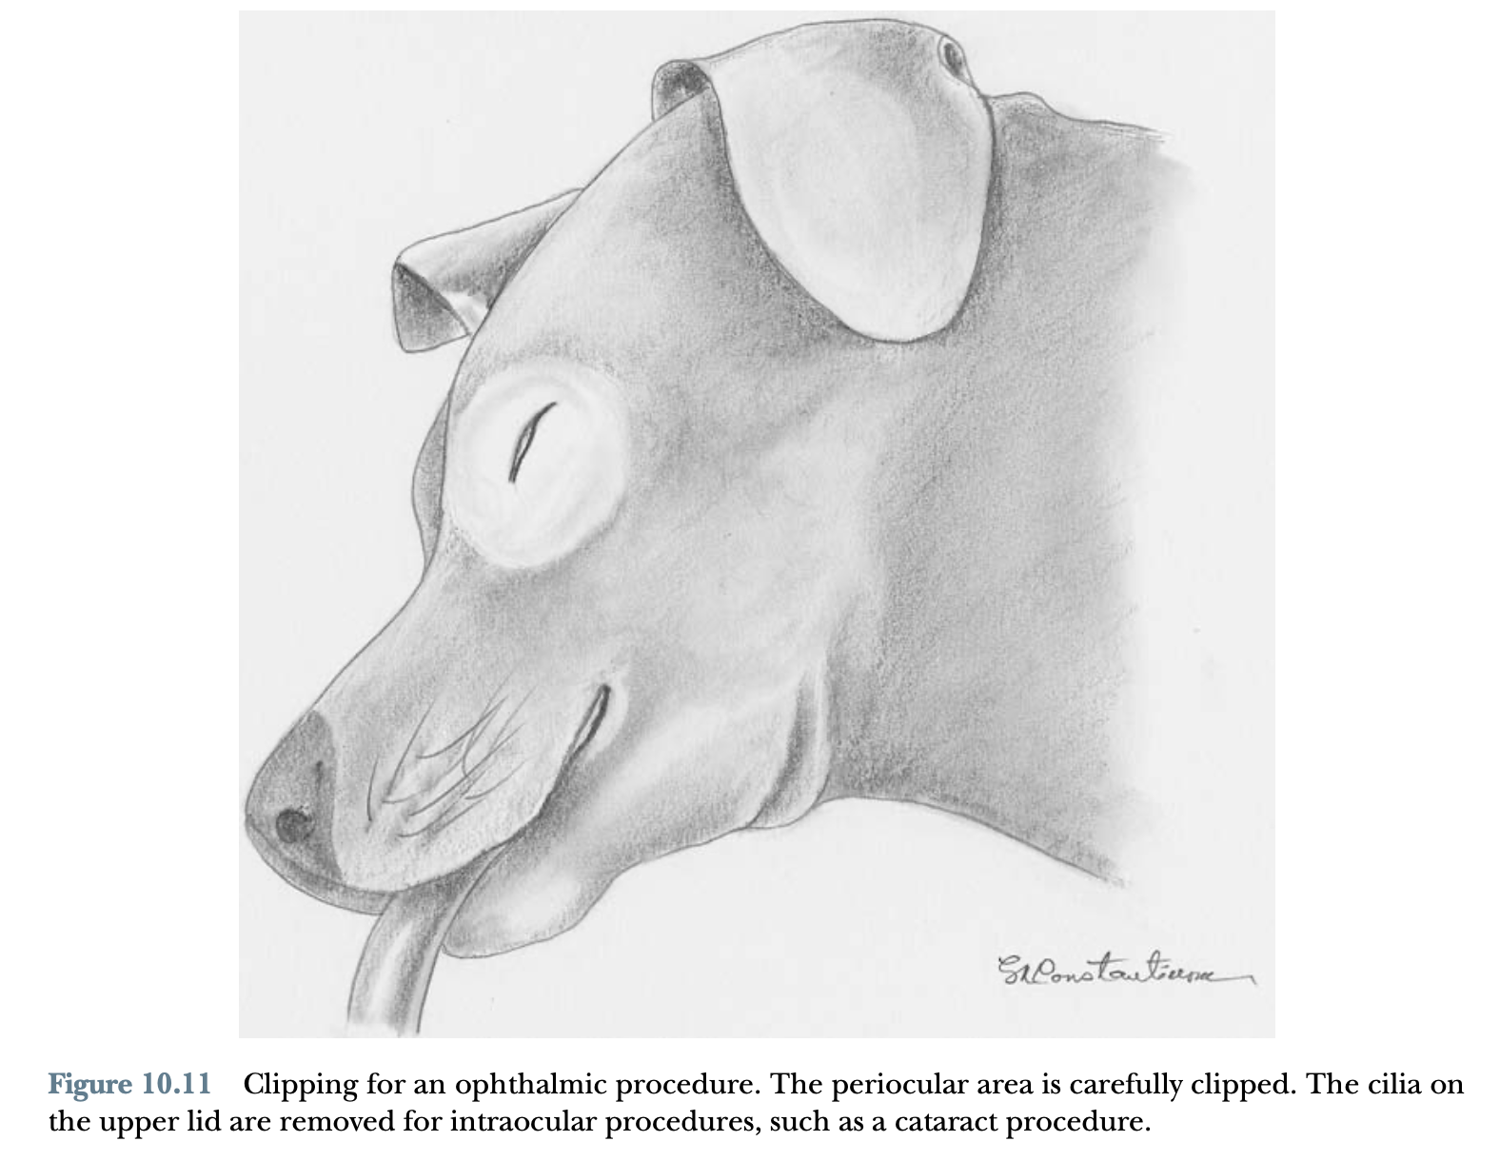

Slide 45
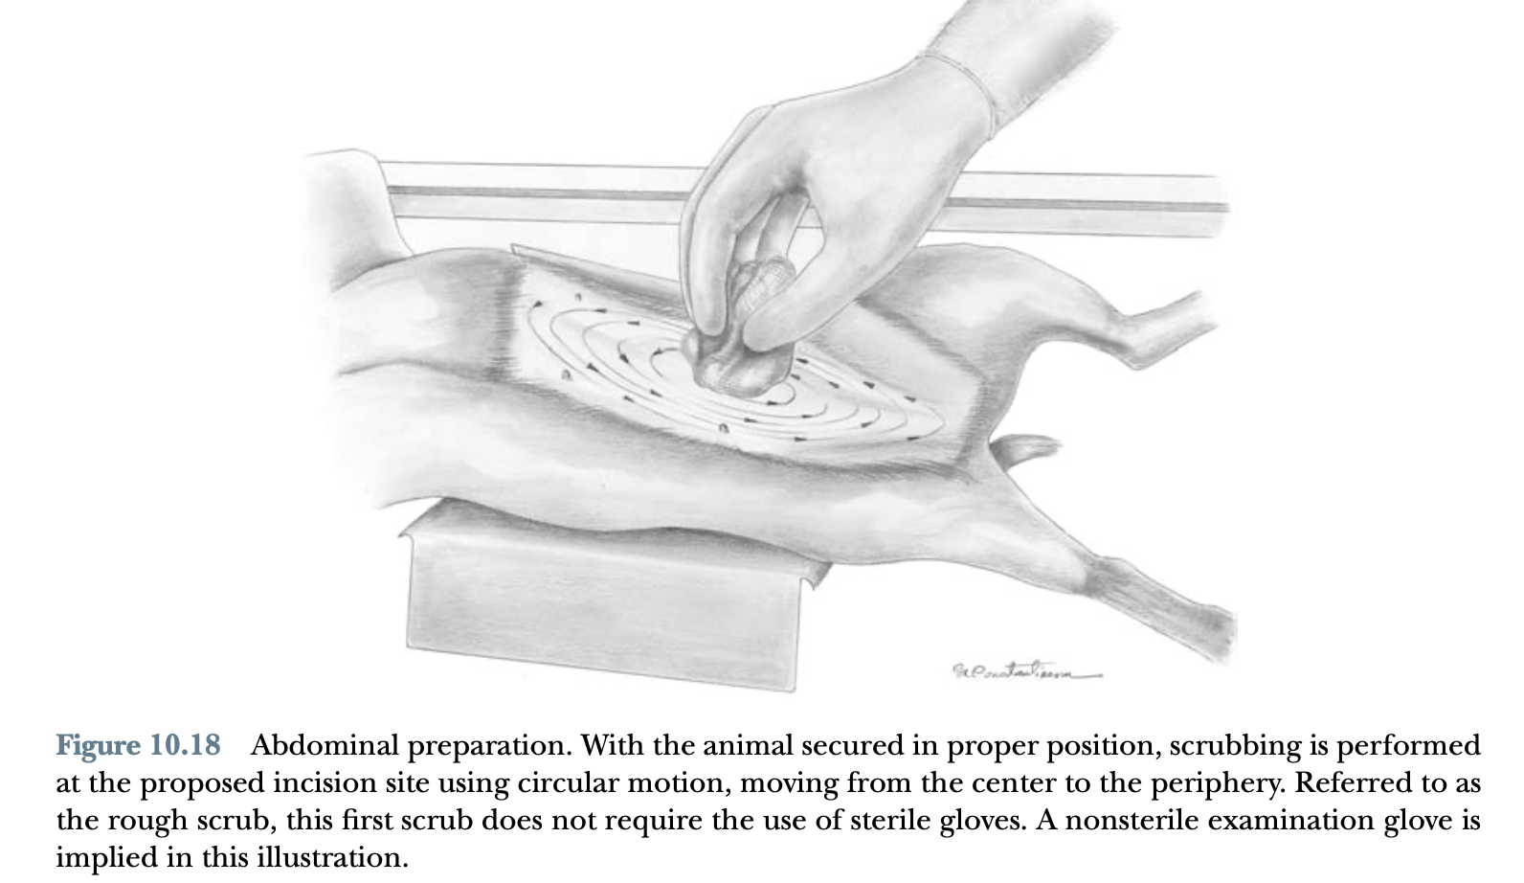

Slide 46
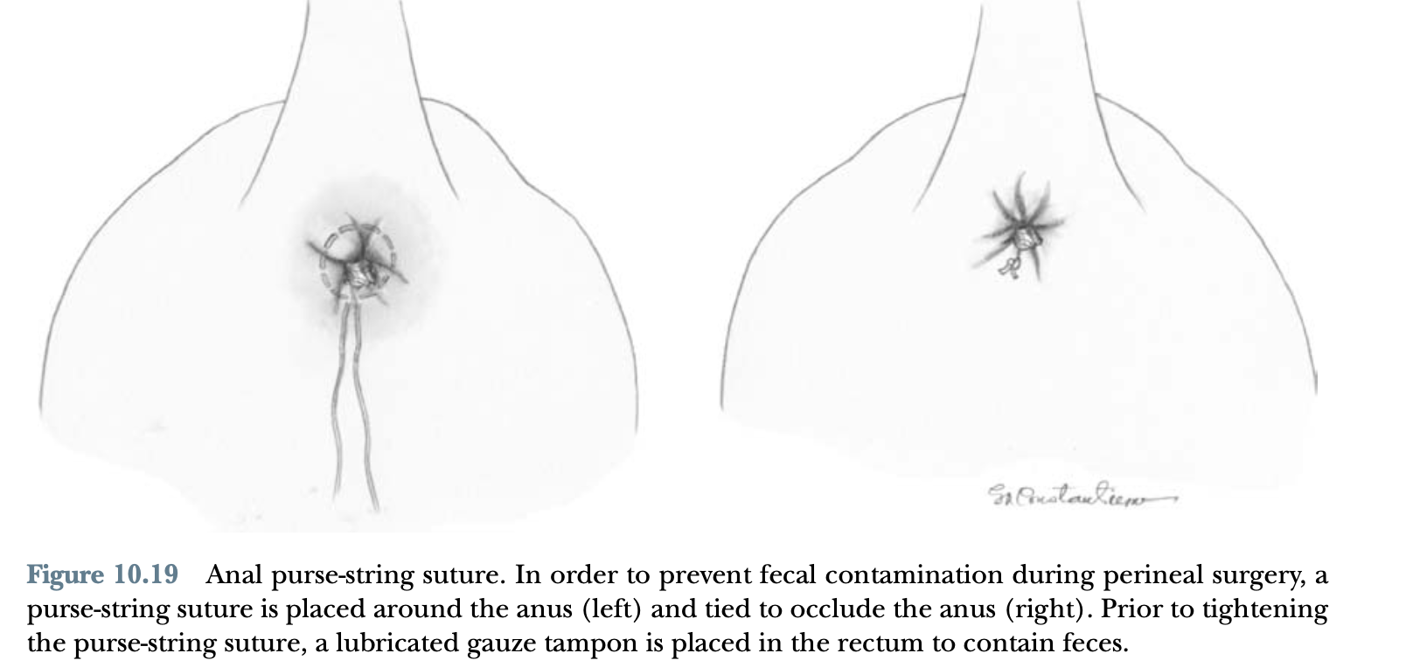

Slide 47
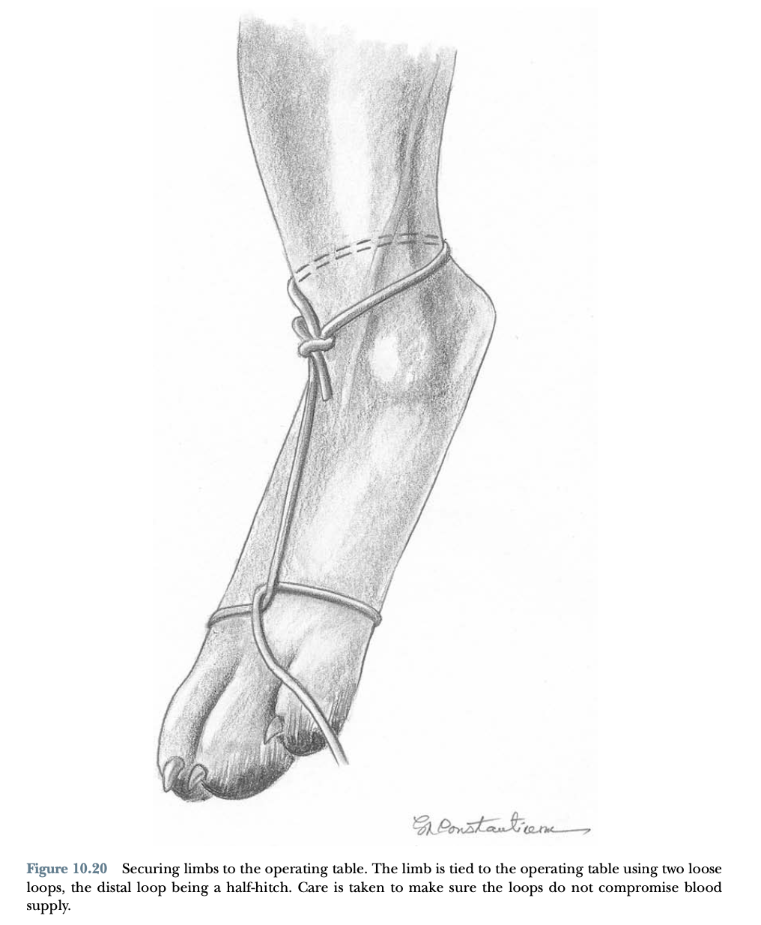

Slide 48
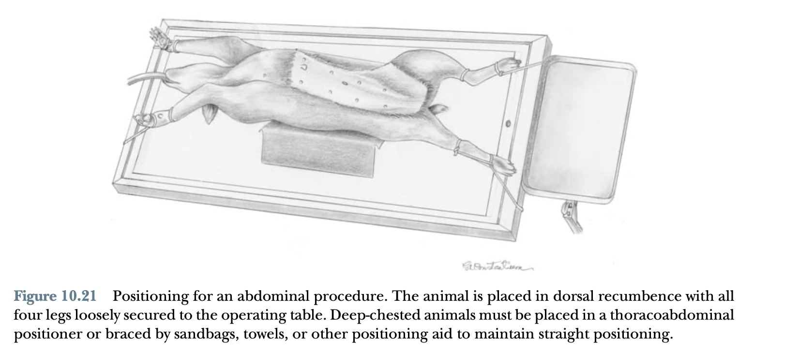

Slide 49
