Slide 1
Glandular epithelium Part 2

Slide 2
The glandular epithelium cells take necessary molecules and with intracellular biosynthetic mechanisms turn them to complex products
Excrete them to blood, inner or outer medulla, skin, mouth and digestive cavity etc.
This phenomenon is called secretion,
Cells or cell groups specialized for secretion are called secretory glands.

Slide 3
Formation
Glandular epithelium is formed from an grow in of surface epithelium:
There are two functions in the glandular epithelium: 1- the cell has done for itself in the basal part, 2. Depending on the function of the cell in the apical part.

Slide 4
Glandular epithelium can release substances with different chemical structure.
Secretion can be
protein (pancreas)
lipid (in the adrenal glands and sebaceous glands)
carbohydrate and protein (salivary glands)
Carbohydrates, fat and protein (mammary gland)

Slide 5
Secretion is influenced by various factors.
It depends on the age of the individual.
The growth hormone is secreted until a certain age.
During puberty, sex hormones are secreted
Prolactin is secreted during pregnancy.

Slide 6
Internal and external factors also affect secretion.
Sadness -tear glands,
excitement -adrenal glands,
anxiety or extreme heat stimulate sweat glands.
The amount of the secretion is also very variable
A worker working in extreme heat can release 1.5 liters of sweat a day.
On the other hand, secretion at the level of μg from the endocrine glands can also be sufficient for the organism.

Slide 7
Secretion can be,
Continuous (salivary gland)
Or for a certain periods of time (pancreas, stomach, Goblet cell)
Examination with autoradiographic methods has shown that secretory function can also to be carried out by other cells
Fibroblasts,
Chondroblasts,
Osteoblasts; secrete substances into the extracellular matrix, forming fibrillary and amorphous structures of connective tissue.

Slide 8
Depending on the release of the secretion products:
Exocrine glandular tissue
Endocrine glandular tissue

Slide 9
Exocrine glandular tissue
Maintains a connection to the surface epithelium during development, has a duct system
The secreting cells are grouped together to form a gap in their center.
The secretion is gathered in this space, and sent to the necessary areas.

Slide 10
Tissues that drain their products into the channels opening to the inner or outer surface, are called exocrine glands (salivary glands).
Their sizes are variable
Located near the covering epithelial in connective tissue.
Therefore, they are connected to the covering epithelial

Slide 11
Endocrine glandular tissue
Does not maintain a connection to the surface epithelium, lacks a duct system
Endocrine glands give their product to blood or lymph to reach their target cells in the other parts of the body.
Example: thyroid, adrenal gland.
The endocrine gland cells may be located in a certain order (thyroid gland) or in bulk (the pancreas).

Slide 12
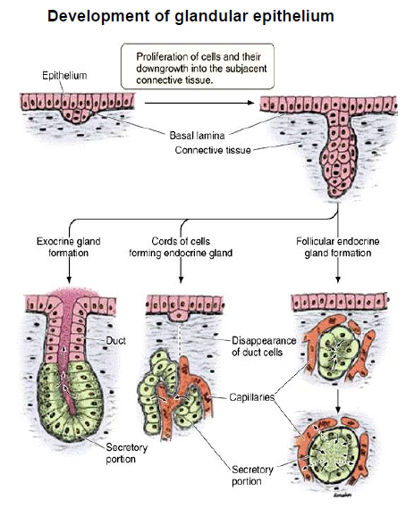

Slide 13
HISTOLOGICAL STRUCTURE
Secretory glands are composed of two parts: Stroma and Parankima.
The part of the glands that comes from the connective tissue is called the stroma and the part of the epithelium is called the parenchyma.

Slide 14
The stroma supports the parenchyma of the gland and other organs.
Outward like a crust, this structure is called capsule and formed by a dense network of collagen fibrils
The connective tissue entering the inner part of the secretory gland is called the septum.
The parts separated by the septum are called lobes.

Slide 15
The loops are divided into smaller segments with smaller septums.
These units, which can be seen even with the naked eye, are called lobules.
Are also separated into small secretory units that can be seen with a microscope.

Slide 16
The distribution of the blood and lymph vessels and nerves of the glands are just as if they were in the connective tissue.
They enter the capsule and follow the septum of collagen fibers and enter the thinner sections between the lobes.

Slide 17
The exocrine gland channel system carries salivation into the internal or external cavities of the body.
The channels do not carry only the secretion material, but change it while passing.
The main channel divides connective tissue, creating the lob ducts.
These channels between the lobules makes more branching

Slide 18
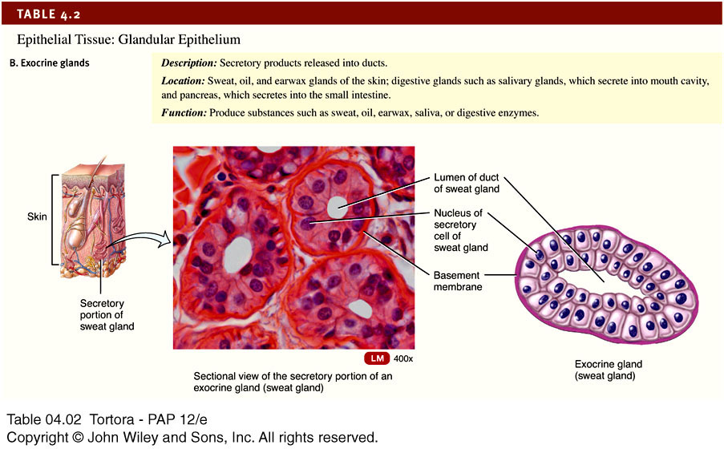

Slide 19
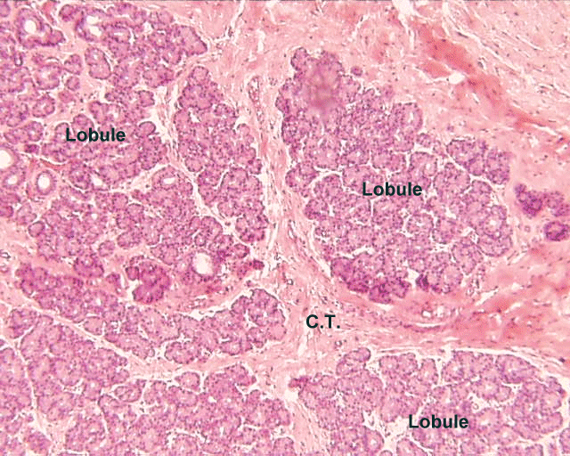
Lopçuk
Lopçuk
Bağ
dokusu
Lopçuk
Gözyaşı bezi ve lopçuklar (Birleşik tübüler bez)
http://neuromedia.neurobio.ucla.edu/campbell/glands/wp_images/170_lp.gif

Slide 20
Çene altı tükrük bezi– Bez boşaltım kanalı, çizgili kanal

Slide 21
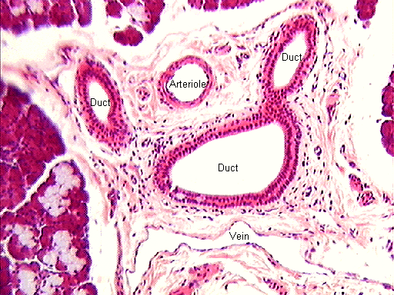
Kanal
Arteryol
Kanal
Kanal
Asinar
bez
Loplar arası kanal, çene altı tükürük bezi (H-E)

Slide 22
CLASSIFICATION

Slide 23
Relation to epithelial tissue
Endoepithelial glands
Secretory cells are among the cells of the covering epithelium.
There are single-celled and multicellular types.
Exoepithelial glands
The gland-secreting cells are located within the connective tissue beneath the covering epithelium, reaching the surface with the secretory drainage channel. Saliva and skin glands,

Slide 24
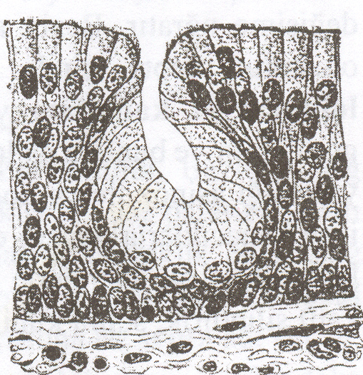
Salgı
granülleri
Epitel h.
Lökosit
(x 4 000)
Endoepitelyal tek hücreli bez.
Bağırsak epitelinde goblet hücresi
Endoepitelyal çok hücreli bez.

Slide 25
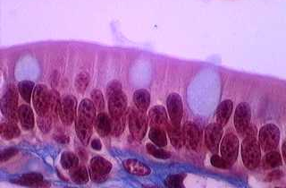
Goblet
Hücresi
Endoepitelyal bez. Tek tabakalı silindirik epitel hücreleri arasında tek hücreli bez, Goblet hücreleri

Slide 26
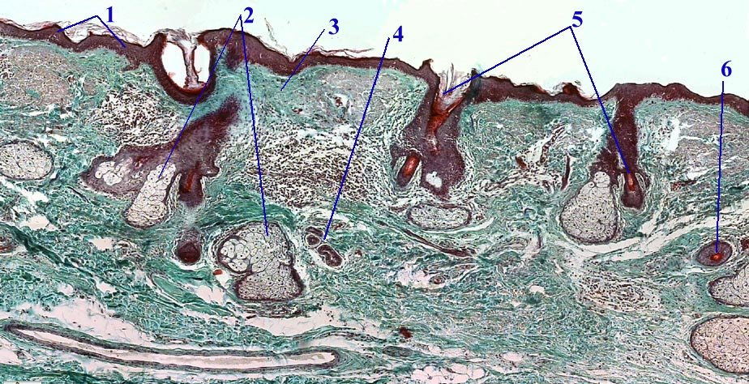
Ekzoepitelyal
Epidermis
Yağ bezi
Dermis
Kıl folikülü
Kıl folikülünün
enine kesiti
Ter bezi
Deri kesidi (Gomori Boyası)

Slide 27
Exocrine glands are classified by
Number of gland cells
Unicellular exocrine glands
Multicellular exocrine glands

Slide 28
Unicellular exocrine glands
The most common example in mammals is the Goblet cell
Found dispersedly in, e.g., respiratory and intestinal epithelium
Life span is 3-4 days.
Flask-shaped cell, with nucleus placed in the narrow basal part of the cell.
Apical broad cell part is filled with mucin-containing vesicles
It is also called the Kalisiform cell because it resembles a glass or vase

Slide 29
Goblet Cell

Slide 30
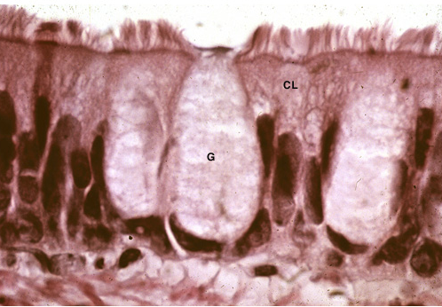
Trake, yalancı tabakalı silli silindirik epitel hücreleri (CL) ve aralarında tek hücreli bez (Goblet hücreleri, G).

Slide 31
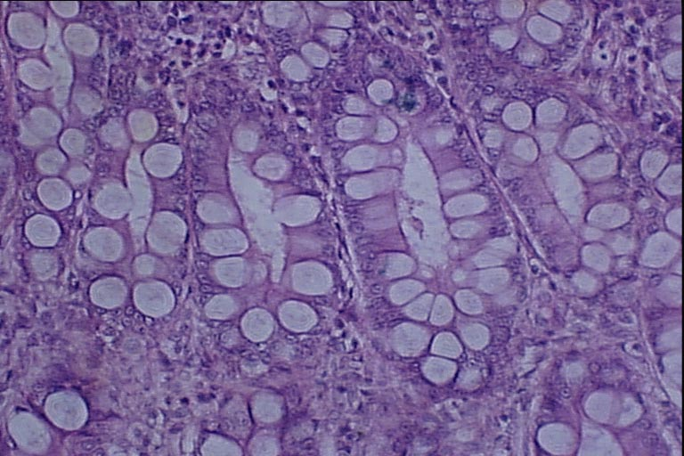
Tek hücreli bez, Goblet hücresi (İnce bağırsak)

Slide 32
Goblet hücreleri
Fare ince bağırsağında silindirik epitel ve goblet hücreleri. Glikoproteinleri boyayan Periyodik asit-Schiff tekniğiyle musin içeren salgı mor boyanır

Slide 33
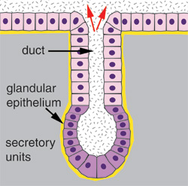
Multicellular glands; It occurs by invagination to connective tissue under the epithelium. There are two parts. - Secretory part (terminal part, terminal) - The part that secretion reaching the surface (drainage channel) The secretion is given to lumen.
The secretion in the lumen is thrown away with the drainage channel.
Boşaltım kanalı
Lümen
Salgı yapan kısım

Slide 34
Multicellular glands are categorized according to two criteria:
Ducts are branched or unbranched
Shape of the secretory portion of the gland
Simple gland duct does not branch
Compound gland duct branches
Tubular glands have tubular secretory parts
Acinar glands have rounded secretory parts
Tubuloacinar glands have both tubular and rounded secretory parts

Slide 35
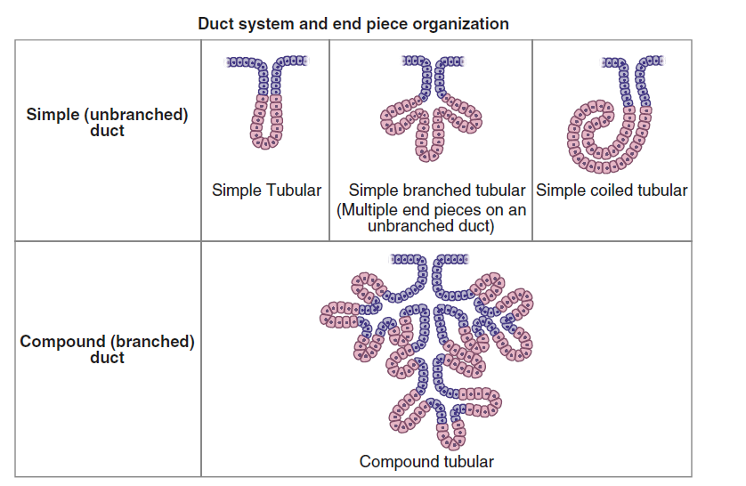

Slide 36
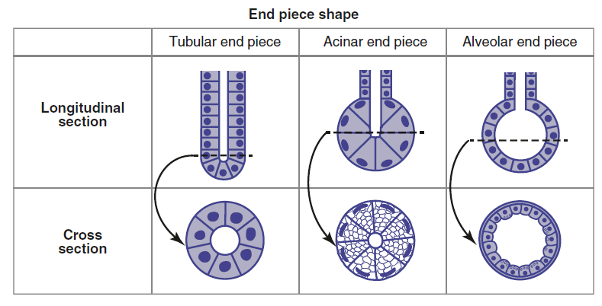

Slide 37
Compound glands

Slide 38
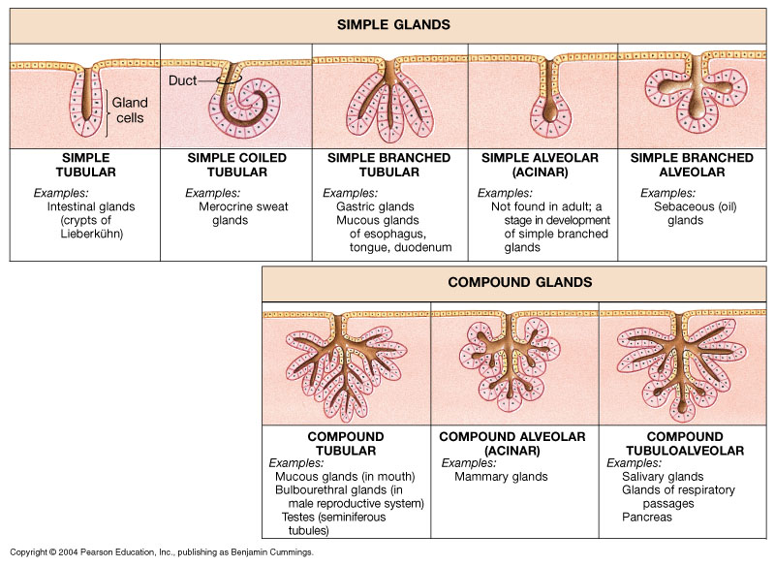
A Structural Classification of Exocrine Glands

Slide 39
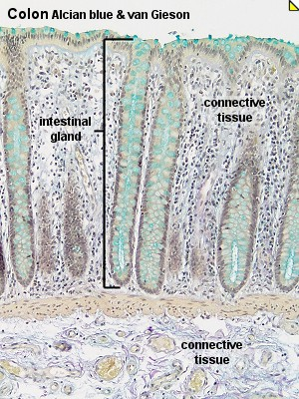
Simple tubular gland.
The gland extends from the surface of the large intestine to the underlying connective tissue in the human large intestine.
The lumen of the gland is narrow and surrounded by various types of secretory cells containing goblet cells.(Alcian Blue & Van Gieson)
Bağ dokusu
Bağırsak
bezi
Bağ dokusu

Slide 40
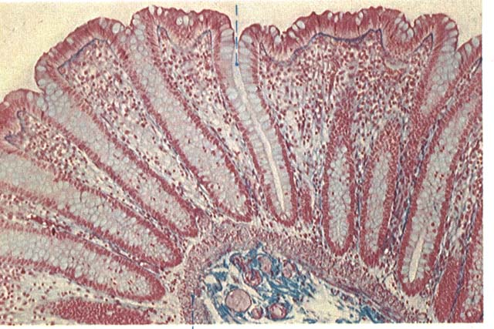
T
Basit tübüler bez(T), insan kalın bağırsak duvarından enine kesit (Mallory&Azan)
http://www.city.ac.uk/optometry/Biolabs/Tissue/

Slide 41
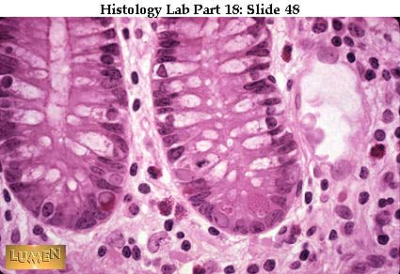
Simple tubular gland, two Lieberkühn depressions in the small intestine. To the right is a pair of large acidophilic granulated Paneth cells, to the left is a bright, orange-pink granular endocrine cell at the cell basal.

Slide 42
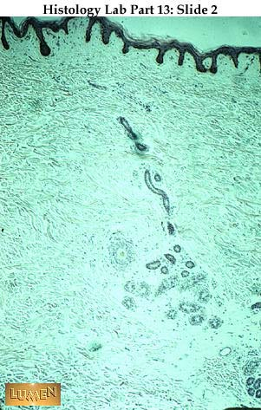
Basit kıvrımlı tübüler bez:
Salgının oluştuğu son kısım kıvrılmıştır.
Düz bir boşaltım kanalı ile yüzeye açılır.
Örnek; deride merokrin tip ter bezleri.

Slide 43
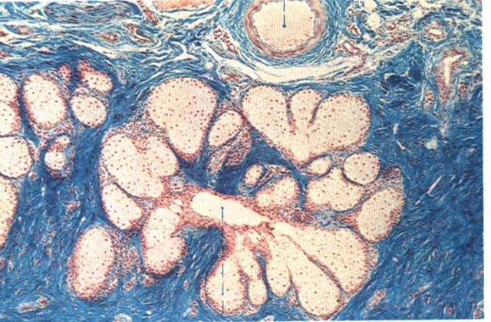
Basit dallı alveolar bez, insan üst göz kapağının yağ bezi (Zeis bezi) (Mallory-Azan)
http://www.city.ac.uk/optometry/Biolabs/Tissue/

Slide 44
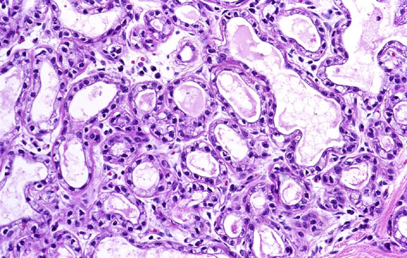
Meme bezi, birleşik alveolar bez. x66 (H&E)
http://pathology.mc.duke.edu/ research/PTH225.html

Slide 45
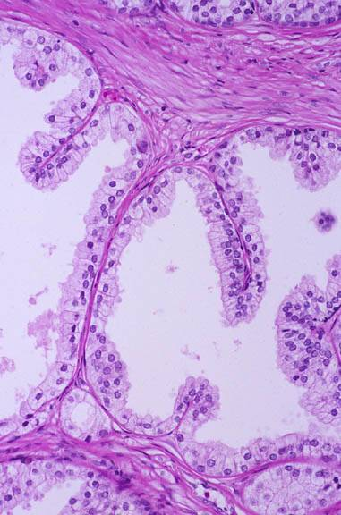
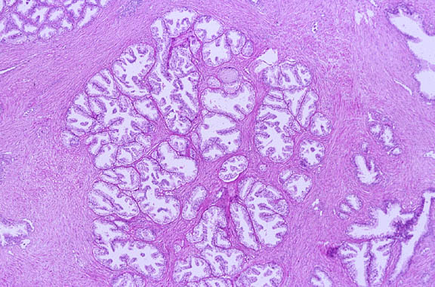
Prostat bezi, birleşik tübülo-alveolar bez.
(H&E) (üstte x10, sağda x66). http://pathology.mc.duke.edu/ research/PTH225.html

Slide 46
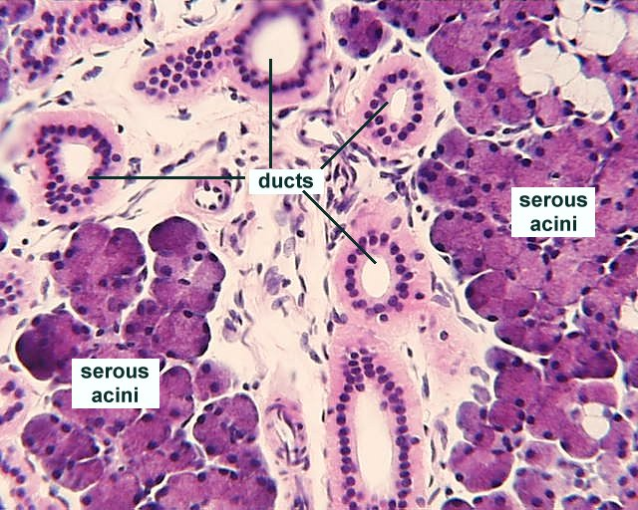
Kanallar
Seröz
asinar
Seröz
asinar
Birleşik tübülo-alveolar bez,çene altı tükürük bezi (H-E)

Slide 47
Secretory product
Mucous
Serous
Mixed mucoserous

Slide 48
Mucous
The mucous acidic cell is filled with polysaccharide rich musino granules.
For this reason, the cytoplasm is slightly painted.
The cytoplasm looks like a hollow foam.
The nucleus are darker and smaller than serous cells, is pushed towards the base and flattened.
These mucus-filled glands are called mucous glands.
It is painted with toluidine
Goblet cell, salivary gland

Slide 49
Serous
Viscosity of serous gland secretion is low, mucous gland is high
The apical cytoplasm of the serous cell is better stained.
In the sections secretory granules can be seen, the nucleus is round or slightly oval, and is located in the basal part of the cell. Example: Exocrine units of liver, kidney and pancreas, sub-salivary gland, serous units of salivary glands in the mouth

Slide 50
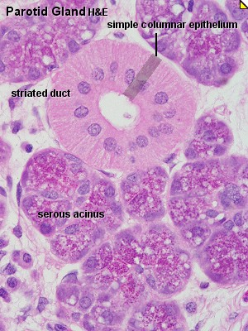
Parotid bezi
Tek tabakalı silindirik epitel
Çizgili kanal
Seröz-asinar bez
Seröz asinar bez
(İnsan Parotid bezi) (H&E).
Loplar arasındaki tek tabakalı silindirik epitelden oluşan çizgili kanal.

Slide 51
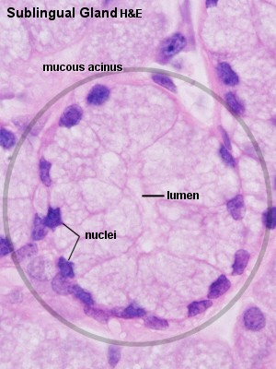
Dil altı tükürük bezi
Parotid bez
Salgı kesecikleri
Mükoz bez
Seröz bez

Slide 52
Mixed mucoserous
Both serous and mucous cells are present.
Mucous cells form the majority, serous cells envelop it like half a month.
Serous cells secrete secretions from the intercellular spaces to the gland lumen.
Metachromasia is only seen in mucous cells. Example: subgluteal salivary gland

Slide 53
Çene altı tükürük bezi

Slide 54
Mükoz hücreler
Seröz hücreler
Salgı kanalı
hücreleri
Seromüköz bez (Çene altı tükürük bezi)

Slide 55
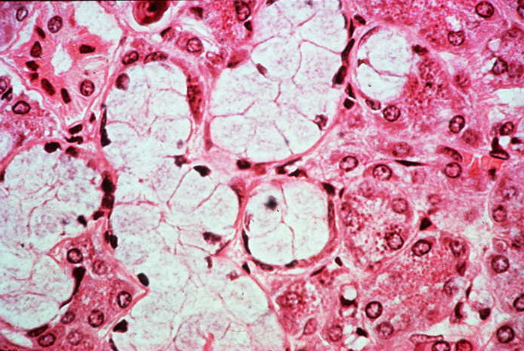
Ç
S
M
S
Seromüköz bez, çizgili kanal (Ç) ve lümeni, asinar bez, kassı epitel hücreleri (Çene altı tükrük bezi)

Slide 56
According to the mode of secretion
Merocrine secretion
Apocrine secretion
Holocrine secretion

Slide 57
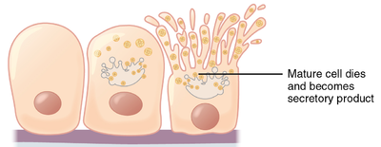
Holocrine. whole cell dies, the discharges go
together with the cellular contents
(remnants of a dead cell)
eg. sebaceous and tarsal gland cells.

Slide 58
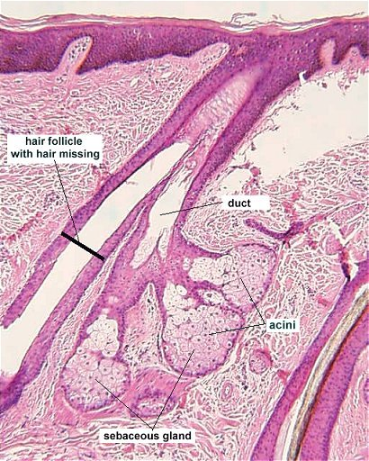
Kıl folikülü
Kanal
Yağ bezi
Deri yağ bezi, basit dallı alveolar bez, holokrin salgılama (Dejeneratif tip).
http://neuromedia.neurobio.ucla.edu/campbell/glands/wp_images/sebaceous%20gland.jpg
Yağ bezi

Slide 59
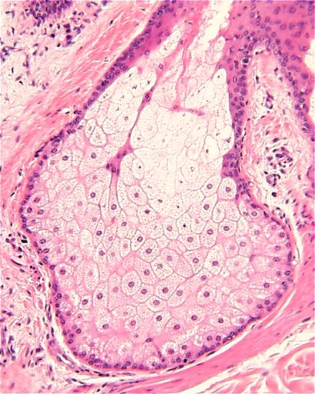
Deri yağ bezi,
holokrin salgılama
http://neuromedia.neurobio.ucla.edu/campbell/glands/wp_images/sebaceous%20gland.jpg

Slide 60
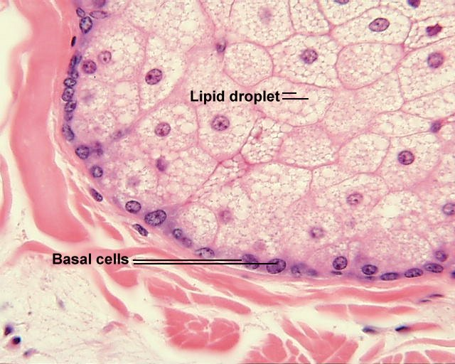
Lipit damlacıkları
Bazal hücreler
Deri, yağ bezi. http://neuromedia.neurobio.ucla.edu/campbell/glands/wp_images/sebaceous%20gland.jpg

Slide 61
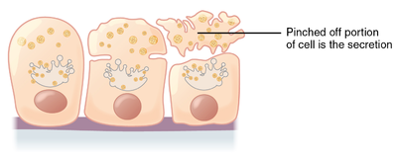
Apocrine. (membrane budding)
Products accumulate at the apical part of the cell then discharges its apical cytoplasm
eg mammary gland cells.

Slide 62
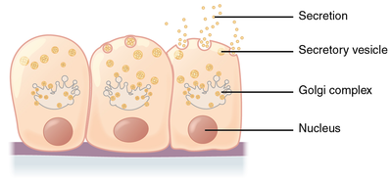
Merocrine. Only cell products are discharged
eg sweat gland cells.
Cytogenous. A product is a complete living cell. eg gonads (testes and ovaries)

Slide 63
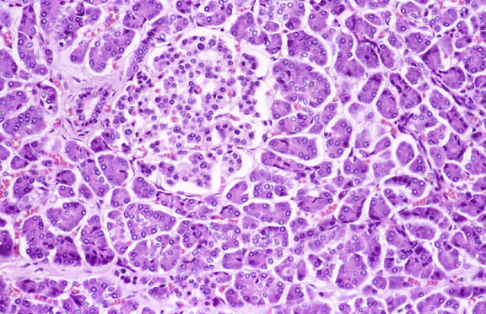
Langerhans adası
(Endokrin kısım)
Seröz asinar hücreler
(Ekzokrin kısım)
Pankreasın seröz asinar kısmı, merokrin bez, x66 (H-E).
http://pathology.mc.duke.edu/ research/PTH225.html

Slide 64
CONTROL OF EXOCRINE SECRETION
Most glands release secretions in small amounts; but increases the amount of secretion when a impulse is received.
Physiological control mechanisms of the secretion vary from gland to gland.
In most cases, the stimulation is provided through the autonomic nervous system.
In some of them stimulation is via hormones, while some are stimulated by both mechanisms

Slide 65
The smell or appearance of a food increases the secretion of acid, mucus and digestive enzymes.
Even hearing to the names of certain foods increases the saliva of the glands in the mouth.
This physical stimulus in the stomach is provided through the vagus nerves.
If this nerve is cut off, the stomach glands do not release their secretions.

Slide 66
On the other hand, a nutrient placed inside the stomach initiates the secretion of stomach
The secretion in this case depends on the intrinsic nerves of the organ and the hormones released from that area.
As a result of stimulation of the nerves in the gastric mucosa, acetylcholine is secreted.
This leads to secretion of gastrin hormone from endocrine cells
It stimulates the secretion of the gastric glands.

