Slide 1
Polymer Technology
Chapter 10
Solid-State Properties

Slide 2
Solid-State Properties Mechanical Properties Methods of Testing Static Testing
The initial length of a central section of the dogbone shape contained within the thinner region of the tensile specimen is called the initial gage length, Lo.
During the tensile deformation, the force, F, is determined as a function of elongation at the fixed end by means of a transducer, which measures the change in length of the sample.
Most of the time, the tensile response is plotted as engineering stress or nominal stress, σ, vs engineering strain or nominal) strain, ε, using the following relation given below:
where A_{o} is the undeformed cross-sectional area of the gage region of the dogbone shape and ∆L is the change in sample gage length (L – Lo) due to the deformation of the sample.

Slide 3
Solid-State Properties Mechanical Properties Methods of Testing Static Testing
Aa an alternative to the engineering stress-strain relation, the stress-strain response of a polymeric sample can be determined in terms of true stress and true strain.
The true stress is defined as the ratio of measured force to the actual cross-sectional area, A, of the sample at a certain elongation
The actual cross-sectional area ‘A’ goes down as the sample elongates, then the true stress value will always be greater than the engineering stress value.
The true strain, ε^{T}, can be defined as following:
where Lo and L is the initil and the final length values.

Slide 4
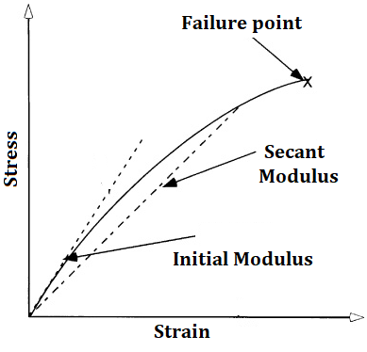
Solid-State Properties Mechanical Properties Methods of Testing Static Testing
Hooke’s law given below provides a relationship between the stress and the strain for tensile deformation of an ideal elastic solid as following:
in which the proportionality factor, E, is called the tensile modulus or Young’s modulus.
According to the representative stress-strain plot for a typical brittle polymer on the right, only the initial portion of the stress-strain plot follows Hookean behavior.
The critical point at which the stress starts to deviate from a linear stress-strain relation is called the proportional limit.
The stress-strain curve for a plastic sample with brittle failure

Slide 5
Solid-State Properties Mechanical Properties Methods of Testing Static Testing
In to determine a value for the modulus, a convenient procedural definition needs be adopted.
Thus, the initial slope of the stress-strain curve is called the initial modulus as shown on the figure.
Aas an alternative to the initial modulus definition, a line may be drawn from the origin to some convenient point along the stress-strain curve, for example, at 1% strain.
This new line defines a secant and the slope of this line defines the secant modulus in this case.
The modulus is an important material property and it is a function of both temperature and the deformation rate.
The stress-strain curve for a plastic sample with brittle failure

Slide 6
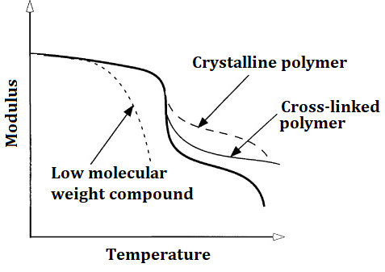
Solid-State Properties Mechanical Properties Methods of Testing Static Testing
Figure on the right illustrates a representative plot of modulus vs temperature.
The modulus value goes down slightly with an increase in temperature and then the modulus value goes down sharply within the region of the glass transition temperature.
For low-molecular-weight materials, the modulus value continues to drop rapidly with increasing temperature.
For high-molecular-weight amorphous polymers, the modulus value goes down to a secondary plateau region, which is called the rubbery plateau.
This point marks the viscous flow region.
Modulus vs temperature plot

Slide 7
Solid-State Properties Mechanical Properties Methods of Testing Static Testing
The plastics are typically melt-processed in the temperature range where the viscosity is low.
The presence of a rubbery plateau for high-molecular-weight polymers is the result of the creation of entanglement of the polymer chains.
The specified entanglement of the polymer chains hinders slippage at temperatures immediately above the glass transition temperature ‘Tg’, and therefore, the modulus value remains relatively high.
Above the glass transition temperature, the entanglement of the polymer chains is easily disassociated due to high kinetic energy and the modulus value drops.
Modulus vs temperature plot

Slide 8
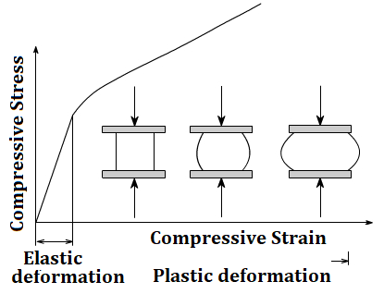
Solid-State Properties Mechanical Properties Methods of Testing Static Testing
In addition to the tensile deformation, the polymeric samples may be subjected to the compressive stress or the shear stress.
In the case of the compressive stress, the polymeric sample is prepared in the form of a disk as shown on the right.
Now, the measured parameter is the bulk modulus, K.
The engineering shear stress, τ, is defined as:
in which Ao is the area of the surface of the sample on which the shear force acts.
The shear strain, γ, can be calculated using the angle of deformation, θ.

Slide 9
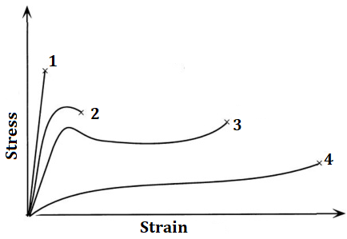
Solid-State Properties Mechanical Properties Methods of Testing Static Testing
Typical stress-strain curves of different polymeric samples are illustrated in the figure on the right.
At normal use temperatures, brittle plastics like commercial grade polystyrene exhibit a rapid increase in stress with increasing strain up to the point of sample failure (curve 1).
At the same time, this sample exhibits high modulus value.
Meanwhile, the stress at failure is called the ultimate stress (σu) or stress-at-break (σb).
Ductile polymers such as polyamides, and toughened-plastics, exhibit stress-strain behavior illustrated by curves 2 and 3 in the figure on the right .
Stress-strain curves for different samples

Slide 10
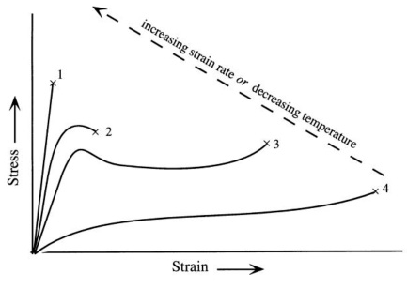
Solid-State Properties Mechanical Properties Methods of Testing Static Testing
The initial slope of the stress-strain plot for ductile plastics (curve 2 and curve 3) is smaller than that obtained with the plastics that fail in a brittle mode (curve 1).
In other words, the modulus of ductile polymers is lower than that of the brittle polymers.
Meanwhile, the energy required to deform the sample to the point of failure is much higher for ductile plastics when compared with brittle plastics, which means that ductile plastics can absorb more energy.
In general, rubbery plastics follow stress-strain behavior similar to that of curve 4.
Stress-strain curves for different samples

Slide 11
Solid-State Properties Mechanical Properties Methods of Testing Transient Testing & Impact Testing
Stress-relaxation experiments can be conducted with the same commercial instruments utilized in the tensile tests.
In the stress relaxation test, a rapid extension is applied to the plastic sample and the stress on the specified sample is recorded as a function of time by means of a force transducer.
In this test, the stress is a function of time and, hence, the stress-relaxation modulus, Et, is also time dependent.
Impact tests determine the energy expended up to failure under conditions of rapid loading applied to the polymeric sample.
There are a number of different types of impact tests, which are Izod test and Charpy test.
In these tests, a hammer-like weight strikes a plastic specimen and the energy-to-break is calculated from the loss in the kinetic energy of the hammer.

Slide 12
References
Robert O. Ebewele, «POLYMER SCIENCE AND TECHNOLOGY», CRC Press, 2000.
Fried, Joel R., «Polymer science and technology», Prentice Hall, Third edition.

