Slide 1
GENETICS VME205
Asist. Prof. Nüket Bilgen
Ankara University Faculty of Veterinary Medicine
Department of Genetics

Slide 2
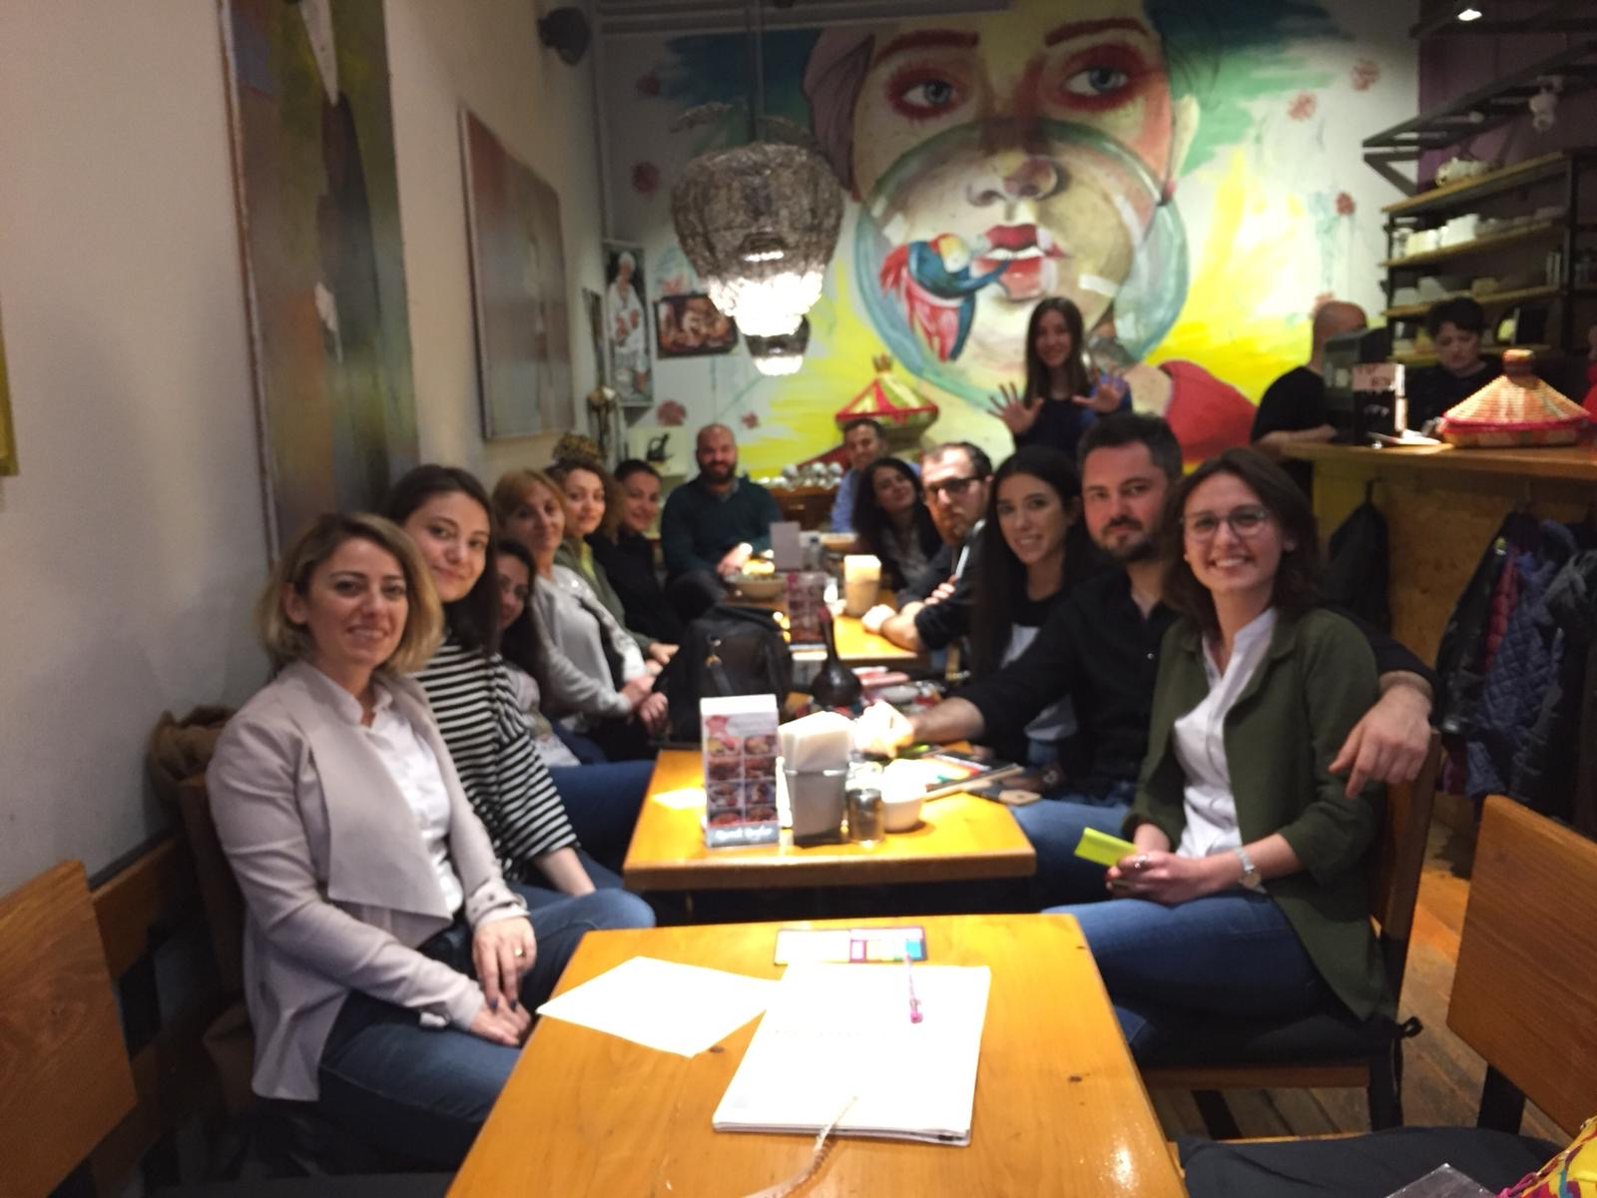
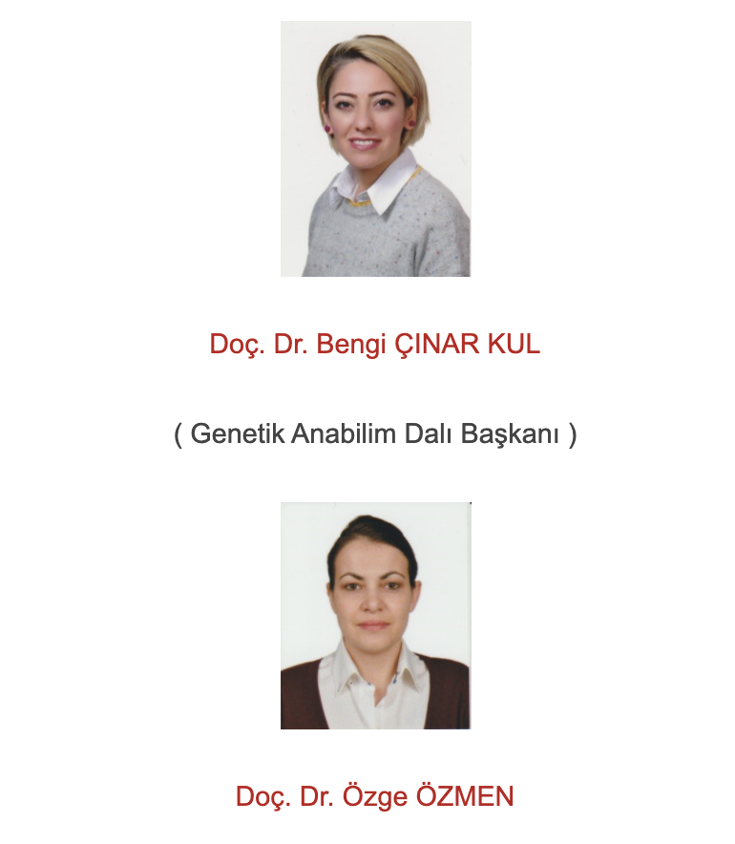
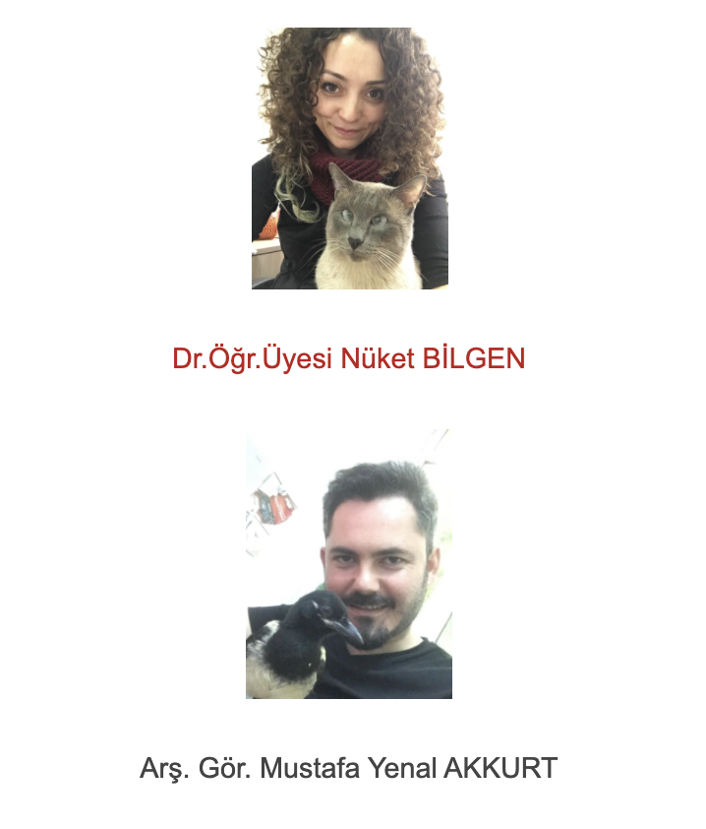
The department

Slide 3
Why study genetics?
Main goals of this lecture:
 | To teach - Genetic mechanisms affecting the phenotypic and genotypic characteristics - Organization of DNA into the chromosomes - Structure and function of the genomes and genes, - Mutations types, - Inherited disorders in animals.
Evaluation;
Mid term exam
Final exam
(written answers, short text answers and multiple choice questions)
Group works
Q-A
Online resources
Notes:
How do the genetic mechanisms affect phenotype and genotype?
How does DNA organize into the chromosomes
How is the structure of the genomes and genes and how can express their self
Which inherited diseaes are important in animals.
For evaluation of lecture you will hace two exams. The first one is mid term the other one is final exam including written essay answers, short text answers and multiple choice questions.

Slide 4
https://www.sciencemag.org/news/2019/08/did-crispr-help-or-harm-first-ever-gene-edited-babies

