Slide 1
GENETICS VME205
Asist. Prof. Nüket Bilgen
Ankara University Faculty of Veterinary Medicine
Department of Genetics

Slide 2
Why study genetics?
Main goals of this lecture:
 | to teach - Genetic mechanisms affecting the phenotypic and genotypic characteristics - Organization of DNA into the chromosomes - Structure and function of the genomes and genes, - Mutations types, - Inherited disorders in animals.
Evaluation;
mid term exam
final exam
(written answers, short text answers and multiple choice questions)
Group works
Q-A
Online resources
Notes:
How do the genetic mechanisms affect phenotype and genotype?
How does DNA organize into the chromosomes
How is the structure of the genomes and genes and how can express their self
Which inherited diseaes are important in animals.
For evaluation of lecture you will hace two exams. The first one is mid term the other one is final exam including written essay answers, short text answers and multiple choice questions.

Slide 3
Lecture content
Week | Subject
1 | Introduction; History; Definitions, The Place and Importance of Genetics in Veterinary Medicine, Variations; Genotype and Phenotype
2 | The Genetic Make-up of a Cell; Definition of Organism;
3 | Cell divisions; Mitosis and meiosis, Crossing Over;
4 | Mendelian Genetics; Mendel’s Laws
5 | Non-Mendelian inheritance; Interaction of Genes; Interaction of Alleles; Pleiotropy, Penetrance, Expressivity; Interaction of Non-Allele Genes; Epistasis;
6 | Structure of DNA and RNA; Structure of Genes and Genomes; Chemical Composition of DNA and RNA
Notes:
this content will be followed through out the class. I would recommend you to read before class to make it more efficient.

Slide 4
Lecture content
Week | Subject
7 | Structural Features and Organisation Chromosomes; Inheritance of Gender; Gender Defects, Inheritance of Characters Related with Gender;
8 | DNA Replication in Prokaryotes and Eukaryotes
9 | Transcription, gene expression
10 | Translation and Protein synthesis
11 | Mutations; Causes of Mutation; Chromosomal Aberrations; Numerical and Structural Chromosome Aberrations, Point Mutations (Base Mutations)
12 | Multiple Alleles; Polymorphism
13 | Inherited disorders in Livestock; Identification and elimination of Detrimental Genes, Pedigree Analyses
14 | Role and Importance of Biotechnology in Veterinary Medicine; Analysis of DNA Sequence; Polymerase Chain Reaction; Analytical Approaches to Solve Genetical Problems

Slide 5
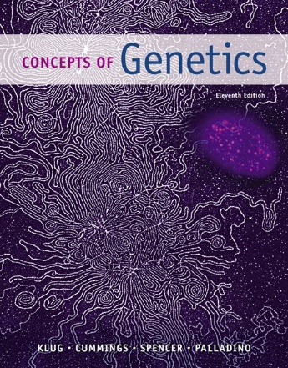
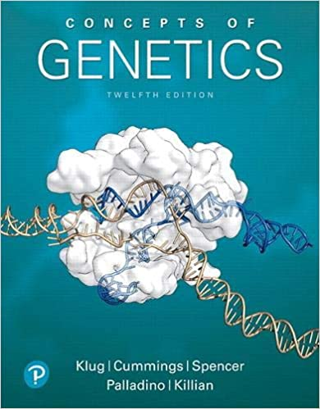
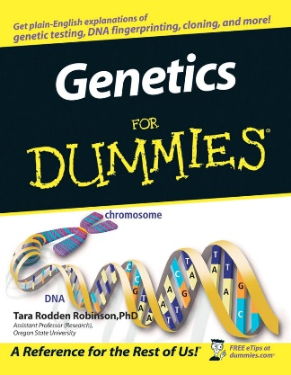
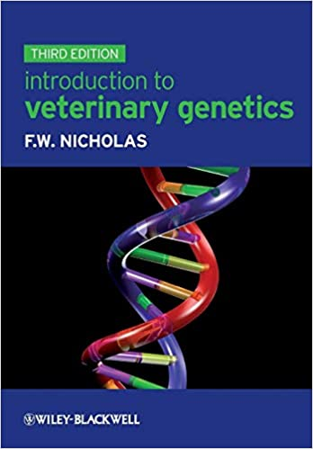
Klug, W. S., & Cummings, M. R. Concepts of genetics Pearson Education, Inc.
Genetik Kavramlar, (Türkçe Çeviri) Öner C., Palme Yayınevi
Robinson, T. R. Genetics for dummies. John Wiley & Sons.
Nicholas, F.W. Introduction to Veterinary Genetics. Oxford University Press Inc
You are wellcome to our deparment library
Online resources:
http://www.dnaftb.org/
https://www.ncbi.nlm.nih.gov/books/NBK21766/
https://www.ncbi.nlm.nih.gov/books/NBK21054/
Notes:
You can find the books online you dont need to purchase, both turkish and english versions are avilable for concepts of genetics book.
Also some reading boks like the double helix, selfish gene, and other boks from Richard Dawkins are availlable.

Slide 6
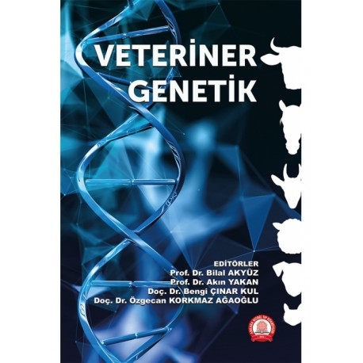

Slide 7
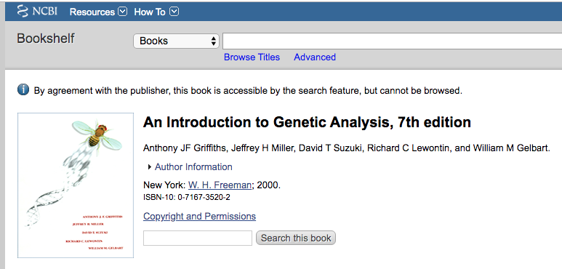
Online resources:
http://www.dnaftb.org/
https://www.ncbi.nlm.nih.gov/books/NBK21766/

Slide 8
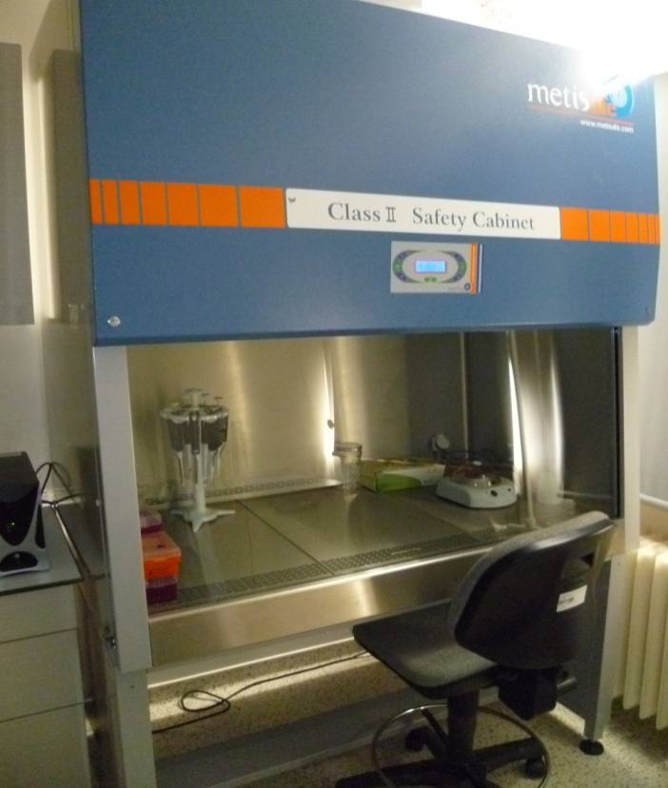
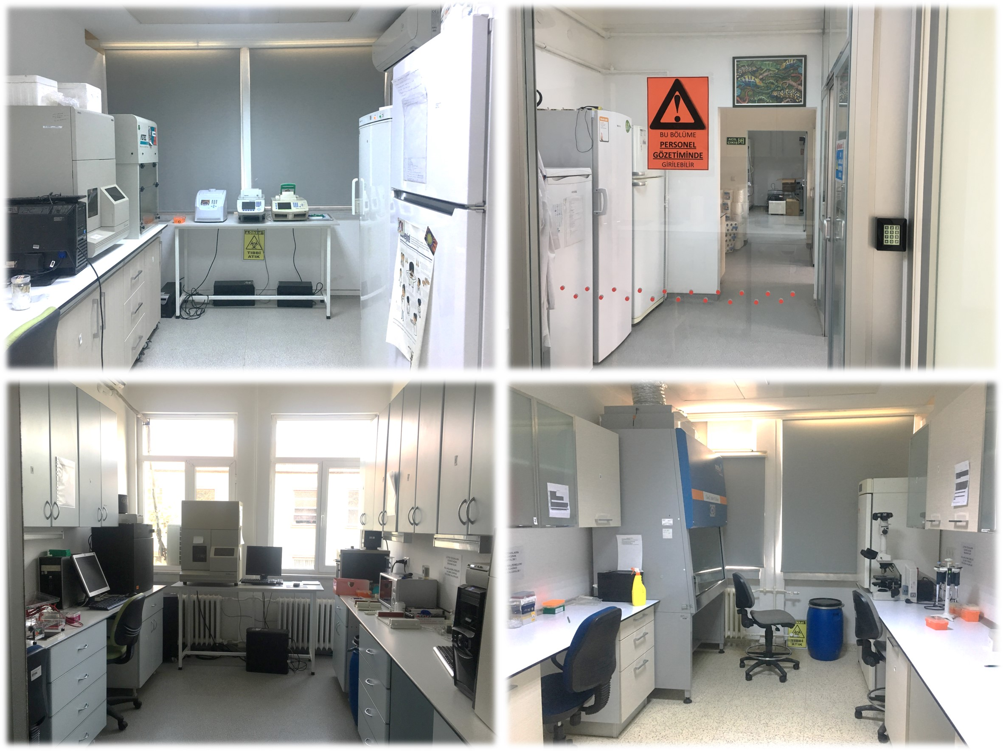
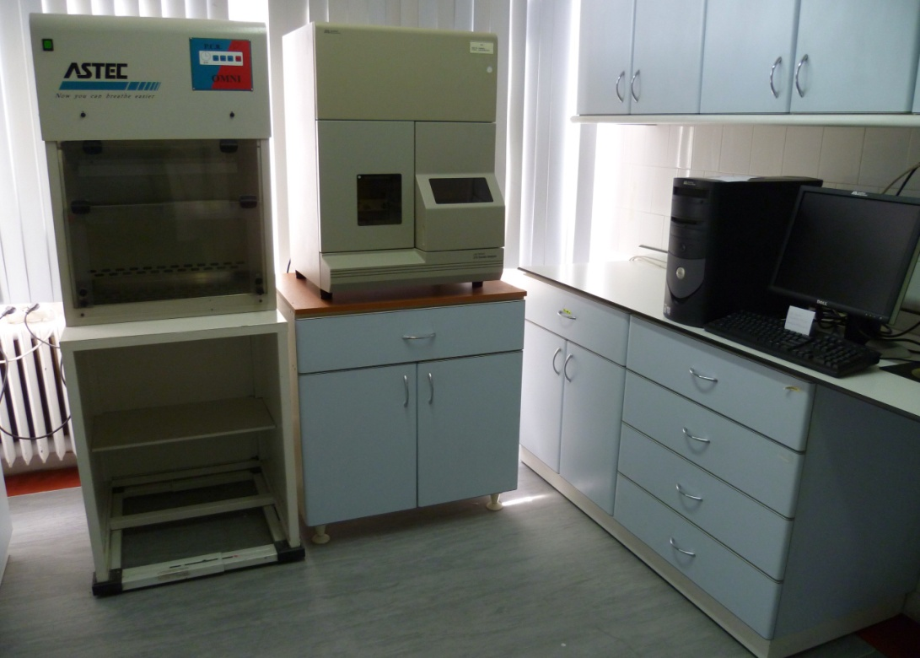
To the laboratories...

Slide 9
Research Projects Completed by Undergrads.
-TUBİTAK → The Scientific and Technological Research Council of Turkey
2209-Undergraduate Research Projects Funding Program
-BAP → Ankara University Scientific Research Projects Coordination Unit
TUBİTAK -2209 – 2009
Title: Identification of the BoLA-DRB3 gene Polymorphism in ANATOLIAN BLACK CATTLE by PCR-RFLP
Supervisor: Prof. Dr. Okan ERTUĞRUL
Researcher: Mustafa Yenal AKKURT
BAP - 2009
Title: DNA sequencing of the Melanocortin1 Receptor Gene in KANGAL Dog Breed.
Supervisor : Prof. Dr. Okan ERTUĞRUL
Researcher : Ahmet YURTSEVEN
TUBİTAK -2209 – 2021 Grant application submitted
Title: Genome Wide Analysis of the Calf with Complex Vertebral Malformation
Supervisor: Assist. Prof. Dr. Nüket BİLGEN
Researcher: Bilge TABAK and Manolya Bekleviç

Slide 10
We wIll begIn thIs course wIth a quIck questOon: What Is GenetIcs?
This will take fourteen weeks to answer…
The answer might be hidden in the milestones of genetics…
Notes:
because the humans have tried to understand and change genetics since the time of their first cognitive abilities appeared.
So lets start with the milestones for genetics. History of genetics…

Slide 11
People have known about inheritance for a long time…
History of Genetics
Selective breeding for desired characters
Offspring resemble their parent
Indivuduals can be identified as a member of a particular family through traits.
animals and plants can be selected and bred for desired characters
Notes:
People have known about inheritance for a long time.
Children resemble their parents
Indivuduals can be identified as a member of a particular family through particular traits
animals and plants can be selected and bred for desired characters

Slide 12
Ancıent theorıes

Slide 13
preformatıon theory
Several incorrect ideas generated and overcame in time with the observations and discoveries…
“PREFORMATION” tiny, fully-formed human in each sperm (or egg)
Notes:
Although the general knowledge about inheritance, a number of incorrect ideas had to be generated and overcame before modern genetics could arise.
One of them was preformation theory. This theory suggests that there is a tiny but fully formed human in every sperm and egg. This theory is just after the Loevenhock’s invention about microscopy. people saw the cell and then hypothesized that there should be a human inside.

Slide 14
GARDEN theorY
ancient Greek idea: male plants a “SEED” in the female “GARDEN”.
Aeschylus: the male as the parent and the female as a nurse for “the young life sown within her”
Hippocrates: “seeds” were produced by various body parts and transmitted to offspring at the time of conception
Notes:
Today we know that, male and female parents contribute equally to the offspring. However in ancient times, people didn’t. for example, there was an ancient Greek idea suggesting that male supplies a “seed” while female serves as a “garden”. Or similar one is from aeschylus: he proposed the male as the parent and the female as a nurse for “the young life sown within her”
May be you have never heard aeschylus, but I’m sure you know Hippocrates, who is considered one of the most outstanding figures in the history of medicine and referred as the "Father of Medicine”, He suggested that each organ has unique seeds and they are transmitted to the reproductive organs. They merge to produce an offspring. Sounds like a correct, but still there are missing parts to understand the inheritance.

Slide 15
BLENDING THEORY
The mixture of sperm and egg resulted in progeny that were a “BLEND” of two parent’s characteristics.
If the blending theory were the mechanism of inheritance it would make natural selection IMPOSSIBLE.
Notes:
The blending theory says that the progeny inherits any characteristic as the average of the parents' values of that characteristic. As an example of this; a crossing of a red flower with a white one of the same species would yield pink-flowered offspring. And then you would not see any parental phenotypes as white or red. You could only see pink flowers.

Slide 16
Pangenesis theory Every part of the body contribute to egg or sperm.
https://en.wikipedia.org/wiki/Blending_inheritance
Notes:
Pangenesis is Charles Darwin's theory of inheritance,
The idea was that each part of the parent's body emitted tiny particles called gemmules, which migrated through the body to contribute to that parent's gametes, their eggs or sperms

Slide 17
Acquired characters inheritance Lamarckism (Jean Baptiste Lamarck)
Thinking work: According to current knowledge is this a true theory?
You can write a paragraph –don’t copy paste!- and send it to geneticsnuket@gmail.com
Notes:
Lamarckism is the hypothesis that an organism can pass on characteristics that it has acquired through use or disuse during its lifetime to its offspring.
For example, as a giraffe stretches its neck to browse higher in trees, the continuation of the habit over an extended period results in a gradual lengthening of the limbs and neck.

Slide 19
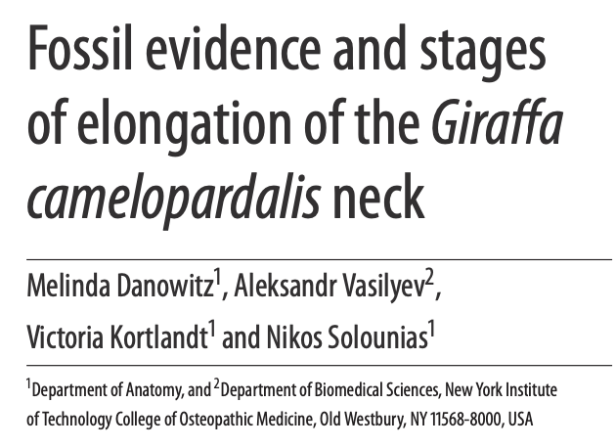
“First, only the front portion of the C3 vertebra lengthened in one group of species,”
Dr Nikos Solounias from the New York Institute of Technology College of Osteopathic Medicine.
“Second stage was the elongation of the back portion of the C3 neck vertebra.”
Resource: http://www.sci-news.com/paleontology/science-giraffe-neck-evolution-03321.html

Slide 20
1800’s mIlestones
Three major events in the mid-1800’s led directly to the development of modern genetics.
1859: Charles Darwin published The Origin of Species, which describes the theory of evolution by natural selection.
1866: Gregor Mendel presented his Experiments on Plant Hybridization, which lays out the basic theory of genetics. It is ignored until 1900.
1871: Friedrich Miescher isolates “nucleic acid” from pus cells.

Slide 21
20th Century’s mIlestones
1900: Mendel’s work rediscovered by three scientists working independently in different countries.
Robert Correns, Germany
Hugo de Vries, Holland
Erich von Tschermak, Austria
The traits are determined by discrete "factors," later known as genes, which are inherited from the parents.

Slide 22
20th Century’s mIlestones
Genes are located on chromosomes.
1910: Thomas Hunt Morgan proves that genes are located on the chromosomes (using Drosophila).
1944: Oswald Avery, Colin MacLeod and Maclyn McCarty showed that DNA (not proteins) can transform the properties of cells, demonstrating that DNA is the hereditary material. In an era when it had been widely believed that it was proteins that served the function of carrying genetic information
Genes are composed of DNA
Notes:
Morgan Studied fruit fly eye color, determining that trait was sex-linked
He Won the Nobel Prize for his work on chromosomes and genetics

Slide 23
James Watson and Francis Crick
1953: James Watson and Francis Crick determine the structure of the DNA molecule.
It was the first demonstration of the structure of the DNA .

Slide 24
RosalinD Franklın, James Watson and Francis Crick
Used Franklin’s x-ray crystallograph models
Described the structure to be a double helix
Lead to understanding of mutation and relationship between DNA and proteins at a molecular level

Slide 25
1966: Marshall Nirenberg cracks the genetic code, showing that 3 DNA bases code for one amino acid.
1983: Kary Mullis developes the PCR

Slide 26
2001: Fırst Draft Sequence of the entire human genome is announced.
The Human Genome Project (HGP) was an international scientific research project with the goal of determining the sequence of nucleotide base pairs that make up human DNA, and of identifying and mapping all of the genes of the human genome from both a physical and a functional standpoint

Slide 27
Human genome

Slide 28
GENOME PROJECTS
AIM:
Whole genomes of 10.000 species will be sequenced
Frozen zoo

Slide 29
https://www.sciencemag.org/news/2019/08/did-crispr-help-or-harm-first-ever-gene-edited-babies

