Slide 1
VARIATON
- Genetic variation is a term used to describe the variation in the DNA sequence in each of our genomes.
- Genetic variation is what makes us all UNIQUE, whether in terms of hair color, skin color or even the shape of our faces.
- Genetic variation is a result of subtle differences in our DNA.
- Single Nucleotide Polymorphisms (SNPs, pronounced ‘snips’) are the most common type of genetic variation amongst people.

Slide 2
Structural Variations (SVs)

Slide 4
varIATION

Slide 6
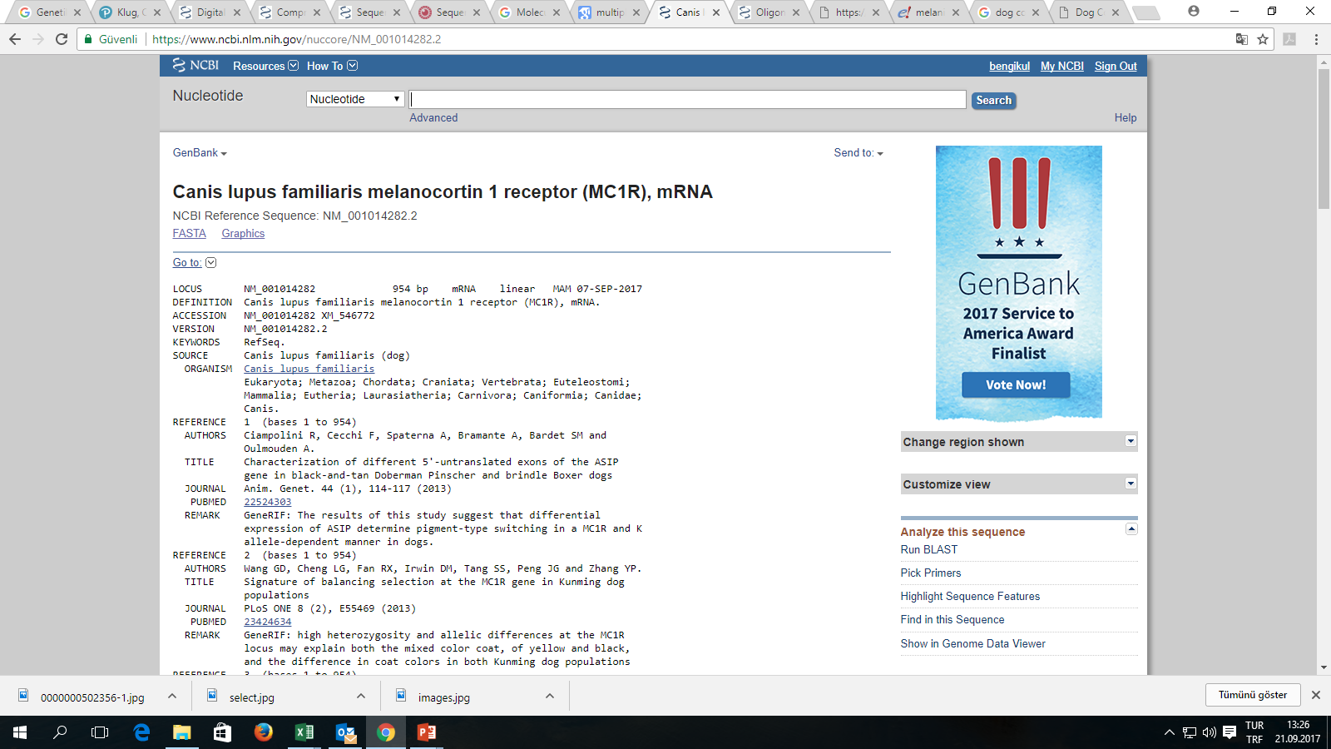

Slide 7
http://omia.angis.org.au/home/

Slide 8
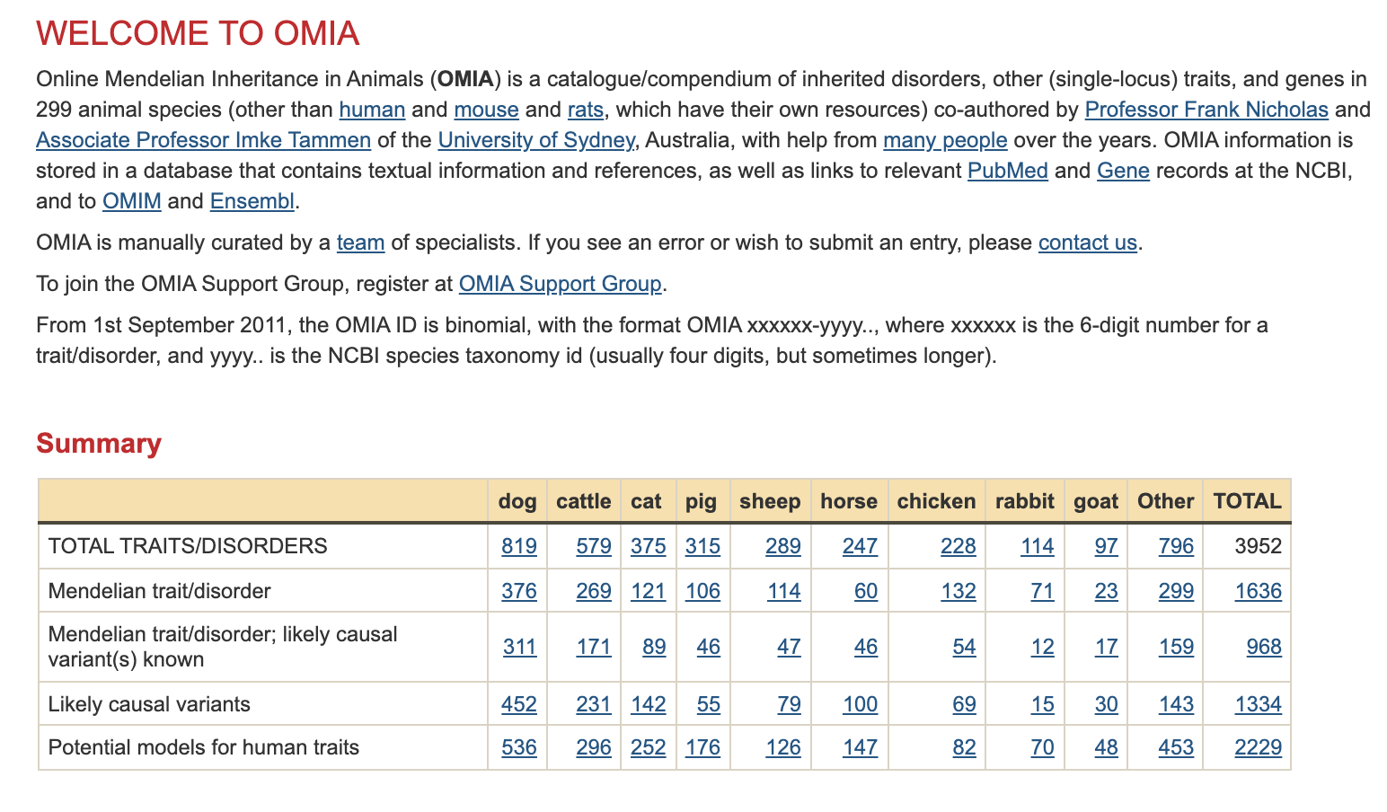

Slide 9
DIVIDE IN groups Go to http://omia.angis.org.au/home/ Search the Followıng topIcs;
Cattle → Embryonic lethal
Sheep → Inborn error of metabolism
Dog → Inherited bleeding disorder
Horse → Colour
Which species is more appropriate for «Potential models for human disease» How many traits are there? (5 examples)

Slide 10
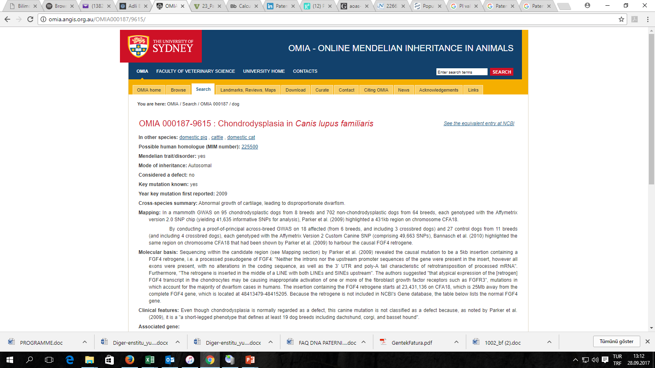
FGF4

Slide 11
FGF4 based variation (cases for Chondrodysplasia )
Breed-defining chondrodysplasia, also called short-leggedness, is a favorable phenotype found in some breeds. The well-known features of this breed-defining trait are caused by the FGF4 retrogene insertion. Short-leggedness caused by the FGF4 insertion is a desirable trait, and it is caused by different mutation than the undesired dwarfism causing genetic disorder found in some breeds
Corgi
Dachshund
Basset hound
Chondrodysplasia is a DEFECT!!!
But it is a breed-specific feature for several breeds.

Slide 12
Scottish Fold disease – osteochondrodysplasia
Cats have a genetic mutation which affects their cartilage development leading to the folding of the ears and an owl-like appearance.
The cartilage is deformed, and it is not supporting the ears.
Same cartilage mutation also leads to problems with other parts of the body.
These genetic mutations, which all the Scottish fold cats will have, develop into lifelong incurable and painful diseases such as a type of arthritis.
Osteochondrodysplasia is a DEFECT!!!
But it is a breed-specific feature for several breeds.

Slide 13
Scottish Fold disease – osteochondrodysplasia
The mutation causing osteochondrodysplasia results from a single autosomal dominant gene.
Mutation has incomplete penetrance meaning the abnormalities may vary in severity between one cat and another.
All Scottish Fold cats suffer from variable degrees of painful degenerative joint disease, which can result in fusing of the tail, tarsi (ankles) and stifles (knees).
Clinically cats are reluctant to move, and abnormal posture and gait, lameness and short misshapen limbs.

Slide 14
The long mane of the horse- hyperthricosis
Extant wild equid species (Equus ferus) and other closely related species of the Equidae family have a short upright mane.

Slide 15
SUBDIVISION OF GENETICS

Slide 16
Classical Genetics
The oldest discipline in the field of genetics - roots were seeded by the experiments of Gregor Mendel (Mendelian inheritance)
- Based on visible results of reproductive acts.
Notes:
It is the branch of genetics based on visible results of reproductive acts.
It is the oldest discipline in the field of genetics, going back to the experiments on Mendelian inheritance by Gregor Mendel who made it possible to identify the basic mechanisms of heredity.
We call them Mendel’s law and we will discuss them in next lecture.

Slide 17
Molecular Genetics
Examines the structure and functions of genes at the molecular level.
Notes:
Molecular genetics is the field of biology that studies the structure and function of genes at a molecular level and thus employs methods of both molecular biology and genetics. The study of chromosomes and gene expression of an organism can give insight into heredity, genetic variation, and mutations.

Slide 18
Population Genetics, Quantitative Genetics & Ecological Genetics
POPULATION GEN. :Investigates the sources of similarities and differences of individuals in populations, as well as distributions and variations of the allele frequency in populations.
Population genetics traditionally deals with gene frequencies, whereas quantitative genetics focuses on the ways that individual variation in genotype and environmental contribution to variance in phenotype.
Quantitative characters, such as effective milk yield, growth rate, genes cannot be fully reflected in the phenotype. Because of the polygenic effects…

Slide 19
Genetıcs ın anımal breedıng
Genetic researches made significant contributions to many areas in animal husbandry.
Genetic studies related to animal research is conducted in many fields such as biotechnology and drug development.
Some milestones in biotechnology :
DNA structure
Restriction enzymes
Recombinant DNA (rDNA)
The birth of Dolly
PCR
Genome sequence

Slide 20
Molecular genetics in veterinary medicine
Identification of genes associated with hereditary diseases
Molecular screening of hereditary diseases in populations
Thraphy of genetic diseases with gene transfer
Measurement of treatment effectiveness
Forensic cases
Evolutionary history of domestic species, domestication process,
Diversity research
Establishing of protection programs for animal species and breeds under risk of extinction.

Slide 21
Molecular genetics in veterinary medicine
Production of bioreactive organism
Embryo cloning
Gender control of embryo
Genomic selection
………….

Slide 22
Further readıng
Concept of Genetics Twelfth Edition, page 12

