Slide 1
POLYMORPHISM
Genetics

Slide 2
Polymorphism
A DNA polymorphism is a sequence difference compared to a reference standard that is present in at least 1–2% of a population.
Polymorphisms can be single bases or thousands of bases.
Polymorphisms may or may not have phenotypic effects.
Notes:
‹#›

Slide 3
Polymorphic DNA Sequences
Polymorphisms are found throughout the genome.
If the location of a polymorphic sequence is known, it can serve as a landmark or marker for locating other genes or genetics regions.
Each polymorphic marker has different versions or alleles.
Notes:
‹#›

Slide 4
Types of Polymorphic DNA Sequences
RFLP: restriction fragment length polymorphisms
VNTR: variable number tandem repeats (8 to >50 base pairs)
STR: short tandem repeats (1–8 base pairs)
SNP: single-nucleotide polymorphisms
Notes:
‹#›

Slide 5
Restriction Fragment Length Polymorphisms
Restriction fragment sizes are altered by changes in or between enzyme recognition sites.
GTCCAGTCTAGC
GAATTC
GTGGCAAAGGCT
CAGGTCAGATCG
CTTAAG
CACCGTTTCCGA
GTCCAGTCTAGC
GAA
A
TC
CG
TGGC
C
A
AGGCT
CAGGTCAGATCG
CTT
T
AG
GC
ACCG
G
T
TCCGA
Point mutations
GTCCAGTCTAGC
GA
AGCGA
ATTC
GTGGC
AAAGGCT
CAGGTCAGATCG
CT
TCGCT
TAAG
CACCG
TTTCCGA
Insertion (duplication)
GTTCTAGC
GAATTC
GTGGC
AAA
GGCT
GAATTC
GTGG
TCAGATCG
CTTAAG
CACCG
TTT
CCGA
CTTAAG
CACC
GTTCTAGC
GAATTC
GTGGC
AAAAAA
GGCT
GAATTC
GTGG
TCAGATCG
CTTAAG
CACCG
TTTTT T
CCGA
CTTAAG
CACC
Fragment insertion (or deletion)
Notes:
‹#›

Slide 6
Restriction Fragment Length Polymorphisms
RFLP genotypes are inherited.
For each locus, one allele is inherited from each parent.
Notes:
‹#›

Slide 7
Short Tandem Repeat Polymorphisms (STR)
STR are repeats of nucleotide sequences.
AAAAAA… - mononucleotide
ATATAT… - dinucleotide
TAGTAGTAG… - trinucleotide
TAGTTAGTTAGT… - tetranucleotide
TAGGCTAGGCTAGGC… - pentanucleotide
Different alleles contain different numbers of repeats.
TTCTTCTTCTTC - four repeat allele
TTCTTCTTCTTCTTC - five repeat allele
Notes:
‹#›

Slide 8
Short Tandem Repeat Polymorphisms
STR alleles can be analyzed by fragment size (Southern blot).
One repeat unit
Restriction site
Allele
M 1 2 M
Allele 1
GTTCTAGC
GGCC
GTGGC
AGCTAGCTAGCTAGCT
GCTG
GGCC
GTGG
CAAGATCG
CCGG
CACCG
TCGATCGATCGATCGA
CGAC
CCGG
CACC
tandem repeat
Allele 2
GTTCTAGC
GGCC
GTGGC
AGCTAGCTAGCT
GCTG
GGCC
GTGG
CAAGATCG
CCGG
CACCG
TCGATCGATCGA
CGAC
CCGG
CACC
Notes:
‹#›

Slide 9
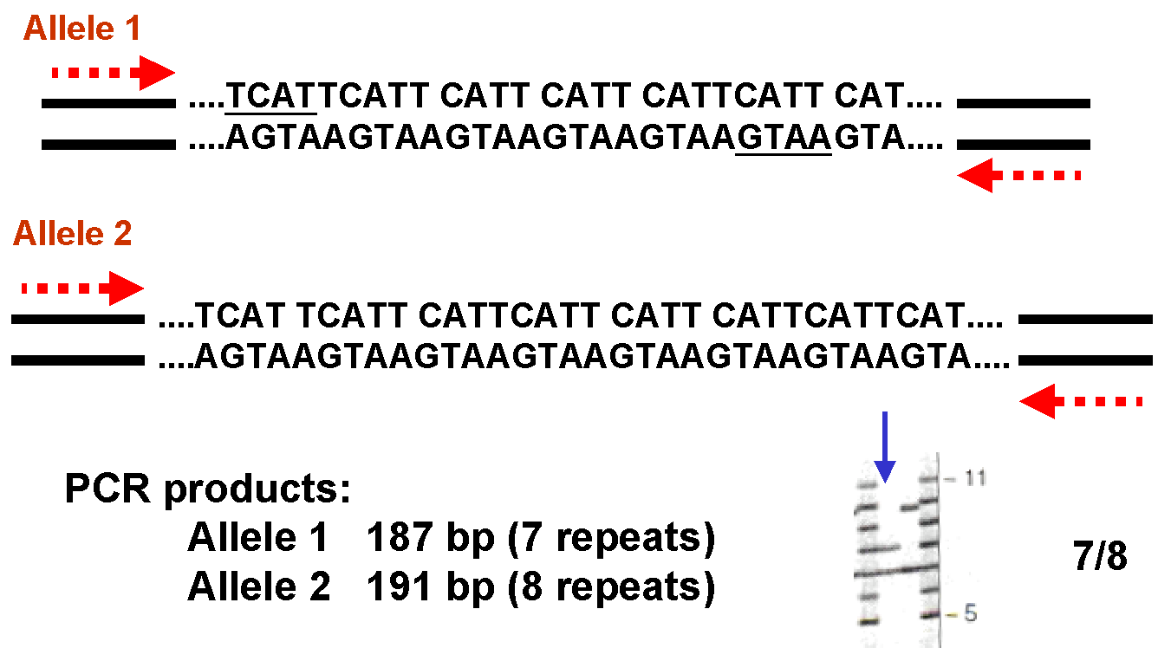
Short Tandem Repeat Polymorphisms
STR alleles can also be analyzed by amplicon size (PCR).
(Genotype)
Notes:
‹#›

Slide 10
Parentage Testing by STR-PCR
Which alleged father’s genotype has the paternal alleles?
Notes:
‹#›

Slide 11
Evidence Testing by STR-PCR
Which suspect—S1 S2 or S3 —was at the crime scene?

Slide 12
Short Tandem Repeat Polymorphisms: Y-STR
The Y chromosome is inherited in a block without recombination.
STR on the Y chromosome are inherited paternally as a haplotype.
Y haplotypes are used for exclusion and paternal lineage analysis.
Notes:
‹#›

Slide 13
Mitochondrial DNA Polymorphisms
Sequence differences in the hypervariable regions (HV) of the mitochondrial genome.
Notes:
‹#›

Slide 14
Mitochondrial DNA Polymorphisms
Mitochondria are maternally inherited.
There are an average of 8.5 base differences in the mitochondrial HV sequences of unrelated individuals.
All maternal relatives will have the same mitochondrial sequences.
Mitochondrial typing can be used for legal exclusion of individuals or confirmation of maternal lineage.
Notes:
‹#›

Slide 15
Single Nucleotide Polymorphisms (SNP)
Single-nucleotide differences between DNA sequences.
SNP occurrence frequency is different across species.
Ex: One SNP occurs approximately every 1,250 base pairs in human DNA.
What is the occurrence frequency in cattle?
SNPs are detected by sequencing, melt curve analysis, PCR-RFLP or other methods.
99% have no biological effect; 60,000 are within genes.
Notes:
‹#›

Slide 16
SNP Detection by Sequencing
T/T T/A A/A
5′ AGTCTG
5′ AG(T/A)CTG
5′ AGACTG
Notes:
‹#›

Slide 17
SNP Haplotypes
SNPs are inherited in blocks or haplotypes.
Notes:
‹#›

Slide 18
SNP Applications

Slide 19
Genomes and SNPs
Now that the genomes of animals are (mostly) sequenced…
Genomic selection applications, character and variant association, GWAS.
Alterations in DNA involving a single base pair are called single nucleotide polymorphisms, or SNPs

Slide 20
Areas of SNP Application
Gene discovery and mapping
Association-based candidate polymorphism testing
Diagnostics/risk profiling
Response prediction
Homogeneity testing/study design
Gene function identification
…etc.

Slide 21
Use of Polymorphism in Gene Mapping
1980s – RFLP marker maps
1990s – microsatellite marker maps

Slide 22
SNPs in Genetic Analysis
Abundance – lots
Position – throughout genome
Haplotype patterns – groups of SNPs may provide exploitable diversity
Rapid and efficient to genotype
Increased stability over other types of mutation
Recombination patterns – e.g. ‘hot spots’

Slide 23
Disease-Marker Association
A marker locus is associated with a disease if the distribution of genotypes at the marker locus in disease-affected individuals differs from the distribution in the general population
A specific allele may be positively associated (over-represented in affecteds) or negatively associated (under-represented)

Slide 24
Linkage Disequilibrium
Disease locus
Alleles D, d
LD
penetrance
Marker locus
Alleles M, m
Disease

Slide 25
Linkage Disequilibrium
Concept of the ‘historical recombinant’
Explanations for observed association between marker and disease:
Marker locus may be a disease susceptibility locus
Marker locus may be linked to disease susceptibility locus
Mutation occurs
Allele D is created
Nearby marker
Allele M was nearby
D and M subsequently transmitted together

Slide 26
Candidate Polymorphism Testing
Linkage and LD assume markers have indirect association with the trait
Large SNP collections may allow testing for direct, physiologically relevant associations with trait

Slide 27
Gene Function Identification
Alternative to other experimental procedures (e.g. knock-outs, which cannot be used in humans)
Studies to compare individuals with and without naturally occurring disease predisposing genetic profiles

