Slide 1
MENDELIAN GENETCS
Asist. Prof. Nüket BİLGEN

Slide 2
Modern genetics had its beginnings in an monastery garden, where a monk named Gregor Mendel documented a particulate mechanism of inheritance.
He discovered the basic principles of heredity by breeding garden peas in carefully planned experiments.
His approach to science had been influenced at the University of Vienna by one of his professors: the physicist Doppler.
He crossed 28,000 peas Between 1856 and 1863

Slide 3
Underestimated for 30 years
Rediscovered by
- Carl Erich Correns (1864 - 1933) (Germany)
-Erich Tschermak von Seysenegg (1871-1962) (Austria)
-Hugo Marie de Vries (1845-1935) (Holand)
copyright cmassengale

Slide 4
BEFORE MENDEL "BLENDING THEORY"
http://www.scientificamerican.com/article.cfm?id=making-scents-of-sounds-n

Slide 5
MENDEL’S IMPACT
Mendel’s theories of inheritance, first discovered in garden peas, are equally valid for figs, flies, fish, birds and human beings.
Mendel’s impact endures, not only on genetics, but on all of science, as a case study of the power of hypothesis/deductive thinking.

Slide 6
WHY PEAS?
In order to study inheritance, Mendel chose to use peas, probably as they are available in many varieties.
The use of plants also allowed strict control over the mating through the hermaphroditism
Pea plants reproduce rapidly, and have many visible traits
He chose to study only characters that varied in an ‘either-or’ rather than a ‘more-or-less’ manner.

Slide 7
GENETIC CROSSES
To hybridise 2 varieties of pea plants, Mendel used an artist’s brush.
He transferred pollen from a true breeding white flower to the carpel of a true breeding purple flower.

Slide 8
Seed coat colour (gray or white)
Seed shape (round or wrinkled)
Seed colour (yellow or green)
Pod colour (green or yellow)
Flower position (axial or terminal)
Pod shape (inflated or constricted)
Stem length (tall or dwarf)

Slide 11
PARTICULATE INHERITANCE
Mendel stated that physical traits are inherited as “particles”
Mendel did not know that the “particles” were actually Chromosomes & DNA

Slide 12
GENETIC TERMINOLOGY
TRAIT - any characteristic that can be passed from parent to offspring
MONOHYBRID CROSS - cross involving a single trait
e.g. flower color
DIHYBRID CROSS - cross involving two traits
e.g. flower color & plant height

Slide 13
GENOTYPE 🡪 is the letter or term used to describe the allele of an individual gene or pair of genes
PHENOTYPE – is how the gene (or pair) shows itself, how it appears.

Slide 14
PUNNETT SQUARE
Used to help solve genetics problems

Slide 15
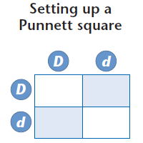
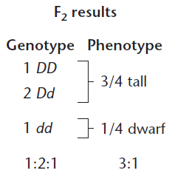
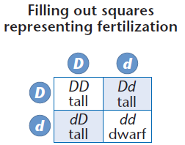

Slide 16
Phenotypic rate
Aa +AA : aa 3:1
AA | Aa
Aa | aa
Genotypic rate
AA :Aa :aa
1:2:1

Slide 18
MENDEL’S EXPERIMENTS
Mendel noticed that some plants always produced offspring that had a form of a trait exactly like the parent plant. He called these plants “purebred” plants.
For instance, purebred short plants always produced short offspring and purebred tall plants always produced tall offspring.
X
Purebred Short Parents
Short Offspring
X
Purebred Tall Parents
Tall Offspring

Slide 19
MENDEL’S FIRST EXPERIMENT
Mendel crossed purebred plants with opposite forms of a trait. He called these plants the parental generation , or P generation. For instance, purebred tall plants were crossed with purebred short plants.
X
Parent Short P generation
Parent Tall P generation
Offspring Tall F1 generation
Mendel observed that all of the offspring grew to be tall plants. None resembled the short parent. He called this generation of offspring the first filial , or F1 generation,
(The word filial means “son” in Latin.)

Slide 20
due to statistical error

Slide 21
MENDEL’S SECOND EXPERIMENT
Mendel then crossed two of the offspring tall plants produced from his first experiment.
Parent Plants Offspring
X
Tall
F1 generation
3⁄4 Tall & 1⁄4 Short F2 generation
Mendel called this second generation of plants the second filial, F2, generation. To his surprise, Mendel observed that this generation had a mix of tall and short plants. This occurred even though none of the F1 parents were short.

Slide 22
MENDEL’S CONCLUSIONS
Mendel’s first law, the LAW OF SEGREGATION, has three parts.From his experiments, Mendel concluded that:
Plant traits are handed down through “hereditary factors” in the sperm and egg.
Because offspring obtain hereditary factors from both parents, each plant must contain two factors for every trait.
The factors in a pair segregate (separate) during the formation of sex cells, and each sperm or egg receives only one member of the pair.

Slide 23
TODAY, SCIENTISTS REFER TO THE “FACTORS” THAT CONTROL TRAITS AS GENES. THE DIFFERENT FORMS OF A GENE ARE CALLED ALLELES.
Alleles that mask or hide other alleles, such as the “tall” allele, are said to be DOMINANT.
A RECESSIVE allele, such as the short allele, is masked, or covered up, whenever the dominant allele is present.

Slide 24
LAW OF SEGREGATION
During the formation of gametes (eggs or sperm), the two alleles responsible for a trait separate from each other.
The Principle of Segregation describes how pairs of gene variants are separated into reproductive cells.

Slide 25
HYBRID ALLELS
In Mendel’s first experiment, F1 offspring plants received one tall gene and one short gene from the parent plants. Therefore, all offspring contained both alleles, a short allele and a tall allele. When both alleles for a trait are present, the plant is said to be a hybrid for that trait. Today, we call hybrid alleles heterozygous.
tall-tall
short-tall short-tall
short-short
X
Parent Short
P generation
Parent Tall
P generation
Offspring Tall
F1 generation
Although the offspring have both a tall and a short allele, only the tall allele is expressed and is therefore dominant over short.

Slide 26
WHAT IF MORE THERE WAS MORE THAN ONE TRAIT…
DIHYBRID CROSS
Two different alleles of the two different genes

Slide 29
Possible genotypes of the sperm or egg
Formula: 2^{n} (Where n is the number of heterozygous position of gene)

Slide 30
QUESTION
How many types of gametes are produced by an individual with the genotypes shown below ??
₂n
RrYy
AaBbCCDd
MmNnOoPPQQRrssTtQq

Slide 31
ANSWER
RrYy: 2^{n} = 2² = 4 gametes
RY Ry rY ry
AaBbCCDd: 2^{n} = 2³ = 8 gametes
ABCD | ABCd | AbCD | AbCd
aBCD | aBCd | abCD | abCD
3. MmNnOoPPQQRrssTtQq: 2^{n} = 2⁶ = 64 gametes

Slide 32
TRAITS: SEED SHAPE & SEED COLOR ALLELES: R SMOUTH r WRINKLED Y YELLOW y GREEN
RrYy x RrYy
Possible genotypes of the gametes?
Possible genotypes of F1?

Slide 33
Traits: seed shape & seed color Alleles: R smouth
r wrinkled Y yellow y green
RrYy x RrYy
_{RY Ry rY ry} RY Ry rY ry

Slide 34
DIHYBRID CROSS
RY Ry rY ry
RY
Ry
rY ry

Slide 35
9:3:3:1

Slide 36
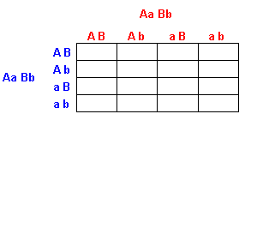

Slide 37
POLYHYBRID CROSS
It's when you cross more than one trait (usually more than 2 also, as 2 traits are a dihybrid cross)
AaBbCc X AaBbCc
Possible genotypes of the gametes ABC Abc AbC aBC abC aBc Abc abc

Slide 38
HOW TO DETERMINE THE GENOTYPE OF AN INDIVIDUAL WITH A DOMINANT GENOTYPE?
P : purple p : white
genotypes

Slide 39
TEST CROSS
A genetic test for heterozygosity in which an organism of dominant phenotype, but unknown genotype, is crossed with an recessive organism.

Slide 41
PEDIGREE CHART
Is a diagram that shows the occurrence and appearance or phenotypes of a particular gene or organism and
its ancestors from one generation to the next

Slide 42
AUTOSOMAL RECESSIVE TRAIT

Slide 43
AUTOSOMAL DOMINANT TRAIT

Slide 44
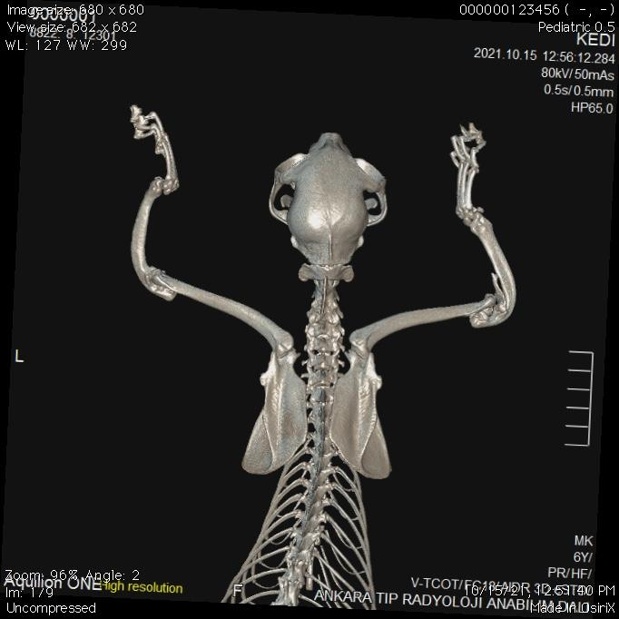
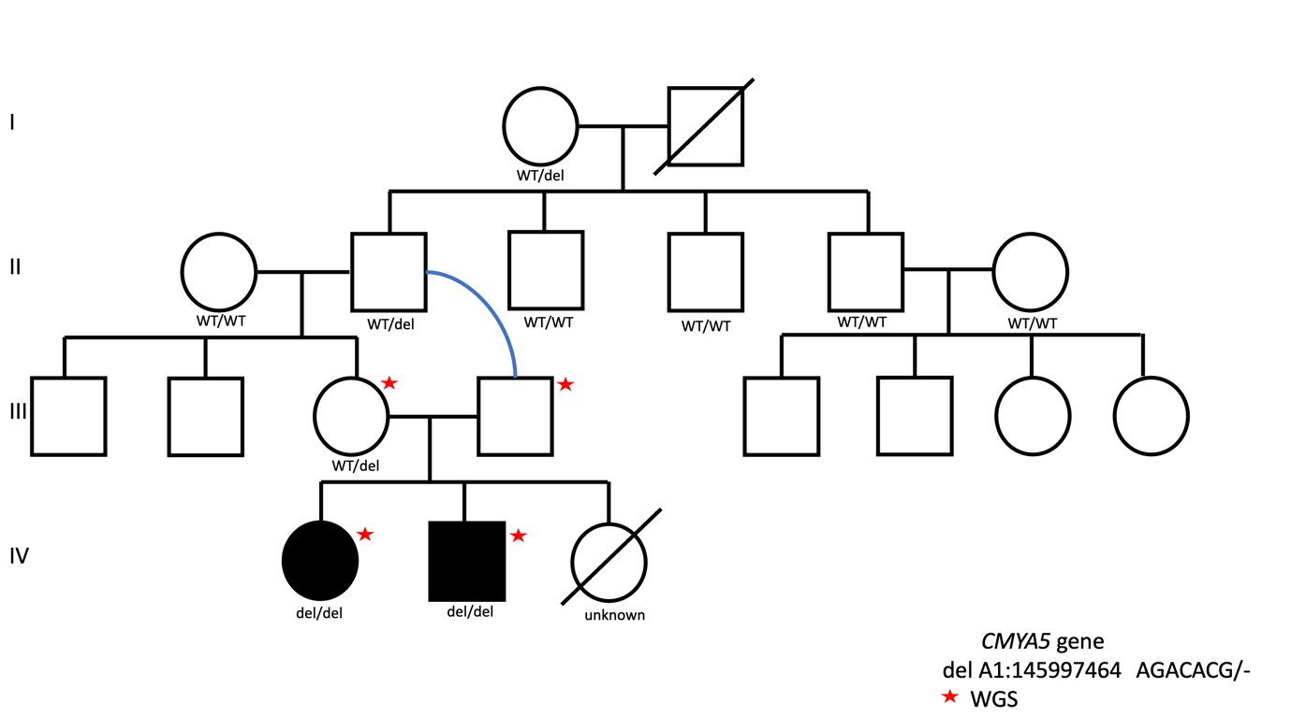
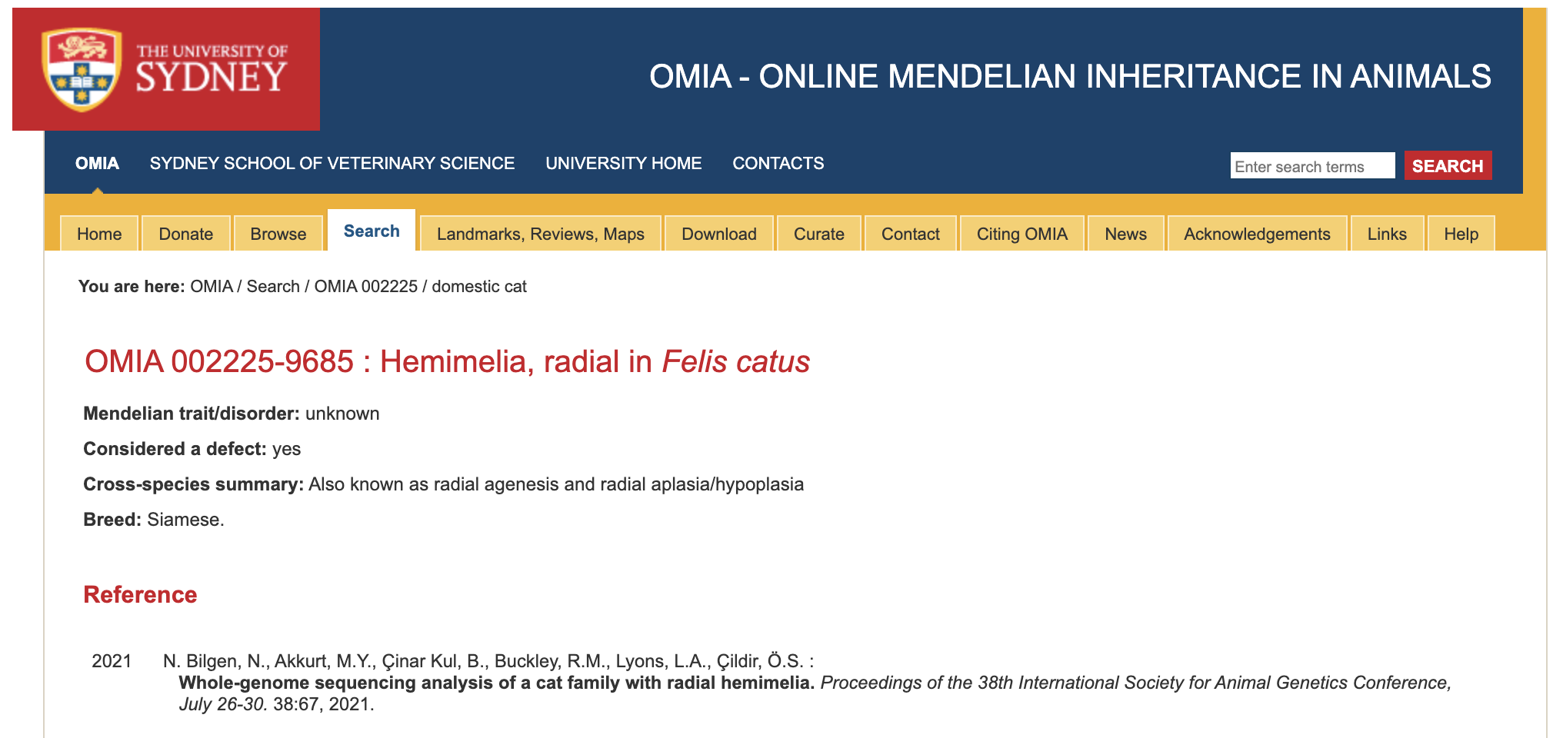
EXAMPLE

