Slide 1
Drug Interactions between MAO inhibitors and TCAs
MASOUD PIROUTI DEHBAKRI
17030184

Slide 2
• Monoamine oxidase inhibitors (MAOIs) are a class of medication used to treat depression. They were introduced in the 1950s as the first drugs for depression.
• MAOIs elevate the levels of norepinephrine, serotonin, and dopamineby inhibiting an enzyme called monoamine oxidase.
• Monoamine oxidase breaks down norepinephrine, serotonin, and dopamine. When monoamine oxidase is inhibited, norepinephrine, serotonin, and dopamine are not broken down, increasing the concentration of all three neurotransmitters in the brain.
HIPPOCRATES

Slide 3
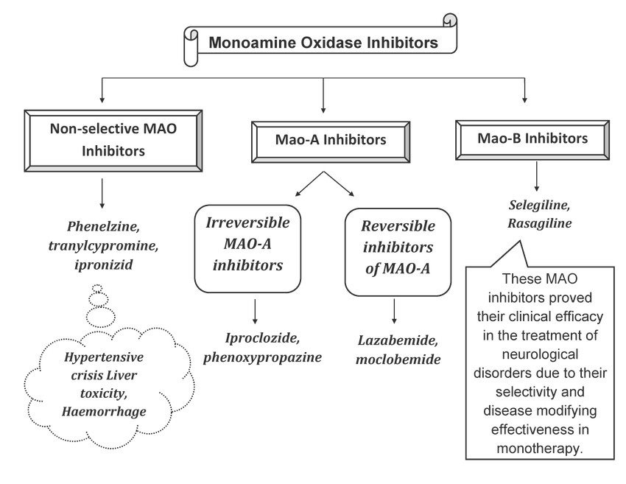

Slide 4
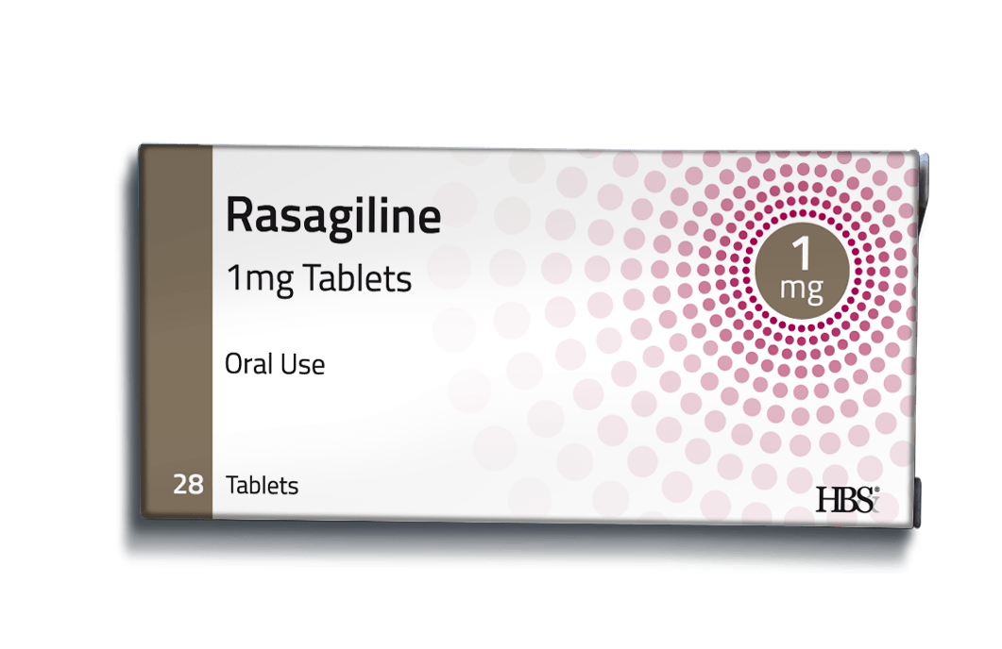
RASAGLINE
• Rasagiline is a propargylamine and an irreversible inhibitor of monoamine oxidase (MAO).
• Rasagiline used for the symptomatic management of idiopathic Parkinson's disease as initial monotherapy and as adjunct therapy to levodopa.

Slide 5
• The drug has two distinct actions: selective irreversible inhibition of MAO-B, and neuroprotective effect not dependent on MAO inhibition.
• Rasagiline possesses neuroprotective properties in a variety of primary neuronal preparations and neuron-like cell lines, which is not due to MAO inhibition.

Slide 6
Tricyclic antidepressants (TCAs)
• Tricyclic antidepressants (TCAs) are a drug class that was first released to the market in 1959 as a pharmacotherapy for major depressive disorder (MDD).
• Tricyclic antidepressants act on neurotransmitterpathways to achieve their effects. They block the reuptake of serotonin and norepinephrine in presynaptic terminals, which leads to increased concentration of these neurotransmitters in the synaptic cleft.
• The increased concentrations of norepinephrine and serotonin in the synapse likely contributes to its anti-depressive effect.

Slide 7
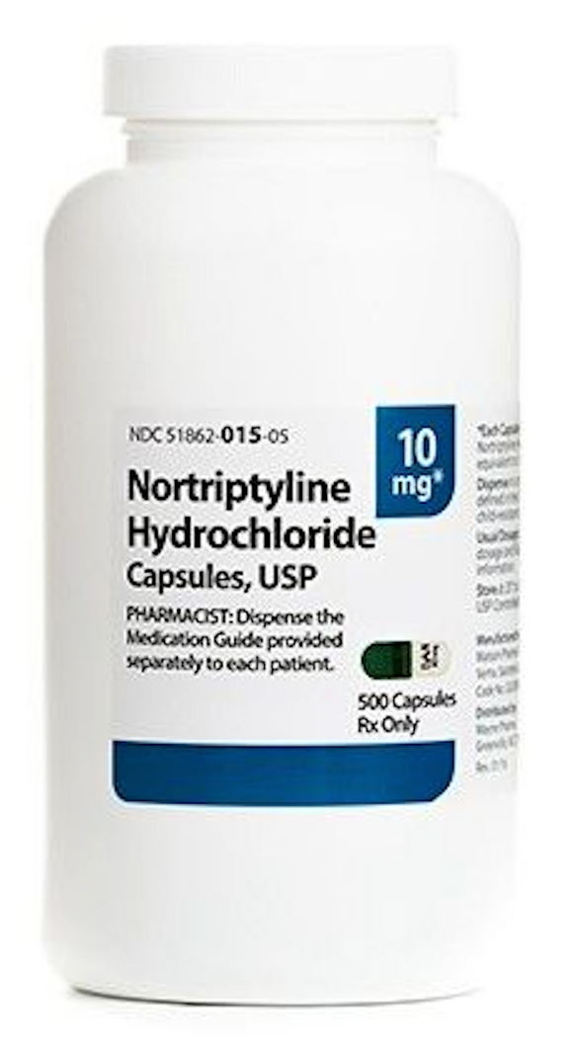
Nortriptyline
• Nortriptyline is an antidepressant that falls under the pharmacological category of tricyclics.
• The consensus is that nortriptyline inhibits the reuptake of serotonin and norepinephrine by the presynaptic neuronal membrane, thereby increasing the concentration of those neurotransmitters in the synapse.
• Additionally, nortriptyline inhibits the activity of histamine, 5-hydroxytryptamine, and acetylcholine. Nortriptyline increases the pressor effect of norepinephrine but hinders the pressor response of phenethylamine.

Slide 8
RASAGLINE AND NOTRIPTYLINE INTERACTION
• Coadministration of monoamine oxidase inhibitors (MAOIs) and dibenzazepine derivatives (tricyclicand tetracyclic antidepressants) may produce significant adverse reactions including nausea, vomiting, flushing, dizziness, tremor, myoclonus, rigidity, diaphoresis, hyperthermia, autonomic instability, hypertensive crises, disseminated intravascular coagulation, severe convulsive seizures, coma, and death.

Slide 9
• In general, you should wait at least 14 days after stopping rasagiline before you start treatment with nortriptyline.
• The exact mechanism of interaction is unknown, but may involve excessive serotonergic activity in the central nervous system .
• As rasagiline and nortriptyline both increase serotonin levels Severe CNS toxicity associated with hyperpyrexia has been reported with the combined treatment of an antidepressant and rasagiline.

Slide 10
References:
1.Pathak, Ashish & Srivastava, Amit Kumar & Singour, Pradeep & Gouda, Panchanan. (2015). Synthetic and Natural Monoamine Oxidase Inhibitors as Potential Lead Compounds for Effective Therapeutics. Central Nervous System Agents in Medicinal Chemistry(Formerly Current Medicinal Chemistry - Central Nervous System Agents). 16. 81-97. 10.2174/1871524915666150624120516.
2.Moraczewski J, Aedma KK. Tricyclic Antidepressants. [Updated 2020 Dec 7]. In: StatPearls [Internet]. Treasure Island (FL): StatPearls Publishing; 2021 Jan-. Available from: https://www.ncbi.nlm.nih.gov/books/NBK557791/
3. Merwar G, Gibbons JR, Hosseini SA, et al. Nortriptyline. [Updated 2021 Aug 6]. In: StatPearls [Internet]. Treasure Island (FL): StatPearls Publishing; 2021 Jan-. Available from: https://www.ncbi.nlm.nih.gov/books/NBK482214/
4.Finberg, John P M. “Pharmacology of Rasagiline, a New MAO-B Inhibitor Drug for the Treatment of Parkinson's Disease with Neuroprotective Potential.” Rambam Maimonides medical journalvol. 1,1 e0003. 2 Jul. 2010, doi:10.5041/RMMJ.10003

