Slide 1
Drug Interactions
‘’Synergistic interaction of remdesivir with fluoxetine-itraconazole in covid-19 treatment.’’
REBEKA BOĞUSOĞLU
16030150

Slide 2
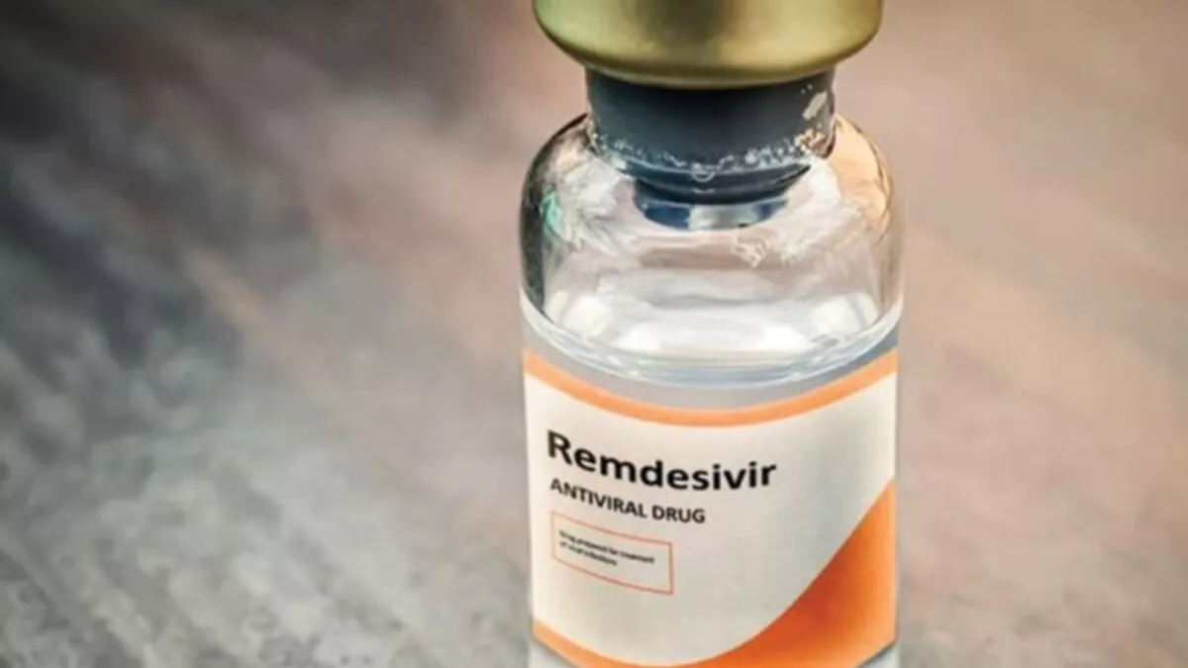
COMBINATORY TREATMENT OF REMDESIVIR WITH FLUOXITINE AND ITRACONAZOLE
• Itraconazole, similar to fluoxetine, showed effective antiviral activity against SARS-CoV-2 infection in vitro.
• Combinatory treatments with itraconazole–remdesivir and fluoxetine–remdesivir displayed enhanced potency through synergy in vitro.
Combinatory treatments of itraconazole and fluoxetine along remdesivir might offer superior treatment to inhibit SARS-CoV-2.

Slide 3
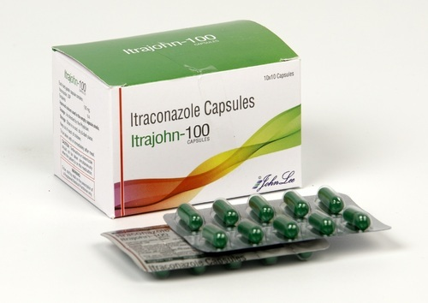
The clinically licensed antifungal drug itraconazole efficiently blocks the production of SARS-CoV-2 infectious particles.
Based on the successful repurposing of itraconazole for the treatment of influenza virus infection reported in our earlier studies (Schloeret al., 2019; Schloer, Goretzko, et al., 2020), we first established whether this clinically licensed drug also had an antiviral potential on the production of infectious SARS-CoV-2 particles.
Treatment with itraconazole 2 hours post-infection potently inhibited SARS-CoV-2 replication in a dose-dependent manner in both cell types (Calu-3 and VeroE6 cell lines).

Slide 4
How does Itraconazole work?
Elevated cholesterol levels inhibit the fusion of the influenza lipid envelope with the endosomal membranes and thus inhibit the efficient transfer of the viral genome into the host cytosol (Kühnl et al., 2018; Musiol et al., 2013). We found that the clinically licensed antifungal itraconazole, a triazole derivative that blocks the fungal ergosterol pathway, has antiviral properties against a range of viruses and is effective against influenzas A virus infections.
The late endosome is an entry site for many zoonotically transmitted viruses, in particular for enveloped viruses including SARS-CoV-2 (Tang et al., 2020). Because of the functional similarities in transmitting the viral genome into the host cell, the same endosomal components might serve as pharmacological targets for abroad host-directed antiviral strategy against such viruses. Continuing our work on the endosomal host–virus interface, we explored whether a similar repurposing strategy could be used to impair SARS-CoV-2 entry and infection.

Slide 5
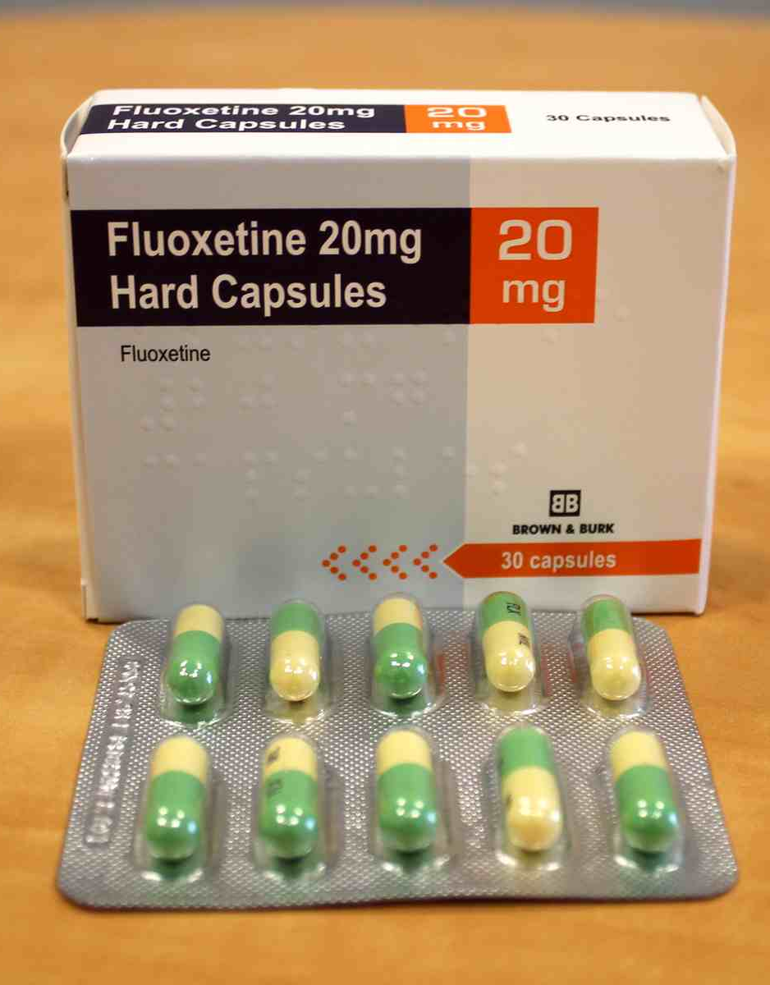
Together with the findings presented here on the inhibitory function of itraconazole treatment on SARS-CoV-2 replication, these results suggest that both drugs are promising candidates for repurposing as a host-directed drug for SARS-CoV-2 infection treatment. Both drugs most likely interfere with the proper endosomal cholesterol levels. Whereas itraconazole and posaconazole both directly inhibit the endosomal cholesterol transporter Niemann–PickType C1 (Trinh et al., 2017), fluoxetine functionally blocks the endolysosome-residing enzyme sphingomyelin phosphodiesterase(acid sphingomyelinase), which in turn causes sphingomyelin accumulation and negatively affects cholesterol release from this compartment (Kornhuber et al., 2010). However, host-directed drugs will rather cause impaired viral replication and suppress infection than completely eradicate the pathogen. The resulting demand for high drug doses and early and prolonged treatment is often associated with poor patient compliance.

Slide 6
Therefore, we assessed clinically licensed drugs that also affect endolysosomal lipid storage and cholesterol build-up for their antiviral potential. Here, we report that itraconazole treatment potently inhibited the production of SARS-CoV-2 infectious particles. Together with our recently published work on the antiviral potential of the widely used 5-HT uptake inhibitor fluoxetine, which also negatively affects endosomal cholesterol release (Kornhuber et al., 2010; Schloer, Brunotte, et al., 2020)on SARS-CoV-2 infection, the results presented in this studystrongly argue for the endolysosomal host–SARS-CoV-2 interface as a druggable target.

Slide 7
Antiviral activities of single and
combination treatments
Here, we report that ItraRem and FluoRem drug combinations, in both cases targeting the host cell and the virus independently, showed stronger antiviral activities against SARS-CoV-2 than the remdesivir monotherapy. Moreover, the overall therapeutic effect of the combinations was larger than the expected sum of the independent drug effects and underlying synergistic effects were determined, allowing for lower concentrations of the individual drugs. Of note, their reported plasma concentrations are well within these ranges.

Slide 8
Combination therapy using several drugs that each target different molecular pathways is considered a key strategy to achieve therapeutic success with lower doses and a reduced likelihood of the development of drug resistance. Thus, we assessed the efficacy of a combined treatment using remdesivir, a nucleotide analogue prodrug that inhibits SARS-CoV-2 viral RNA-dependent RNA polymerase(Gordon et al., 2020) together with itraconazole or fluoxetine. Both two-drug combinations showed stronger antiviral activities against SARS-CoV-2 compared to remdesivir monotherapy (Schloer,Goretzko, et al., 2020) and pharmacodynamic evaluation via commonly used reference models to study drug interaction revealed synergistic interaction.

Slide 9
References
British Journal of Pharmacology by S. Schloer, pages:2339-2350, 2021.
https://bpspubs.onlinelibrary.wiley.com/doi/epdf/10.1111/bph.15418

