Slide 2
Hyperadrenocortisism (Cushing syndrome)

Slide 3
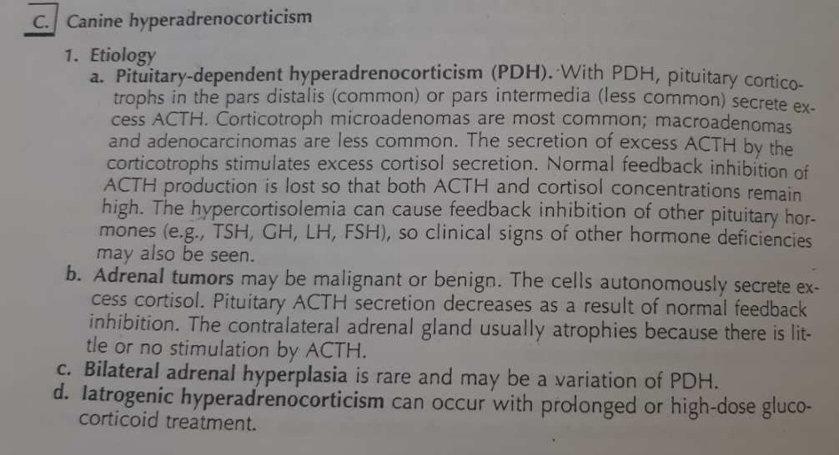

Slide 4
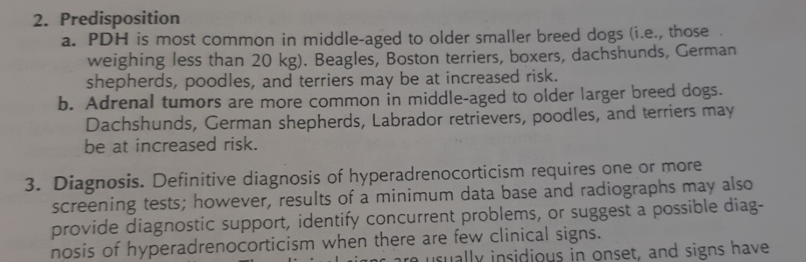

Slide 5
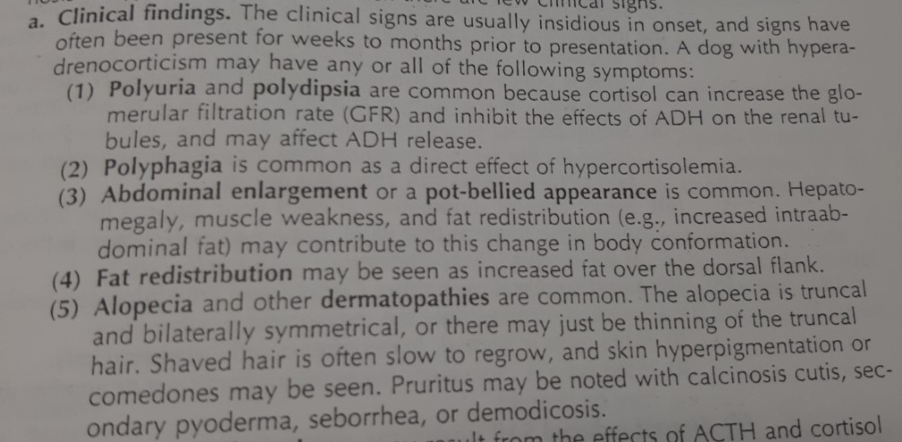

Slide 6
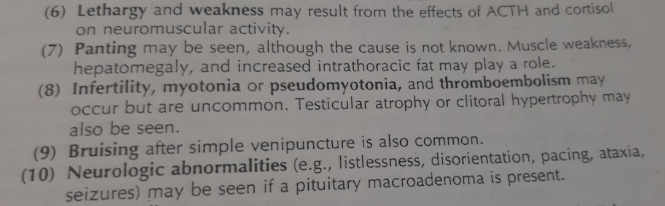

Slide 7
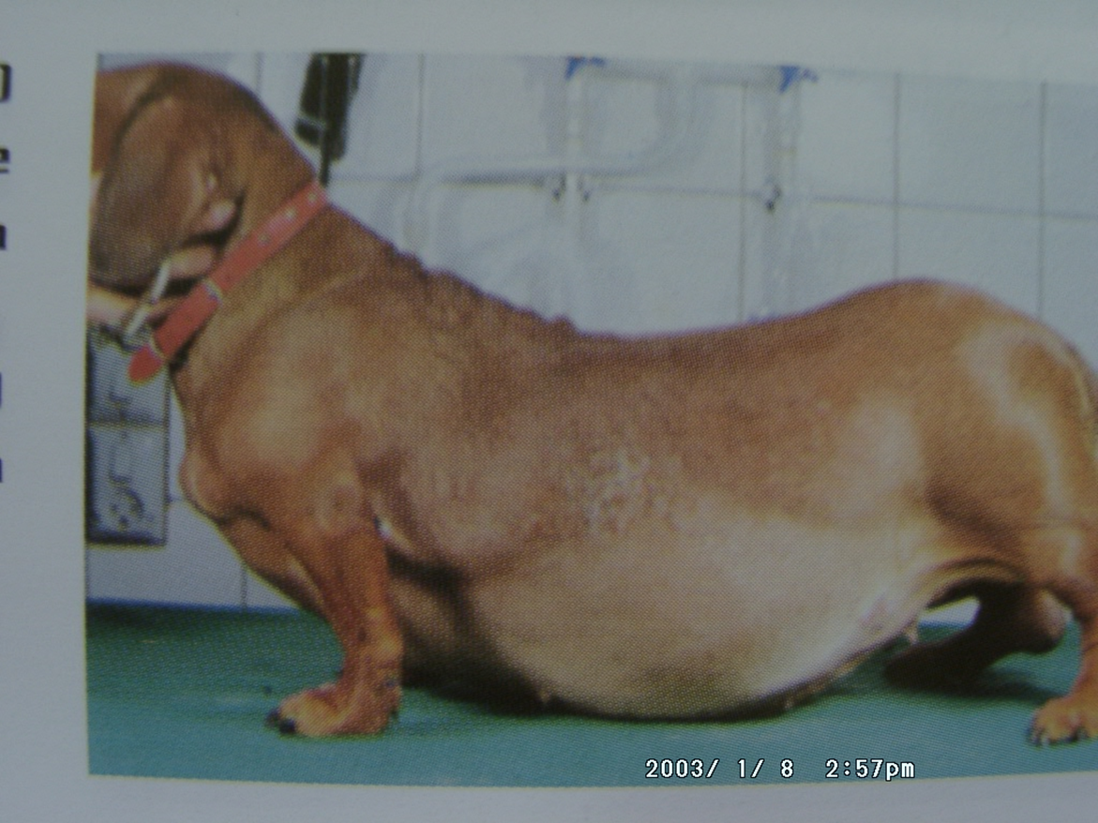
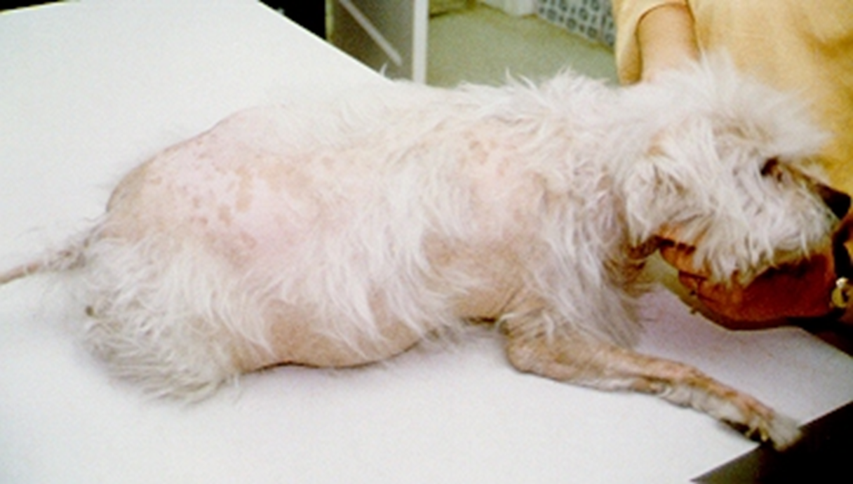
Pot-bellied appearence Abdominal enlargement
Alopecia

Slide 8
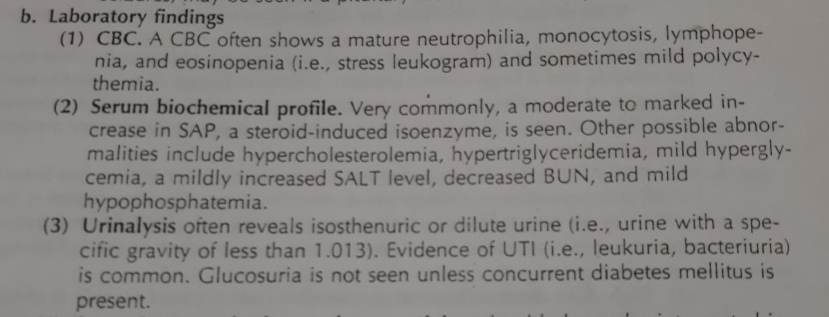

Slide 9
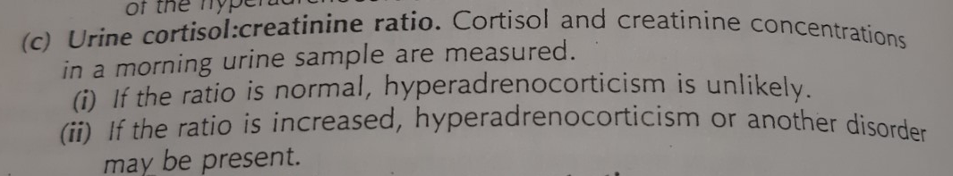

Slide 10
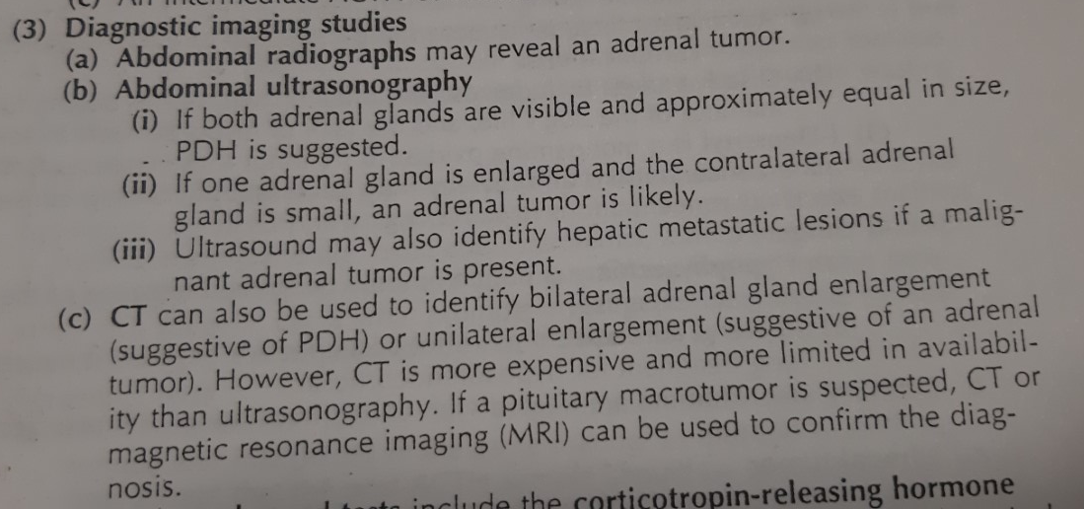

Slide 11
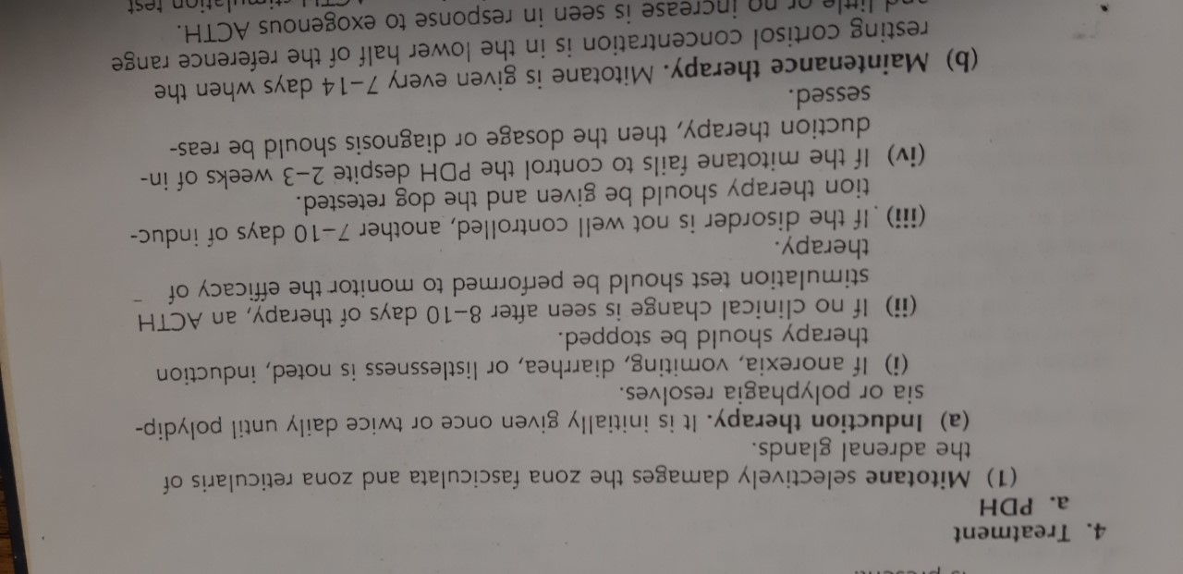
Mitotane(Lysodren) 25-75 mg/kg/day. Divided 2-3 orally. İf necessary fludrokortizon additive 0.0125 mg/kg/day from 3. day starting.

Slide 12
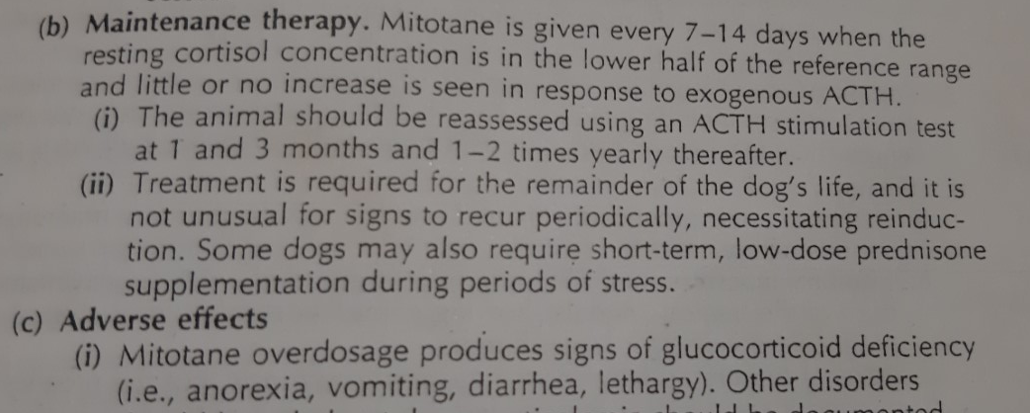

Slide 13
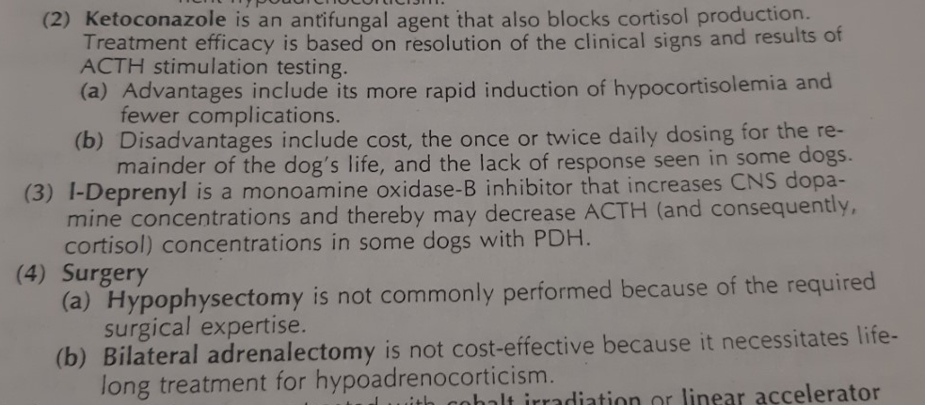
ketoconazole 30 mg / kg / day dose is divided into two and used for 60 days

Slide 14
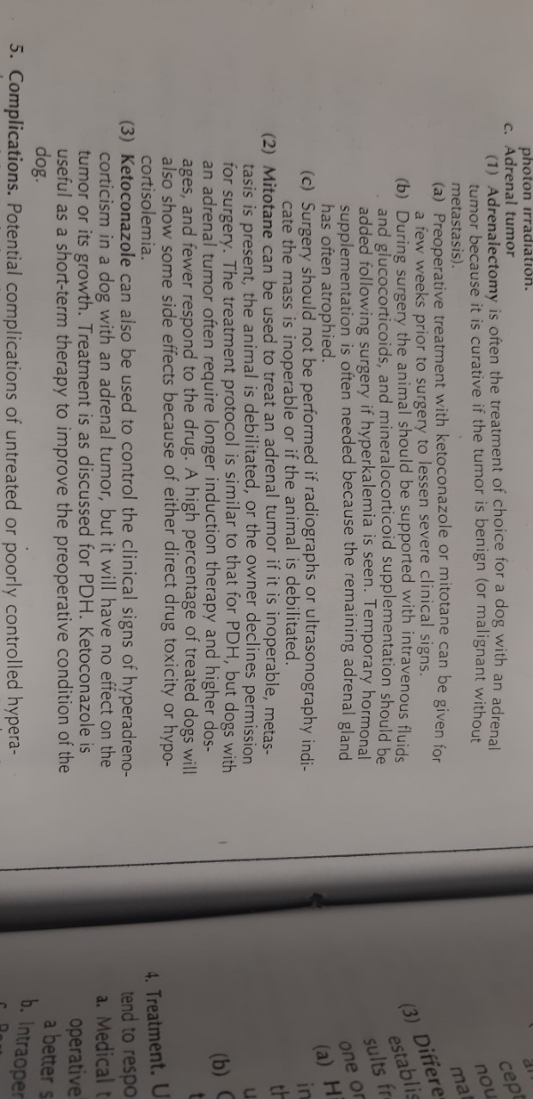

Slide 15
