Slide 2
Hyperthyroidism in cats
Prof.Dr. Aslan kalınbacak

Slide 3
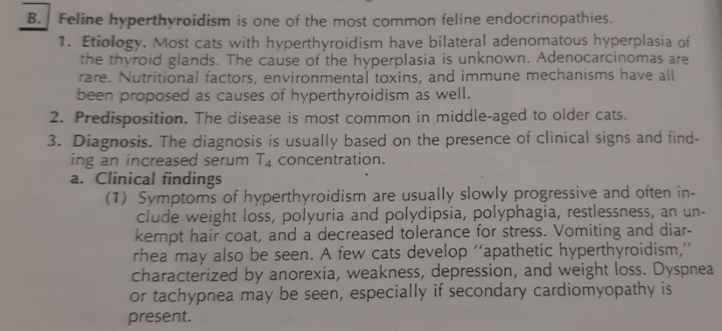

Slide 4
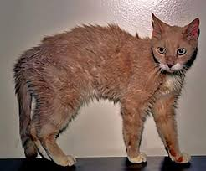
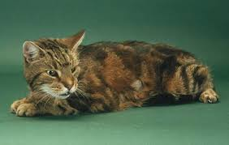

Slide 5
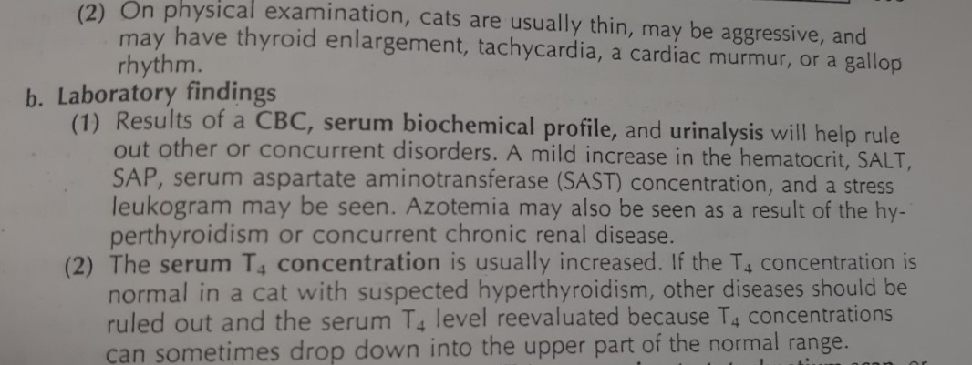

Slide 6
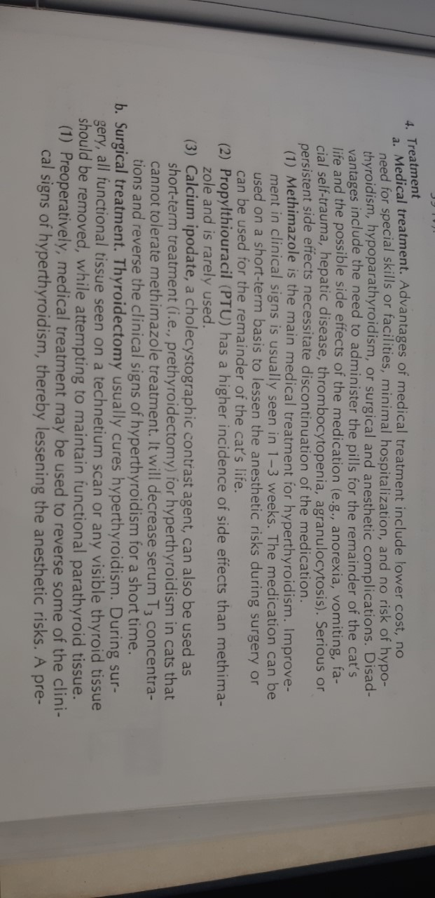
Methimazole is started with 10-15 mg / kg. A decrease in the T-4 level is expected. If not, the dose is increased by 5 mg

Slide 7
