Slide 1
Based on S/F Books:
Films
TV Series
2001: A Space Odyssey
The War of the Worlds
The Time Machine
Dune
Starship Troopers
Fahrenheit 451
Slaughterhouse-Five
Breakfast of Champions
Solaris
Bladerunner
Minority Report
Total Recall
The Hunger Games
The Road
The Martian
Children of Men
Ready Player One
The Expanse
The Man in the High Castle
Childhood’s End
Dirk Gently’s Holistic Detective Agency
The 100
Altered Carbon
Under the Dome
Brave New World
Wayward Pines

Slide 2
Other Popular Examples:
E. T.
Star Trek
Star Wars
Battlestar Galactica
Doctor Who
Life on Mars
X-Files
Black Mirror
Firefly
Serenity
Extant
Interstellar
Mortal Engines
Transformers
Planet of the Apes
Mad Max
Avatar
Moon
The Terminator
Her
Snowpiercer
District 9
Gravity
Inception
Arrival
Alien
Ex Machina
The Hitchhiker’s Guide to the Galaxy
Westworld
Everything Marvel and DC

Slide 3
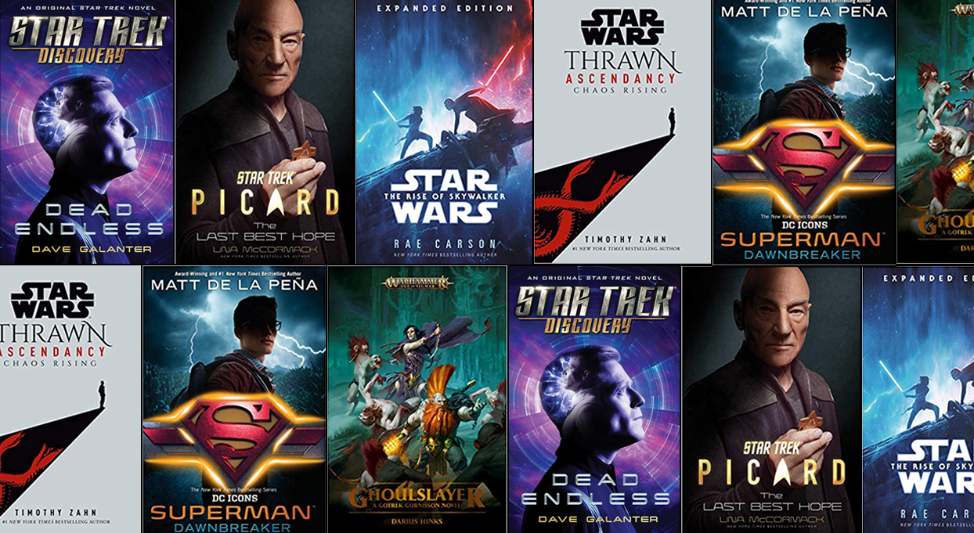
Tie-in Fiction
Novels based on film/TV/radio:
Star Trek
Star Wars
The Hitchhiker’s Guide to the Galaxy

Slide 4
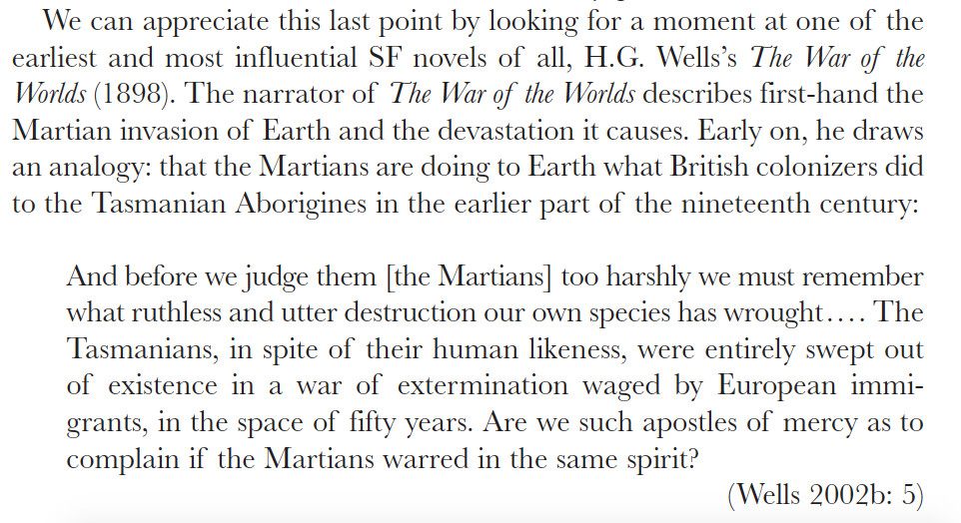
Ken Gelder, Popular Fiction

Slide 5
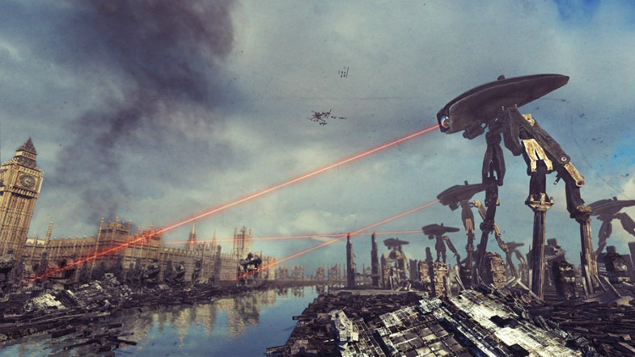
The War of the Worlds
British colonialism
Being colonized and dispossessed
What human society might become in the future
Adventure

Slide 6
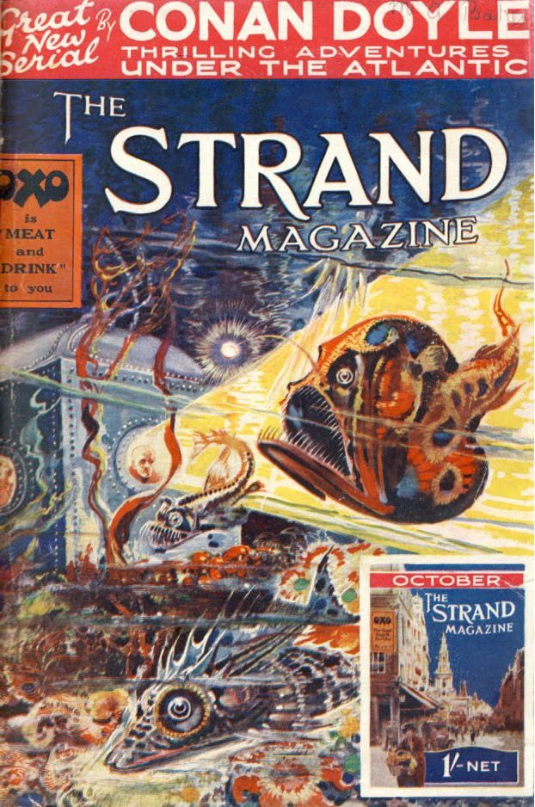
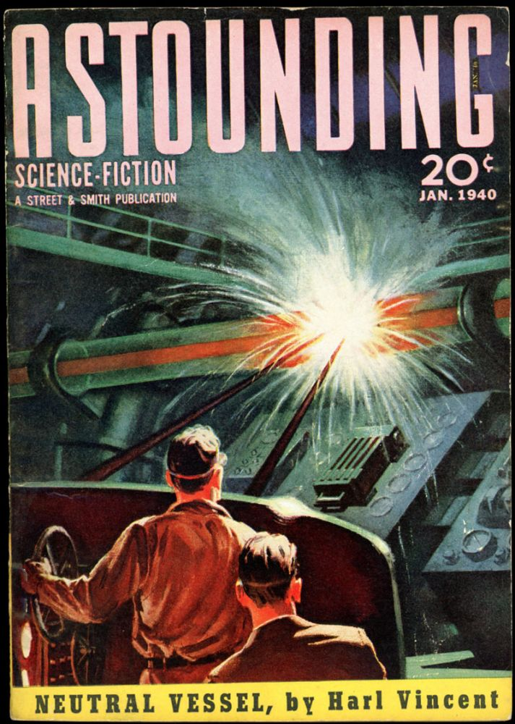
New Magazines and Periodicals in the 20th Century
The Strand
Amazing Stories
Astounding Science Fiction

