Slide 1
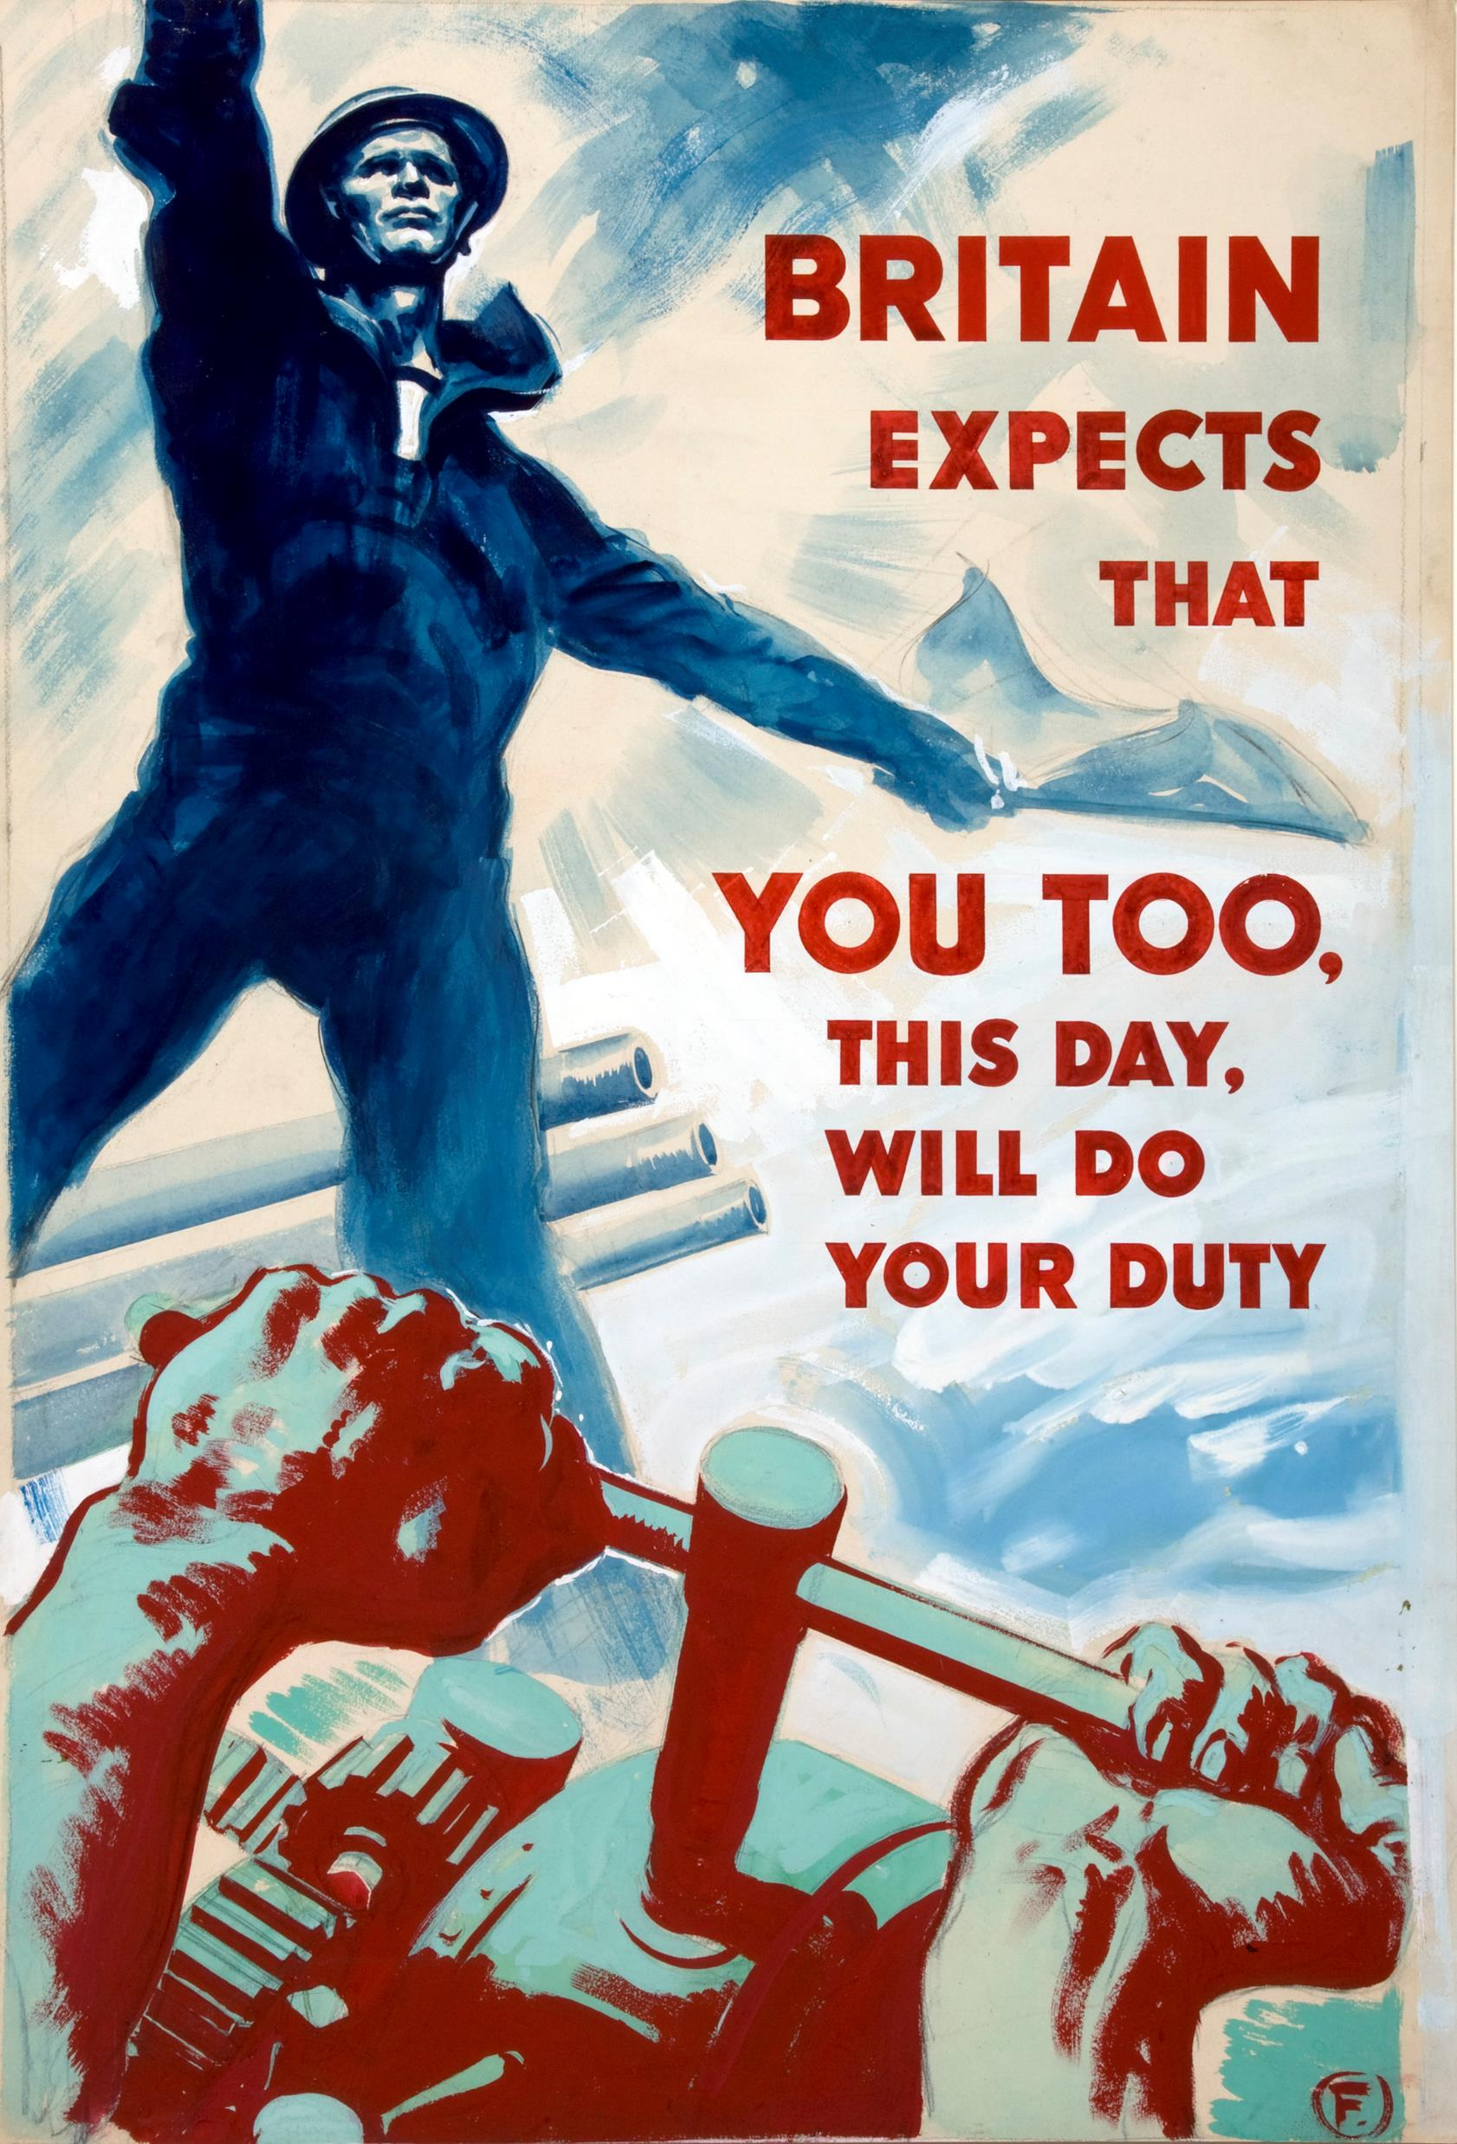
WWII and POST-WAR PERIOD
Dr. Funda Hay
fhay@ankara.edu.tr
Ankara University
From the website Wikipedia

Slide 2
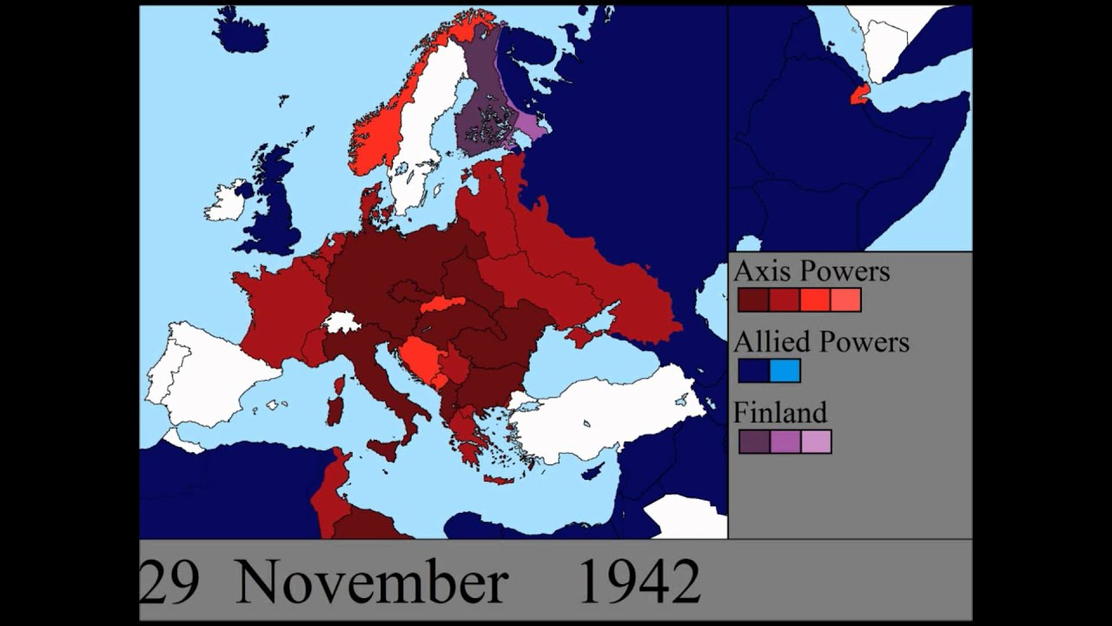
In the 1930s German control began to spread over Europe.
In 1935 Italy invaded Abyssinia (Ethiopia).
In September 1939 Germany invaded Poland, and Britain entered the war.
From the website Youtube

Slide 3
From the website Pinterest

Slide 4
From the website Sutori

Slide 5
From the website Wikipedia

Slide 6
Post-war Britain & Nationalism
In 1944, for the first time, the government promised free secondary education for all.
In 1946 a Labour government brought in a new National Health Service.
in 1948, the National Assistance Act provided financial help for the old, the unemployed

Slide 7
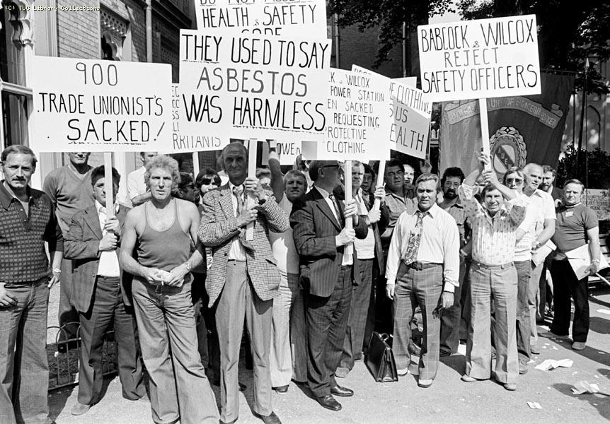
The Labour government took over control of credit (the Bank of England), power (coal, iron and steel), and transport (railways and airlines).
20 per cent of British industry was nationalised.
From the website Union History

Slide 8
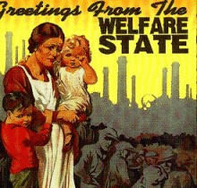
The government became known as "the welfare state." For the next quarter century both the Conservative and Labour parties agreed on the need to keep up the "welfare state,"
From the website School Work Helper

Slide 9
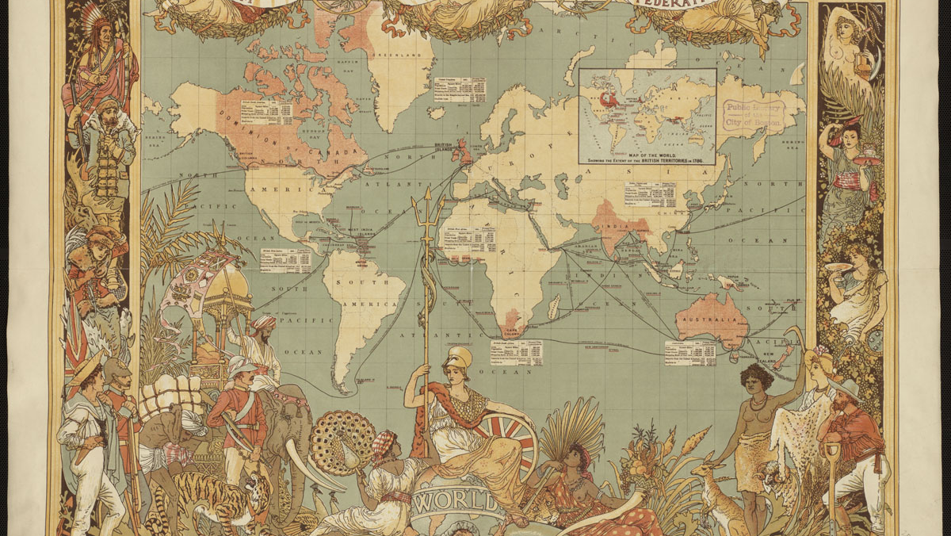
The Loss of Empire
From the website E-International Relations

Slide 10
From the website Wikipedia

Slide 11
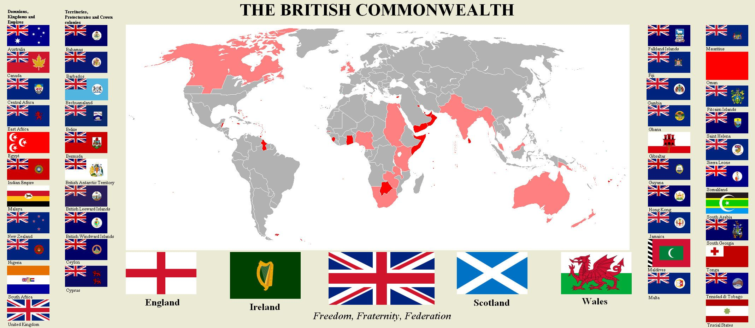
From the website Blog in2English

Slide 12
Bibliography
Burns, William E. A Brief History of Great Britain. Facts on File, 2010.
McDowall, David. An Illustrated History of Britain. Longman, 1989.
Morgan, Kenneth O. Twentieth-Century Britain: A Very Short Introduction. Oxford UP, 2000.
Varal, Seçil. ‘Everendum’: National Identity and Scottish Independence in Contemporary Scottish Drama. Ankara University, 2019. PhD Dissertation. The CoHE Thesis Center.

