Slide 1
earLy settLeMents, CeLts, anD roMans (prehistory to Ca. 450 c.e.)
The Old Stone Age: The very first men of all are called Eolithic, from a Greek word meaning “early stone.”
Palæolithic (Old Stone Age) men came after them.

Slide 2
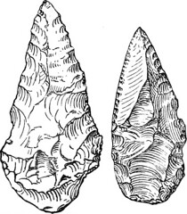
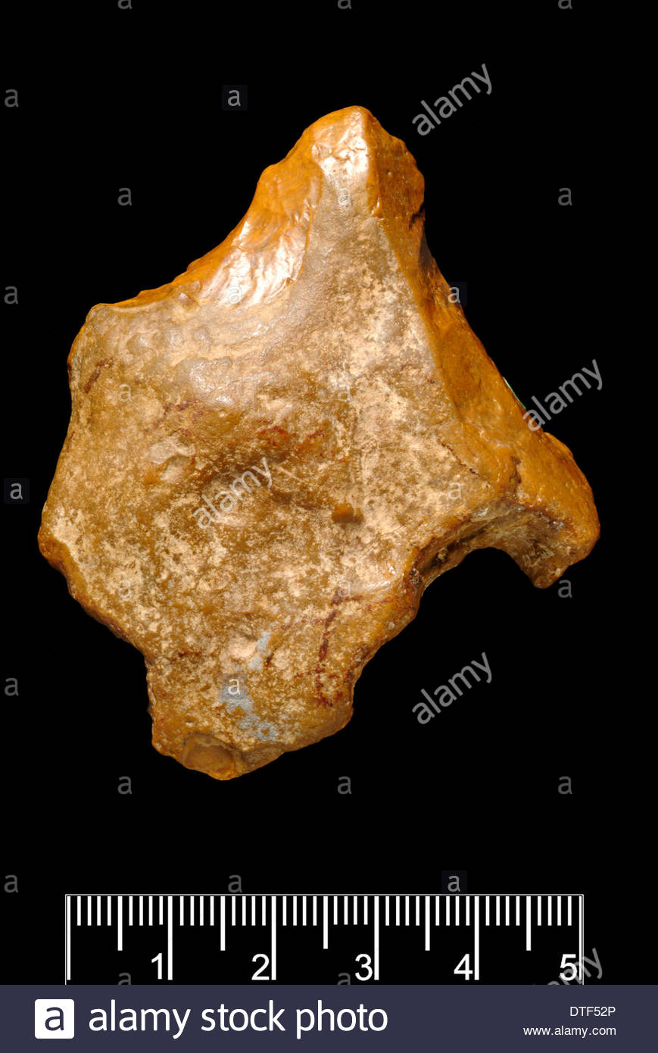
Palæolithic
Eolithic

Slide 3
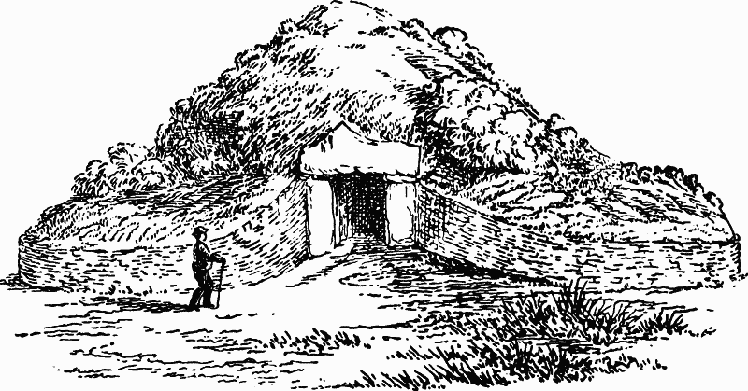
Weapons of Palæolithic manwere rough.
Palæolithic man even began to build huts and to scratch pictures on the sides of the caves.
British History

Slide 4
The New Stone Age
Men began to progress rapidly in civilisation. This more civilised period is called the Neolithic.
They made their stone weapons and tools much more skilfully.
They built their huts together in villages.

Slide 5
The Bronze Age
It is guessed the period lasted for 3500 (41 BC – 6 BC) years and ended.
The inhabitants of Britain were still quite savage at a time (about 2000 years before Christ).

Slide 6
Trade in the Bronze Age
Traders came Britain to obtain tin in exchange for goods from their own lands.

Slide 7
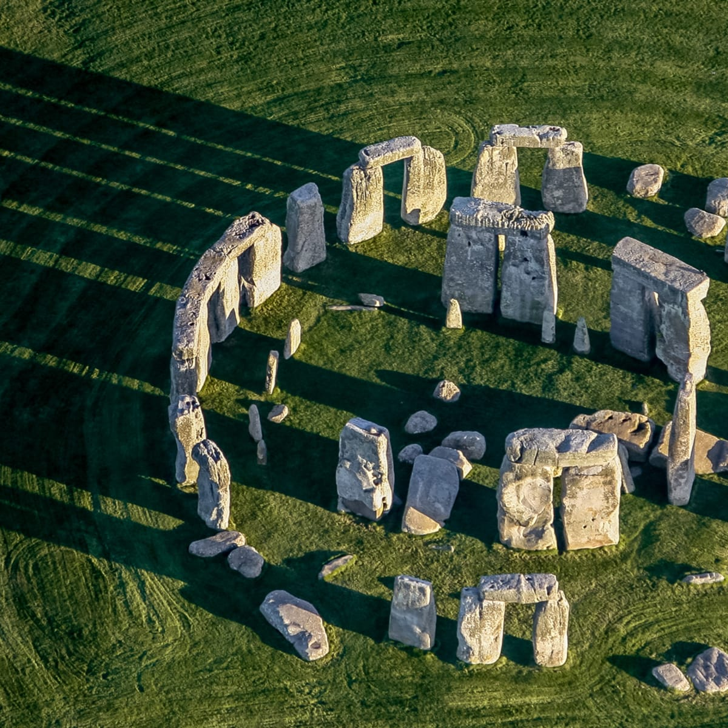
Stonehenge
History

Slide 8
Goidels and Brythons
England was invaded by a tribe called Goidels.
Then in the 5th BC a new tribe called Brythons came.

Slide 9
The Iron Age and the Britons
Iron came relatively late to Britain compared to other parts of Europe.

Slide 10
The Britons
The Britons lived in huts covered with mud and straw.
They were nearly all farmers.
They made their own clothes.

Slide 11
The Celts and the Iron Age
In the Iron Age, Britain came to be dominated by a group of people known as the Celts.

Slide 12
Trade
Money began to be used.
The earliest link between Britain and the Mediterranean economy was the Cornish tin trade

Slide 13
The Coming of the Romans
The date of the first invasion of Britain by the Romans is 55 BC.
Julius Caesar had conquered Gaul in 58 and become proconsul of the province.

Slide 14
The Roman Conquest
In the year 43 AD. the Roman Emperor Claudius conquered Britain and make the Britons pay him taxes or tribute.

Slide 15
Julius Agricola (40–93)
Julius Agricola (40–93) was the governor of Britannia in the late 70s.
He spreads garrisons of Roman troops all over the country to keep it in order and gradually the headquarters of each garrison became a town.

Slide 16
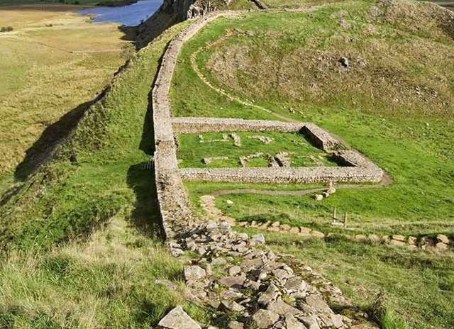
Hadrian’s Wall
English Heritage

Slide 17
The Roman Peace
All military arrangements kept Britons quiet and undisturbed by their enemies.

Slide 18
BIBLIOGRAPHY
Burns, William E. A Brief History of Great Britain. Facts on File, 2010.
Dance, E. H. Outlines of British Social History. Longmans, Green & Co., 1950.

