Slide 1
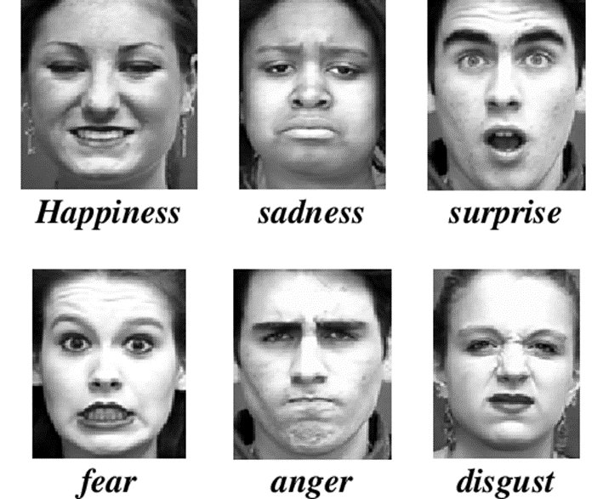
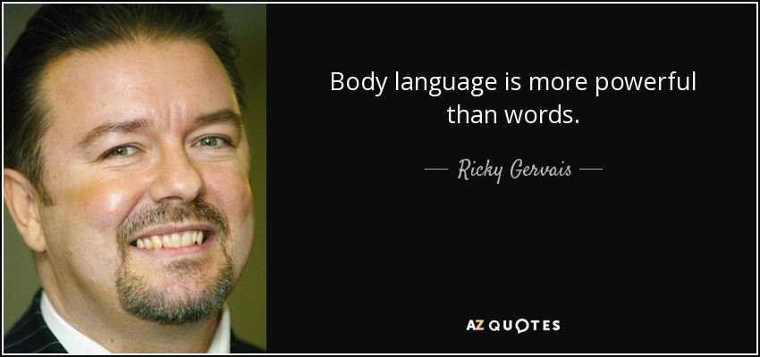
Body Language

Slide 2
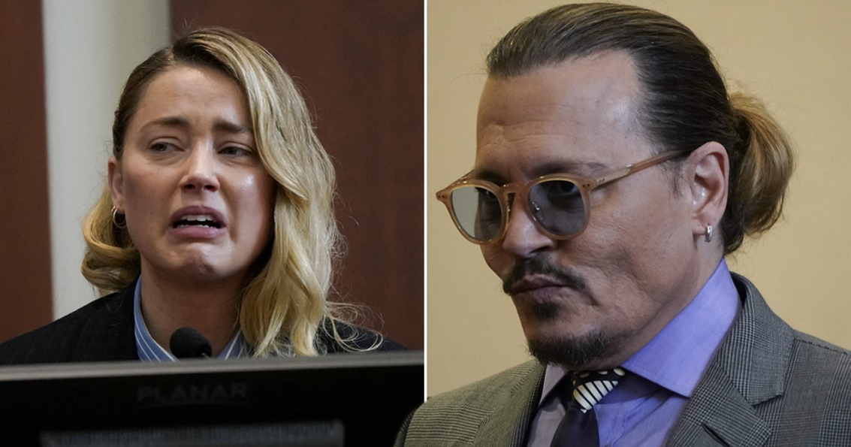
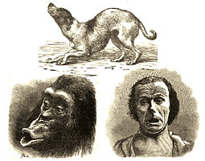
Understanding Emotions
There is an emotion under every expression.
The ability to interpret expressions is important for social relationships.
In humans, facial expressions are important for understanding emotions.
How much can two different species understand each other?

Slide 3
Dogs' ability to understand humans
Dogs' ability to read humans is better than chimpanzees and bonobos.
Dogs are smilar to infants in paying attention to adults.
Dogs show "left gaze bias" - only looking at human face
Sanni Somppi, Heini Törnqvist, Miiamaaria V. Kujala, Laura Hänninen, Christina M. Krause, Outi Vainio. Dogs Evaluate Threatening Facial Expressions by Their Biological Validity – Evidence from Gazing Patterns. PLOS ONE, 2016; 11 (1): e0143047 DOI: 10.1371/journal.pone.0143047
Guo ve ark. (2009). Left gaze bias in humans, rhesus monkeys and domestic dogs. Animal cognition.

Slide 4
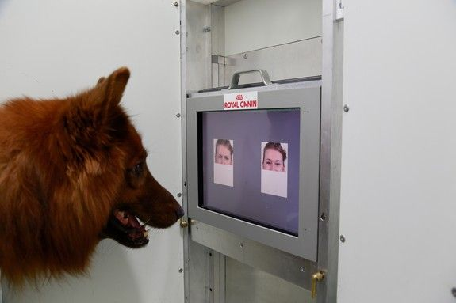
Can dogs understand our feelings?
Dogs can link human facial expressions and emotional sounds.
Albuquerque N. ve ark. (2016). Dogs recognize dog and human emotions. Biology Letters
Corsin A. Müller, Kira Schmitt, Anjuli L.A. Barber, Ludwig Huber, (2014). Dogs Can Discriminate Emotional Expressions of Human Faces. Current Biology

Slide 5
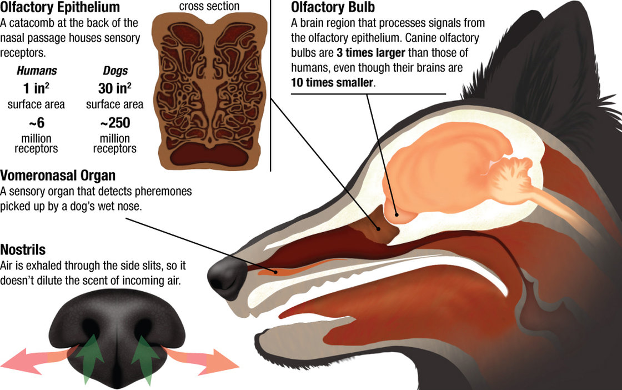
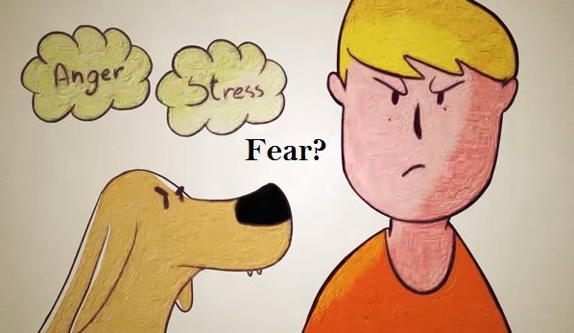
Can dogs smell fear? -Olfactory communication
D’Aniello, B., Semin, G.R., Alterisio, A., Aria, M., Scandurra, A.(2017). Interspecies transmission of emotional information via chemo signals: from humans to dogs (Canis lupus familiaris). Animal Cognition

Slide 6
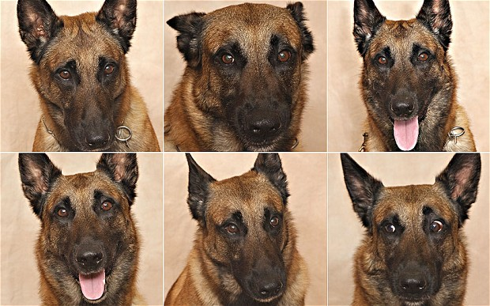
Our ability to undestand dogs’ emotions
We cannot understand stress related-facial expressions in dogs
Bloom T(1), Friedman H..Classifying dogs' (Canis familiaris) facial expressions from photographs. Behav. Processes. 2013

Slide 7
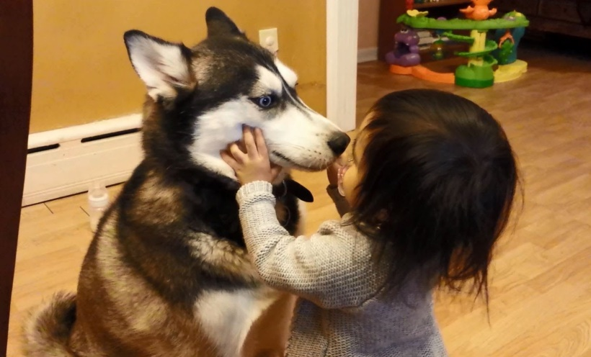

Slide 8
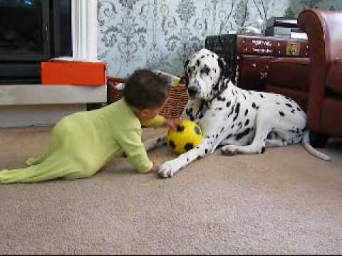
Reading dogs with children
When the dog and the child are together:
Dog's emotional state?
The dog's behavior?
Why?
Expert panel:
Behaviors associated with anxiety / fear / emotional conflict
Most of the participants: Dogs are relaxed and happy
Dominant behavior: Play and friendly behaviors

Slide 9
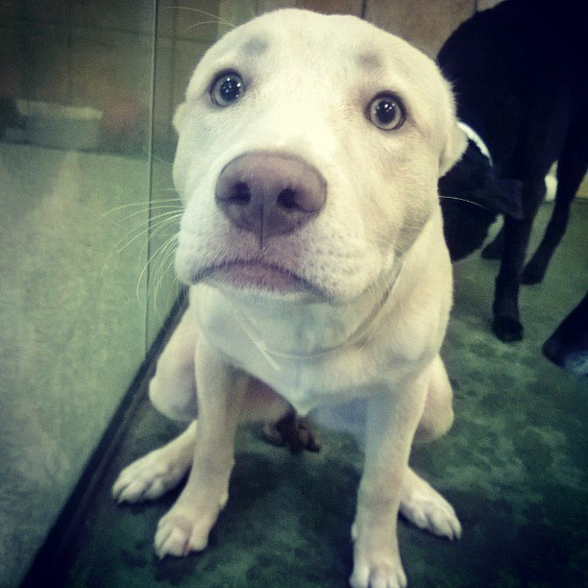
Another Research:
27 shelter dogs
Behavior during visits
Adoption rate
The link between one facial expression and adoption
Human interpretation:
If at shelter: Sad
If at home: Guilty
Kaminski J. (2016) Paedomorphic Facial Expressions Give Dogs a Selective Advantage. PlosOne

Slide 10
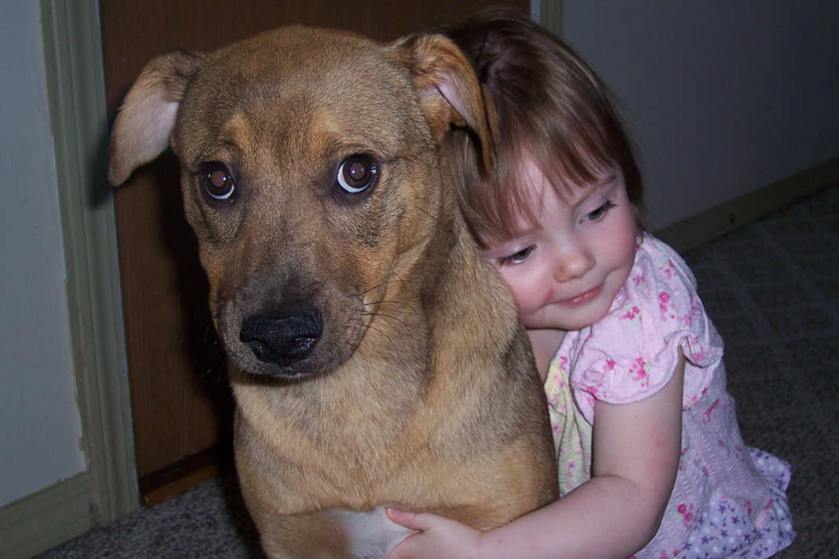
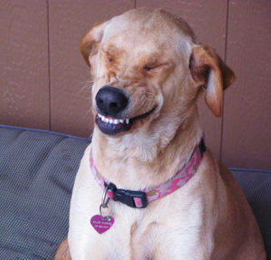
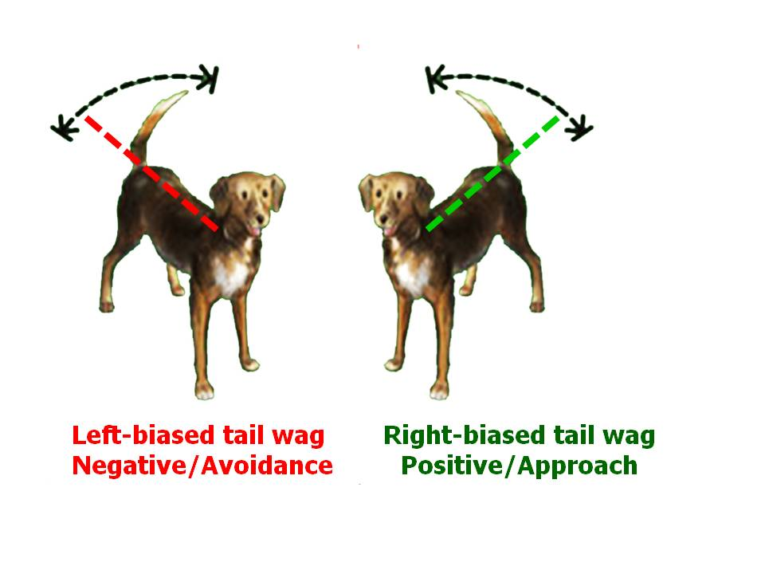
Why are we making mistakes?
Context specific approach
Anthropomorphic approach - have you really tried to listen to your dog?
Established-taboo misinformation
Ignorance

