Slide 1
PROSTATE CANCER
Assoc.Prof.Dr. Evren Süer
Department of Urology
Ankara University Faculty of Medicine

Slide 2
INTRODUCTION
Most frequently diagnosed urologic cancer
Most common cancer in USA and Europe
Recently diagnosed in localised stage
African > Caucausian > Asian

Slide 3
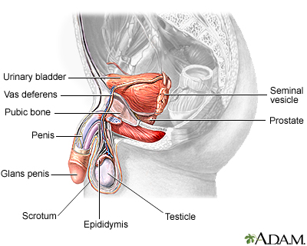

Slide 7
STAGE
Microscopic
Localised
Regional
Metastatic

Slide 8
PSA
Serine proteases
Human kallikrein 3
First identification in 1970
Clinical practice after 1987
Secreted from the prostate epithelium
BPH, Prostatitis and trauma may cause PSA elevation

Slide 9
Efficacy
PSA > 4 ng/ml;
Sensitivity%78
Specifity %33
The rise in PSA due to non-cancerous diagnosis is the reason of low specifity

Slide 10
(PSA 4 – 10 ng/ml) Gray Zone
f/t PSA
PSA Density- > 0,15
PSAV -> 0,75 ng/ml
Age specific PSA
PSA DT
PSA İsoforms
To increase specifity

Slide 11
SCREENING

Slide 12
PSA (Prostat spesific antigen – human kallikrein 3) utilization increased continously after 1980`s
Recommended in the guidelines
The widespread usage of PSA for screening

Slide 13
The aim of screening
Early diagnosis of potentially lethal cancer
To determine the patients who may benefit from the treatment of prostate cancer
The diagnosis of low risk prostate cancer patients must be decreased to reduce the complications due to treatment

Slide 14
A Balanced Approach
Benefit
Safe
Metastasis
Harm
False Positivity
Overdiagnosis
Overtreatment
Death

Slide 15
Screening - Recommendations
Patients must be informed
Patients who have a life expectancy > 10 years are the main target
Men older than 50
Family history ve Africans > 45 yaş
BRCA 2 mutation > 40 yaş

Slide 16
DIAGNOSIS

Slide 17
Tools
s/t PSA
Digital Rectal Exam
Firmness, nodularity, size, invasion
TRUS
Multiparametric MRI
Biyopsy
PSMA PET/CT

Slide 18
CURRENT APPROACH
PSA > 2-5-4 ng/ml
DRE
Mp MRI
TRUS 12 quadrant biyopsy + Targeted biyopsy

Slide 19
Why MRI ?
The diagnosis of cancer
Guide for biopsy
Targeted lesions
To increase clinically significant cancer
To decrease clinically insignficant cancer
To define the grade and stage
Cost- Effectivity

Slide 20
PİRADS Scoring System
PİRADS 1
PİRADS 2
PİRADS 3
PİRADS 4
PİRADS 5
Low risk for prostate cancer
No biopsy indcation
Intermediate Risk
Targeted bx
High Risk

Slide 21
HAK – 51 y - 68701
PI-RADS 3 LEZYON

Slide 22
PI-RADS 4 lezyon

Slide 23
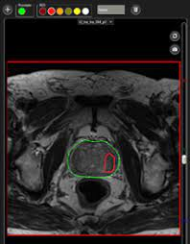
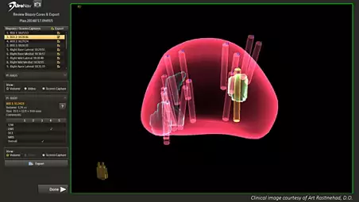

Slide 24
Parameters in patients are diagnosed as
tPSA 4-10 ng/ml, 10-20 ng/ml, > 20 ng/ml
DRM – Mp MRI (Stage)
Biyopsy Gleason Grade
ISUP Grade 1: Gleason score 3,3
ISUP Grade 2: Gleason score 3,4
ISUP Grade 3: Gleason score 4,3
ISUP Grade 4: Gleason score 4,4
ISUP Grade 5 : Gleason score 4,5 -5,4 -5,5
Biyopsy core number ve core percentage

Slide 25
EAU – Risk Classification
Low Risk | Intermediate Risk | High Risk
PSA < 10 ng/ml T1-2a ISUP Grade 1 | PSA 10 -20 ng/ml T2b ISUP Grade 2-3 | PSA > 20 ng/ml T2c ISUP Grade >3 | T3-4 veya N+ All Grade
LOCALİSED |  |  | LOCALLY ADVANCED

Slide 26
Staging
Abdominopelvic CT
Bone Scan
Pelvic MRI
Galium 68 PSMA PET/CT-MRI
Kranial MRI – Not routine

Slide 27
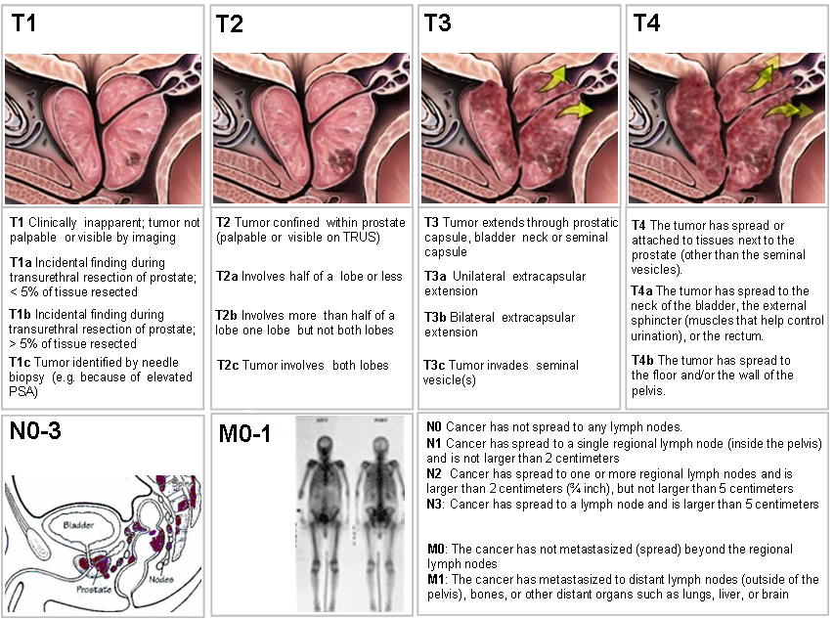

Slide 31
Treatment
Localised
Locally Advanced
Metastatic

Slide 32
Localised Prostate Cancer - Treatment
Low Risk
Active Surveillance
Radical Prostatectomy
Radiotherapy
Ablation
Intermediate Risk
Radical Prostatectomy + Pelvic Lymphadenectomy
Radiotherapy + 6 months ADT
Ablation
High Risk
Radical Prostatectomy + Pelvic Lymphadenectomy
Radiotherapy +2-3 years ADT
ADT: Androjen deprivasyon tedavisi

Slide 33
Active Surviellance
Mostly indicated in low risk patients
Aim
1. To follow potentially low lethal cancers until they require treatment
2. Protect the patient from the side effects of treatment

Slide 34
Active Surviellance
PSA , PRM, MRI
TRUS Fusion biyopsy
Low risk Prostat Ca
Active Surviellance
3-6 months PSA
1-4-7.year biyopsy ve MpMRI
PROGRESYON
Consecutive rise of PSA in the control period
Higher core number or upgrading

Slide 35
Radical Prostatectomy
May performed in all risk groups
Prostate, Seminal vesicule ve Vas Deferens is removed
Int-High risk patients also underwent a concurrent Pelvic Lymphadenectomy
Lymphadenectomy is the best modality for staging

Slide 37
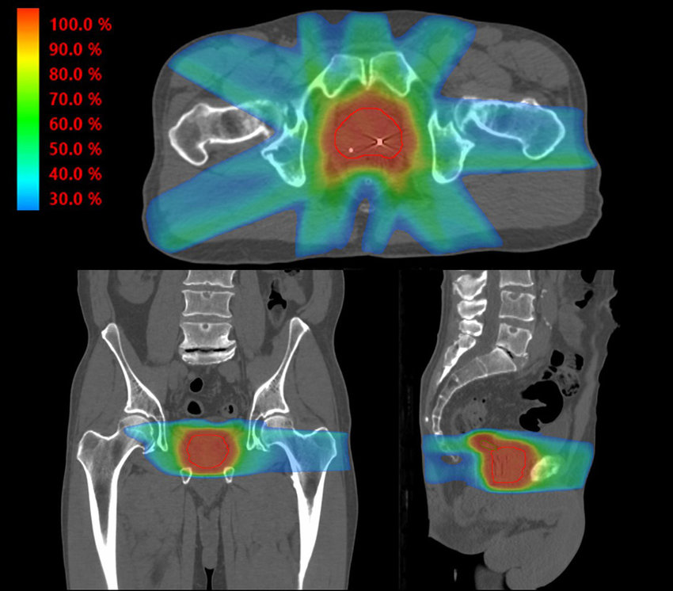
Radiotherapy
Utilized in low risk group as a monotherapy
ADT is included to the treatment regimen in int-high risk patients
Fractions
> 74 Gy

Slide 38
Metastatic Disease

Slide 40
Treatment
Main treatment strategy is androgen deprivation treatment (CASTRATION)
Methods
LHRH Agonist
LHRH Antagonist
Bilateral Orchiectomy

Slide 41
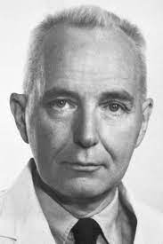
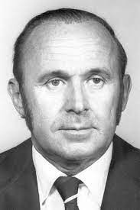
Two Nobel Prizes
Charles Huggins
Andrew Schally

Slide 42
Treatment regimens
LHRH
LHRH + Bicalutamid
LHRH – Docetaxel
LHRH – Abiraterone
LHRH – Enzalutamide
LHRH – Apalutamide
Diğer

Slide 43
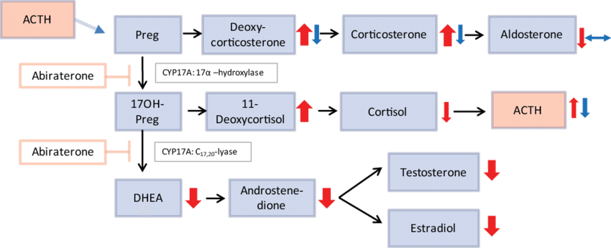
Abiraterone

Slide 44
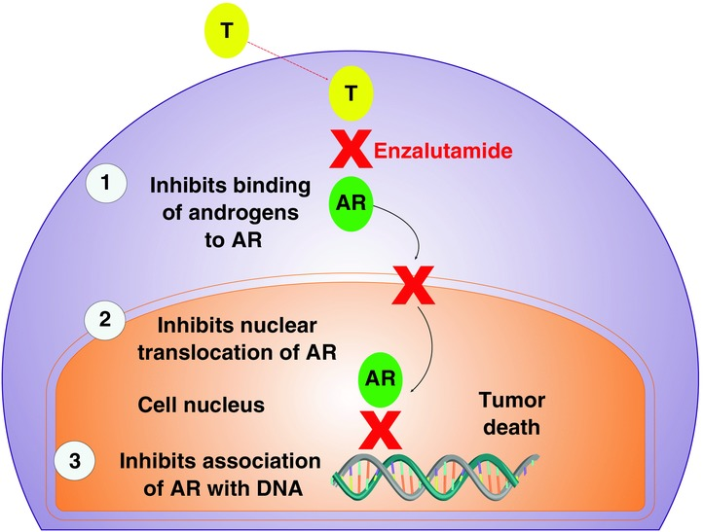
Enzalutamide - Apalutamide

Slide 45
METASTATİC PROSTATE CANCER
Enzalutamid
ADT + Docetaxel
Abirateron
Apalutamid
2-3 years after Castration resistance

