Slide 1
Types of Scrotal Conditions
Doç. Dr. Evren Süer

Slide 2
Contents
Varicocele
Hydrocele
Spermatocele
Acute Scrotum
Testicular Torsion

Slide 3
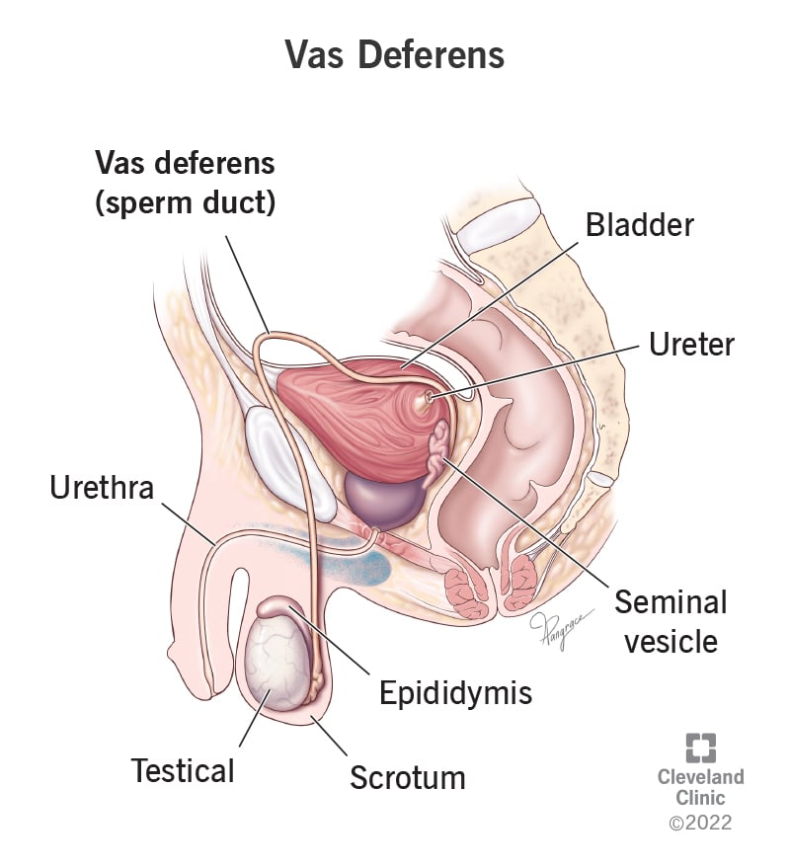
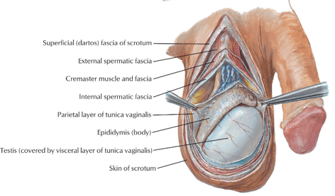
Scrotum
The testicles are contained in a sac outside the abdominal cavity.
Since it is outside the abdominal cavity, the temperature of the scrotum remains below body temperature.
Keeping the temperature below body temperature is extremely critical for the production of healthy sperm.

Slide 4
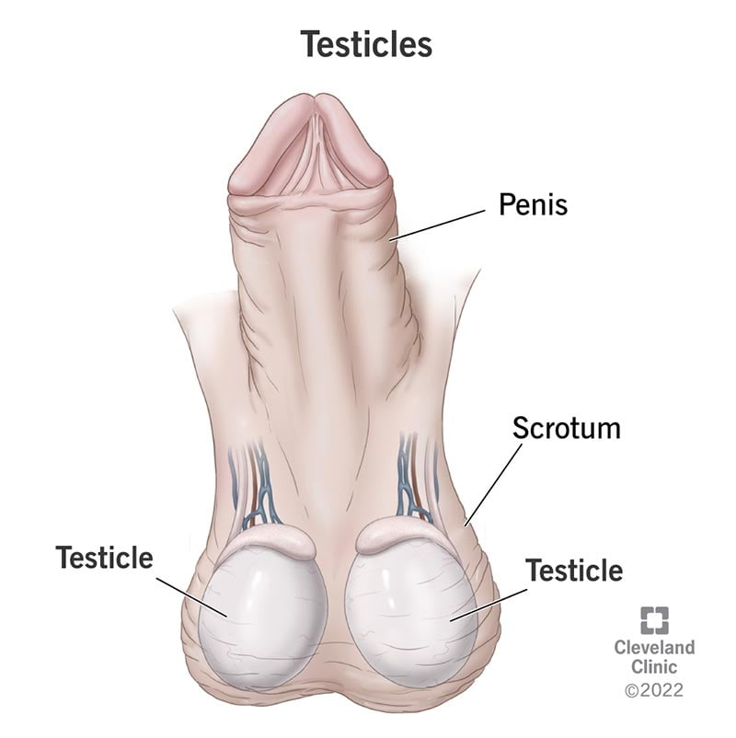
Testicles (Orchis)
Oval shaped
5 cm in size
Weighs 15 g
Produce sperm and testosterone

Slide 5
Testicles
Testicles have two main functions.
Leydig cells Testosterone synthesis
Sertoli cells Sperm production
(spermatogenesis)

Slide 6
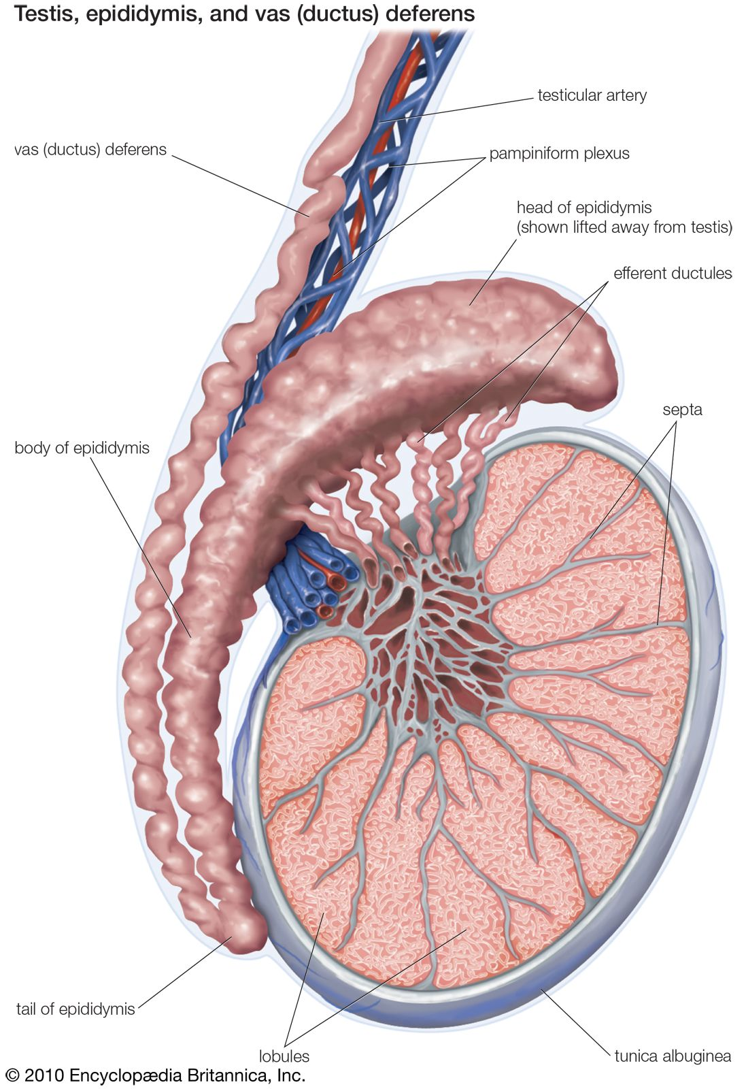
Epididymis
It is located on the posterior upper part of each testis and lies within the scrotum.
Sperm produced in the testicles are transmitted here.
This is where newly formed sperm are stored.

Slide 7
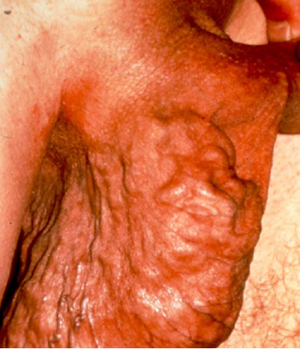
Varicocele
A varicocele is enlarged or dilated veins in the scrotum.
It is normally a painless and harmless condition; however, it can cause low sperm production and reduced sperm quality that can lead to male infertility.

Slide 8
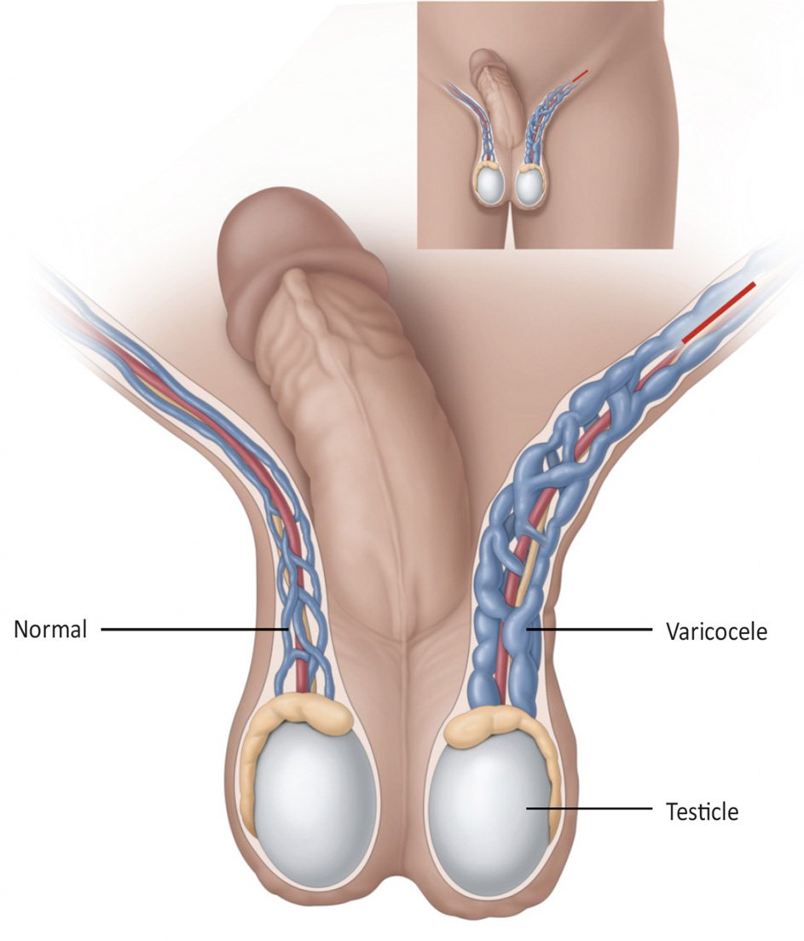
Varicocele
Sometimes, varicocele can produce symptoms, such as pain and swelling.
Although most varicoceles don’t need to be treated, some will need to be corrected with surgery.

Slide 9
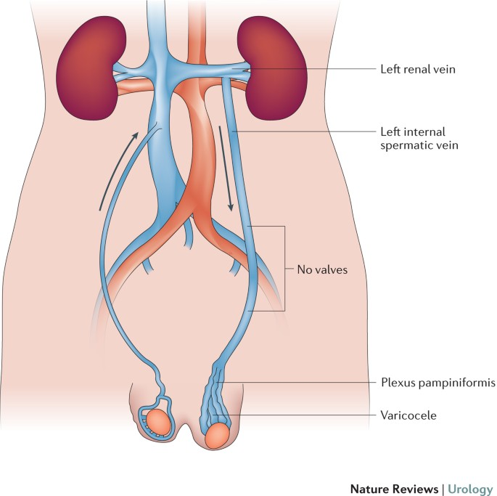
Varicocele
Clinically, they are found more commonly on the left side
The reason for the prevalence of left varicoceles can be clarified by retroperitoneal anatomy.
The left internal spermatic vein drains perpendicularly into the left renal vein, whereas the right internal spermatic vein drains obliquely into the vena cava.

Slide 10
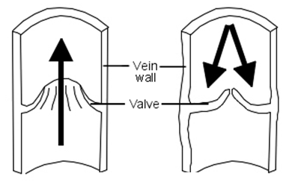
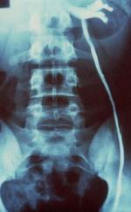
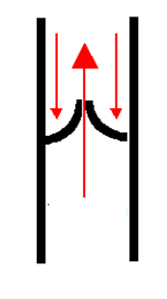
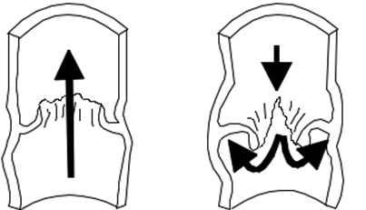
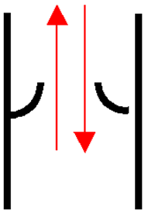
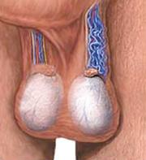
PATHOPHYSIOLOGY OF VARICOCELE
Disfonksiyone testiküler ven
Peritestiküler staz

Slide 12
Incidence
General male population %13.4 (%4.4-22.6)
Primary infertility %35-40 (%19-41)
Isolated right varicocele %2
Usually isolated left varicocele %78-93
Bilateral varicocele in normal population %1, in the infertile group %40 (%15-50)
Rare under 10 years old, increases progressively with puberty (%15-20)

Slide 13
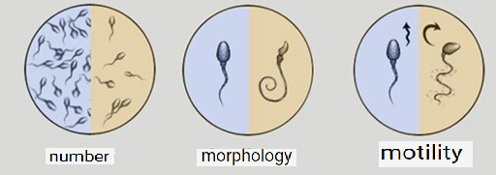
Varicocele is the most common and treatable cause of male factor infertility.
After varicocelectomy;
%60-80 improvement in semen parameters
%20-60 pregnancy rates

Slide 14
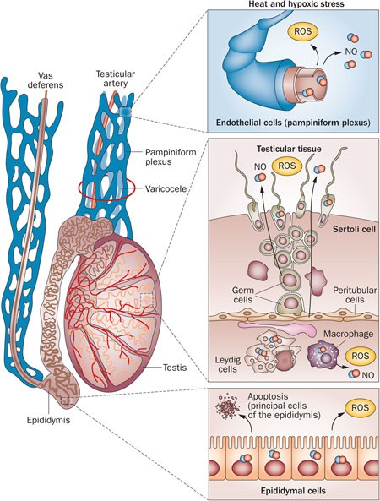
Pathophysiology
Hyperthermia
Testicular blood flow and venous pressure changes
Hormonal dysfunction
Increased oxidative stress (ROS)
Apoptosis
DNA damage

Slide 15
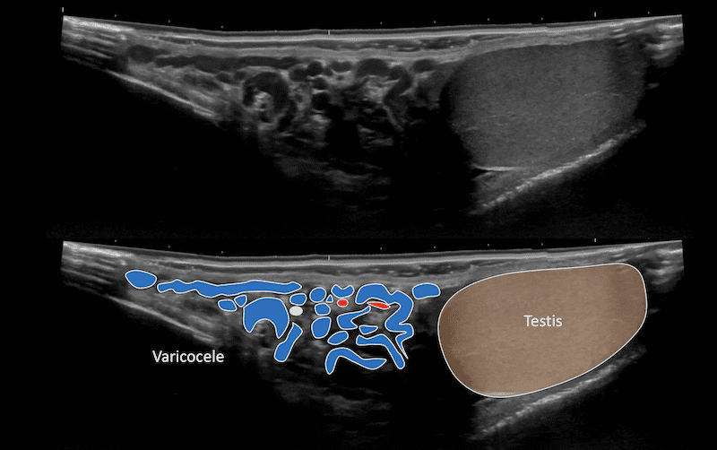
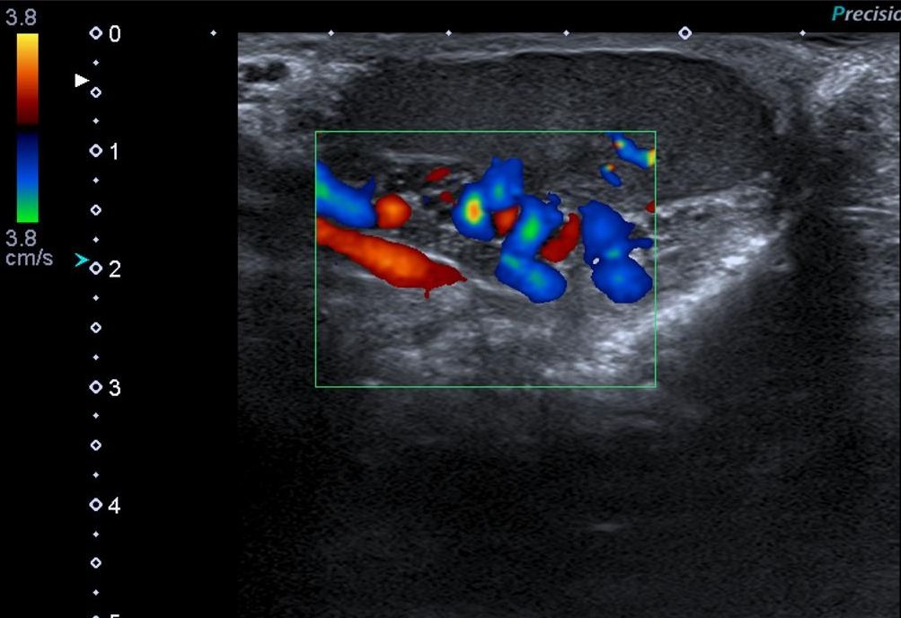
Diagnosis and Evaluation
Anamnesis, physical examination, at least 2 semen analysis (7 days-3 weeks)
Although physical examination is often sufficient for diagnosis, doppler ultrasound can help in diagnosis.

Slide 16
Physical examination :
1. Grade : Palpable with Valsalva
2. Grade : Directly palpable
3. Grade : Visible without physical examination

Slide 17
Varicocelectomy Indications
Persistent sperm parameters disorder with infertility
To obtain better quality sperm for the next assisted reproductive technique
Adolescent varicocele and suboptimal testicular enlargement
Large varicocele causing cosmetic problems
Persistent testicular pain with varicocele

Slide 18
Surgical Approaches in Varicocele
Open surgery;
Retroperitoneal(Palamo)
Inguinal (İvanissevich)
Subinguinal(Marmar)
Scrotal
Laparoskopik

Slide 19
Spermatic Cord Anatomy
Internal spermatic artery branches
Internal spermatic vein branches
Lymphatic vessel branches
Vas deferens
Deferential artery and vein

Slide 20
Testicular-Scrotal Veins
internal spermatic vein
external spermatic vein
Gubernacular vein
Deferential vein

Slide 21
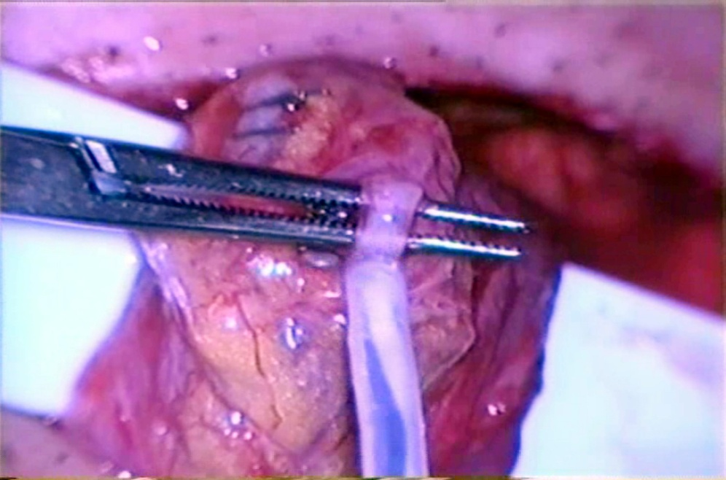
In an Ideal Varicocelectomy
All internal and external spermatic veins should be ligated.
Internal spermatic artery and deferential artery should be preserved
Lymphatics and ductus deferens should be preserved

Slide 22
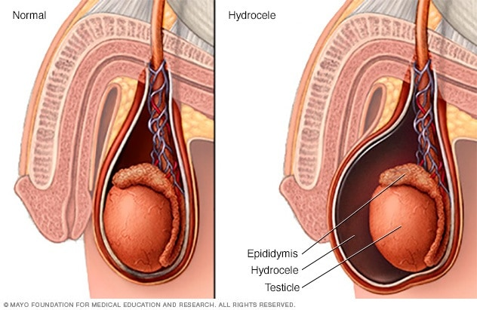
Hydrocele
It is the presence of more than normal fluid between the parietal and visceral leaves of the tunica vaginalis.
Normally there is 1-3 cc of fluid. This ensures the mobility of the testicles and takes part in thermoregulation.
It occurs when the balance between secretion and resorption is disturbed.
The liquid is yellow in color and clear.

Slide 23
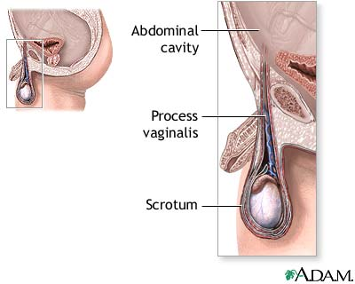
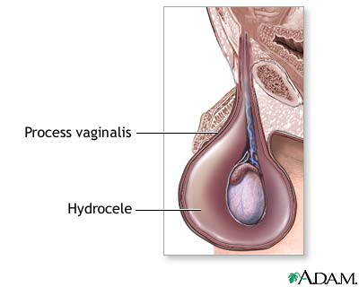

Slide 24
Hydrocele

Slide 25
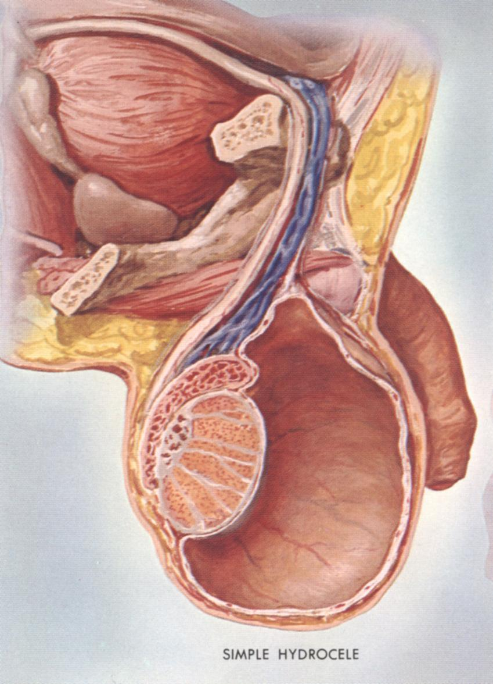
Hydrocele Types
Associated with the peritoneal cavity (pediatric) (Communicating)
Limited to testis and/or funiculus spermaticus only (adult) (Non-communicating)

Slide 26
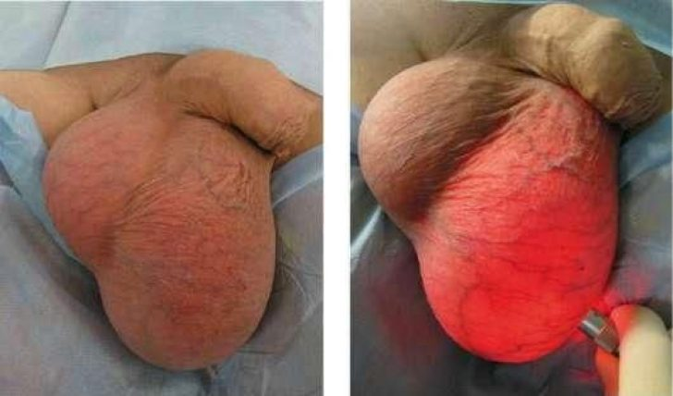
Etiology
Incomplete closure of the internal inguinal ring
Idiopathic
Tumor
Infection
Trauma
Surgical

Slide 27
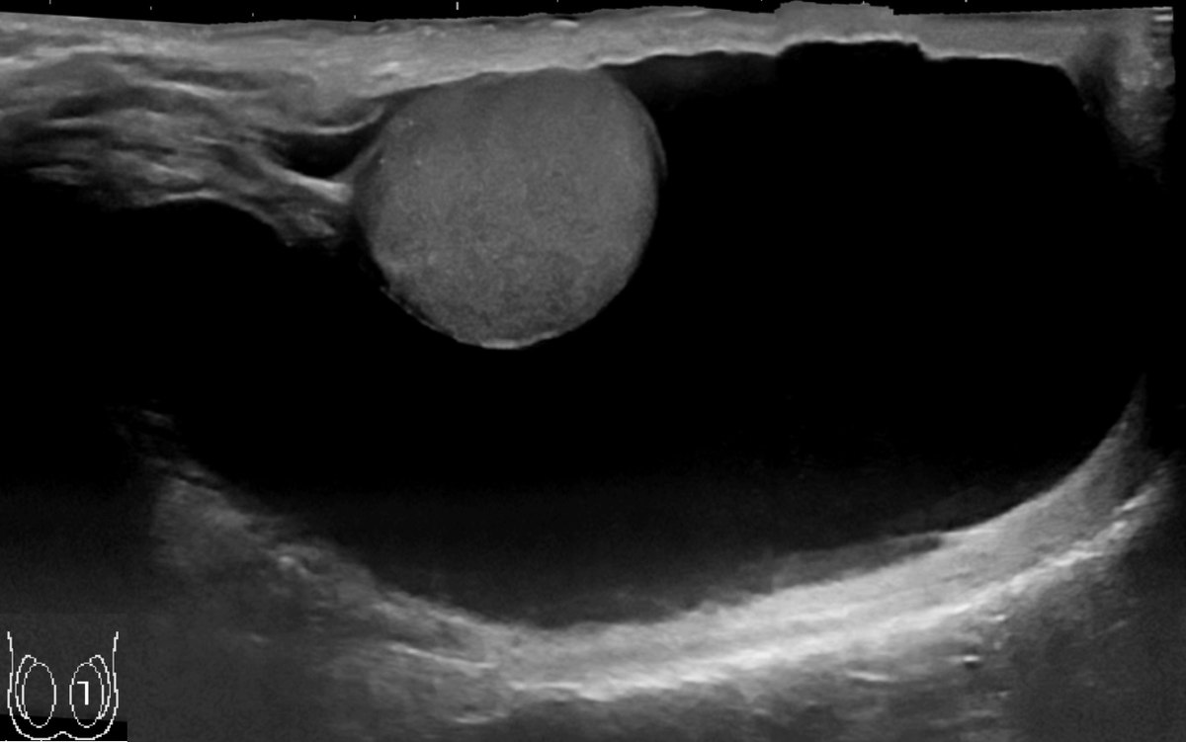
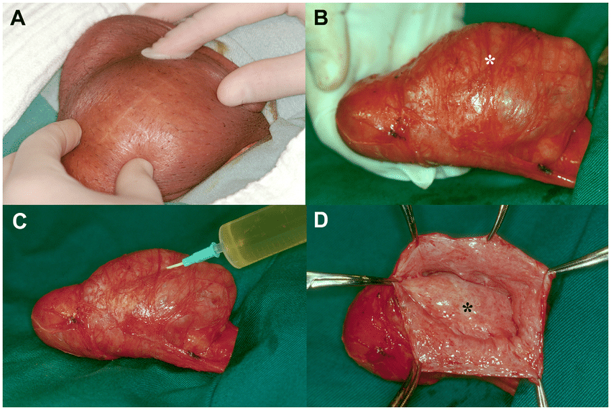
Hydrocele
Symptoms and signs;
Painless swelling in the scrotum
Hyperemia and edema may also be seen in acute hydrocele.
Symptoms are minimal in chronic hydrocele
If infection is added, hematocele and pyocele may develop.

Slide 28
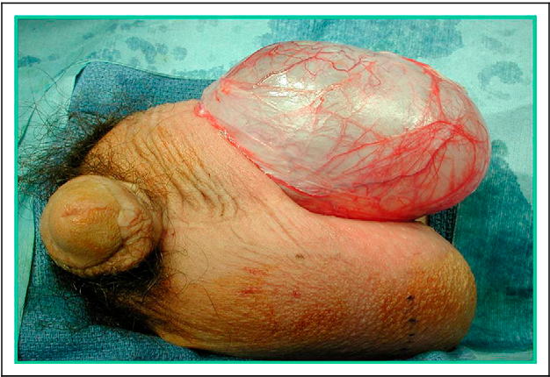
Treatment Indications
Pediatric
Presence of hernia
Idiopathic hydrocele in adults
Pain
Size that restricts daily activity
Cosmetic

Slide 29
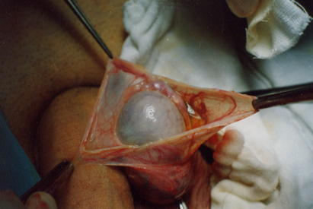
Hydrocele Treatment

Slide 30
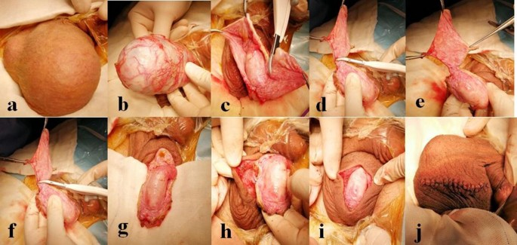

Slide 31
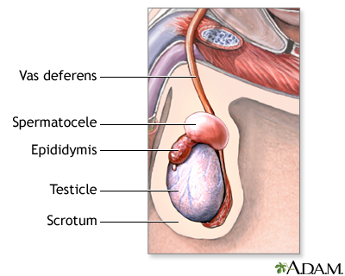
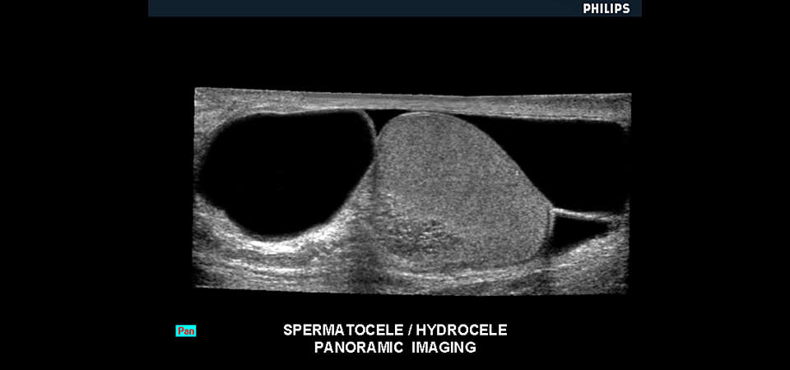
Spermatocele
Benign dilatation of the efferent ductules in the rete testis or head of the epididymis
Usually idiopathic but cystic dilation from outflow obstruction may play a role
Diagnose by ultrasound demonstrating a well defined simple cyst

Slide 32
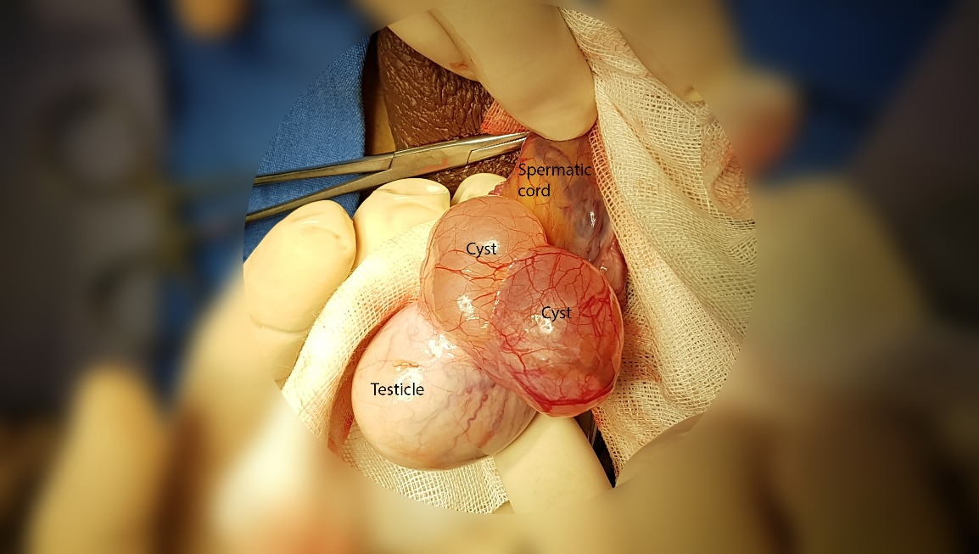
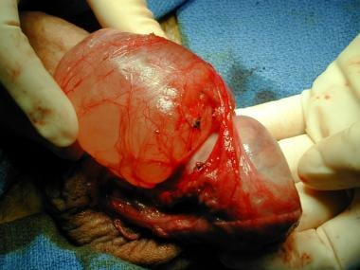
Spermatocele
Clinical features;
Painless bulging mass separate from testicle

Slide 33
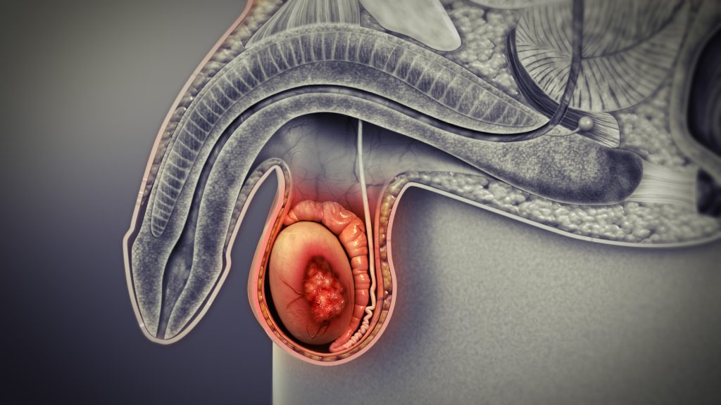
Acute Scrotum
Acute scrotum pain is an umbrella term that includes a wide variety of unique disease processes.
Patients may describe the rapid onset of symptoms within minutes or may describe the development of symptoms over one or two days, depending on the etiology.
Rapid evaluation and treatment are necessary due to the time dependency of certain morbid but reversible conditions, such as acute testicular torsion.

Slide 34
Acute Scrotum
Symptoms;
Swelling
Urethral discharge
Erythema
Rash
Skin color changes
Associated symptoms;
Fevers
Dysuria
Frequency
Urgency
Hematospermia
Abdominal pain
Back pain

Slide 35
Acute Scrotum
Physical examination;
Rashes
Ulcers
Abnormal scrotal asymmetry
Subcutaneous emphysema
Intratesticular masses
Hernias
Cremasteric reflex
Prehn's sign
Blue dot sign

Slide 36
Acute Scrotum
Evaluation
blood counts
urinalysis with microscopy
urine culture
urethral swabs for gonorrhea and chlamydia

Slide 37
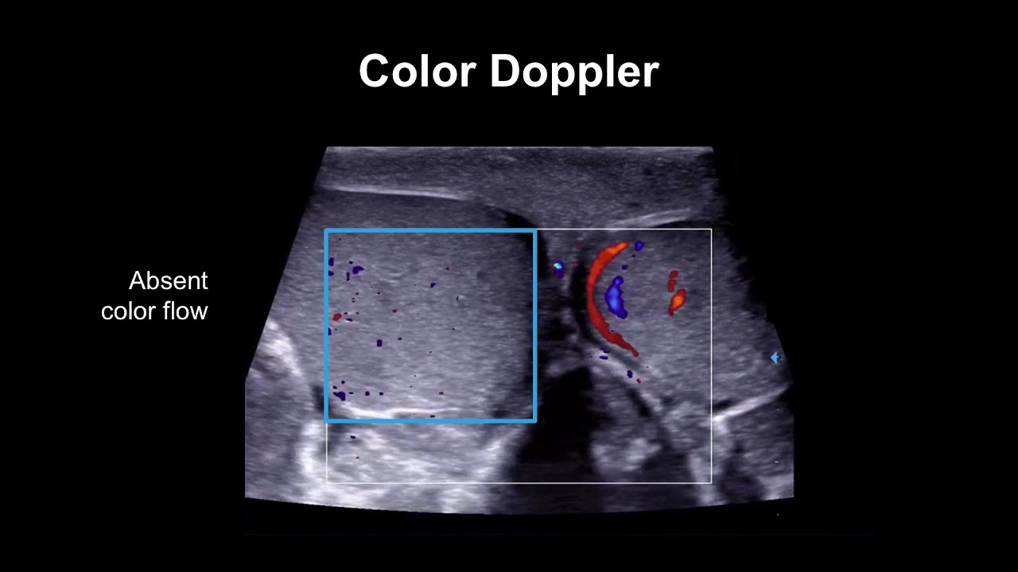
Acute Scrotum
Doppler ultrasonography;
This is the most appropriate imaging modality for evaluation of the acute scrotum when it does not delay definitive surgical consultation in cases of presumed torsion.

Slide 38
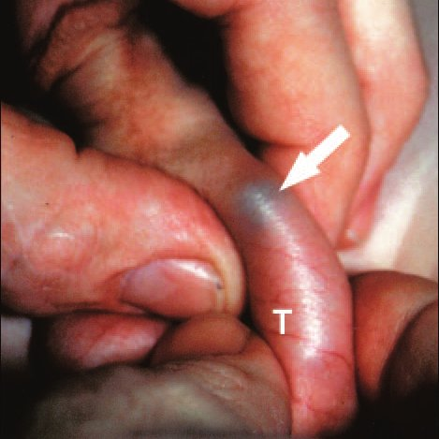
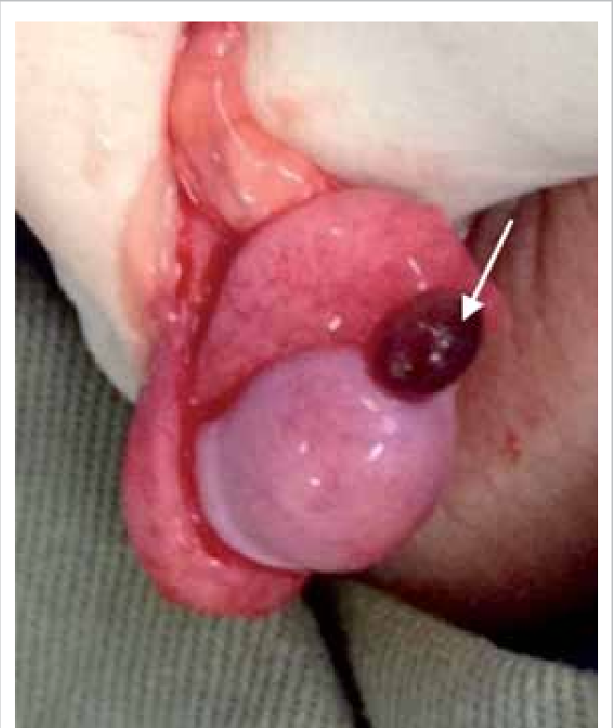
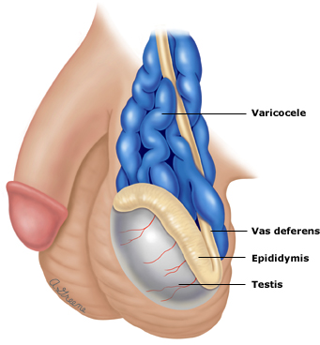
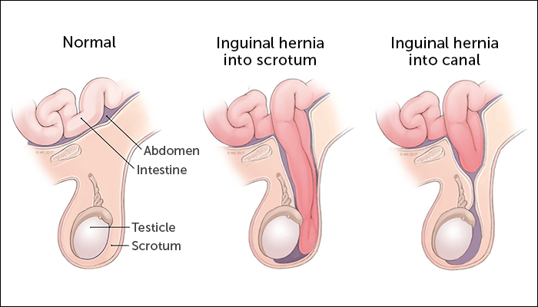
Acute Scrotum
Etiology
Ischemic/traumatic
Torsion of testes
Torsion of testicular appendages (blue dot sign)
Testicular hematoma
Thrombosed varicocele
Inguinoscrotal hernia

Slide 39
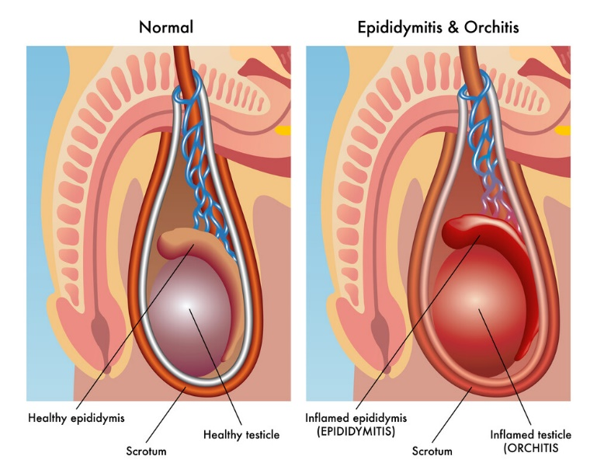
Acute Scrotum
Etiology
Infective/inflammatory
Epididymitis
Epididymo-orchitis
Neuropathic/referred pain
Mid urethral stone
Inguinal hernias (obstructed/strangulated)
Aortic/common iliac artery aneurysm
Nerve entrapment
Diabetic neuropathy (chronic presentation is more common)

Slide 40
Acute Scrotum
EAU Guidelines 2022

Slide 41
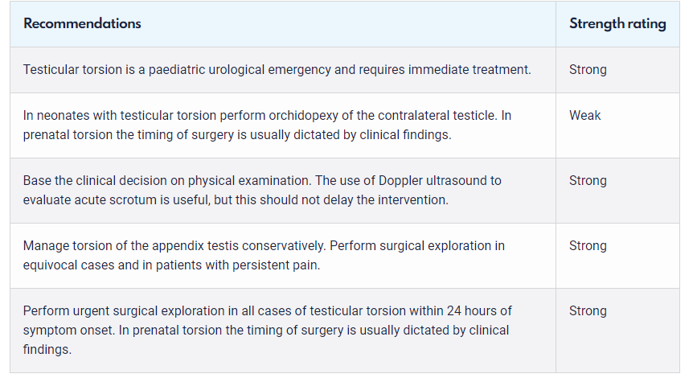
Acute Scrotum
EAU Guidelines 2022

Slide 42
Acute Scrotum

Slide 43
Testicular Torsion
Testicular torsion occurs when the spermatic cord gets twisted and cuts off blood supply to the testicle.
It is a medical emergency that requires immediate treatment in order to save the testicle.
Although surgery doesn’t guarantee that the testicle will be saved, not having treatment within six hours almost always results in permanent damage that requires testicle removal.

Slide 44
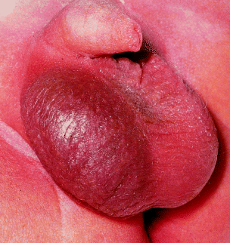
Testicular Torsion
Symptoms of testicular torsion;
sudden onset of severe pain in the testicle
Swelling and tenderness of the testicles and scrotum
Fever
Nausea and vomiting

Slide 45
Testicular Torsion
Physical Examination;
Erythema and edema in the scrotum
Presence of testis in upper localization
Pain increase with elevation (Prehn's sign)

Slide 47
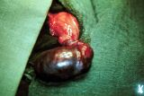
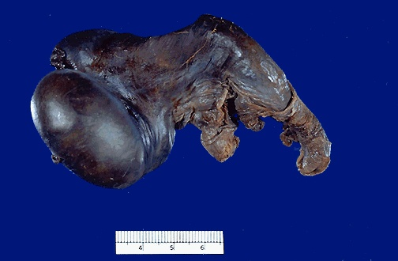
Testicular Torsion

Slide 48
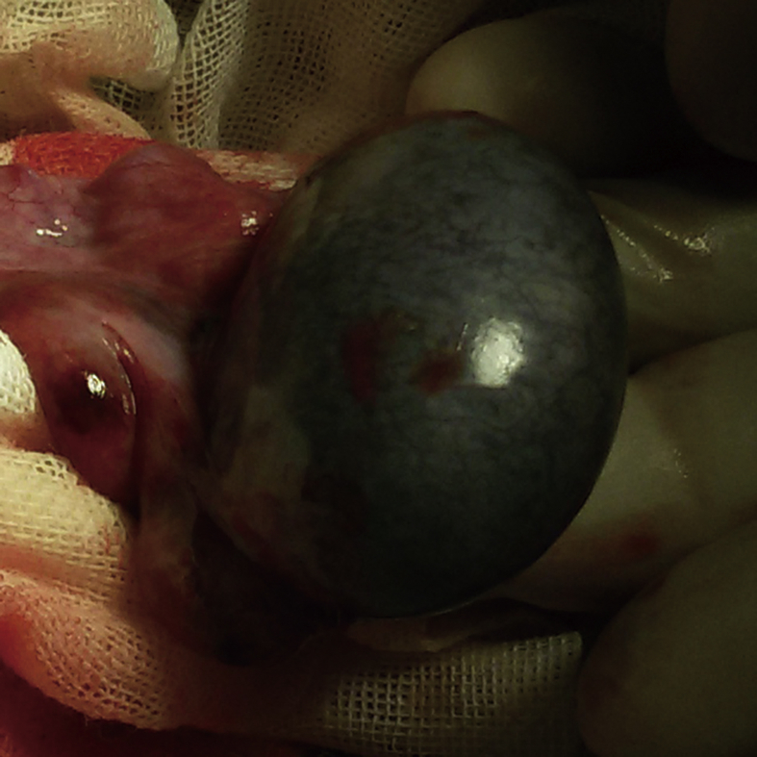
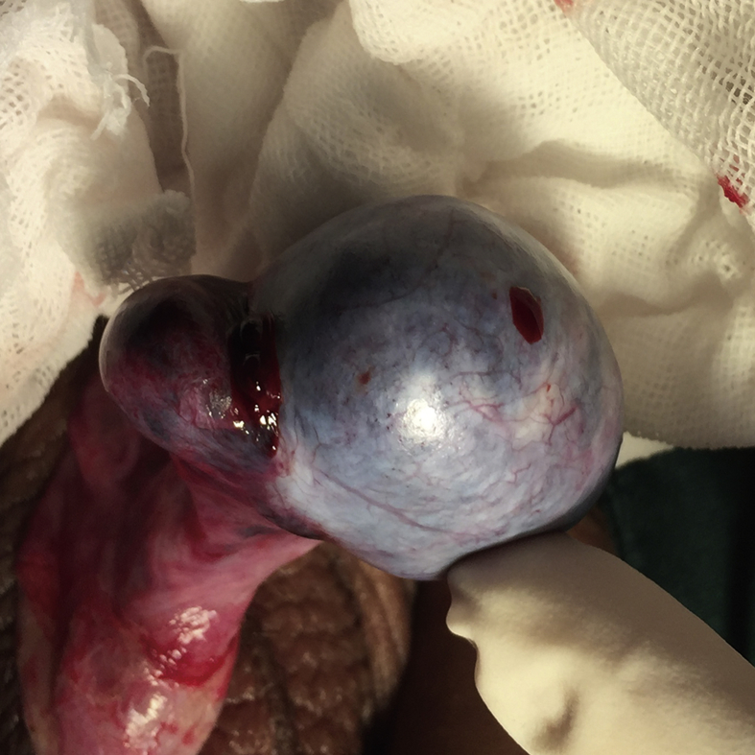
Testicular Torsion
Delayed testicular torsion
This testis necrotized because the ischemia time was too long (more than 6 h).
Early intervention testicular torsion
This testis remained vital after detorsion.

Slide 49
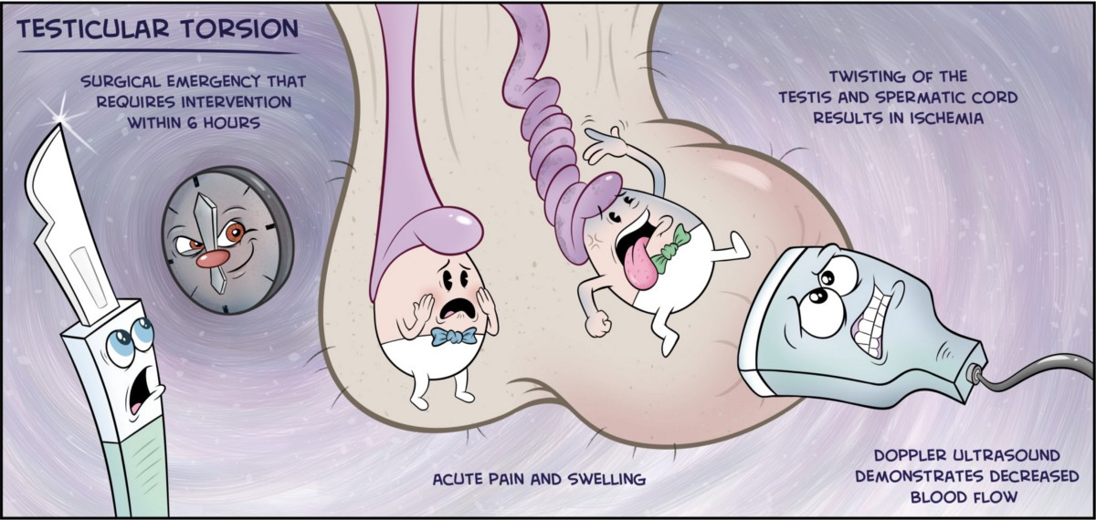
Testicular Torsion
Imaging
Doppler Ultrasound

Slide 50
Testicular Torsion
Differential diagnosis
Acute Epididymo-orchitis
Trauma
Inguinal hernia

