Slide 1
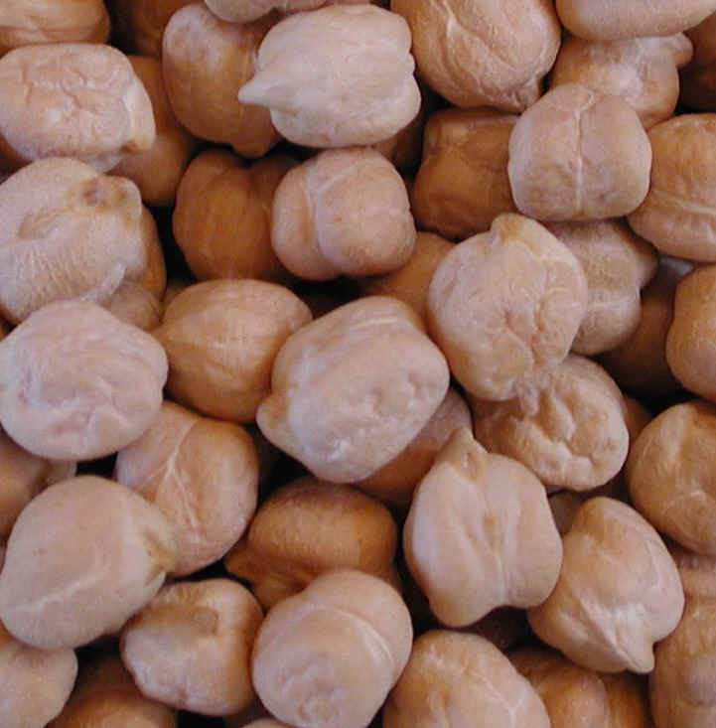
Main insect pests of stored grain, pulses & products
Tribolium confusum (Confused flour beetle)
Tribolium castaneum (Red flour beetle)
Sitophilus granarius (Granary weevil)
Sitophilus oryzae (Rice weevil)
Sitophilus zeamais (Maize weevil)
Rhyzopertha dominica (Lesser grain borer)
Prostephanus truncatus (Larger grain borer)
Lasioderma serricorne (F.), (Cigarette beetle)
Stegobium paniceum (L.), (Drugstore beetle)
Callosobruchus maculatus (Cowpea weevil)
Callosobruchus chinensis (Adzuki bean weevil, pulse beetle)
Acanthoscelides obtectus (Bean weevil)
Cryptolestes spp. (Flat grain beetles)
Trogoderma granarium (Khapra beetle)
Oryzaephilus surinamensis (Sawtoothed grain beetle)
Ephestia kuehniella (Mediterranean flour moth)
Plodia interpunctella (Dried fruit moth)
Sitotroga cerealella (Grain moth)

Slide 2
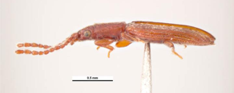
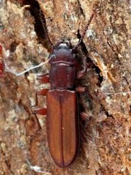
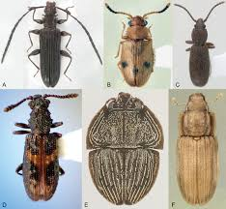
Cucujiidae «flat bark beetles»
(Coleoptera)
Adults are:
  Characteristically flattened and
  Generally about 1.5−2 mm long
  The antennae are usually long, often half or more of the body length.

Slide 3
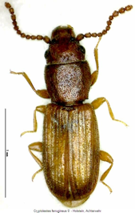
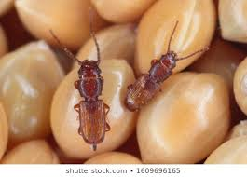
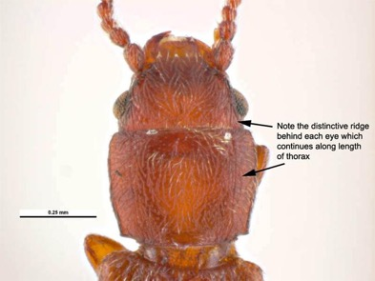
Cryptolestes spp
Members of the genus Cryptolestes are common secondary pests of cereals and cereal products.
Adults are small (1.5−2 mm long), oblong, flattened, light-brown beetles.
The head and prothorax are comparatively large and account for nearly half of the body length.
A ridge or carina runs from behind each eye and then in parallel down each side of the pronotum

Slide 4
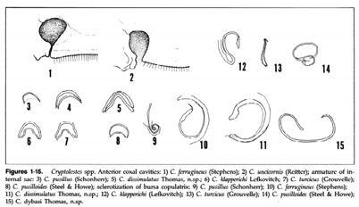
Cryptolestes spp
Eight species of the genus Cryptolestes are known to infest stored products.
All are externally very similar and microscopic examination of genitalia of cleared mounted specimens is the most reliable means to identify species.
Banks (1979) describes how this may be done for the six most common species.
All species can be identified by the keys of Halstead (1993).
Banks, H.J. 1979. Identification of stored product Cryptolestes spp. (Coleoptera:Cucujidae): A rapid technique for preparation of suitable mounts. J. Australian Ent. Soc. 18:217-222.

Slide 5
Cryptolestes spp.
Four species of Cryptolestes are important stored products pests of nearly worldwide distribution:
  Cryptolestes ferrugineus (Stephens)
  Cryptolestes turcicus (Grouvelle)
  Cryptolestes pusillus (Schonherr), and
  Cryptolestes pusilloides (Steel and Howe)
Three others are also known from stored products but are of more limited distribution.
  Cryptolestes capensis (Waltl) occurs in Mediterranean bordering countries
  Cryptolestes ugandae Steel and Howe is restricted to Central Africa, and
  Cryptolestes klapperichi Lefkovitch occurs in Asia and America
http://coleonet.de/coleo/texte/cryptolestes.htm

Slide 6
Cryptolestes spp.
Cryptolestes ferrugineus, has developed a strong resistance to phosphine at a number of sites in eastern Australia. Correct identification of this pest will facilitate appropriate management practices.

Slide 7

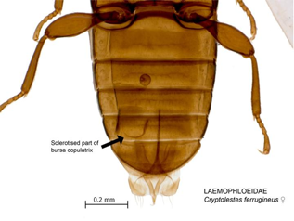
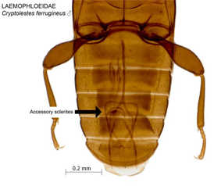
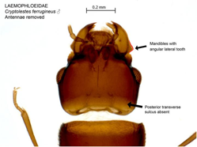
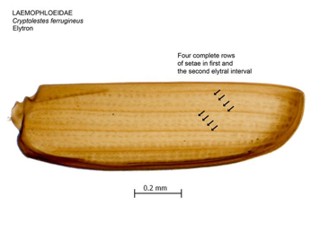
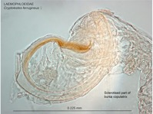
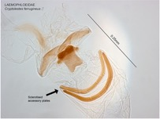
C. ferrugineus

Slide 8
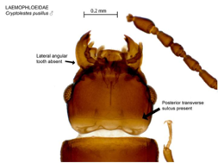
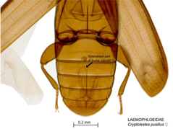
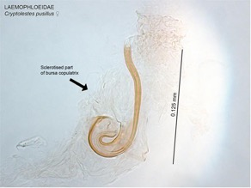
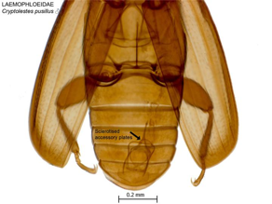
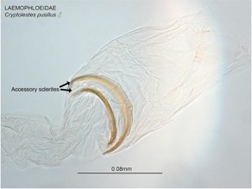
C. pusillus

Slide 9
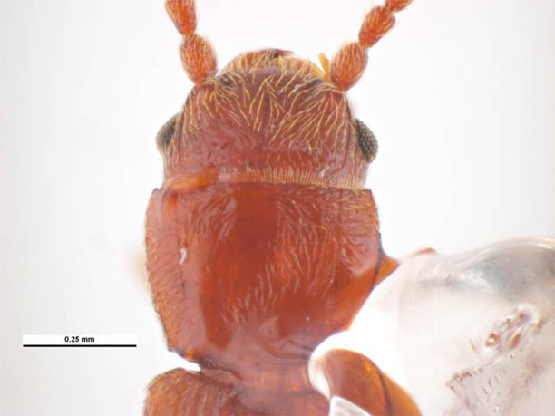
C. pusilloides

Slide 10
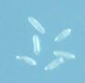

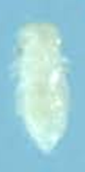
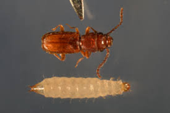
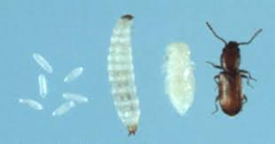
Life History and Behavior
Eggs (up to about 200 per female) are laid among the commodity.
After four instars the campodeiform larva pupates in a silk cocoon.
The life cycle of C. ferrugineus takes 103 to 17 days at temperatures from 21−38°C, 75% RH.
Optimal conditions are 33°C, 70% RH, when thelife cycle is completed in 23 days. C. ferrugineus can survive exposure to winter conditions in temperate climates. However, C. pusillus is less capable of surviving conditions of low temperature and humidity and C. pusilloides is particularly sensitive to low humidities.
Cryptolestes species are some of the most common secondary pests ofcereals, cereal products, and a variety of other materials in both temperate and tropical regions.
They can attack grains that have only very slight imperfections. Being highly flattened they are able to enter very small cracks and crevices in grains and enter otherwise wellpackaged processed food.

Slide 11
Distribution
C. ferrugineus is the most widely distributed species, being cosmopolitan. It is a common pest in all temperate regions.
C. pusillus is also cosmopolitan but is most abundant under warm, humid conditions, such as, for example, in Southeast Asia.
C. pusilloides has been recorded from tropical and subtropical regions of the southern hemisphere.
C. turcicus (Grouvelle) has been found in most temperate areas of the world, especially under humid conditions, but apparently not from Australasia.
C. capensis (Waltl) occurs in Europe and North Africa and is probably established in southern Africa.
C. ugandae Steel & Howe appears restricted to tropical Africa.
C. klapperichi is a little-known species initially described in Afghanistan but also found in South and Southeast Asia.
C. cornutus Thomas & Zimmerman is a recently described species intercepted in California on an import of dried chili peppers from Thailand.

Slide 12
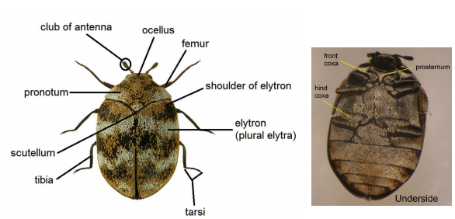
Dermestiadae Family
(skin beetles, larder beetle, hide or leather beetles, carpet beetles, khapra beetles)
Pest species are known from a wide range of commodities, including dried fish, skins, woollen articles, museum specimens, and cereal grains.
Members of the Dermestidae can be identified using the keys provided by Banks (1994), Haines (1991), Kingsolver (1987b), and Peacock (1993).

Slide 13
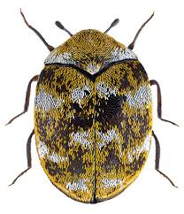
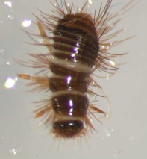

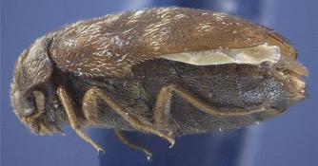
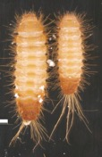
General features
They can range in size from 1 to 12 mm.
Key characteristics for adults are round oval shaped bodies usually covered with hairs or colored scales.
When the latter are present, as in Anthrenus spp, they give a colorful patterned appearance.
Dermestid adults (except Dermestes and Thorictodes species) have a simple third eye (median ocellus) between the two compound eyes.
The (usually) clubbed antennae fit into deep grooves.
The hind femora also fit into recesses of the coxa.
Larvae are scarabaeiform and also have setae. Setae can become detached from both cast skins and live larvae and can be highly irritant on the skin or when ingested or inhaled.
Anthrenus verbasci
Anthrenus sp. larva
Dermestes sp.
antenna
Trogoderma sp, adult & larvae

Slide 14
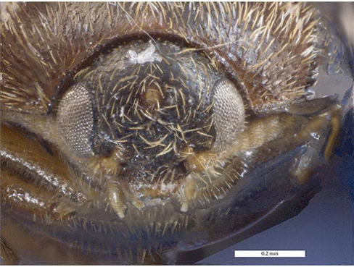
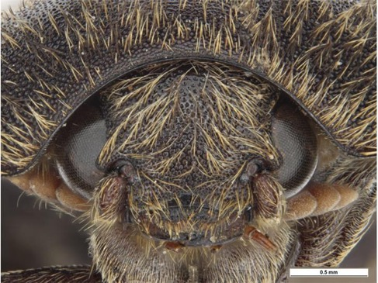
Trogoderma sp, with median ocellus
(head front)
Dermestes sp, without a median ocellus
(head front)

Slide 15
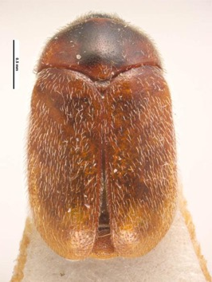
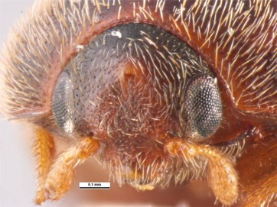
Trogoderma Species
2−5 mm long, oval, hairy, reddishbrown to black beetles
The elytra are either one color or have a weak pattern.
Adults have a median ocellus and can be differentiated from the otherwise similar Anthrenus species by not being covered with colored scales.

Slide 16
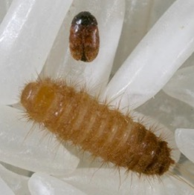
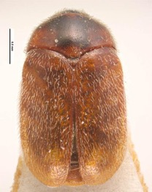

Trogoderma granarium Everts, (khapra beetle)
Adult T. granarium are oval, reddishbrown hairy beetles 2−3 mm long, females being somewhat larger than the males. Adults rarely, if ever, feed or drink and, although possessing flight wings, are not known to fly.
The larvae are very hairy and grow to about 5 mm,
Larval development does not occur at temperatures below 21°C, but can occur at humidities as low as 2%. However, development is most rapid in hot humid conditions, taking 18 days at 35ºC, 73% RH. These optimal conditions do not correspond with its known distribution, because it is mainly confined to hot dry areas, since under moister conditions, T. granarium appears not to compete well against other, faster breeding,species such as Sitophilus spp or R. dominica.
Some larvae can undergo a form of suspended animation or facultative diapause for months or even years, usually in response to adverse conditions, during which metabolism falls to a very low level, making them highly tolerant to fumigants and insecticides.

Slide 17
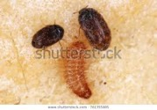
Khapra beetle

Slide 18
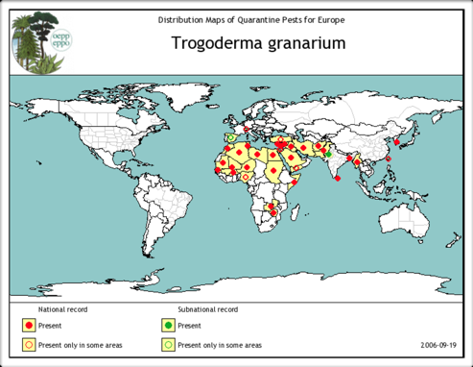
T. granarium: hosts & distribution
T. granarium is an important pest of cereals and oilseeds but will also attack pulses.
It is most serious as a pest in hot dry regions, in particular in areas inside a broad band stretching from the Sahel in western Africa to northern regions of the Indian subcontinent.
It has also been found in certain specialized warm, dry habitats in temperate regions, for example,in maltings in Britain.
T. granarium appears not to be established in the Americas, Australia, and parts of Southeast Asia.
It is the subject of strict quarantine regulations to prevent its entry to a number of countries, for example, the United States and Australia.
Its distribution, current and potential, is reviewed by Banks (1977).

Slide 19
Other Trogoderma Species.-
A number of other Trogoderma species have been found in association with stored products, but none has the pest status of T. granarium.
The presence of these species often creates interest because of their similarity in appearance to T. granarium.
Species that commonly occur in stores can mostly be identified by examination of a number of characteristics including mouthparts, antennae, antennal cavity, elytral pattern, and genitalia (Banks 1994; Beal 1954, 1956; Kingsolver 1987b).
Keys for larvae also exist (Banks 1994; Beal 1960; Spangler 1961; Kingsolver 1987b).

Slide 20
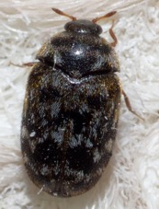
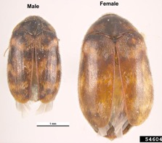
Other Trogoderma species
Trogoderma glabrum (Herbst) (glabrous cabinet beetle or colored cabinet beetle) is known from Europe and North America. It can breed on cereal and cereal products alone and heavy infestations have been reported in stored wheat and maize in the United States.
Trogoderma variabile Ballion (the warehouse beetle) has been reported on cereal grains and pulses in many parts of the United States. It is also established in Australia.
Other species from stores include Trogoderma inclusum LeConte (larger cabinet beetle) and Trogoderma sternale Jayne.
Trogoderma glabrum
Trogoderma variabile

Slide 21
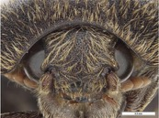
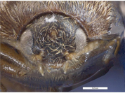
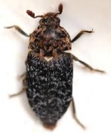
Dermestes spp.
Dermestes species are elongate oval beetles, 6−10 mm long.
Adults do not have a median ocellus.
The upper surface of the adult is black or dark brown, covered with black, grey, brown, or yellowish hairs
The underside is covered with either black and white or brown and golden hairs.
Dermestes species can be identified using the keys referred to under Trogoderma, or that of Haines and Rees (1989) and Peacock (1993).
Dermestes sp, without median ocellus
(head front)
Trogoderma sp, with median ocellus
(head front)

Slide 22
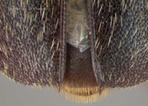
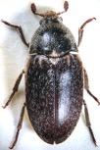
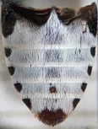



Dermestes maculatus Degeer (Hide beetle) and D. frischi Kugelann
These species can be differentiated from other Dermestes spp by the white underside of the abdomen with black spots at the sides and tip.
D. maculatus has a spine at the end of each elytron, which is absent in D. frischi.
Both species are important cosmopolitan pests of animal products, especially of hides and dried fish in both tropical and temperate regions. They have also been found in animal accommodation, for example, chicken houses.
Dried fish of freshwater origin is most frequently attacked by D. maculatus and salt-water fish by D. frischi. The latter species appears more tolerant of the higher salt content.
D. maculatus.- dorsal, ventral and larva
Distal end of the elytra of Dermestes maculatus. adult Each elytra ending in a point. Photograph by Lyle J. Buss and Brianna Shaver, Univ. of Florida.
D. Frischi, dorsal, ventral

Slide 23

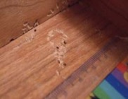
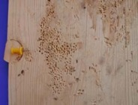
Dermestes maculatus Degeer and D. frischii Kugelann; Biology
About 100−150 eggs are laid by a female over 2 months.
Egg laying is increased if the female has water to drink.
The larvae burrow into the foodstuff as they feed, passing through five or more instars, the number of which increases as conditions become more unfavorable.
Before pupation, larvae burrow into a solid material to make a pupal cell. This may be the infested commodity, another material stored nearby, or the wood of a drying rack or storage structure. Such tunnelling may, over time, so weaken drying racks as to necessitate their replacement.
Complete development takes place in about 5−7 weeks under optimal conditions of 30−35°C, 75% RH. Adults are strong fliers and can quickly find new sources of food.

Slide 24
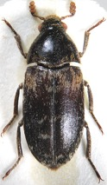
Other Dermestes spp
The third most widespread species attacking dried fish in tropical climates is Dermestes ater Degeer (black larder beetle). It is also an important pest of copra, as is D. maculatus.
D. carnivorus F. is an important pest of dried fish in South and Southeast Asia and is also known from Europe and the Americas.
D. lardarius L. (larder beetle) is a cosmopolitan pest of a wide range of animal products. It is also a scavenger, feeding on the remains of dead insects and other animals, but can breed on cereal products such as wheat germ. It is often an inhabitant of domestic premises in temperate countries. The elytra in this species are distinctive: the basal half of each elytron has a large area of pale brown-grey hairs that is absent in other species.
Two other species, D. haemorrhoidalis Kuster and D. peruvianus Laporte de Castelnau, believed to be of South American origin, have spread to North America and Europe. In the United Kingdom, for example, both species have become domestic pests.
D. ater
D. carnivorus
D. lardarius
D. haemorrhoidalis
D. peruvianus

Slide 25
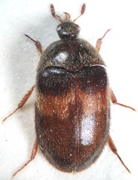
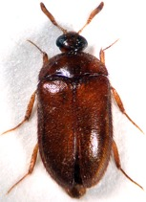
Attagenus spp.
A number of species of Attagenus (2−5 mm long) are common and destructive domestic pests in temperate regions, feeding on wool, fur, skins, and other materials (Fig. 7c).
They also occur in stores, usually as scavengers feeding on dead insects.
Species include A. unicolor (Brahm) (black carpet beetle), A. fasciatus (Thunberg) banded black carpet beetle), A. cyphonoides Wrestler, and A. beali (L.).
Attagenus species can be identified using keys provided by Beal (1970) and Peacock (1979 and 1993).
A. unicolor
A. fasciatus
A. cyphonoides
A. beali

Slide 26




Anthrenus spp.
Anthrenus species are small (1.5 to 4 mm) oval to round beetles easily recognized by their dorsal surfaces covered with colorful scales arranged in distinct patterns (Fig. 7d).
Many are widely distributed or cosmopolitan and are well known as domestic pests and are often encountered in stores.
Species include A. verbasci (L.) (varied carpet beetle), A. flavipes LeConte (furniture carpet beetle), A. coloratus Wrestler (Asian carpet beetle), and A. museorum (L.) (museum beetle).
Many species can be identified using the keys of Hinton (1945a) and Peacock (1993).
The larvae are common household pests on wool and are a serious problem in museums housing dried biological specimens. They are also common inhabitants of bird nests. The adults feed on the nectar and pollen from flowers.
A. verbasci
A. flavipes
A. coloratus
A. museorum

