Slide 1
Androlojik Muayene Sistematiği
5. Libido / Mounting Behaviours
Fast and intense interest in the mare
Exciting movements
Mapping
Neighing
Sniffing, biting, hitting the mare
Sniffing the mare's genital area/urine
Flehmen
Erection
30 – 60 seconds

Slide 2
Androlojik Muayene Sistematiği
5. Libido / Mounting Behaviours
Erection
Mounting without hesitation
Intromission
Friction
Ejaculation
Leaving
25 – 35 seconds

Slide 3
Androlojik Muayene Sistematiği
Libido and Mounting Behaviours
Mounting number untill an exact ejaculation
Total time duration from recognize the mare to ejaculation
Complete and sequential execution of mounting behaviors
Time duration from mounting to ejaculation
Conform with the artificial vagina
Libido ve Mounting Behaviours
Totally <1 min.
Evaluation; scoring in a 1-5 scale
(-1) score for each missing point

Slide 4
Androlojik Muayene Sistematiği
6. Spermanın Muayenesi
Hacim 60 (30 - 300) ml
Renk Düşük yoğunluk: Gri
Yüksek yoğunluk: Krem
Kıvam Düşük yoğunluk: Sulu
Yüksek yoğunluk: Koyu
pH 7.2-7.7
Spermanın Ön Muayenesi
Hacim
Renk
Kıvam
pH

Slide 5
Breeding Soundness Examination
6. Semen Evaluation
Microscopical (Advanced) Evaluation
Concentration
Motility / Progressive Motility
Morphology
Viability
Plasma Membrane Integrity
DNA Integrity
Capasitation
Akrosome Integrity
Oxidation
…
Conc. 4-12 x 10⁹
Motility >%60
Normal >%40
Head abnormality <%30
Cytoplasmic droplet <%25
9 x 10⁹ spz/ejaculate (200-300 x 10⁶ spz/ml)

Slide 6
Androlojik Muayene Sistematiği
Motility = Movement
Progressive Motility = Straight line, forward, strong movement

Slide 7
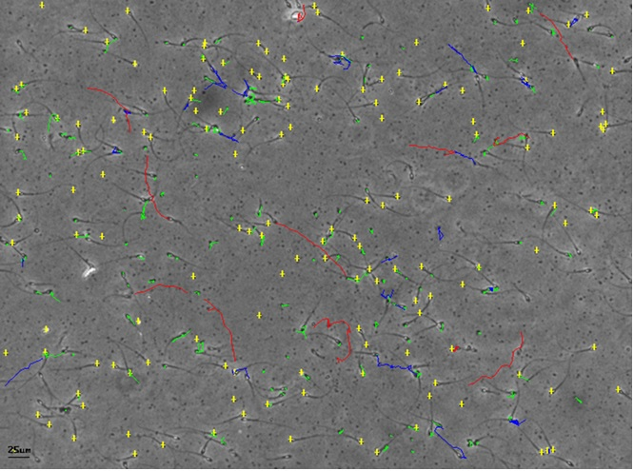
Androlojik Muayene Sistematiği
Motility = Movement
Progressive Motility = Straight line, forward, strong movement

Slide 8
Androlojik Muayene Sistematiği
Morphology
Normal
Head defects
Mid Piece Abnormalities
Tangled Tails
Acrosomal Abnormalities
*
Detached head, midpiece and tails
Tail Abnormalities
Cytoplasmic Droplet
?

