Slide 1
ANGLOPHONE LITERATURE

Slide 2
Outline of the Course
Information about Canada
Margaret Atwood
“The Little Red Hen” (Original Story)
Rewriting of “The Little Red Hen”: “The Little Red Hen Tells All”
Differences Between the Two Stories
Critique of the Capitalist Ideology
Reflections of Feminist Discourse

Slide 3
Canada is a country in the northern part of North America. Its ten provinces and three territories extend from the Atlantic to the Pacific and nortward into the Arctic Ocean.

Slide 4
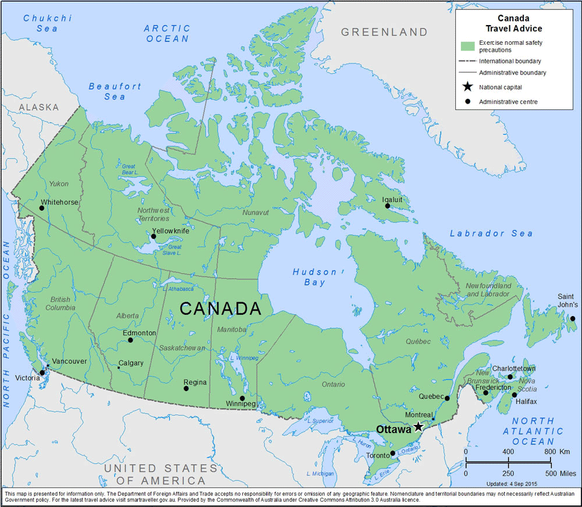

Slide 5
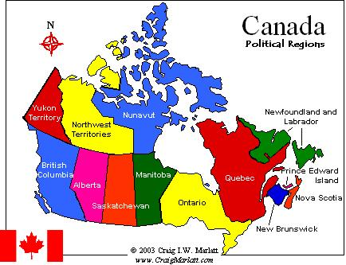

Slide 6
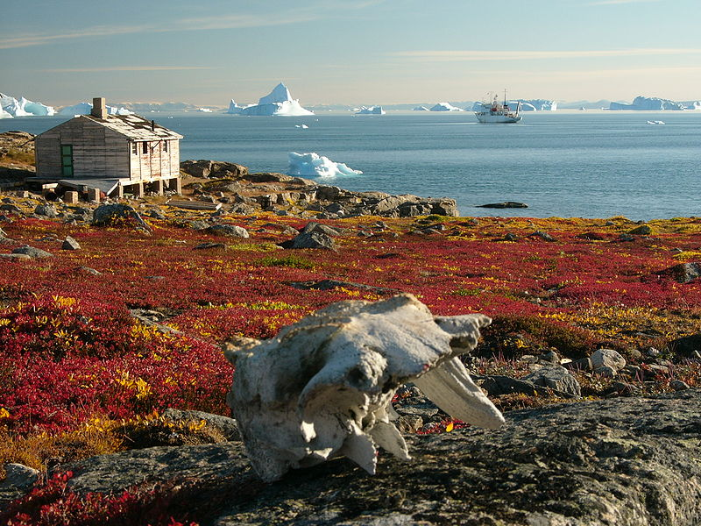
The majority of its
land territory is
dominated by
forest and tundra and
The Rocky Mountains.
Canada has been
inhabited for milennia
by various Aboriginal
peoples.

Slide 7
Valley of the Ten Peaks and Moraine Lake, Banff National Park, Canada. Mountains from left to right: Tonsa (3057 m), Mount Perren (3051 m), Mount Allen (3310 m), Mount Tuzo (3246 m), Deltaform Mountain (3424 m), Neptuak Mountain (3233 m)

Slide 9
Beginning in the 15th century, British and French colonies were established on the Atlantic coast.
The first establishment of a region called Canada occured in 1537.
As a consequence of various conflicts, the United Kingdom gained and lost territories within British North America.

Slide 10
Following the British North America Act (July 1 1867), the colonies of Canada, New Brunswick and Nova Scotia joined to form the federal dominion of Canada.

Slide 11
The Constitution Act, 1867 (originally enacted as The British North America Act, 1867, and referred to as the BNA Act), is a major part of Canada's Constitution. The Act created a federal dominion and defines much of the operation of the Government of Canada, including its federal structure, the House of Commons, the Senate, the justice system, and the taxation system.

Slide 12
In 1931, Canada achieved a near total independence from the United Kingdom with the Statute of Westminster 1931.
Passed on 11 December 1931, by the Statute of Westminster, the British dominions, including Canada, were formally declared to be partner nations with Britain, “equal in status, in no way subordinate to each other,” and bound together only by allegiance to a common Crown.

Slide 13
Full sovereignty was attained when the Canada Act 1982 removed the last remaining ties of legal dependence on the British parliament.
Canada is a federal parliamentary democracy and a constitutional maonarchy, with Queen Elizabeth being the head of the state.
The country is officially bilingual (French& English)

Slide 14
MARGARET ATWOOD
Known as one of Canada’s finest living writers, Margaret Atwood is a poet, novelist, story writer, essayist, and environmental activist.

Slide 15
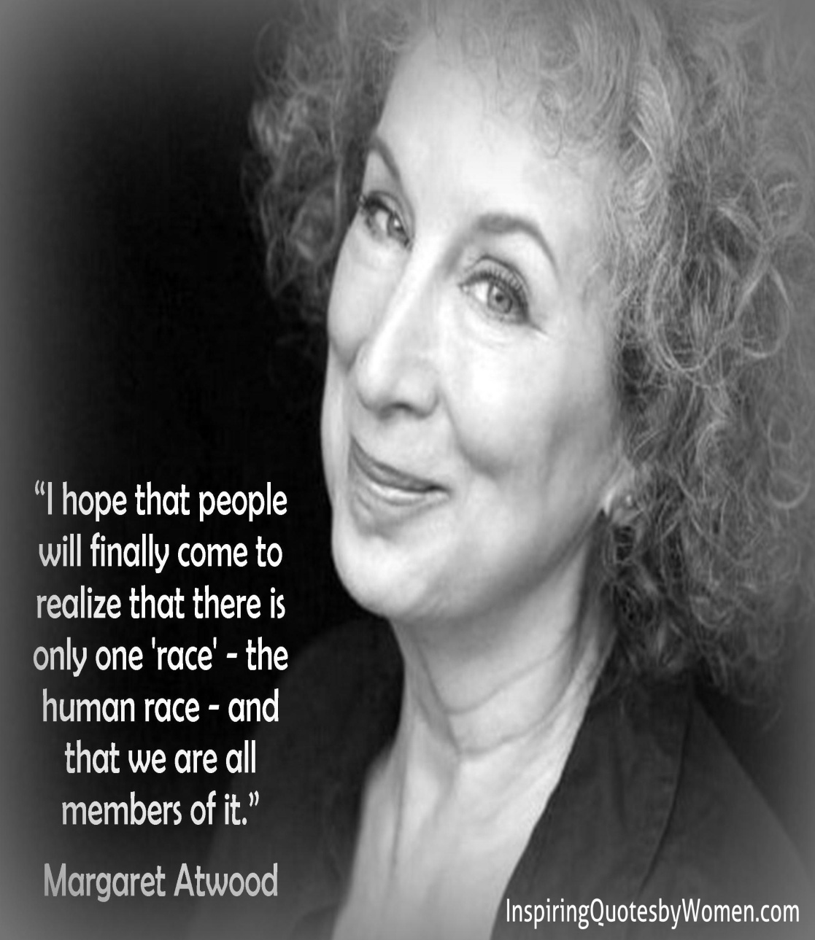
Margaret Eleanor
Atwood was born on
November 18, in
Ottowa, Canada.
She studied at the
University of Toronto
and Radcliffe College,
becoming a lecturer
in English literature.

Slide 16
Her books have received critical acclaim in the United States, Europe, and her native Canada, and she has received numerous literary awards, including the Booker Prize, the Arthur C. Clarke Award, and the Governor General’s Award, twice.
Atwood first came to public attention as a poet in the 1960s with her collections Double Persephone (1961), winner of the E.J. Pratt Medal, and The Circle Game (1964), winner of a Governor General’s award.

Slide 17
Atwood’s poems concern “modern woman’s anguish at finding herself isolated and exploited by the imposition of a sex role power structure.”
Atwood’s interest in women and female experience also emerges clearly in her novels, particularly in The Edible Woman (1969),Surfacing (1972),Life before Man (1979),Bodily Harm (1981), and The Handmaid’s Tale (1985). Even her later novels The Robber Bride (1993) and Alias Grace (1996) deal with female characters defined by their intelligence and complexity.

Slide 18
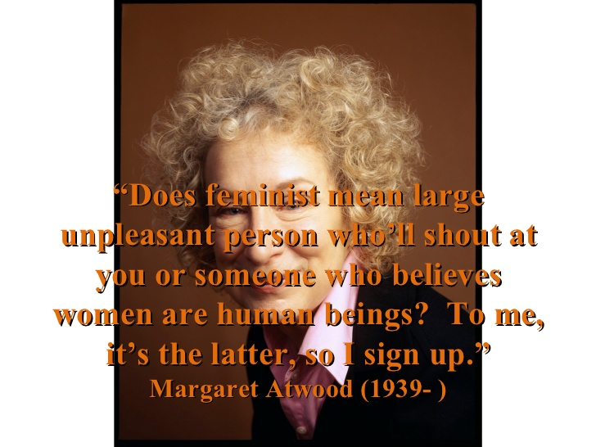
Margaret Atwood is
considered to be the
best-known feminist
writer since she deals
with the suffering of
women in her poems,
novels and short
stories.

Slide 19
Women’s suffering is common in her short stories like “The Bluebeard’s Egg” (1983), “The Little Red Hen Tells All” (1994).
“The Little Red Hen Tells All” is based on a popular tale known by many children and adults in English speaking world.

Slide 20
QUESTIONS… QUESTONS…
What’s the moral message of the story?
What’s allegory?
Who’s the narrator?
Why is the protagonist or the narrator a hen?
What do you think about the attitude of the hen at the end of the story?

Slide 21
This popular tale is told to teach lesson about the benefits of hard work and individuality, the importance of taking responsibility in the society and the consequences of laziness.
An allegory is a complete narrative which involves characters, and events that stand for an abstract idea or an event. (George Orwell’s Animal Farm.)

Slide 22
QUESTIONS… QUESTIONS…
What is “rewriting”?
Why do you think Margaret Atwood rewrites this folktale? What’s her purpose?

Slide 23
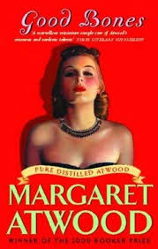
Margaret Atwood’s
story “The Little Red Hen
Tells All” is included in a
book entitled Good
Bones and Simple
Murders published in
1994.

Slide 24
Although classified with Atwood’s short fiction, it is an eclectic collection, featuring parables, monologues, prose poems, condensed science fiction, reconfigured fairy tales, as well as Atwood’s own illustrations.

Slide 25
The basic structure of
the folktale gains a new
shape in Atwood’s
rewriting. Atwood turned
the tale inside out and
upside down, placing it in
new concepts,
undermining textual norms
and the conventional
patterns and thoughts,
especially gender based ideology.

Slide 26
In her rewriting, Atwood intends to mingle contemporary themes and motifs from classic literature in a humorous and witty way. It is her intellectual strength and humorous approach that still appeal to modern readers.

Slide 27
It shows the agility of her mind that in only one page story, she employs the old version in order to create a new but complex one which offers new meanings for the readers to make interpretations. In this short short story, we see the old version and the new version of the story (intertextuality). Though the old version is inextricably bound with the new one, the differences between the old one and Atwoodian one is visibly explored.

Slide 28
What are the differences between the folktale and Atwood’s story?

Slide 29
Differrences between the Folktale and Atwood’s Story
Title
A small community
The greedy, selfish hen
The ending of the story (the red hen eats the bread)
Title
A large community
The unselfish, self sacrificing hen
The ending of the story (the red hen gives away what she produced)
The Folktale
Atwood’s Story

Slide 30
The Little Red Hen X The Little Red Hen Tells All
What does “All” in the title refer to?
Look at the beginning of the story. EVERYONE WANTS IN on it. Everyone!
Why does Margaret Atwood start her story with a capitalized sentence?
Who does the word “everyone” refer to?
What does “it” refer to?

Slide 31
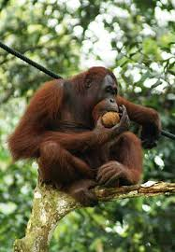
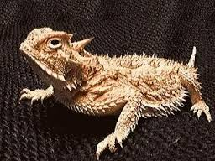
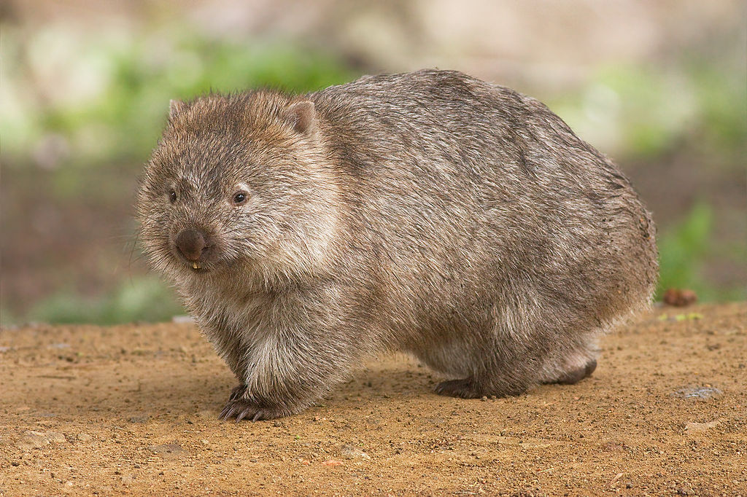

Slide 32
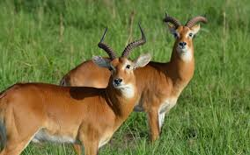
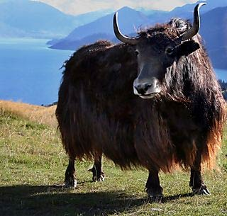
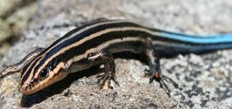

Slide 33
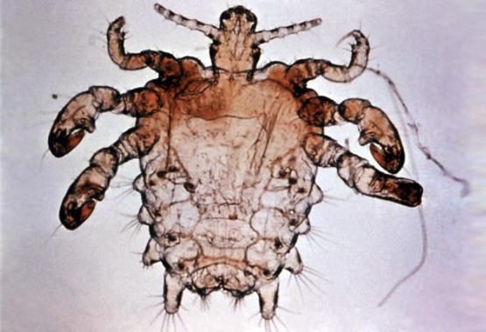

Slide 34
In Atwood’s story, we see different animals from differents regions and countries come together. By enlarging the community, Atwood underlines tha fact that capitalism spread all over the world. It became pervasive and contagious, influencing every person all over the world.

Slide 35
QUESTIONS… QUESTIONS…
What’s the productive force in the story ?
Is there any social and technical relationship between the animals and the relations of work?
Is there any social and technical relationship between social classes?
What kind of economic system is it?
Does the story support this economic system or offer a criticism?

Slide 36
In contrast to the hen of the first story who advocates capitalist ideology, the hen in Atwood’s story gives voice to her discontentment about being a mouthpiece for capitalism:
“Sobriety and elbow-grease. Do it yourself. Then invest your capital. Then collect. I’m supposed to be an illustration of that? Don’t make me laugh.”
The story offers a critique of the ideology which favors a capitalist economic system, concerned with only production and the maximization of the profits.

Slide 37
Capitalist Mode of Production
A mode of production according to capitalist ideology consists of two important factors:
Productive Forces: human labor power, means of productions (tools, equipments, buildings, technologies, knowledge, materials and improved land)
Social and Technical Relations of Production: property, power and control relations, cooperative work relations and forms of association and relations between people and the objects of their work and the relations between social classes.

Slide 38
Capitalism= Economic Individualism
Economic individualism’s basic principle
the pursuit of self interest
and the right to have private property
Individuals are free to decide
where to invest
what to produce or sell
what prices to charge.

Slide 39
QUESTIONS… QUESTIONS…
“It’s not easy, being a hen.” “I’m a hen, not a rooster.”Why do you think the protagonist hen say these sentences?
Why dou you think Atwood changes the ending of the story?
Why do you think the hen apologizes at the end of the story?

Slide 40
Together with the parody of the capitalist notions of production and hard work, the story raises some questions about feminine altruism. The little red hen decides to behave like “a hen” but not “a rooster” and offers her bred to the others, her bread that is the product of her hard work:
“Have some more. Have mine.”

Slide 41
Atwood rewrites the the folktale by turning the selfish, egocentric and greedy hen who refuses to share her product with the others into a self sacrifing one who gives away her own product. In this way, Atwood underlines the feminine self denial in a society which is regulated by self-interest, showing it as a willing martyrdom.

Slide 42
In Atwoodian version of the story, gender difference is given prominence. By highlighting the gender of the narrator, Atwood brings to surface the influences of the gender based ideology in the old and new versions of the story. Gender based society creates a female image with certain traditions in order to determine feminine qualities.

Slide 43
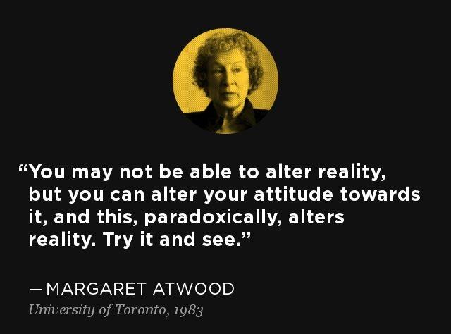
Women are supposed to take care of their house, nourish their children, do the housework, to be subservient, obedient, generous and self-devoted.

Slide 44
The Angel in the House
“She was intensely sympathetic. She was immensely charming. She was utterly unselfish. She excelled in the difficult arts of family life. She sacrificed herself daily. If there was chicken, she took the leg; if there was a draught she sat in it—in short she was so constituted that she never had a mind or a wish of her own, but preferred to sympathize always with the minds and wishes of others.” (Professions for Women by Virginia Woolf 1931)

Slide 45
In Atwoodian version, the little red hen, leaving her own interests and needs aside, acts as opposed to the traditional female image of nourishment and generosity, that is, in favor of the community. While Atwood reverses the capitalist ideology of the folktale, she highlights fallaciousness of gender differentiation, through which rather than men, women are reduced into victims.

Slide 46
The story puts it
clearly that woman’s
self image, prescribed
by the gender based
society, is the main
cause of the
subjugation of
women and the
force to keep them
silenced , thereby
powerless.

Slide 47
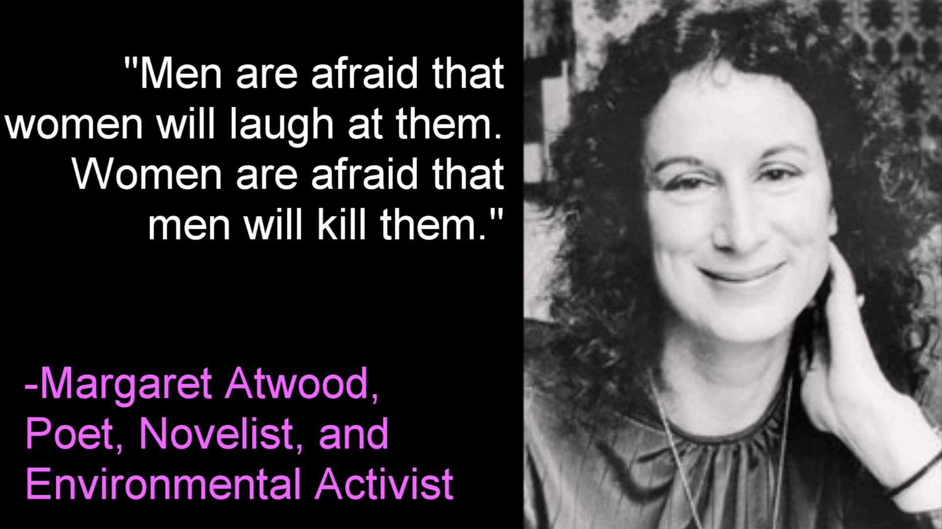

Slide 49
Assignment
Rewrite the same story from a male perspective.

Slide 50
THANK YOU!

Slide 51
https://www.youtube.com/watch?v=rn2pq3SiqHc Margaret Atwood - One on One

