Slide 1
2 OPERATIONS BEFORE THE LABORATORY WORK STARTED
Before we start working, we should be able to answer the following questions:
Help desk, escape ladder, general escape route?
Alarm system, telephone, assistant room?
Fire extinguisher, fire telephone, protective masks and filters?
First-aid kit, available facilities to wash the eyes?
Infirmary (hospital), patient transportation?

Slide 2
Where and how gas, electricity and water can be shut down
During the fire, the elevators can not be used.
After each use, the fire extinguisher must be refilled
The pressure tubes must always be attached to the wall or to a solid support
What to do in heavy accidents
Whether the materials are poisonous and dangerous to explode or easy to ignite
Where you can find safety information

Slide 3
Transport of gas cylinders

Slide 5
Gas cylinders must be connected to a solid support

Slide 6
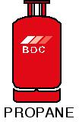
Color codes of gas cylinders (UK)

Slide 9
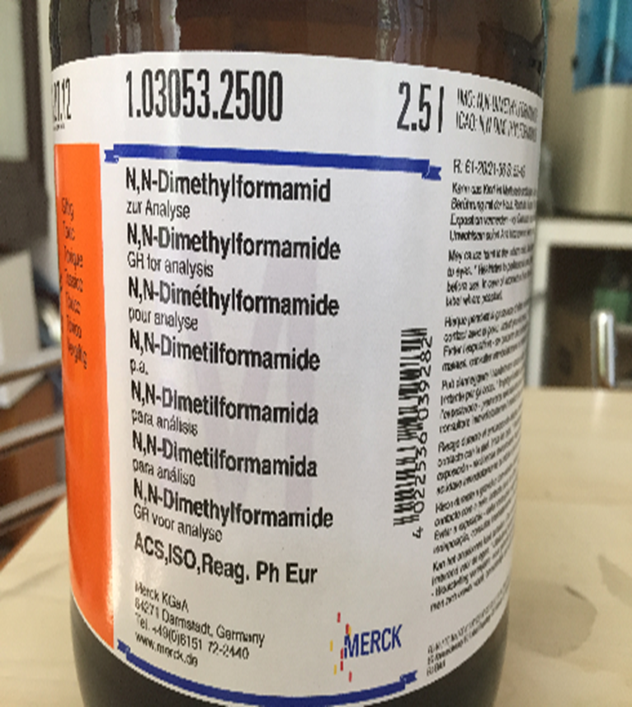
On the labels are the information shown by the numbers R and S

Slide 10
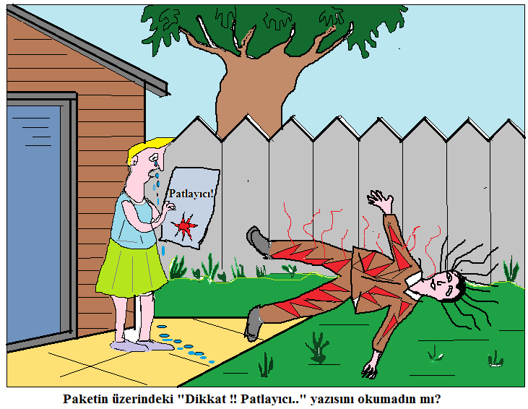
Haven’t you read the text “don’t touch the skin” on the package

Slide 11
Risk (R) and Safety (S) Phrases
The terms Hazard, Risk and Risk Assessment are often used in relation to chemical substances.
Hazard: The potential for harm of a chemical substance. Hazard is a property of chemical substance and can not be reduced or changed.
Risk: Indicate how a chemical substance will harm in use conditions. The risk can be reduced by using chemicals in small quantities and taking necessary precautions.
Risk Assessment: This includes the steps to be taken step-by-step in order to minimize the risk of harm, taking risks into account and reliably harming the waste materials used.

Slide 12
Hazard (H) and Precautinary (P)Statements
The Globally Harmonized System of Classification and Labeling of Chemicals (GHS) has been developed by the United Nations for the classification and labeling of hazardous chemical substances in the same way, and the Risk Phrases in the EU Classification Directives as of 01.06.2015 have been replaced by H Hazard Codes-Hazard Statements and Safety Phrases have been replaced by Precautionary Statements. The following is a schematic representation of what the letters and numbers used in these sentences express

Slide 13
