Slide 4
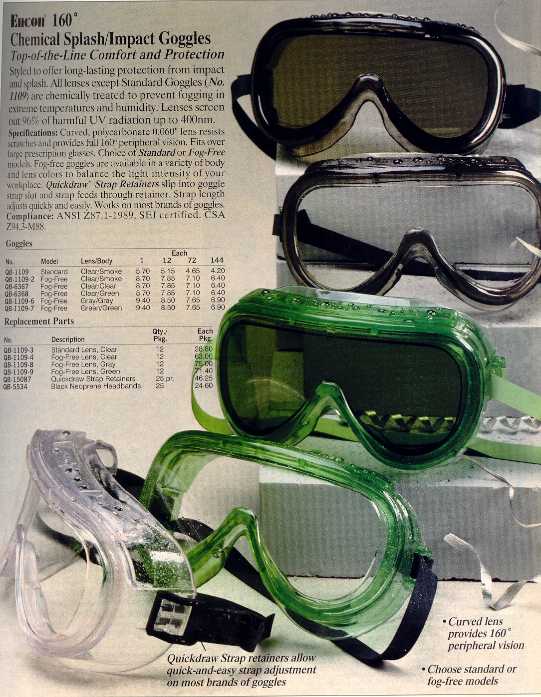

Slide 6
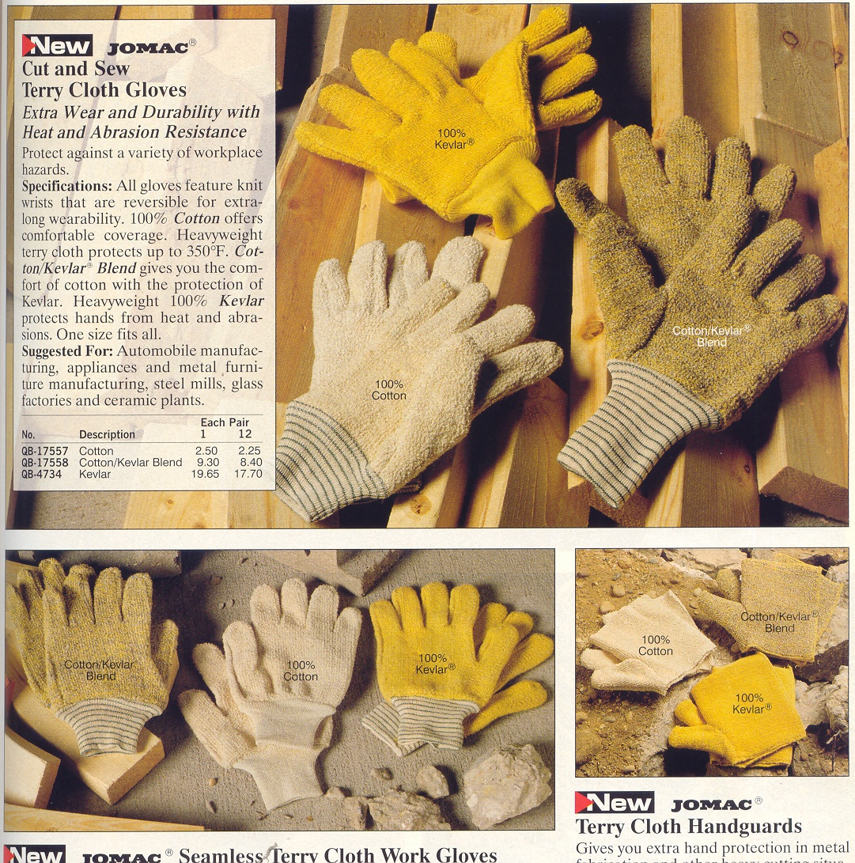

Slide 7
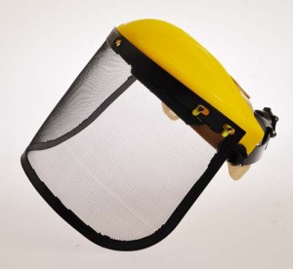
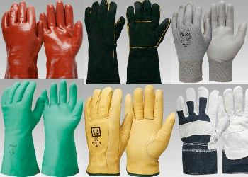
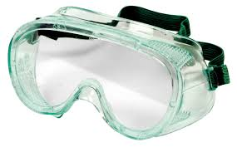
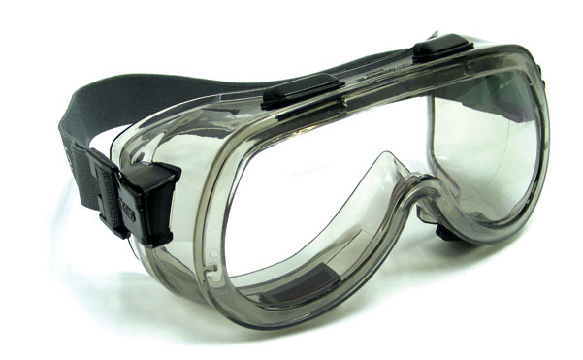

Slide 8
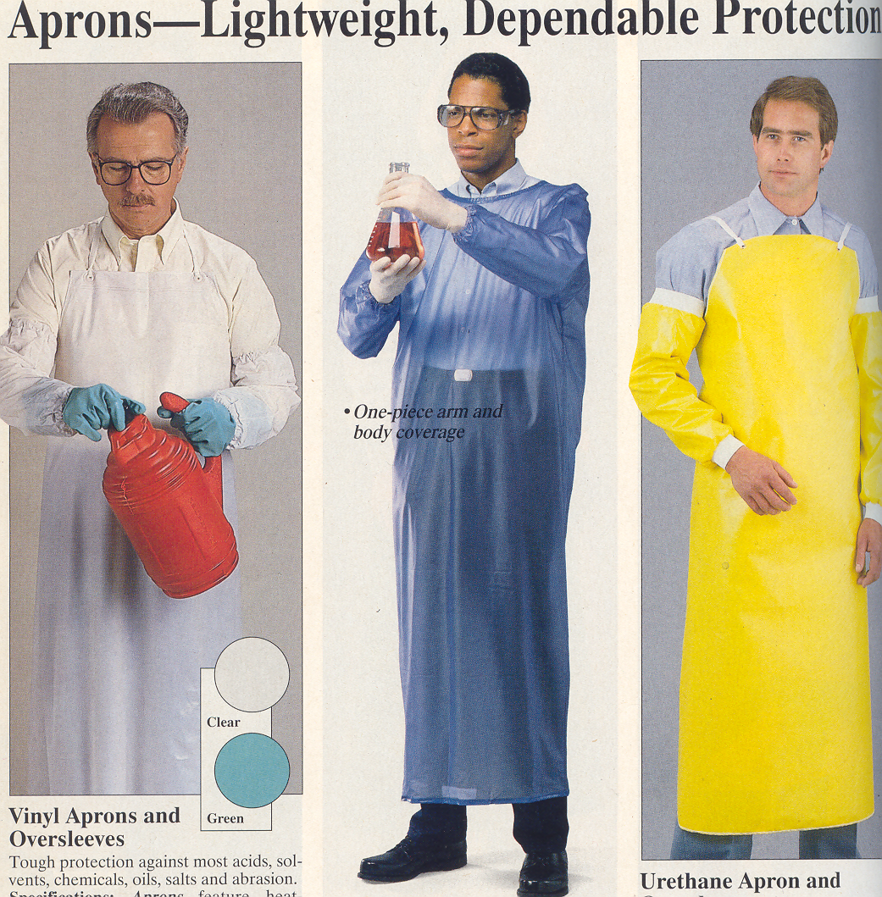

Slide 9
Basically what should be aware and what should be taken into account? -Body Protection and Work Dresses -Finding in the Laboratory -Eating, Drinking and Smoking -Washing the hands ad faces

Slide 10
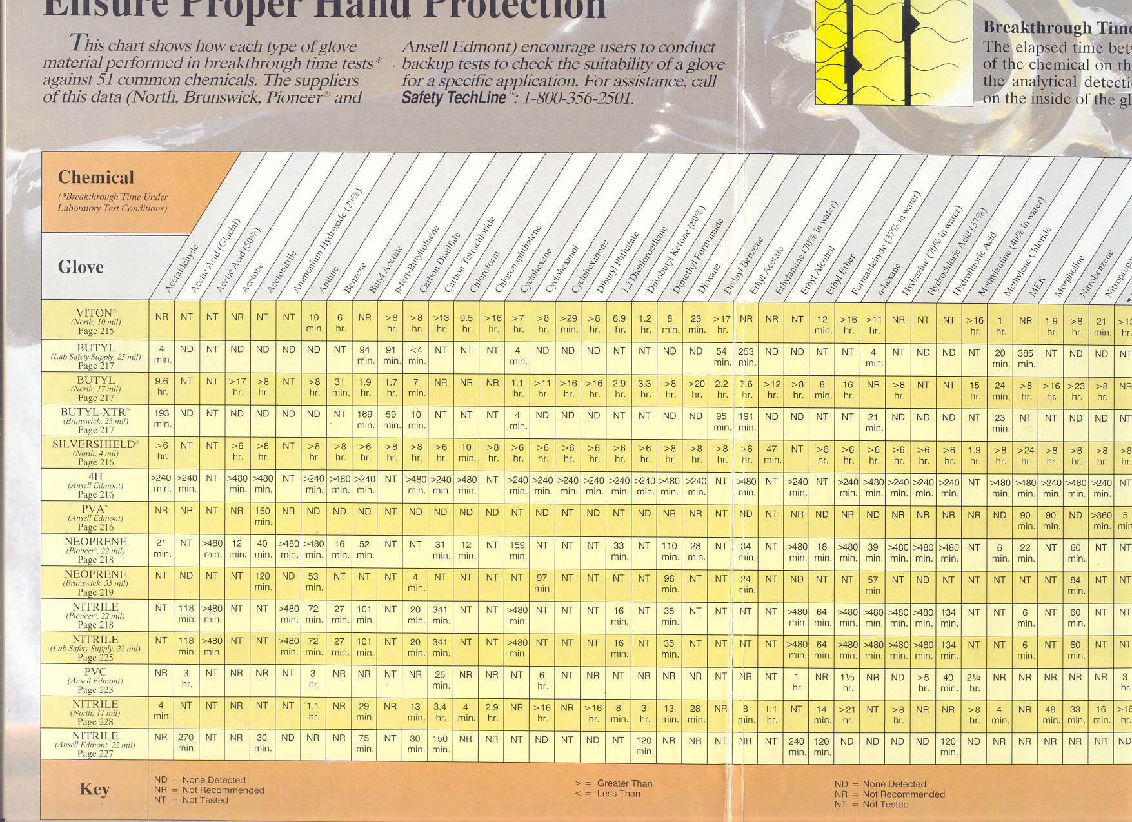

Slide 11
Chemical resistant gloves
Material
Generally suitable for
Butyl rubber
Aldehydes Carboxylic acids Glycols and ethers Hydroxyl compounds and alcohols Peroxides
Latex
See note (can causing irritation, sensitisation or allergic reaction )
Natural rubber
Acetone Alcohols Alkalies and Caustics Ammonium fluoride Dimethyl sulphoxide (DMSO) Phenol Plating solutions
Neoprene
Alcohols Alkalies and caustics Cellosolve Degreasing solvents Mineral acids Oils Plating solutions
Nitrile rubber
Alcohols Ammonium fluoride Freons Hexane Hydrofluoric and hydrochloric acid Perchloric acid Perchloroethylene Phosphoric acid Potassium and sodium hydroxide Water soluble materials, dilute acids and bases
Vinyl
General prevention of contamination Medical examination Nuisance materials

