Slide 1
10 – RESPIRATORY PROTECTION
Physiological Basis of Respiration Respiration has vital prognosis as it provides oxygen to the blood. Oxygen exchange is carried out by approximately 300 million alveoli (pores in lungs), and the surface area of these pores is around 80-100 m2. The frequency of breathing is adjusted depending on the concentration of CO2. It is necessary to breathe twice as often when the CO2 concentration in the vicinity increases by 0.2%. A person has a rest breathes 16 times in a minute and again uses 10 liters of air per minute. Breathing frequency increases according to the effort spent during work.Heavy duty person can use air at 100 l / min. 21% oxygen, 0.04% CO2, 17% oxygen, 4% CO2 are present in air drawn to the lungs in respiration. If the amount of oxygen in the air is below 15%, significant loss of power and loss of consciousness may result.

Slide 2
Filtered Devices (Masks)
They are used to protect from harmful vapors or gases in inhaled air. Half masks do not prevent irritation of the eyes only when closing the mouth and nose. Full masks cover the entire face and provide full protection. The following considerations should be observed when choosing the appropriate filter. A- The oxygen concentration should be at least 17% by volume. B- The nature and composition of the harmful substance must be known and the filter type should be selected accordingly. C- The concentration of harmful substances in gaseous or solid state should not exceed the maximum values given in the charts. There are three types of filters: 1- Pure gas filters 2- Pure particle filters 3- Combined filters (used in the laboratory).

Slide 3
Combined Filters
Particulate and gas filters are in the same cover. It protects against harmful gas, vapor and particle mixture in the breathing air.
First, airborne particles are trapped, then harmful gases are adsorbed on special coal or chemically reacted.
In the laboratory, a combined filter marked A2B2E2K2-P3 can be used for general protection.
The usage time of a filter depends on its size and usage conditions. Air temperature, air humidity and concentration of harmful substances affect the duration of use. If the smell is felt in the air passing through the filter or difficult breathing is taking place, the life of the filter is over.

Slide 4
Gas filters according to usage area
Identification letter | Identification colour | Using area
A | Brown | Organic gases, vapours, solvents
B | Grey | Anorganic gases, vapours, Example: H2S, Cl2, HCN
E | Yellow | SO2, HCl
K | Green | NH3
A B E K | Brown, grey, yellow, green

Slide 5
Special filters
CO | Black | Carbon monoxide
Hg | red | Mercury vapour
NO | Blue | Nitrogen oxides and NO
Reactor | Orange | Radioactive iodine, radioactive methyl iodide

Slide 6
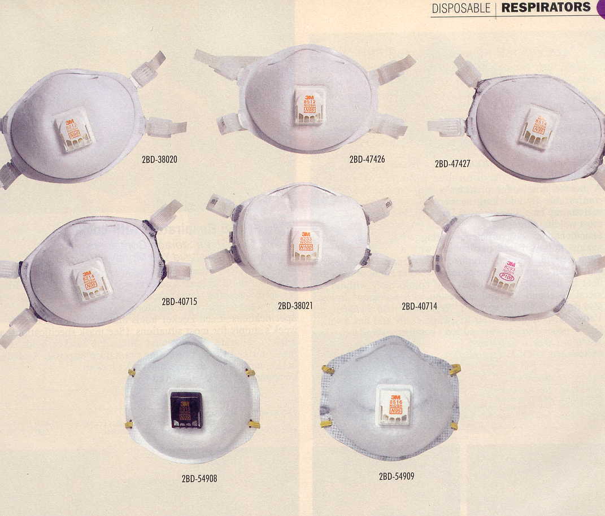

Slide 7
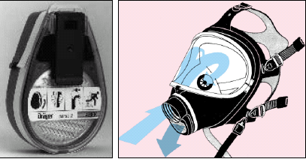

Slide 8
Mask and filter

Slide 9
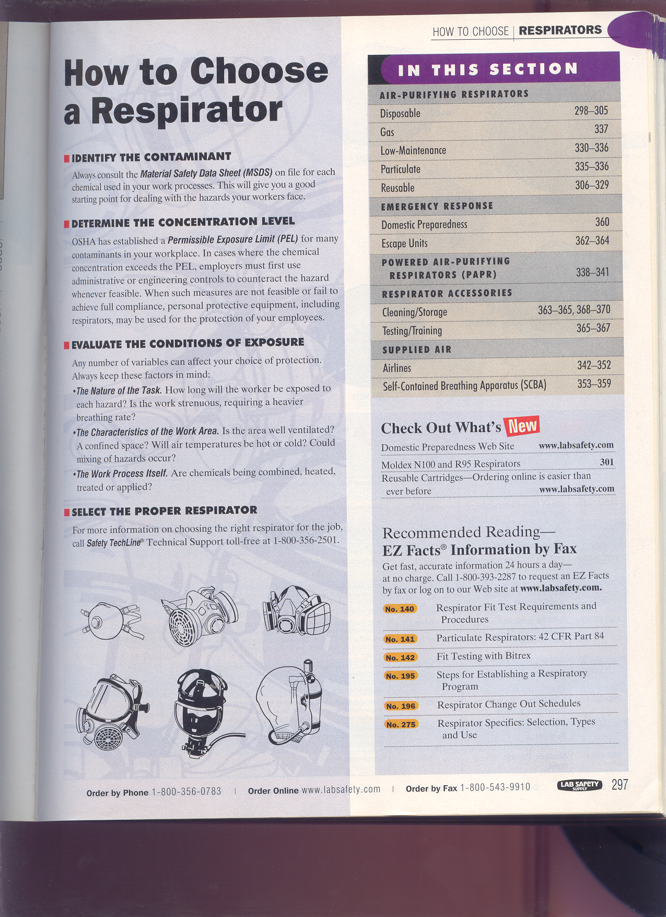

Slide 10
