Slide 1
ln this undergraduate lesson the information, instructions and data are exactly the same as in the book titled “Laboratory Safety” written by Prof. Dr. Muammer Canel and Prof. Dr. Esin Canel, Gazi Bookstore, 2016 Exam questions are prepared based on the topics in the same book

Slide 2
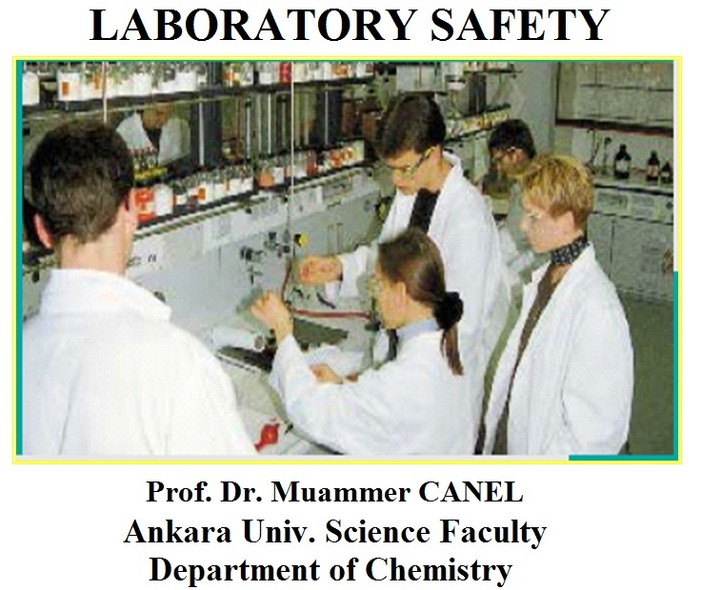

Slide 3
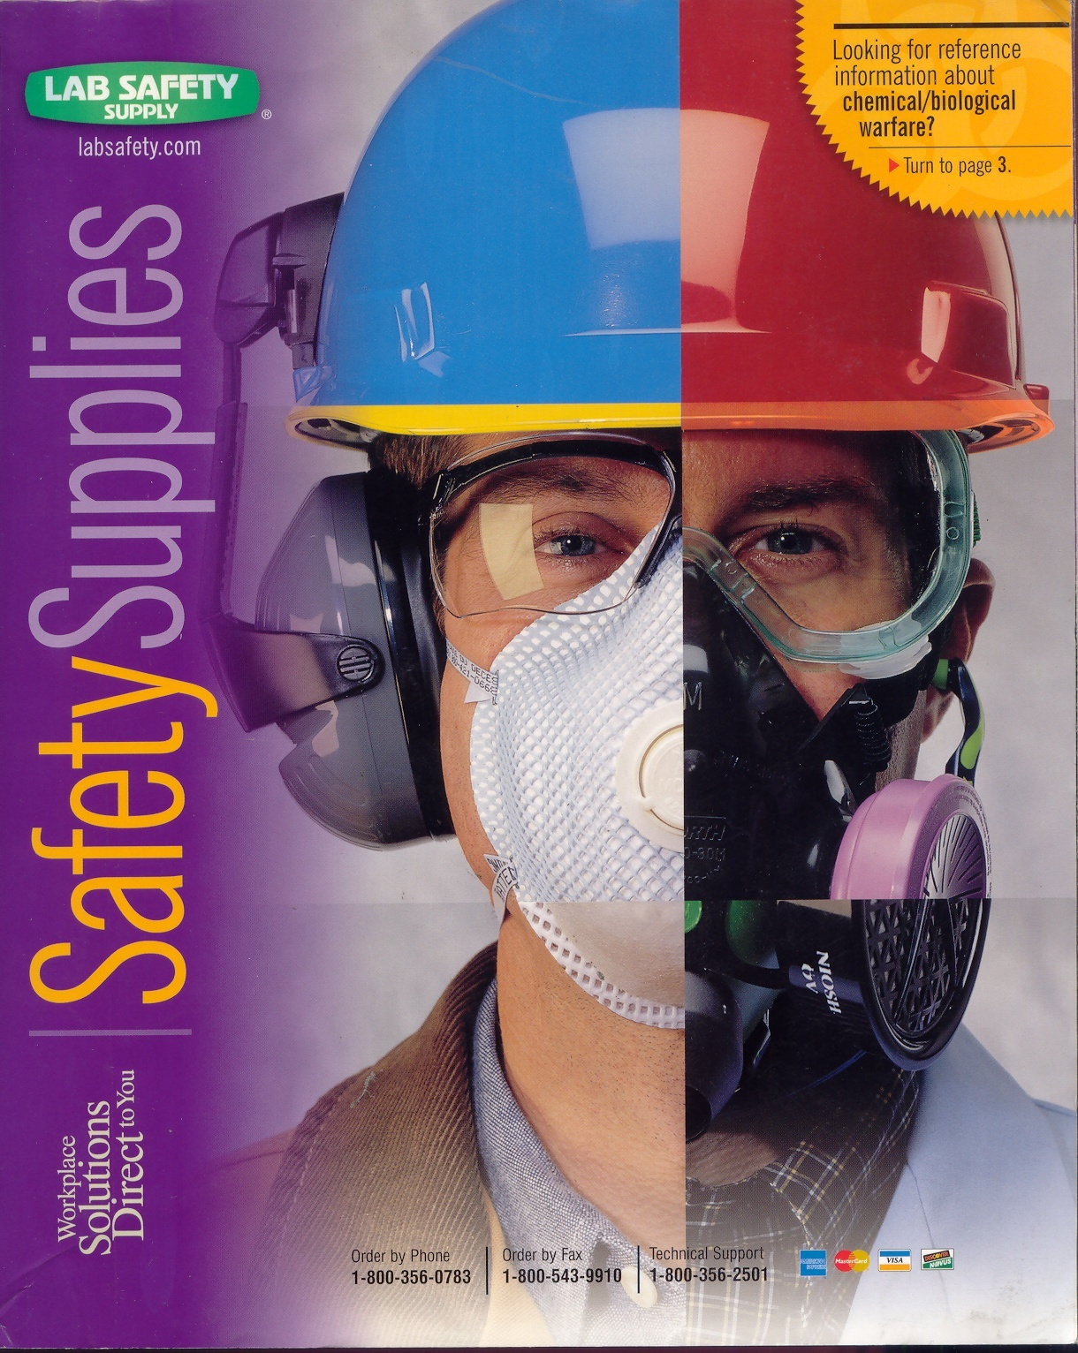

Slide 4
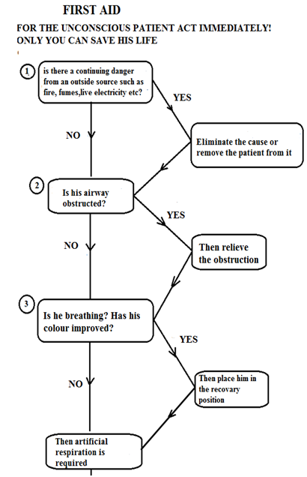
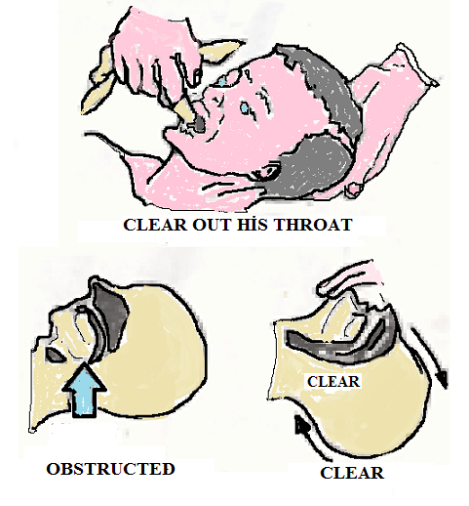
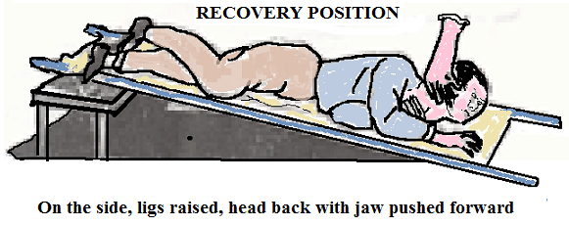

Slide 5
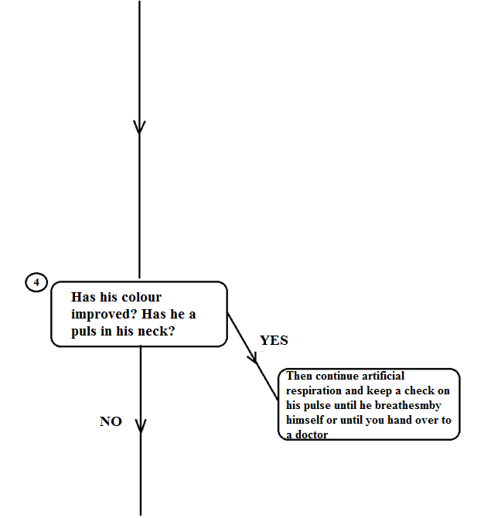
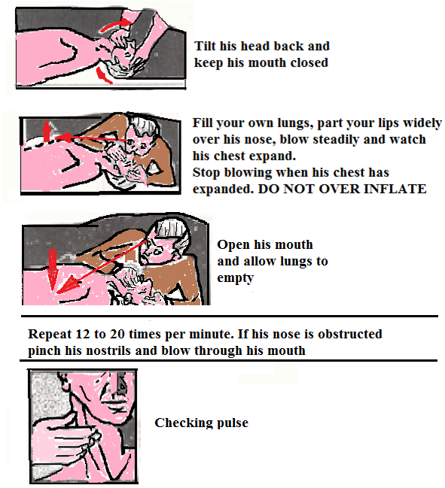

Slide 6
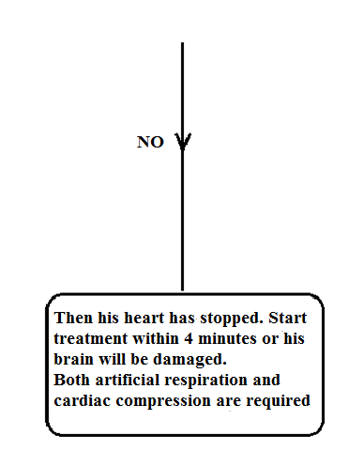
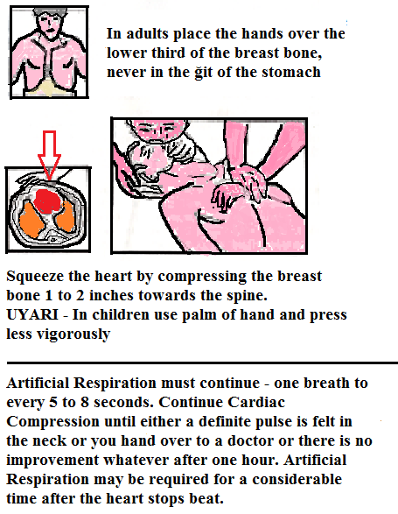

Slide 7
In a study conducted in the United States, it was found that the number of accidents in laboratories was 10 to 50 times higher than the number of accidents in the chemical industry. Again in this research, over the last decade, some accidents of 120 university-college laboratories caused to die the people.

Slide 8
It is statistically determined that a very small part of the accidents that occurred in laboratories and production places are caused by technical faults and 85% by human faults. Lack of information or lack of knowledge for the substance being studied plays an important role here.
The worst enemy of working safely is some wrong habits. People who are careful at the beginning tend to obey the rules of safety in time less as their experience increases.

Slide 9
1 The importance of working SAFELY
A chemist acquires highly detailed knowledge and experience about the hazards and risks of the materials he or she produces or produces during his / her profession. Working safely is up to the job and at least as important as learning new techniques and information. The following issues should be emphasized during the training of a chemist:
To work safely with chemical substances
Protect yourself and your friends from danger.
To be sensitive to environmental pollution.
Identify possible hazards of chemical substances and protect them from these hazards with the help of warnings

Slide 10
For example, in 2010, a student working in a laboratory at the Texas Tech University had an explosion when working with a 10 g explosive, which was 100 times more than the permissible value, and the student lost three fingers and severe burns occurred in his body.
In 2008, a student died at the University of UCLA in a chemical fire.
In 2010, four students were injured in the explosion caused by hydrogen gas at the University of Missouri.
Heavy burns occurred in two students becuse of the acid splashing at Maryland University in 2011

Slide 11
Some examples of accidents in the laboratory are given below:
Even some experiments with tubing can be dangerous.
A chemist mixes 0.5 ml of cyclohexanone and 30% hydrogen peroxide in a glass tube to obtain cyclohexane peroxide. The vigorous reaction breaks down the tube and is wounded by the chemist's face and his hands. the left window. His eyes are not hurt.

Slide 12
The characteristics of the materials should be well known.
A female chemist is seriously injured by the explosion that occurs while trying to break up the silver perchlorate from the solution and dried in desiccant by spatula. She can not be saved in four weeks and dies.

Slide 13
Waste materials and their risks should also be known.
A chemistry student is pouring cyanide-containing waste into the washbasin of the lab in contradiction to the rules. Another student is pouring into the same washbasin hydrochloric acid a little later. The resulting cyanide acid vapors cause this student to die.

Slide 14
It should not be forgotten that there may be a source of ignition everywhere.
In a research lab, some solutions that are easy to ignite are stored in a household type refrigerator. Vapour escaping from one of the bottles brings an explosive blend to the air in the refrigerator. Explosion and fire during the automatic opening of the refrigerator thermostat cause great damage.

