Slide 1
Enzootic Bovine Leukosis (BLV)
Bovine lymphosarcoma, Leukemia, Malignant lymphoma

Slide 2
Enzootic Bovine Leukosis is contagious disease of cattle caused by the retrovirus, bovine leukaemia virus (BLV). The disease causes fatal malignant cancer in a small percentage of infected animals and can be responsible for major economic losses.
Notifable Disease

Slide 3
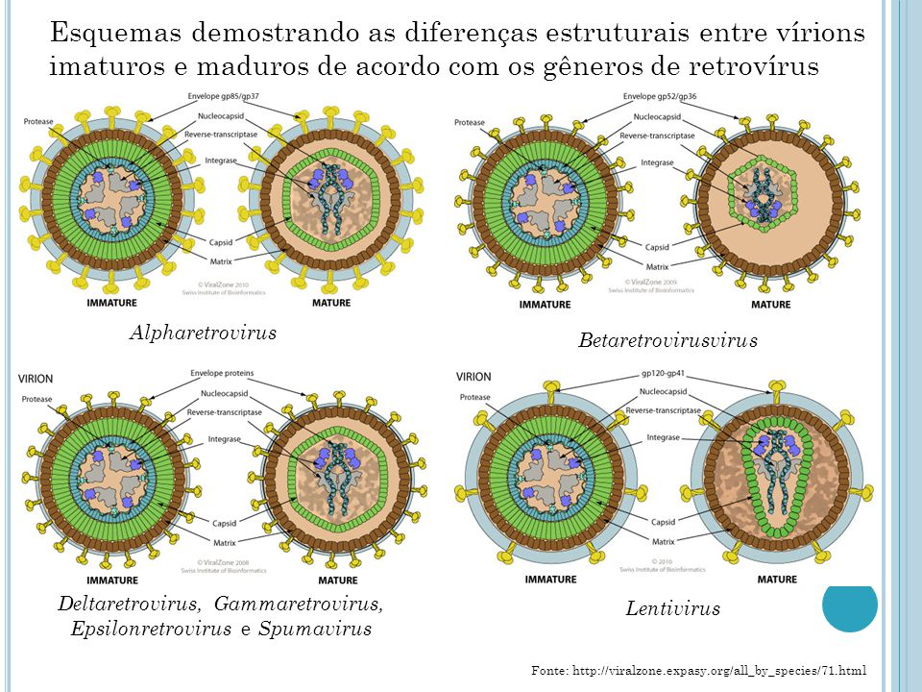
Retroviridae Deltaretrovirus genus
RNA
Enveloped
Serologically one type
Disease of Cattle although infections
have rarely been described in buffaloes,
sheep and capybaras.

Slide 4
Enzootic bovine leukosis is caused by BLV, an exogenous C-type oncogenic retrovirus.
BLV has a stable genome,
does not cause chronic viremia,
and has no preferred site of proviral integration.
Despite the lack of preferred proviral integration sites, the tumors generated by the virus in a single individual are typically monoclonal and have a single integration site.
The virus escapes the immune response by low levels of viral replication.
It appears that replication is blocked at the transcriptional level, but the mechanism is not completely understood.

Slide 5
Distribution
BLV was probably present in Europe during the 19th century, from where it spread to the American continent in the first half of the 20th century. It may then have spread back into Europe and introduced into other countries for the first time by the import of cattle from North America.
The prevalence of BLV infection varies from country to country. Many European countries, Australia, and New Zealand have eradication programs in place that have led to negligible rates of BLV infection.

Slide 6
Transmission
1- Most BLV transmission is horizontal.
Close contact between BLV-negative and BLV-positive cattle is thought to be a risk factor.
A) Secrets: Virus is also found in the cellular fraction of various body fluids (nasal and bronchial fluids, saliva, milk).
B) Iatrogenic: Many common farm practices have been implicated in viral transmission, including tattooing, dehorning, rectal palpation, injections, and blood collection.
C) Vectors: In regions where blood-sucking insects occur in large numbers, especially tabanids, these may transmit the virus mechanically.
2- Vertical transmission
may occur transplacentally from an infected dam to the fetus, intrapartum by contact with infected blood, or postpartum from the dam to the calf through ingestion of infected colostrum.
Any material that is blood contaminated or lymphocyte rich has the potential to infect animals with BLV.

Slide 7
Pathogenesis:
There are three main outcomes in cattle infected with BLV.
1- Most animals remain persistently infected with no outward signs of infection.
2- Approximately 29% of BLV-infected cattle develop persistent lymphocytosis,
3- while <5% of BLV-infected cattle develop lymphosarcoma.

Slide 8
2- Persistent lymphocytosis is sometimes referred to as a preneoplastic syndrome, but there is no convincing evidence that affected cattle have an increased risk of developing lymphosarcoma.
The lymphocytes present in persistent lymphocytosis are not neoplastic, although they may have mild reactive changes consistent with normal blood smears in cattle.
Persistent lymphocytosis is considered a benign condition associated with BLV infection. For this reason, it is often overlooked. However, these cows may serve as a reservoir of infection.
It has been suggested that cows with persistent lymphocytosis may be at greater risk of passing BLV infection on to their calves in utero and may show decreased milk production and alteration of milk components.

Slide 9
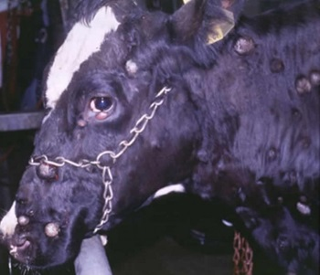
3- Lymphosarcoma is rarely seen in animals <2 yr old and is most common in the 4- to 8-yr-old age group.
Less than 5% of BLV-infected cattle develop lymphosarcoma. Lymphosarcoma, including both sporadic and enzootic forms, is one of the main causes of condemnation of adult dairy cows at slaughter.
http://www.msdvetmanual.com/generalized-conditions/bovine-leukosis/overview-of-bovine-leukosis Courtesy of Dr. Peter Constable

Slide 10
Once BLV enters the organism, antibodies are formed against the virus.
the antibodies are insufficient for the elimination of the virus.
Virus integrates into the DNA of lymphocyte cells.
BLV is constantly carried in the blood of infected animals.(Persistent Infection) BLV infected animals carry life-time viruses and infect healthy animals.

Slide 11
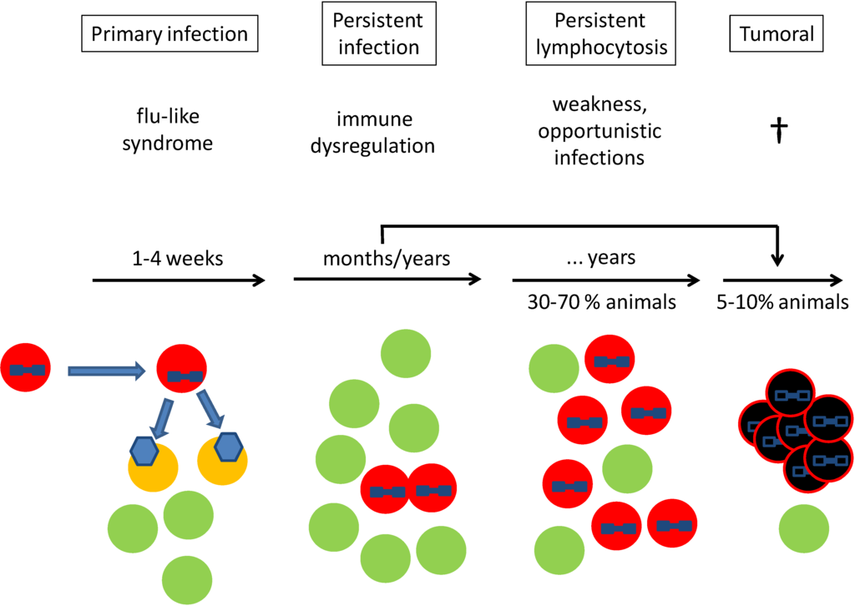
Clinical course of bovine leukemia virus (BLV) infection. Primary infection: an infected cell (red) with a BLV integrated into the host chromosome (blue provirus) is transmitted into a new animal. During primary infection, the BLV provirus is expressed into viral particles (blue hexagon), which further infect B-cells (yellow). Active BLV replication is responsible for a “flu-like” syndrome, as observed during primary infection by HIV in humans. During persistent infection, provirus-carrying cells (red) expand mainly by mitosis, because of the presence of an active immune response. This phase extends for several months/years and is characterized by an immune dysregulation.
During this persistent lymphocytosis phase, morbidity is characterized by weakness and opportunistic infections, as observed in chronic lymphocytic leukemia in human. Morbidity (e.g., mastitis) leads to a loss in milk production. In the tumor phase, a single infected cell undergoes genetic mutations (black) and forms a lymphoma within or outside lymph nodes, leading to the death of the animal. Typically, animals undergo sudden death from the hemorrhage of the spleen. Tumors can also occur directly in persistently infected animals without persistent lymphocytosis (PL). The frequency of tumors and clinical latency depend on herd prevalence. A typical picture is 10% death after three years in a herd having 50% BLV prevalence.

Slide 12
Lymphosarcoma in cattle may be sporadic or result from infection with bovine leukemia virus (BLV); the latter is often referred to as an enzootic bovine leukosis.
Sporadic lymphosarcoma in cattle is unrelated to infection with BLV.
Despite the lack of association, animals with sporadic lymphosarcoma may possibly be infected with the virus.
Sporadic lymphosarcoma manifests in three main forms:
Juvenile lymphosarcoma occurs most often in animals <6 mo old,
thymic lymphosarcoma affects cattle 6–24 mo old,
cutaneous lymphosarcoma is most common in cattle 1–3 yr old.

Slide 13
Clinical Signs
1- Juvenile lymphosarcoma is often characterized by a sudden onset of diffuse lymphoid hyperplasia with or without visceral organ involvement. Weight loss, fever, tachycardia, dyspnea, bloat, and posterior paresis have all been described with this form of lymphosarcoma. Profound lymphocytosis (>50,000/μL) often accompanies this fatal form of bovine lymphosarcoma.
2- Thymic lymphosarcoma may involve the cervical or intrathoracic thymus, or both. Clinical signs associated with this form of lymphosarcoma depend heavily on the location and size of the tumor. A cervical swelling may be evident. Dyspnea, bloat, jugular distention, tachycardia, anterior edema, and fever have been documented. The affected cell population is an immature, poorly differentiated lymphocyte.
3- Cutaneous lymphosarcoma presents as cutaneous plaques, 1–5 cm in diameter, on the neck, back, rump, and thighs. Regional lymph nodes may also be enlarged. This form of lymphosarcoma may undergo spontaneous remission; however, relapses may occur.

Slide 14
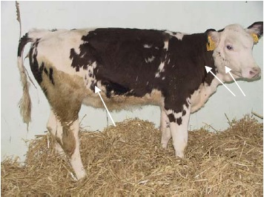
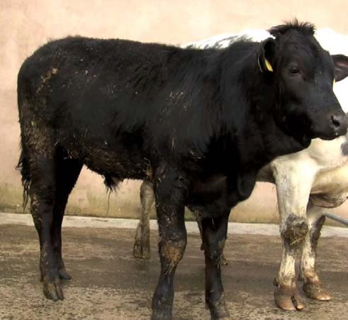
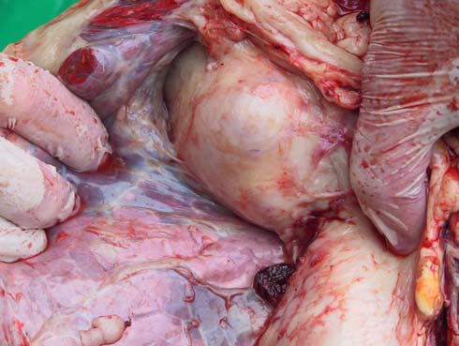
The juvenile form of sporadic bovine leucosis causes weight loss with massive enlargement of lymph nodes.
Growing cattle with thymic lymphosarcoma present with weight loss.
The thymic lymphosarcoma is identified at necropsy.

Slide 15
Enzootic Bovine Leukosis
Most infected animals (about 70% ) do not develop the disease. The clinical signs usually appear in animals between 4 and 8 years old.
When present, the clinical signs observed are related to the organ systems involved and include (non exhaustive list):Weight loss with or without reduced appetite,
Anaemia
Decreased milk yield,
Enlarged external and enlarged internal lymph nodes,
Partial paralysis of the hind legs,
Fever,
Abnormal breathing,
Bulging eyes,
Diarrhoea,
Constipation
Animals that developed tumours will generally progressively loose condition and die.

Slide 16
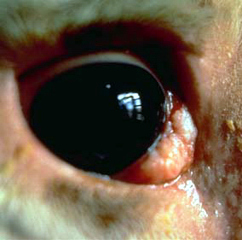
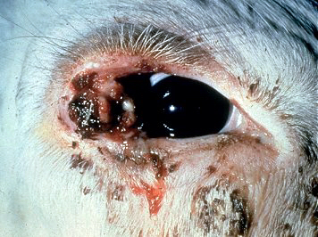

Slide 17
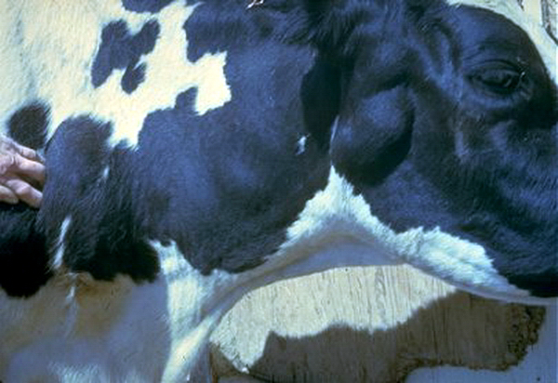

Slide 18
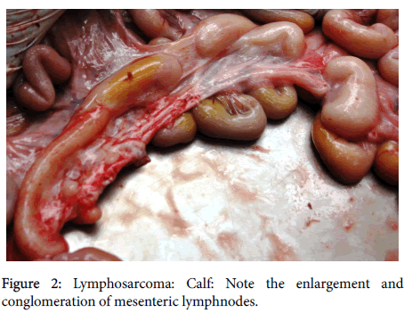
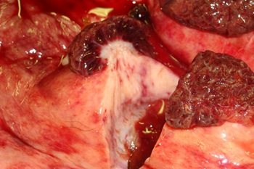
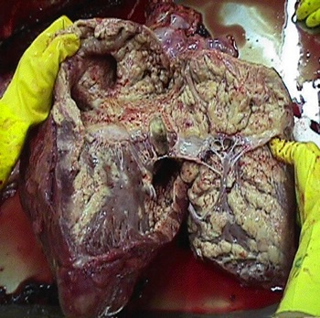
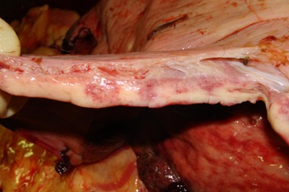
Most affected organs
Heart
abomasum
Spleen
Uterus
Spinal cord
The lymphoid tissue at the back of the eye.
Growth in subcutaneous lymph nodes
The pelvic lymph nodes
The mandibular lymph nodes
Head lymph nodes
Uterus
Gravid uterus
Cardiac Lymphasarcoma
Shruthi, P. J., Sujatha, K., Srilatha, C. H., & Chengalva, R. V. (2016). Nucleolar organizer region count, PCNA and Ki-67 indices are diagnostic markers of malignancy and cell proliferation rate in bovine lymphosarcoma. Journal of Veterinary Science and Technology, 7(2).

Slide 19
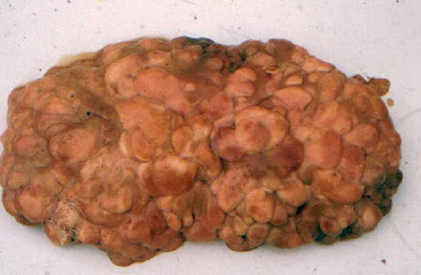
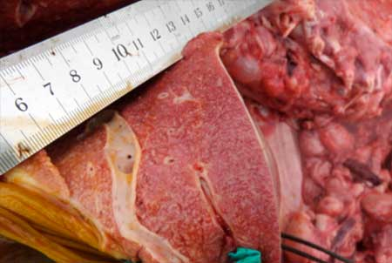
http://www.flockandherd.net.au/cattle/reader/sbl-calf.html
http://www.fmv.ulisboa.pt/atlas/linfoide/pages_us/linf043_ing.htm
Cut surface of liver showing granular appearance and enlarged sinusoids

Slide 20
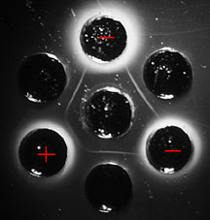
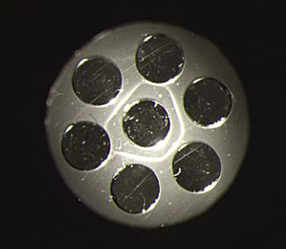
Diagnosis
Lymphosarcoma is often included on the differential diagnosis list for many diseases because of the wide range of clinical findings.
Viral infection is diagnosed by serology or virology,
persistent lymphocytosis is identified by hematology,
neoplastic tumors are identified by histologic examination of biopsies.
Serology is the most common and reliable way to diagnose infection with BLV.
Agar gel immunodiffusion is still recognized by most countries as the official import/export test, but ELISA is the most common test for routine diagnostic use.
AGID can not detect antibody response at low level and early in infection; the blood circulating antibodies pass into the colostrum during the calving period, so the AGID test may give false negative results for 2-6 weeks before and after birth.

Slide 21
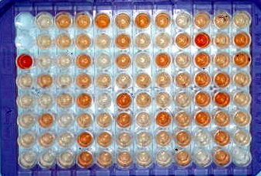
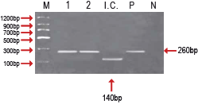
Serology is unreliable in calves that have ingested colostrum from BLV-positive cows because of the passive acquisition of maternal antibodies that typically wane by 4–6 mo of age.
PCR is a sensitive and specific assay for diagnosis of BLV infection in peripheral blood lymphocytes. This test can identify proviral DNA of BLV in the lymphocytes of infected animals and differentiate positive from negative calves in the presence of maternal antibodies.

Slide 22
Prevention and Control
The most commonly recommended eradication protocol is as follows:
1) identify infected animals using a serologic test,
2) cull seropositive animals immediately,
3) retest the herd in 30–60 days,
4) use PCR to test young calves and as a complementary test to clarify test results in herds with a low prevalence of infection,
5) repeat testing and cull until the entire herd tests negative.
Testing is then repeated every 6 mo.
The herd is declared free when there have been no positive tests for 2 yr. Additions to the herd should have two negative tests 30 and 60 days before arrival.

Slide 23
In calves, feeding colostrum from seronegative cows is often advocated.
Cautery or other bloodless methods of dehorning should be used. Equipment used for castration, tattooing, ear tagging, or implanting should be adequately cleaned and disinfected between animals.
Transmission can be decreased in adult cattle by changing rectal sleeves in between cows. Artificial insemination or embryo transfer (using negative recipients) may limit transmission.
Additional recommendations include disinfection of equipment that has come in contact with blood or body tissue. Single use, disposable needles should always be used for blood collection and IM injections.
Fly control helps minimize the potential for tabanid-associated transmission.

Slide 24
In Turkey
In 1997, an EBL control and eradication program covering 31 agricultural managements connected to TİGEM was initiated.
These managements are aimed to set an example for the EBL eradication program in Turkey.
Notifable Disease

Slide 25
http://www.msdvetmanual.com/generalized-conditions/bovine-leukosis/overview-of-bovine-leukosis
OIE Terrestrial Manual 2012, CHAPTER 2.4.11. ENZOOTIC BOVINE LEUKOSIS
Shruthi, P. J., Sujatha, K., Srilatha, C. H., & Chengalva, R. V. (2016). Nucleolar organizer region count, PCNA and Ki-67 indices are diagnostic markers of malignancy and cell proliferation rate in bovine lymphosarcoma. Journal of Veterinary Science and Technology, 7(2).

Slide 26
Feline Leukemia Virus (FeLV)

Slide 27
FeLV is one causative agent of feline lymphosarcoma and leukaemia, which are the most important and common tumours of cats. The same tumours sometimes occur without FeLV, particularly in cats aged over 7 years.
The virus commonly causes anemia or lymphoma, but because it suppresses the immune system, it can also predispose cats to deadly infections.

Slide 28
Ethiology
Retroviridae Gammaretrovirus genus
RNA
Enveloped
4 subgroups A, B, C and T
There are four FeLV subgroups of clinical importance. Almost all naturally infected cats are originally infected by FeLV-A, the original, archetypical form of the virus.
Additional mutated forms of the original FeLV-A subtype as well as FeLV-B, FeLV-C, or FeLV-T may develop in infected cats.

Slide 29
Transmission
Feline leukemia is a disease that only affects cats -- it cannot be transmitted to people, dogs, or other animals.
FeLV is passed from one cat to another through saliva, blood, and to some extent, urine and feces.
The virus does not live long outside the cat’s body -- probably just a few hours.
Kittens can contract the disease in utero or through an infected mother’s milk.
The disease is often spread by apparently healthy cats, so even if a cat appears healthy, it may be infected and able to transmit the virus.

Slide 30
Pathogenesis
After oronasal inoculation, the virus first replicates in oropharyngeal lymphoid tissue.
From there, virus is carried in blood mononuclear cells to spleen, lymph nodes, epithelial cells of the intestine and bladder, salivary glands, and bone marrow.
Virus also appears in secretions and excretions of these tissues and in peripheral blood leukocytes and platelets.
Viremia is usually evident 2–4 wk after infection. The acute stage of FeLV infection occurring 2–6 wk after infection is rarely detected but typically characterized by mild fever, malaise, lymphadenopathy, and blood cytopenias.

Slide 31
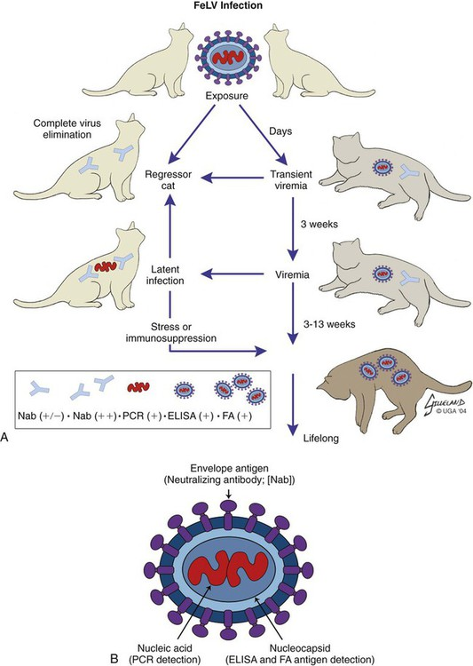
https://veteriankey.com/feline-leukemia-virus-infection-2/

Slide 32
Cats unable to mount an adequate immune response become persistently viremic and develop a progressive infection, often leading to fatal disease.
Oncogenesis occurs when FeLV virus inserts into the host cellular genome, either in proximity to an oncogene resulting in activation or directly into the oncogene itself to form a recombinant subgroup virus such as FeLV-B that can induce new neoplastic activity in any cell the recombinant virus enters.
The most recent classification system for FeLV labels infections as progressive, abortive, regressive, and focal.

Slide 33
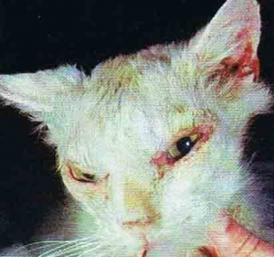
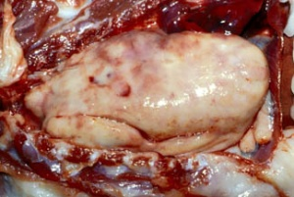
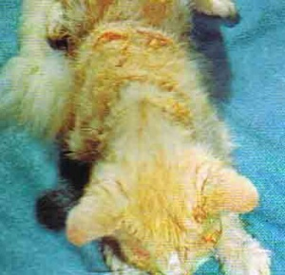
Clinical Signs
FeLV-related disorders are numerous and include
anemia,
neoplasia,
immunosuppression,
immune-mediated diseases,
reproductive problems,
enteritis,
neurologic dysfunction,
stomatitis.
Scaling and crusting on the face of a cat with a giant cell dermatosis associated with FeLV infection
Thymic lymphoma in a feline leukemia virus-infected cat. The mass of neoplastic lymphocytes occupies most of the thoracic cavity and displaces the heart and lungs (image courtesy of Noah’s Arkive, the University of Georgia)

Slide 34
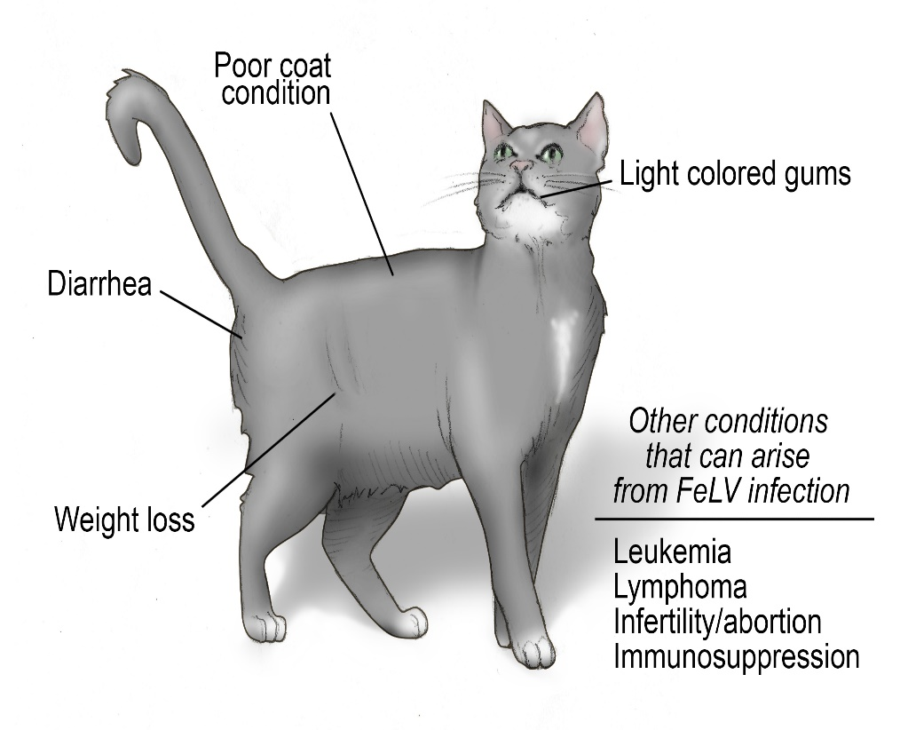
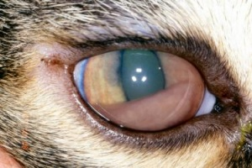
Pale gums
Yellow color in the mouth and whites of eyes
Enlarged lymph nodes
Bladder, skin, or upper respiratory infections
Weight loss and/or loss of appetite
Poor coat condition
Progressive weakness and lethargy
Fever
Diarrhea
Breathing difficulty
Reproductive problems like sterility in unspayed female cats
Stomatitis – Oral disease that includes ulceration of gingiva
Protein deposits in the anterior uvea consistent with FeLV

Slide 35
Diagnosis
Three types of tests are now readily available for clinical use:
immunochromatography (such as ELISA),
immunofluorescent assay (IFA),
PCR.
Virus isolation is considered the gold standard diagnostic test
ELISA or other point-of care antigen test kits can be used in the veterinary clinic to detect antigen in whole blood or serum using a lateral flow test kit or a multi-well plate.
Saliva and tears are not considered to be reliable samples for testing purposes. Several different test kits are available; most have sensitivities and specificities of ~98%.

Slide 36
Disease and Diagnosis
Oral enfeksiyon
Isırma ile enfeksiyon
Tonsil replikas.
ELISA bazen +
Lenf yumru. replikas.
Kemik iliği
timus
Peyer plakları
Yetersiz immun yanıt
ELISA +
FAT +
Koruyucu immun yanıt
iyileşme
“yetersiz” latentlik
viremi
latentlik
FAT -, ELISA +
epitel hücreler
(saçılım)
kemik iliğinden PCR

Slide 37
Prevention and Control
FeLV virus is unstable in the environment and is susceptible to all common detergents and disinfectants.
Thorough cleaning and sterilization of equipment, strict attention to washing contaminated hands, and avoiding reuse and sharing of single use and consumable supplies between patients are critical practices to prevent iatrogenic transmission.
FeLV vaccines are non-core and are intended to protect cats against FeLV infection or to reduce the likelihood of persistent viremia.
Vaccines are indicated only for uninfected cats, because there is no benefit in vaccinating an FeLV-positive cat.

Slide 38
References
https://pets.webmd.com/cats/facts-about-feline-leukemia-virus#1
http://vetbook.org/wiki/cat/index.php/FeLV
http://www.msdvetmanual.com/generalized-conditions/feline-leukemia-virus-and-related-diseases/feline-leukemia-virus-and-related-diseases-in-cats-overview

Slide 39
Feline Immunodeficiency Virus (FIV)

Slide 40
In infected cats, feline immunodeficiency virus (FIV) attacks the immune system, leaving the cat vulnerable to many other infections.
Although cats infected with FIV may appear normal for years, they eventually suffer from this immune deficiency, which allows normally harmless bacteria, viruses, protozoa, and fungi found in the everyday environment to potentially cause severe illnesses.

Slide 41
Ethiology
Retroviridae lentivirus.
Unrelated to HIV.
RNA
The virus can be isolated in T cell lines which become IF-positive
Isolates vary not only in virulence but also antigenically.

Slide 42
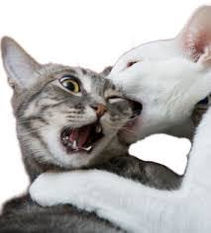
Transmission
FIV has been identified in domestic and wild felids.
The infection is endemic in cats throughout the world.
Virus is shed in the saliva, and biting is the principal mode of transmission.
As a result, free-roaming, male, and aged cats are at greatest risk of infection.
Casual, non-aggressive contact does not appear to be an efficient route of spreading the virus
As a result, cats in households with stable social structures where housemates do not fight are at little risk of acquiring FIV infections.
On rare occasions infection is transmitted from an infected mother cat to her kittens, usually during passage through the birth canal or when the newborn kittens ingest infected milk.

Slide 43
Clinical Signs
FIV infection is uncommon in closed purebred catteries.
After infection, there is a
transient fever,
lymphadenopathy,
neutropenia.
Most cats then recover and appear to be clinically normal for many months or years before progressive immunodeficiency develops.
Cats with acquired immunodeficiency induced by FIV then develop chronic secondary and opportunistic infections of the respiratory, GI (including mouth), and urinary tracts, as well as the skin.
FIV-infected cats have a higher than expected incidence of FeLV-negative lymphomas, usually of the B-cell type, and myeloproliferative disorders (neoplasia and dysplasias).

Slide 44
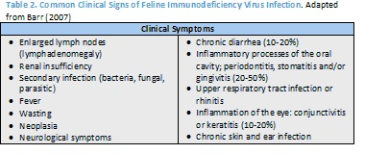
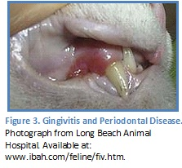

Slide 45
Diagnosis
To diagnose FIV infection, blood samples are examined for the presence of antibodies to the FIV virus.
FIV antibodies can be detected using a number of techniques, including ELISA, western blot, and immunofluorescence (IFA) assays.
These techniques are dependent upon the host cat mounting an immune response to FIV virus.
If a host cat has not had sufficient time after exposure to mount an immune response or if the host cannot mount an immune response due to immunosuppression, antibodies may not be detected in a cat that is actually infected with FIV.
PCR

Slide 46
Prevention and Control
The only sure way to protect cats is to prevent their exposure to the virus.
Cat bites are the major means by which infection is transmitted, so keeping cats indoors, away from potentially infected cats that might bite them, markedly reduces their likelihood of contracting FIV infection.
Unfortunately, many FIV-infected cats are not diagnosed until after they have lived for years with other cats.
In such cases, all the other cats in the household should be tested.
Ideally, all infected cats should be separated from the noninfected ones to eliminate the potential for FIV transmission.

Slide 47
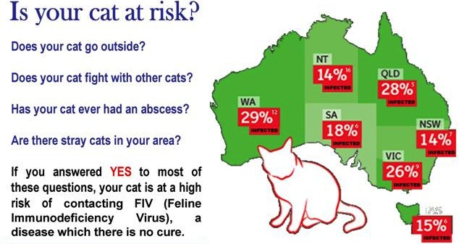
http://www.rochedalevet.com/feline-immunodeficiency-virus-fiv/

Slide 48
Vaccines to help protect against FIV infection are now available, although these are not considered core vaccines for cats.
Not all vaccinated cats will be protected by the vaccine, so preventing exposure is important, even for vaccinated cats.
Vaccination will impact future FIV test results, and any vaccination carries the risk of inducing vaccine–associated-sarcoma (a type of cancer) in cats, so it is important that you discuss the advantages and disadvantages of vaccination.
Vaccine for only (FIV) (-) cats

Slide 49
References
http://www.msdvetmanual.com/immune-system/immunologic-diseases/secondary-immunodeficiencies
http://www.vet.cornell.edu/fhc/Health_Information/brochure_fiv.cfm

Slide 50
EQUINE VIRAL ARTERITIS
Equine Typhoid, Epizootic Cellulitis–Pinkeye, Epizootic Lymphangitis Pinkeye

Slide 51
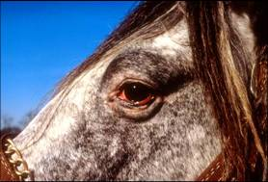
Equine viral arteritis (EVA) is an economically important viral disease of equids.
Stallions can become long term carriers of the virus, and transmit it during breeding.
Acute illness also occurs in some horses. Although deaths are very rare in healthy adults, pregnant mares that become infected may abort, and very young foals may die of fulminating pneumonia and enteritis.
Conjunctivitis (“Pink-eye”)and Supraorbitalor periorbitaledema:
http://equine-reproduction.com/articles/EVA/Presentation/EVA_files/v3_slide0010.htm

Slide 52
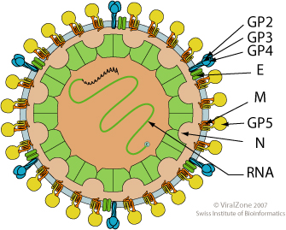
Ethiology
Nidovirales order----Arteriviridae----Arterivirus----Equine arteritis Virus (EAV)
RNA
Enveloped
Sensitive to ether and chloroform
Isolates vary in their virulence and
potential to induce abortions.
Only one serotype has been recognized.
Equine arteritis virus is found in the Equidae.
Antibodies to this virus have been reported in horses, ponies, donkeys and zebras.

Slide 53
Antibodies to EAV have been found in most countries where testing has been done.
Seropositive horses have been reported in North and South America, Europe, Asia, Africa and Australia. Infections are common among horses in continental Europe, but rare in the United Kingdom.

Slide 54
Transmission
Equine arteritis virus can be transmitted by the respiratory and the venereal routes.
Acutely affected horses excrete the virus in respiratory secretions; aerosol transmission is common when horses are gathered at racetracks, sales, shows and other events.
This virus has also been found in urine and feces during the acute stage.
In mares, EAV can be found in vaginal and uterine secretions, as well as in the ovary and oviduct, for a short period after infection. Mares infected late in pregnancy may give birth to infected foals.
Stallions shed EAV in semen, and can carry the virus for years.

Slide 55
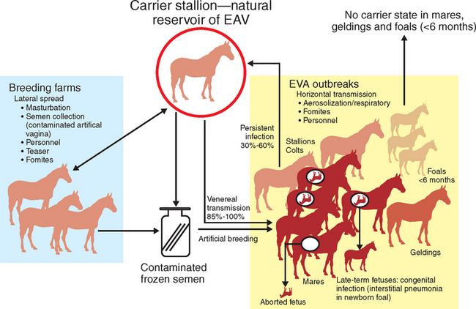
Equine arteritis virus can be transmitted on fomites including equipment, and may be spread mechanically by humans or animals.
This virus is inactivated in 20–30 minutes at 56-58ºC but can remain viable for 2 to 3 days at 37-38ºC and for up to 75 days at 4-8ºC.
Semen remains infectious after freezing.
https://veteriankey.com/equine-viral-arteritis-2/

Slide 56
Pathogenesis and Pathology
Infection of the lymphoid tissue of the nasopharynx then a leucopaenia and immunosuppresion.
Pathognomic medial necrosis of arteries. This lesion is responsible for
oedema,
haemorrhage and
more rarely, thrombosis and infarction.
Conjunctivitis and palpebral oedema give the name ‘pink eye’.
Oedema is also seen in the legs and lower abdomen.
Thoroughbred stallions have been shown to be intermittent or persistent shedders of virus, with the accessory sex glands (prostate and seminal vesicles) being the sites of persistence.
Virus infects the respiratory and alimentary tract resulting in nasal catarrh, coughing, dyspnoea (pleurisy), diarrhoea and colic.
Abortions occur 10-30 days after infection in 50% of pregnant mares. Congenital infection can also occur.

Slide 57
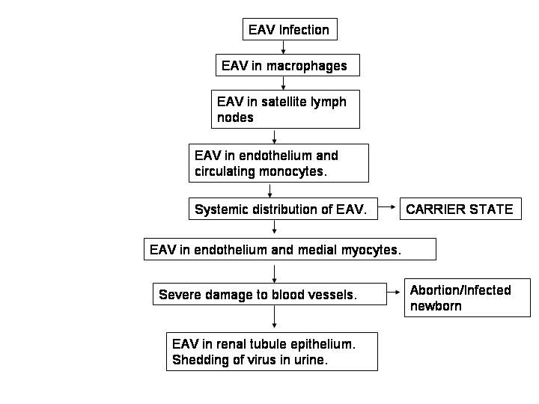
Through experimental and naturally infected models, the possible pathogenesis of this virus is understood.
1- The course of infection includes infection of the respiratory epithelium and alveolar macrophages first, and then onto the satellite lymph nodes.
2- The next stage of infection occurs at the bronchopulmonary lymph nodes, endothelium, and circulating monocytes; replication occurs here.
3- Systemic distribution of the virus follows and localization within the endothelium and medial myocytes of blood vessels and mesothelium occurs; severe damage occurs to blood vessels.
4- Apparently, the last site of invation is the renal tubular epithelium, where the virus may persist for an additional two weeks.
http://homepage.usask.ca/~vim458/virology/studpages2007/EVA/vet.html

Slide 58
Clinical Signs
The incubation period varies from 2 days to 2 weeks. Infections transmitted venereally tend to become apparent in approximately one week.
The incubation period varies from 2 days to 2 weeks.
Infections transmitted venereally tend to become apparent in approximately one week.
Fulminant infections with severe interstitial pneumonia and/ or enteritis can be seen in foals up to a few months of age.
Systemic illness also occurs in some adults.

Slide 59
In adult horses, the clinical signs may include
Fever
depression,
anorexia,
limb edema (particularly in the hindlimbs),
and dependent edema of the prepuce, scrotum, mammary gland and/or ventral body wall.
Conjunctivitis,
photophobia,
periorbital or supraorbital edema and
rhinitis can also be seen.
Some horses develop urticaria; the hives may be localized to the head or neck, but are sometimes generalized.
Abortions or stillbirths can occur in mares that are pregnant when they are exposed.
Temporary decreases in fertility, including reduced quality sperm and decreased libido, may be seen in stallions during the acute stage of the disease

Slide 60
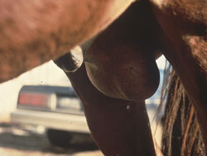
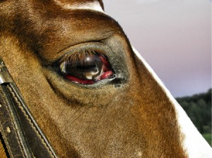
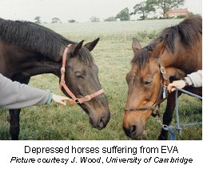
Horse, scrotum. Scrotal edema occurring in equine viral arteritis.
https://vcahospitals.com/know-your-pet/equine-viral-arteritis-eva
http://www.brandonlakesanimalhospital.com/client-resources/breed-info/equine-viral-arteritis-eva/

Slide 61
Diagnosis
Clinical
Equine viral arteritis should be considered when the clinical signs include fever, depression, edema, conjunctivitis, nasal discharges and abortions.
This disease is difficult to differentiate from other systemic and respiratory illnesses of horses.

Slide 62
virus isolation,
In recently infected animals, EAV may be recovered from nasal secretions, blood and semen as well as from a number of tissues and fluids at necropsy.
Carrier stallions can be identified by isolating the virus from semen; EAV is not found in the respiratory secretions, blood or urine of carriers.
This virus can be isolated in rabbit, equine and monkey kidney cells or cell lines. RK–13 (rabbit kidney) cells are the system of choice.
the detection of viral antigens or nucleic acids,
RT-PCR
Serology
virus neutralization, complement fixation (CFT), agar gel immunodiffusion (AGID), indirect fluorescent antibody, fluorescent microsphere immunoassay (MIA) and ELISA.

Slide 63
Differential diagnosis
The differential diagnosis includes
equine influenza,
equine infectious anemia and
African horse sickness,
Getah virus,
Hendra virus,
equine rhinitis A and B viruses,
equine adenoviruses,
equine herpesviruses 1 and 4.
purpura hemorrhagica and other streptococcal infections,
poisoning from the toxic plant.

Slide 64
Prevention and Control
Precautions should also be taken to avoid spreading the virus on fomites.
EAV is readily inactivated by detergents, common disinfectants and lipid solvents.
No specific treatment is available; however, most healthy horses other than young foals recover on their own.
Good nursing and symptomatic treatment should be used in severe cases.
Vaccination can also help contain outbreaks.

Slide 65
Venereal transmission can be controlled by good management and vaccination.
To protect pregnant mares from abortion, they should be separated from other horses and maintained in small groups according to their predicted foaling dates.
For example;
Mandatory notification,
annual testing,
the identification of carrier stallions and
control of transmission from these animals,
and selective vaccination are being used in New Zealand to eradicate equine viral arteritis.

Slide 66
References
http://www.cfsph.iastate.edu/Factsheets/pdfs/equine_viral_arteritis.pdf
https://veteriankey.com/equine-viral-arteritis-2/

Slide 67
Feline Calicivirus Infection

Slide 68
Feline calicivirus infection is a common respiratory disease in cats.
The virus attacks the respiratory tract -- lungs and nasal passages -- the mouth, with ulceration of the tongue, the intestines, and the musculoskeletal system.
It is highly communicable in unvaccinated cats, and is commonly seen in multicat facilities, shelters, poorly ventilated households, and breeding catteries.

Slide 69
Ethiology
Small (35nm in diameter),
non-enveloped spherical virion
Family name derived from the 32 cup-shaped (calix = cup) surface depressions which give a distinctive morphology in the electron microscope.
(+) sense, single-stranded (ss) RNA.
Reasonably resistant allowing survival in the environment.
Antigenity: Considered to be a single serotype but strains form an antigenic mosaic reacting with other strains to different degrees. Some show lack of cross-protection.
http://www.abcdcatsvets.org/feline-calicivirus-infection-2012-edition/

Slide 70
Transmission
Host range: Domestic cats & cheetahs. No zoonotic potential known or alternative hosts.
Transmission occurs mainly by direct contact or via fomites.
Aerosol transmission plays a minor role in spreading virus over distances of more than 1.3 m, probably because of the lack of viral aerosol production and the relatively small feline tidal volume.
As a nonenveloped virus, FCV is highly tolerant to environmental stressors, as opposed to other respiratory pathogens (eg, FHV-1), and persists for at least 1 month in a dry environment at room temperature and perhaps longer at cooler temperatures.

Slide 71
FCV is also more difficult to deactivate with disinfectants compared with most bacteria and enveloped viruses.
Immunosuppressed cats and those living under environmental stress (eg, overcrowding, poor sanitation) are most at risk for infection.
Young cats and kittens are most likely to show clinical signs of disease.

Slide 72
Pathogenesis
The main routes of infection are ocular, nasal, and oral.
The incubation period is 2 to 10 days.
Viral replication occurs mainly in the oropharynx but can occur at other locations depending on biotype.
This causes a variety of clinical presentations.
A viremic phase is thought to occur a few days after the initial infection and before tissue infection causes epithelial necrosis and vesicle formation.
The pathogenesis of virulent systemic feline calicivirus (VSFCV) could be enhanced by facilitated entrance into the circulation as either free or cell-associated virus.
VSFCV appears to have a broader tissue tropism than non-VSFCV.

Slide 73
Clinical Signs
FCV infection can cause acute oral and upper respiratory signs but also has been associated with chronic stomatitis, which may be immune-mediated.
Recently, a new syndrome, the “virulent systemic feline calicivirus (VS-FCV) disease” has been described.

Slide 74
1- Acute oral and upper respiratory tract disease
Clinical findings may differ, depending on the virulence of the FCV strain concerned, on the age of the affected cats and on husbandry factors.
While in some cases infection is subclinical, in many others, there is a typical syndrome of lingual ulceration and a relatively mild acute respiratory disease.
More severe signs can resemble the respiratory disease caused by FHV-1.
Mild epithelial defects after burst calicivirus aphthae ©Susann-Yvonne Mihaljevic
Characteristic tongue map-shaped lesions due to FCV infection ©Marian C. Horzinek

Slide 75
Oral ulcerations,
sneezing
serous nasal discharge are the main signs.
Fever
Anorexia,
hypersalivation due to oral erosions - located mainly on the tongue - They usually resolve after several days.
2- Chronic stomatitis
FCV can be isolated from nearly all cats with the chronic lymphoplasmacytic gingivitis/stomatitis complex, and many cats test positive by PCR.

Slide 76
3- Limping syndrome
An acute transient lameness with fever can be associated with FCV infection and vaccination.
In natural infection, it occurs a few days or weeks after the acute oral or respiratory signs

Slide 77
4- Virulent systemic feline calicivirus (VS-FCV) infection
The causative virus strains are most commonly referred to as “virulent systemic feline calicivirus” (VS-FCV); however, this term is somewhat misleading as all FCV infections are systemic - but the disease caused by other FCV strains is usually local.
The disease appears to be more severe in adults than kittens.
In contrast to the common strains, VS-FCV causes systemic disease characterized by
severe systemic inflammatory response syndrome,
disseminated intravascular coagulation (DIC),
multi-organ failure
commonly death.
Mortality is up to 67%.

Slide 78
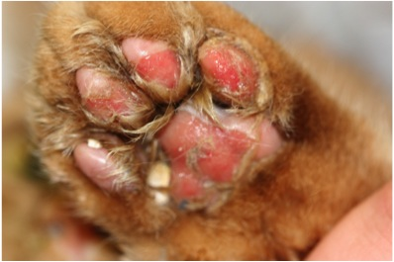
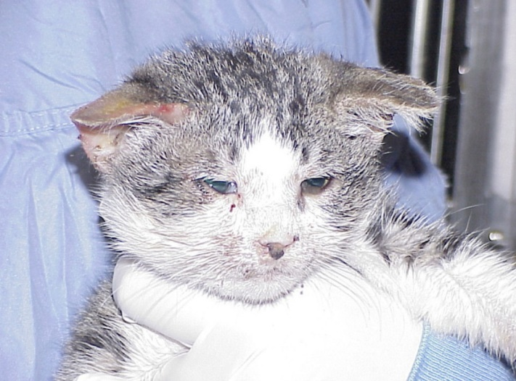
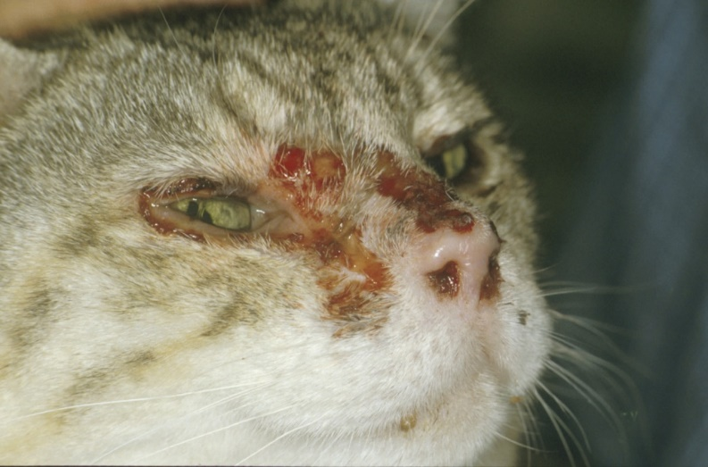
The clinical signs of this form of disease are variable.
The initial findings are frequently typical of a severe acute upper respiratory tract disease.
Characteristic signs are cutaneous oedema and ulcerative lesions on the skin and paws.
Oedema is located mainly on the head and limbs.
Crusted lesions, ulcers and alopecia can be seen on the nose, lips, and ears, around the eyes and on the footpads.
Viirulent systemic calicivirus disease, excoriations of paws ©Uwe Truyen
Crusted lesions and ulcers due to VS-FCV infection ©Tim Gruffydd-Jones

Slide 79
Diagnosis
The diagnosis of VS-FCV relies on clinical signs, high contagiousness and high mortality rate and isolation of the same strain from blood of several diseased cats, assessed by sequencing of hypervariable regions of the capsid gene.
Because of the asymptomatic carrier phase, and the fact that viruses in live vaccines may occasionally be shed post-vaccination, caution should be taken when interpreting any FCV positive result because of the poor correlation between the presence of virus and clinical signs

Slide 80
RT-PCR assays have been developed to detect FCV RNA in conjunctival and oral swabs, blood, cutaneous scrapings or lung tissue, depending on the clinical form and the outcome of the disease.
Virus isolation; FCV replicates in cell lines of feline origin; its rapid growth in tissue culture may compromise identification of concurrent herpesvirus.
Serology; FCV antibodies can be detected by virus neutralization or ELISA (Lappin et al., 2002). The seroprevalence is generally high in cat populations due to natural infection and vaccination.

Slide 81
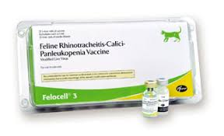
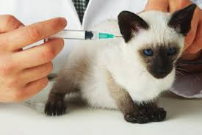
Prevention and Control
Management to limit or even prevent virus transmission is as important as vaccination in control.
Vaccination of the queen will not prevent virus shedding, but may be beneficial in ensuring that the kittens benefit from higher levels of Abs through the colostrum and milk, providing protection for the first month or so of life.
Shelter design and management should be aimed at avoiding cross infection of cats.

Slide 82
References
http://www.petmd.com/cat/conditions/infectious-parasitic/c_ct_feline_calicivirus
http://www.abcdcatsvets.org/feline-calicivirus-infection-2012-edition/

