Slide 1
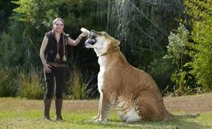
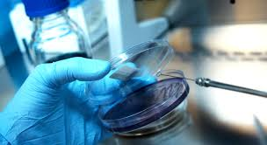
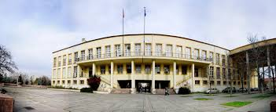
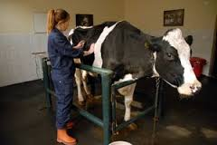
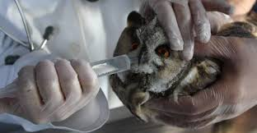
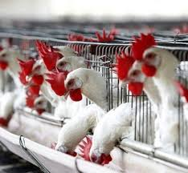
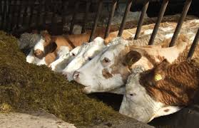
Feed Additives Dr. Özge SIZMAZ University of Ankara Faculty of Veterinary Medicine Department of Animal Nutrition and Nutritional Diseases, Ankara, Turkey

Slide 2
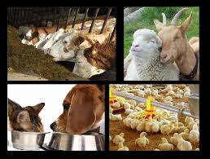
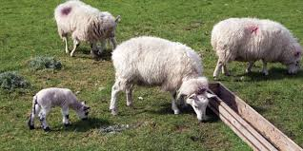
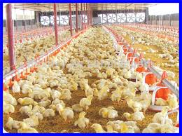
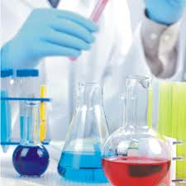
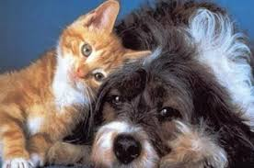
Emulgators-Stabilizers
The unmixed and insoluble liquid for breaking the tension between the upper surface and the boundaries of the two phases and for forming a stable and homogeneous state as a single phase in the form of small droplets of these two liquid phases is called the emulsion.

Slide 3
Emulgators-Stabilizers
2 samples for emulsion are:
Butter
Milk

Slide 4
Emulgators-Stabilizers
In milk
87,5% water (dispersion)
3,5% oil/fat (dispers)
Milk = oil emulsion in water
Because water amount is high

Slide 5
Emulgators-Stabilizers
In butter
Adverse stuation
Fat is dispersion and it can be diluated by adding different fats/oils.

Slide 6
Emulgators-Stabilizers
In animal nutrition
emulsions are formed for
diluetion of full fat milk
preperation of formula for calves
mixation of vitamins that are soluble in oil with water

Slide 7
Emulgators-Stabilizers
Lesitin
Contain linoleic, arachidonic, linolenic as well as stearic and glycerin, colin and phosphoric acid
In fatty seeds, yeast and egg yolk
Especially from soy and rape seed
Easily soluble in oil and ether
De novo from colin, neutral oil and phosphoric acid in intestine Wall.

Slide 8
Emulgators-Stabilizers
Glycerine
Neutral oils include triglycerid
One or two molecules remove from triglycerid = mono and diglycerides which are like emulgator form.
They are in cereal oils and other (oils and fats)
Add to formula 0,5-1,5%
All are digested in digestive system

Slide 9
Emulgators-Stabilizers
Fatty acid esters with sugar
The free carboxyl group of a long-chain fatty acid esterifies with sugar molecule, form sugar fatty acids.
Add to formula 0,5-1,5%

Slide 10
Emulgators-Stabilizers
Fatty acid glycerit polyglucol ether
The free OH group of mono or diglyceride is etherified with polyoxyethylene at different chain lengths.
This compound is whitish yellow, yellowish-white, sublime, fragrant and slightly soap flavor.
Add to oil 2,5%
When it is used as an emulgator, absorb from intestine without altering and is thrown through the kidney

Slide 11
Emulgators-Stabilizers
Stablizers
İs used for prevention the physicochemical structure of feed
Alginic acid, Na, K, amonnium and calcicum alginate, propilen glycol, agar, glycerol and sorbitol

