Slide 1
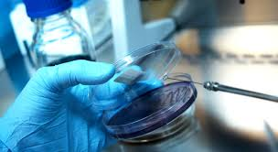
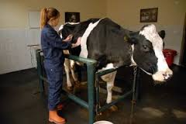
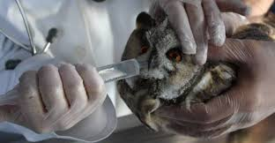
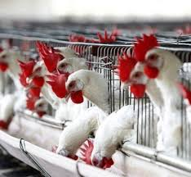
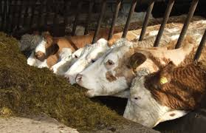
Feed Additives Dr. Özge SIZMAZ University of Ankara Faculty of Veterinary Medicine Department of Animal Nutrition and Nutritional Diseases, Ankara, Turkey

Slide 2
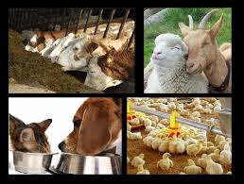
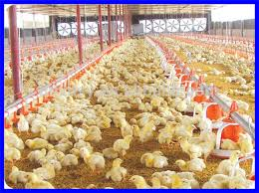
Buffers
In all biological liquid sum of positive charge is equal to sum of negative charge
Electrolites in ration give that charges to the body
Effective on electrical balance, acid-base balance and performance of animal

Slide 3
Buffers
Balance of acid-base;
anion and cation balance in ruminants
Electrolite balance in poultry
= difference between total anions and cations in rations/diets
Unit= miliequaval

Slide 4
Buffers
Absorbtion and metabolism complicate the definition of real amount and properties of balance
It is important to use electrolyte balance to correct any mineral deficiencies or toxicity in the construction of the ration
Exp: NaCl

Slide 5
Buffers
Acid base balance is important for all life
Anion cation balance important in dairies for performance
In dry period the ration must be anionic for prevention of milk fewer

Slide 6
Buffers
In poultry,
High temerature/ heat stress-increase the CO2 retention with respiration-change the electrolite balance- effected the;
Egg Shell quality
Health
metabolism

Slide 7
Buffers
In poultry,
To prevent from these negative effects,
Should arrange the balance
Especially should supply the NaHCO3 instead of NaCl

Slide 8
Buffers
The calculation formula:
Na + K – Cl
(Na + K) – (Cl + S) = miliequaval (mEq) or miliosmol (mOsm)
Additives are: ammonium sulphate, ammonium clorite, calcium sulphate, calcium clorite, magnesium sulphate and magnesium clorit

Slide 9
Buffers
Broiler and laying hens; 250 mEq/kg
Dairy cow; in dry period -100 -150 mEq/kg/KM
in lactation 300-400 mEq/kg/KM

