Slide 1
Acceptance of Islam by the Turks

Slide 2
Did the Muslims and Turks know each other before Islam?
Two possible ways:
1. Turks among Sasanid armies.
2. Through the Silk Trade Route Arabs and Turks met in economic activities.
In the Arab Jahiliyah Poetry Turks was mentioned as handsome, beautiful or brave person.
Prophet Muhammad used Turkish tent in his lifetime
1. in the battle of Uhud or Trench.
2. In his itiqaf practices during Ramadan.

Slide 3
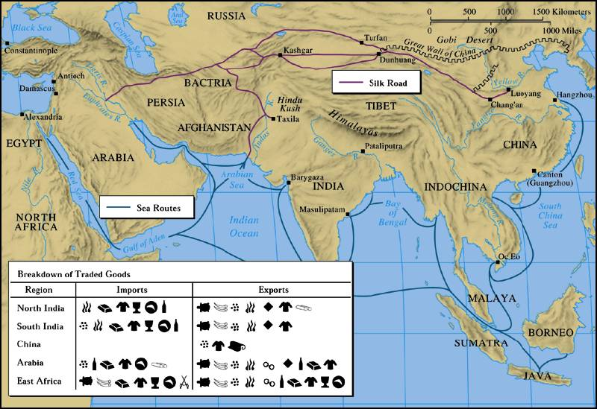
Trade Routes of the Ancient World

Slide 4
“Hadiths” on the Turks?
From the hadith literature (al-Kutub al-Sitta) narrations on the Turks.
"The Hour will not be established until you fight with the Turks; people with small eyes, red faces, and flat noses. Their faces will look like shields coated with leather. The Hour will not be established till you fight with people whose shoes are made of hair.”
"The Hour will not be established till you fight with people wearing shoes made of hair. And the Hour will not be established till you fight with people whose faces look like shields coated with leather.” (Abu Huraira added, "They will be) small-eyed, flat nosed, and their faces will look like shields coated with leather.”
Bukhari, Volume 4, Book 52, Number 179-180: Narrated by Abu Huraira

Slide 5
Religions they followed by Turks
Gök Tangri faith,
Manichaeanism,
Zoroastrianism,
Confucianism,
Buddhism,
Judaism
Christianity
Islam.

Slide 6
Some Factors to convert the Turks to Islam
1. Socio-religious activities of Muslims Colonies in the Turkish tribes
2. Converting Notables Turks
3. The Activities of Muslim Traders / Merchants
4. Activities of Sufi orders
5. Interfaith marriages between Turks and Arabs
6. Migration of Arab Muslims to Turkestan
7. Converting Turkish tribes a. the Karluqs b. the Seljuks

Slide 7
1. Activities of Muslims among the Turks
When non-Muslim Turks conquered a land, they had not forced anyone to make them convert to their religion as Muslims had done.
According to Qur’an ا اِكْرَاهَ فِي الدّ۪ينِ “There is no compulsion in the religion.” 2/256
This similarity caught non-Muslim Turks’ attention. Turkish soldiers in Muslim armies and Turkish origin slaves accepted Islam.

Slide 8
2. Converting Notables Turks
Muslims held Turkish princes as captives to be brought up as Muslims. When the Turks faced a defeat, the Muslim would ask for custody of the princes and princesses of the Turkish royal family on the excuse of holding them as a guarantee.
These royal captives would be brought up in the Islamic tradition and their minds inclined in favor of Islam.
The Shahada (declaration of the acceptance of Islam) was pronounced to them, and they were released to return to their kingdoms.

Slide 9
3. The activities of Muslim traders/merchants
The Silk Road was a great means of joining different civilizations together, its main role was economic but its social role appeared as a consequence. Spread of Islam to these regions was so unique. With relations with the Arab merchants, the Turks alongside the Silk Road thoroughly tested their morals and understood their personalities.
The dictum: “actions speak louder than words” was well embodied in the Islamic history, namely the spread of Islam in many non-Muslim countries through the good conduct of Muslim merchants who came into commercial contacts with the people of those countries.

Slide 10
4. Activities of Sufi orders
One of the influential means of preaching Islam among the Turks was Sufism. Although there were some Sufi activities in Turkestan, mainly the spread of Sufism among Eastern Turks began with Ibrahim b. Adham al-Balkhy (d. 777), Shakik al-Balkhy )d. 809), Hallaj al-Mansur (d. 922) and Ahmad Yasavi (d.562/1166).
The Sufis preached Islam to understanding level of Turks, with clear and basic language.

Slide 11
5. Interfaith or mix marriages between Turks and Arabs
Interfaith marriage can be defined as a marital union in which the partners believe and belong to different faith or religious traditions. Sometimes, the words ‘interfaith marriage’ and the words ‘mix marriage’ are used interchangeably.

Slide 12
6. Migration to Turkestan
Since the beginning of conquest, many Arab Muslims had migrated to Turkestan. They came as soldiers, immigrants and asylum seekers or as part of family reunification.

Slide 13
7. Converting Turkish tribes/ clans
With a Muslim at the helm in a non-Muslim Turkish clan, the conversion of the rest of the clan to Islam was only a matter of time. This was one of the tactics used by the Muslims to infiltrate Islam into the Turkish nation. Conversion of the Karluqsand Saljuks to Islam

Slide 14
The Battle of Talas 1
The victory of Muslims in Central Asia occurred at the Battle of Talas (751). The Turkish rulers, such as the Buhar-hudat Tughshade and Samarkand ruler Gurak, sent a delegation to China, for help against the Arabs.
In 751 a Chinese general, Gao Xianzhi, marched across the mountains, sacked the city of Tashkent and executed its ruler. This ruler’s son fled to Samarqand for help. With Turkish troops in support, Gao confronted the Arabs on the River Talas, north of Tashkent, in today’s Kazakhstan. But the Turkish troops changed sides at the last moment, and the Chinese were defeated.

Slide 15
Battle of Talas 2
The Battle of Talas was not a big battle, but it had far-reaching consequences.
1. The Islamic rule over Transoxiana was secured.
2. It put an end to China’s ambitions for a western empire, placing East Turkistan beyond her grasp for the next thousand years.
3. In large masses the Turkic people living in Turkistan began to convert Islam.
4. Some Chinese inventions and practices transmitted to Muslim Civilization such as gun powder, paper manufacturing, porcelain etc.

Slide 16
Main Contributions of Islam to the Turks
1. Tawhid: Believing one god
2. Written culture
3. urbanization
4. worldly supremacy in the lands and the seas
5. new civilization
5. new geographical direction: to west
6. kept their national identity

Slide 17
Contributions of the Turks to Islamic Civilisation
1. Spreading Islam: India, Balkans, Eastern Europe, Anatolia
2. Defending Islam and Muslims: From East, the polytheist Mongols such as Karakhitays and Genghisis. From West, the crusaders and European imperialism.
3. Establishing Madrasas by the Seljuks
4. Scientific contributions: Farabi, Ibn Sina, Al-Harazmi, Az Zamahsary etc.
5. Military Order: Introduction of decimal ranks, war tactics
6. Architecture: Tombs, spacious and tall domes, stone masonry
7. Administration: serving as governor, wazir, hajib etc.

