Slide 1
Fundamentals of Biological Sciences
Lecture6
Dr. Açelya Yılmazer

Slide 2
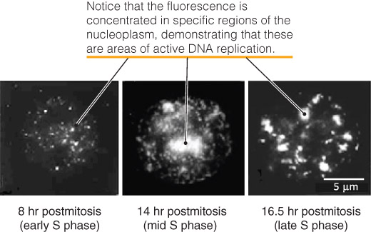
DNA Replication Occurs at Sites Called Replication Factories
Figure 07.08: DNA replication factories appear as bright spots of fluorescently tagged, newly synthesized DNA. Reproduced with permission from J. Cell Sci., vol. 107 (8): 2191–2202. [http://jcs.biologists.org/cgi/content/abstract/107/8/2191].
Photos courtesy of Peter R. Cook, University of Oxford.

Slide 3
RNA Polymerase Complexes and Spliceosomes Are Distinct Structures within the Nucleus
RNA polymerase complexes are responsible for transcribing the DNA sequence in genes into:
mRNA
rRNA
tRNA
other RNAs
Spliceosomes are responsible for splicing the newly synthesized RNAs into their mature form

Slide 4
DNA Polymerases
DNA polymerases add deoxyribonucleotides to the 3′ end of DNA strand
DNA polymerases proofread their work
Figure 07.10: DNA is synthesized in the 5′ -to-3′ direction to permit DNA polymerase to proofread the new strand.

Slide 5
DNA Replication Is Semi-discontinuous
DNA replication begins at sites on chromosomes called origins of replication
During replication, specialized proteins unwind and separate the two strands to form a replication fork

Slide 6
DNA Replication Is Semi-discontinuous
DNA replication begins at sites on chromosomes called origins of replication
During replication, specialized proteins unwind and separate the two strands to form a replication fork

Slide 7
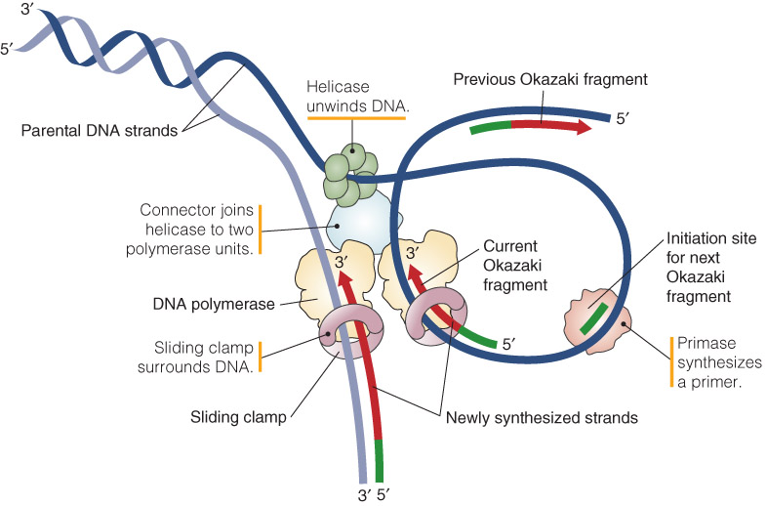
Figure 07.14: The helicase creating the replication fork is connected to two DNA polymerase catalytic subunits, each of which is held onto DNA by a sliding clamp.
DNA Replication Is Semi-discontinuous

Slide 8
DNA Replication Is Semi-discontinuous
DNA replication requires an RNA primer
leading/lagging strand
Okazaki fragments
DNA ligases join fragments of single-stranded DNA
Figure 07.15: Fusion of replication bubbles.

Slide 9
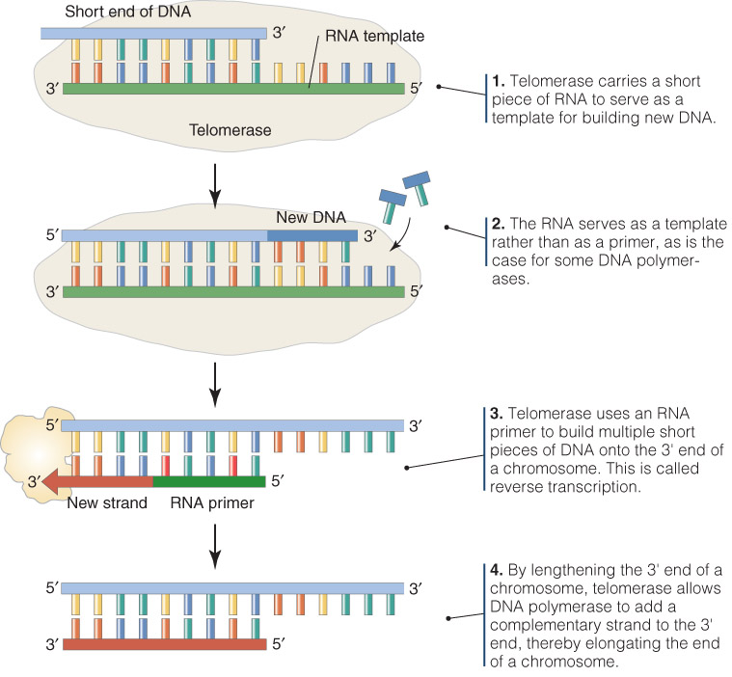
Replication of DNA at the End of Chromosomes Requires Additional Steps
Figure 07.16: Four features of telomerase.

Slide 10
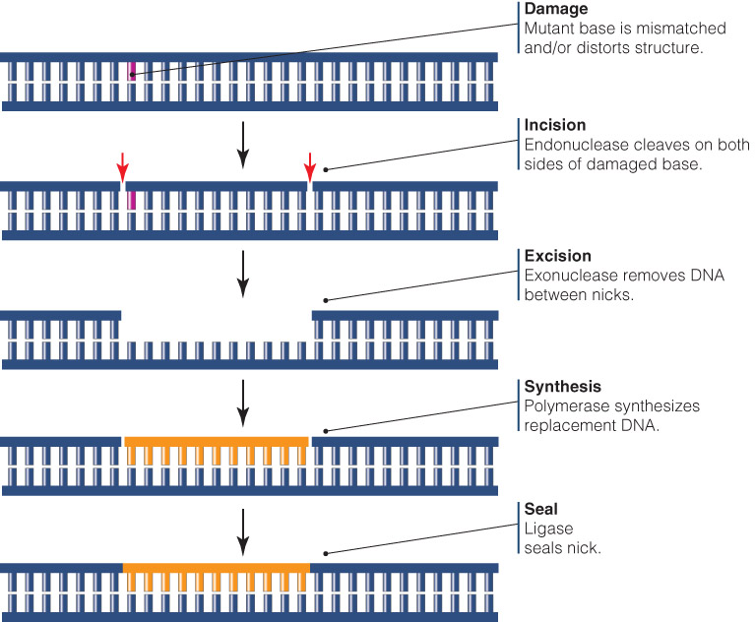
Cells Have Two Main DNA Repair Mechanisms
Excision repair systems
Mismatch repair
Recombination repair
Figure 07.17: Excision repair replaces a damaged strand.

Slide 11
Mitosis Separates Replicated Chromosomes
Key Concepts:
The function of mitosis is to safely separate replicated chromosomes into two daughter cells
Mitosis is divided into five phases, based largely on morphological changes in the location and arrangement of chromosomes
The microtubule cytoskeleton, including microtubule motor proteins, is essential for proper segregation of chromosomes
The actin cytoskeleton is required for the actual division of one cell into two daughter cells following mitosis

Slide 12
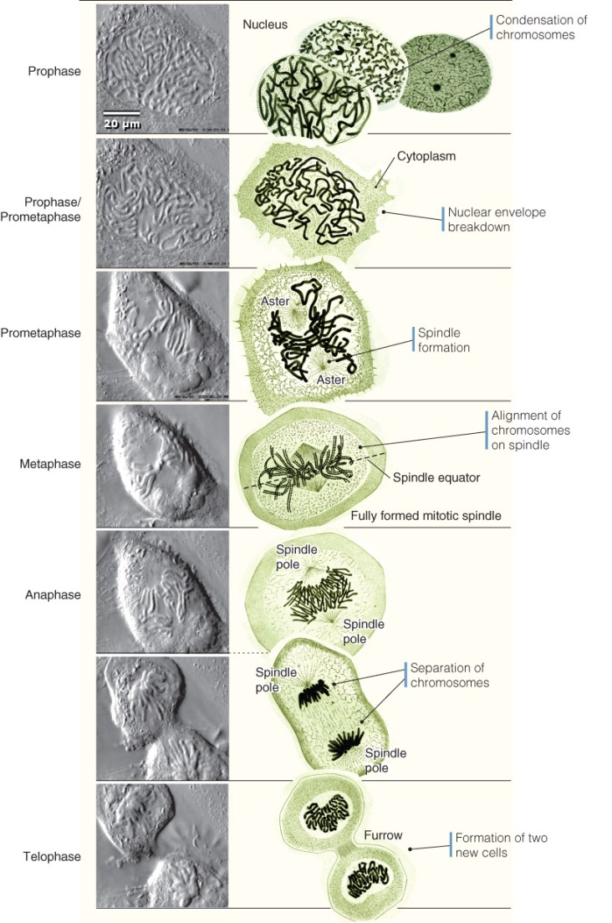
Mitosis Is Divided into Stages
1879—Walther Flemming described the motion of what he saw under the microscope as “threads” (Greek, mitos) moving in an actively dividing cell
Figure 07.18: The events of mitosis. Photos © Conly L. Rieder, Wadsworth Center. Illustrations from W. Flemming, Archiv für Mikroskopische Anatomie. Berlin: J. Springer (1871).

Slide 13
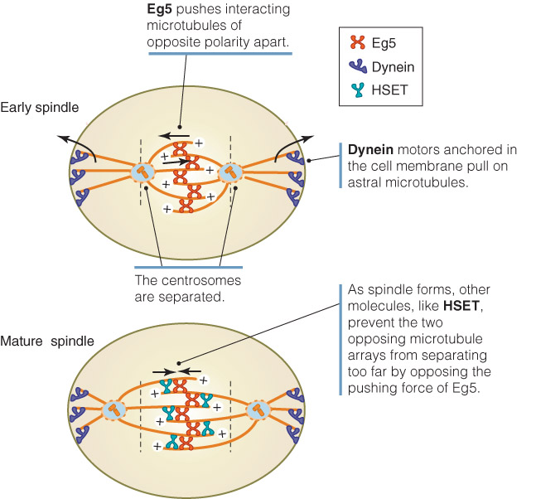
Motors Contribute to the Formation of the Mature Spindle in Prophase
Dynein motor proteins
Kinesin-related motor proteins
Figure 07.20: Microtubule motors help form the mitotic spindle.

Slide 14
Arrival of the Chromosomes at the Spindle Equator Signals the Beginning of Metaphase
Metaphase plate = spindle equator
Chromosome recombination takes place during metaphase

Slide 15
Anaphase: The Separation of Chromosomes
Anaphase Promoting Complex (APC)
Tags securin with ubiquitin, leading to its degradation
Loss of securin frees separase, an enzyme that helps break chromatids apart by digesting cohesin

Slide 16
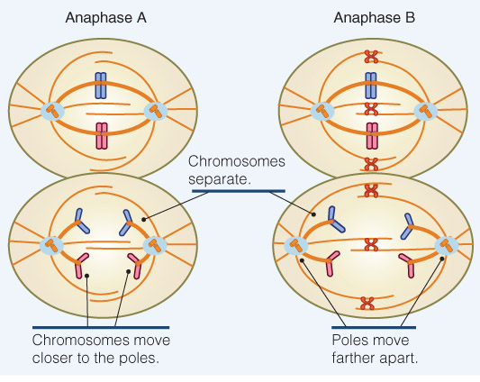
Separation of Chromatids at the Metaphase Plate Occurs During Anaphase
The onset of anaphase requires dissolving the connections between sister chromatids
APC
Anaphase is subdivided into two phases:
anaphase A
anaphase B
Figure 07.25: As the chromosomes move to the poles (anaphase A), the poles themselves move farther apart (anaphase B), increasing the separation between them.

