Slide 1
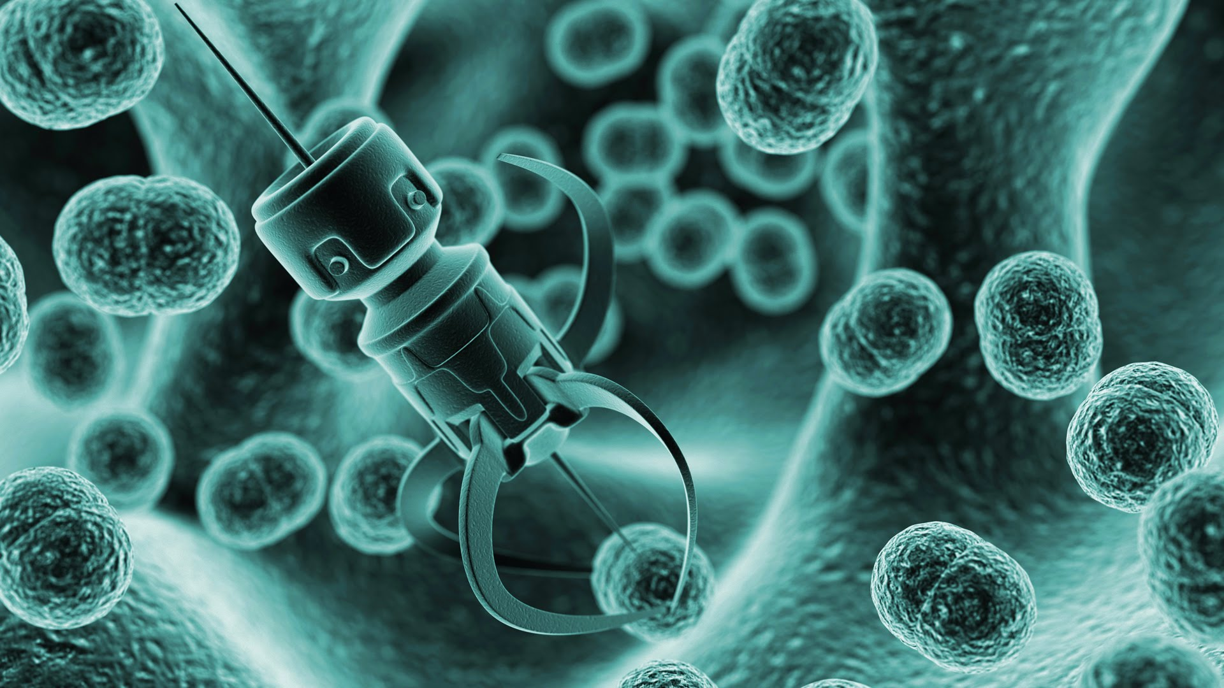
INTRODUCTION TO NANOMEDICINE
Assist. Prof. Dr. Açelya Yılmazer Aktuna

Slide 2
Nanotechnology
Nano is 1×10⁻⁹ m.
Nanotechnology deals with structures with a size range of 1 to 100 nm.
It`s based upon molecular self-assembly

Slide 3
Nanotechnology
AT the nano level, materials begin to demonstrate entirely new chemical and physical properties.
Materials can be stronger, lighter and highly soluble , reducing of melting point ……

Slide 4
Nanotechnology
BY manipulating the arrangement of atoms nanotechnology may be able to create many new materials and devices .

Slide 5
Nanomedicine
•It is the medical application of nanotechnology.
•Defined as: the repair, construction and control of human biological systems using devices built upon nanotechnology standards.

Slide 6
Nanomedicine
Nanomedicine is a huge industry.
Sales reached 6.8 billion dollars in 2004. USA and European Union are investing billions of dollars and plan to invest more in the future.

Slide 7
Application of Nanomedicine
• Diagnostic:
Imaging and identification
• Therapeutic:
Delivering medication to the exact location.
Killing of bacteria, viruses & cancer cells
Repair of damaged tissues

Slide 8
Drug Delivery
Drug delivery: refers to approaches, formulations, technologies, and systems for transporting a pharmaceutical compound in the body as needed to safely achieve its desired therapeutic effect.
By the help of nanomedicine:
The rate at which the drug stays in the body can be manipulated .
It can help in increasing the bioavailability of the drug and biodistributions .
So it will reduce side effects .
It can icrease the solubility of the drug.

Slide 9
Types of drug delivery systems in nanomedicine
A fullerene is a molecule of carbon
in the form of a hollow sphere, ellipsoid, tube, and many other shapes.
a synthetic polymer with a branching, tree-like structure
a minute spherical sac of phospholipid molecules enclosing a water droplet, especially as formed artificially to carry drugs or other substances into the tissues
Nanoparticles have simple core structures with neutral, cationic, or anionic surface chemistries

Slide 10
Example for Cancer Treatment
Nanospectra Biosciences AuraLase® Therapy.
Nanoparticles known as Aurashells® are directly injected into the body.
Localize around tumor because of its “leaky” vasculature.
Laser emitting infrared waves is inserted into tumor and turned on.
Nanoparticles heat up and destroy cells.

Slide 11
Diagnostic use: Imaging
Nanomaterials are being used extensively as contrast agents in non-invasive medical imaging tools, including computed tomography, magnetic resonance, positron emission tomography, single photon- emission computed tomography, ultrasound, and optical imaging
The contrast agents used: nanosized metal oxides, dendrimers, quantum dots, etc.

Slide 12
Improved Imaging of Tumors
Nanoparticles made of a metal such as magnesium oxide.
Coated with antibodies found specifically in cancer cells.
Nanoparticles localize around cancer.
MRI done would should a more detailed image of where the cancer is.

Slide 13
Surgery
There are difficulties and blood leaks caused when the surgeon tries to re-stitch the arteries that have been cut during a kidney or heart transplant.

Slide 14
Example for Surgery
Nanoparticles of cadmium selenide (quantum dots) glow when exposed to ultraviolet light. When injected, they seep into cancer tumors. The surgeon can see the glowing tumor, and use it as a guide for more accurate tumor removal.

