Slide 1
EME 201 Materials Science
Mechanical Properties of Metals

Slide 2
Mechanical Properties of Metals
The mechanical behavior of a material reveals the response or deformation of the material depending on the applied load or force.
Key mechanical design features of materials are strength, hardness, toughness and ductility.
The mechanical properties of the materials are determined by carrying out carefully designed laboratory experiments to increase the service conditions as much as possible.
Factors, which have to be considered, include environmental conditions as well as the quality and duration of the applied load.
The load application time can be only a fraction of the second, or it can be prolonged for many years.
In addition, the service temperature can be an important factor.

Slide 3
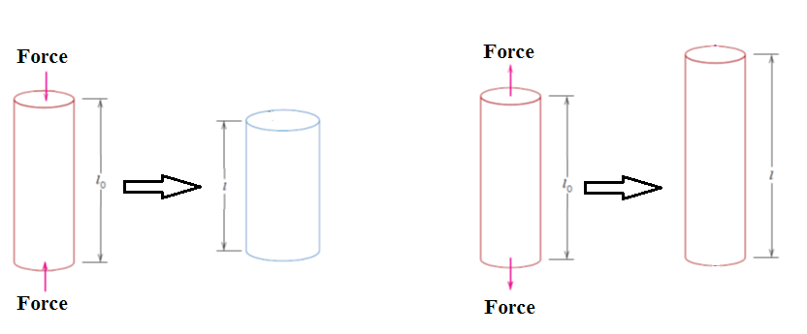
CONCEPTS OF STRESS AND STRAIN
There are two principal ways in which a load may be applied: tension and compression as shown below.
Figure 1. Schematic illustration of (a) tensile load and elongation (b) compressive load and contraction

Slide 4
Tension Tests
One of the most common and commercial mechanical tests is the stress–strain test, which is performed in tension.
The tension test may be used to determine several important mechanical properties of materials, which are crucial in design.
The dogbone shaped specimen is used during the tensile test.
This specimen configuration was chosen because the deformation resulted from the applied load is confined to the narrow center region.
Figure 2. A standard tensile test specimen with circular cross section

Slide 5
Tension Tests
The output of the tensile test is recorded as load versus elongation or force versus elongation.
The output of the tensile test depend on the specimen size.
To eliminate or at least to minimize the geometrical factors, load and elongation are normalized to the respective parameters of engineering stress and engineering strain by using the following equation:
σ = F/Ao
where
-F = the instantaneous load applied perpendicular to the specimen cross section,
-A_{o} = the original cross-sectional area before any load is applied

Slide 6
Tension Tests
Engineering strain ϵ is defined according to the following equation:
ϵ = Δl/lo
Where
-l₀ = the original length before any load is applied,
-Δl = the change in the original length of the specimen
Engineering stree has a unit of Mpa or psi
However, engineering strain is unitless.
The engineering strain can also be expressed as a percentage, where the strain value is multiplied by 100.

Slide 7
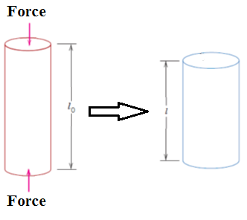
Compression Tests
Compression stress-strain tests can be performed if the in-service forces are of this type.
The compression test is carried out in a similar manner to the tensile test, but the force is compressive and the sample narrows in the direction of tension.
Tensile test is more common when compared with comression test because it is easier to perform.
In addition, very little additional information is obtained from compression tests for most materials used in structural applications.
Figure 3. Schematic illustration of compression test

Slide 8
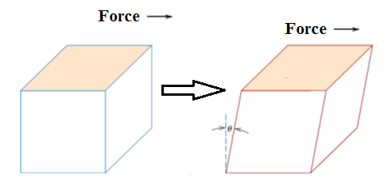
Shear and Torsional Tests
For the mechanical test performed using a shear force, the shear stress τ can be calculated using the following equation:
τ = F/Ao
Where
-τ = the shear stress
-F = the force applied parallel to the upper and lower faces
-Ao = the area of the upper and lower faces
Figure 4. Schematic illustration of shear test

Slide 9
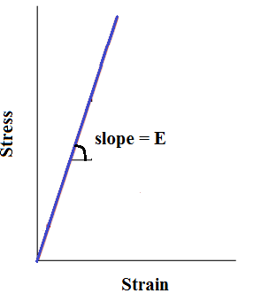
STRESS–STRAIN BEHAVIOR
Stress and strain are proportional to each other throughout the relationship, known as Hooke’s law
The slope of this linear portion of the stress-strain graph refers to the modulus of elasticity E.
The elastic modulus can be thought of as stiffness, or it can be thought of material’s resistance to elastic deformation.
The larger the modulus value, the stiffer the material or the smaller the elastic tension caused by the application of the particular stress.
The elastic modulus is an important design parameter for calculating elastic deviations.
The elastic deformation is not permanent, that is, when the applied load is released, the specimen turns in its original shape.
Figure 5. Schematic illustration of engineering stress–strain

Slide 10
REFERENCES
William D. Callister, ‘Materials Science and Engineering: An Introduction’, Seventh edition, John Wiley & Sons, Inc., U.S.A.
Brian S. Mitchell, ‘AN INTRODUCTION TO MATERIALS ENGINEERING AND SCIENCE FOR CHEMICAL AND MATERIALS ENGINEERS’, John Wiley & Sons, Inc., U.S.A, 2004.
J. W. Martin, ‘Materials for Engineering’, Third Edition, WOODHEAD PUBLISHING LIMITED, Cambridge, England.
Donald R. Askeland & Pradeep P. Fulay, ‘Essentials of Materials Science and Engineering’, Second Edition, Cengage Learning, Toronto, Canada.
G. S. Brady, H. R. Clauser, J. A. Vaccari, ‘Materials Handbook’, Fifteenth Edition, McGraw-Hill Handbooks.

