Slide 1
PHA 297: Laboratory Safety
Fıre emergency

Slide 2
FIRE EMERGENCIES IN INTRODUCTORY COURSES
A beaker of acetone, a very flammable organic solvent, was placed near a hot plate. The acetone fumes, heavier than air, crept along the top of the bench and at some point the frayed electrical wiring of the hot plate generated a spark and ignited the fumes. An instructor’s clothing caught fire. One alert student safely extinguished the fire and another wrapped the instructor in a fire blanket. There were no serious injuries or damage.
What lessons can be learned from this incident?
Fires in laboratories can be incredibly dangerous. Besides the danger of receiving burns, burning chemicals can produce toxic fumes and the risk of explosions. Fortunately, in introductory lab courses the nature and amounts of flammable substances are quite limited so that “worst case” scenarios and explosions are not likely.

Slide 3
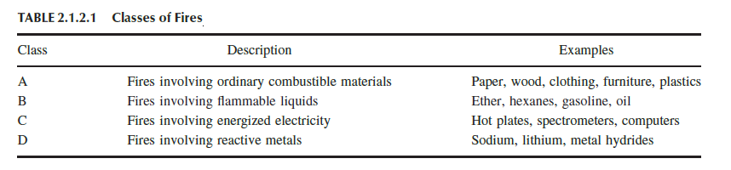
Most laboratories do not use water (extinguishers) because fires with chemicals and electrical equipment should be extinguished with other agents. Class B fires are burning organic liquids. Gasoline that is burning inside an automobile engine is a controlled Class B fire. Class C fires are any fires (Class A or Class B) that also involve energized electricity. A burning computer is a Class C fire. Since this raises the possibility of fatal electrical shock, water should never be used on a Class C fire. Class D fires are pretty rare outside of specific chemical laboratories or workplaces.

Slide 4
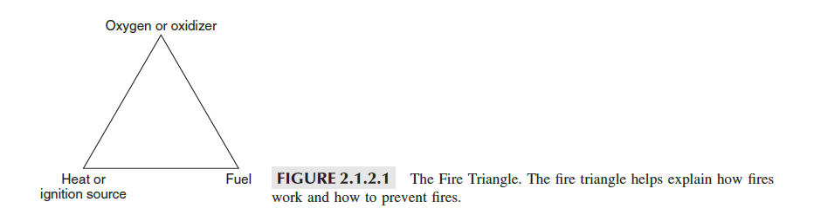
The Fire Triangle and the Fire Tetrahedron
For many years, fire scientists considered fire to consist of three components: oxygen, fuel, and heat. These three features comprised the fire triangle.

Slide 5
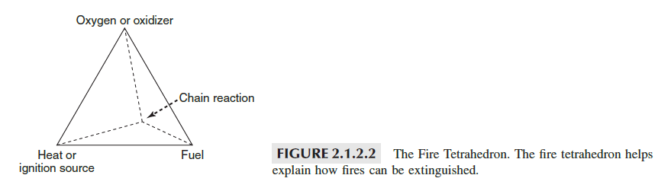
We can use the fire triangle to think about how to prevent a fire from starting by not allowing all three components to meet. Keeping any one of them away from the other two will prevent a fire from starting. We use the fire triangle to understand how to prevent fires. We now better understand the details of the chemistry of fire and this triangle has been replaced by the fire tetrahedron because there is a fourth element that is needed to explain how fires are extinguished.

Slide 6
How Fires Burn
It may surprise you to learn that liquids and solids don’t burn! This statement seems at odds with the common experience of paper, wood, or gasoline burning, but in fact, at the molecular level, the solid or liquid has to be vaporized before it will burn. When a match ignites paper or some flammable liquid, the heat from the match first pyrolyzes (decomposes) the material so that some vapor is produced.

Slide 7
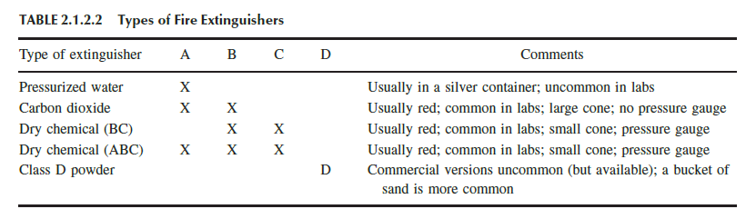
Classes of Fires and Types of Fire Extinguishers
Since most lab fires are Class B and/or Class C fires, water is usually not a good first choice to extinguish a fire in a lab. The only exception to this would be, for example, a situation where some papers caught on fire in a lab. This is clearly a Class A fire and can be doused easily with water or by, if possible, moving the papers into a nearby sink and turning on the water. Water extinguishes a Class A fire primarily by cooling the burning fuel. Type A extinguishers are not likely to be found in laboratories. This removes the “heat” from the fire tetrahedron and the fire stops burning.

Slide 8
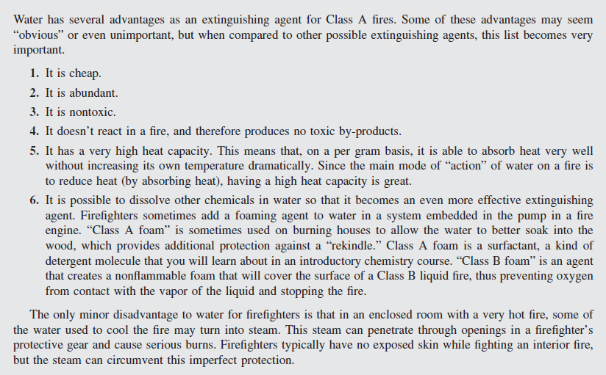
WHY FIREFIGHTERS LOVE WATER

Slide 9
Carbon Dioxide Extinguishers
A common type of fire extinguisher to be found in a lab is a heavy metal container with several pounds of liquid carbon dioxide inside and a large wide-mouth black nozzle. The CO₂ extinguisher is for Class B or Class C fires. The vapor pressure of liquid CO₂ at 20 ◦C is about 58 atm.
When this extinguisher is discharged, gas immediately exits the extinguisher through a large nozzle and is reduced to local atmospheric pressure. The method of extinguishing the fire is to reduce the concentration of atmospheric oxygen to a very low level by creating a “blanket” of CO₂ gas at the site of the fire.
This momentarily extinguishes the fire, and in the case of a burning liquid, the rate of vaporization of the liquid is greatly reduced. For just a moment, no more fuel or heat is available to allow the fire to continue to burn. After the CO₂ quickly dissipates and oxygen returns, the heat from the fire is gone and the fire can’t restart.
Thus, even though the fuel and oxygen are present, interrupting the fire eliminates the heat needed to continue chemical reaction. Most liquids have lower heat capacities so the liquid itself never gets very warm.

Slide 10
What happens if a CO₂ extinguisher is used on a Class A fire such as a burning piece of wood?
The fire is momentarily extinguished due to the lack of oxygen, but when the CO₂ dissipates the very hot wood can easily reignite when oxygen returns. Thus, CO₂ extinguishers should not be used on class A fires.
CO₂ extinguishers are good for Class B fires (organic liquids) but can also be used successfully on some Class C fires. An electrical fire might be extinguished by a CO₂ extinguisher. However, unless the equipment is deenergized by shutting off the electricity supply, the fire may restart. Similarly, solvent fires might reignite if there is sufficient source of heat (besides the heat of the fire itself, which will be eliminated once the fire is extinguished).

Slide 11
Dry Chemical Extinguishers
There are two types of dry chemical extinguishers: BC and ABC, referring to the classes of fires that they extinguish. BC dry chemical extinguishers contain powder that is designed to coat the surface of a flammable liquid and to eliminate the vaporization of the liquid. This stops fire since no more fuel is available.
ABC dry chemical extinguishers work like BC, except that the powder used is also selected so that it forms a sticky solid layer on solid (Class A) materials. This layer prevents oxygen from attacking the fuel, even though it may still be hot enough to burn.
If you use dry chemical extinguishers on electronic equipment, such as computers or laboratory instrumentation, the electronics will likely be seriously damaged. A CO2 extinguisher is a preferable “first choice” extinguisher on electronic equipment, if you have the choice of what type of extinguisher to use. It is more likely that you will use whatever extinguisher is available. Most electronic equipment in the introductory lab is relatively inexpensive, in the range of thousands of dollars, particularly in comparison to advanced instruments, which can cost hundreds of thousands or even millions of dollars. Extinguishing the fire at the cost of destroying an instrument, to prevent a larger fire with more damage, is a top priority.

Slide 12
All portable fire extinguishers work the same way. This commonality of design makes them easy to use. An easy way to remember how to use the extinguisher is the PASS technique: pull, aim, squeeze, and sweep.
• Pull the pin. Fire extinguishers have a safety pin near the handle to prevent accidental discharge. This pin should be secured in place with a plastic tie that can be broken with a good tug on it. If, even with adrenaline flowing, you cannot break the tie by pulling, try to twist it to break it or place the extinguisher flat (sideways) on the ground, kneel on it and pull the pin to break the plastic tie.
• Aim the extinguisher at the base of the fire. Sometimes there is a detachable nozzle connected to the extinguisher by a flexible hose. In other designs the nozzle may simply “swing up” from the side.
• Squeeze the handle to begin the discharge. Dry chemical extinguishers make a little noise and CO₂ extinguishers make a loud noise!
• Sweep the discharge back-and-forth horizontally across the base of the fire.

Slide 13
What If You Are on Fire?
If an incident occurs that sets your clothing on fire, there are a few ways to respond to this. Burning clothing, or skin, is a Class A fire. Since responding very quickly is important, the fastest effective response is the best one when several choices are available.
Burning clothing can sometimes be extinguished by the “stop, drop, and roll” method, where the victim rolls on the floor. The rolling action will extinguish some of the fire; it is helpful if others also “pat” the area of the fire starting at the head and moving down the body. “Patting” with a towel or a jacket will help protect the hands of those who are helping. Do not “pat” a burning person with your bare hands or while wearing gloves that could melt.

Slide 14
Should You Fight the Fire?
A small fire can usually be extinguished by a trained person with the proper extinguisher. But, life preservation trumps property loss. Only try to fight a fire if:
• It is a “small fire.” There is no clear definition of small, but “flames from floor to ceiling” or “an
entire lab bench” is not a small fire. If it seems too big, it is too big.
• You have the correct extinguisher and can retrieve is rapidly.
• You know how to use the extinguisher.
• You always keep an exit available away from the fire. Never allow a fire to get between you and
your only exit.

Slide 15
CHEMICAL SPILLS: ON YOU AND IN THE LABORATORY
Most solids don’t present high hazards when spilled since they do not disperse easily. If some solid chemical is spilled at your lab bench, a dispensing area, or in a balance room, you should have someone “protect the area” so that other students are aware of the spill and can avoid any contamination and then notify your instructor about the spill. Your instructor may tell you how to clean up the spill or someone else may take care of it. When cleaning up a solid spill, it is usually best to use a small brush and dustpan to gather most of the solid. This should not be returned to the original bottle, since it is almost certainly contaminated with trace amounts of dirt or dust.
The first and best response to any liquid spill is to immediately clear the area of all people and quickly notify an instructor. In academic labs, it is very likely that identifying what was spilled will be fairly easy. Since liquids spread easily, if possible to do so safely, it is best to build a small “dike” around the spill area using sand, an absorbent material, or a “spill pillow” that both absorbs the liquid and prevents further spread. Containing the spill is best, but you should not put yourself at risk to do this. If you use a spill kit, you should tell someone in authority about the incident and particularly note that the spill kit was used. Returning an “empty” spill kit to a shelf is unsafe since it will not be ready for a subsequent emergency!

Slide 16
Splashes in Your Eyes
Probably the most harmful thing that could happen to you is to have a chemical splashed into your eyes. This is why you are required to wear chemical splash goggles in the laboratory. But what should you do if you do get a chemical splash into your eyes? Each laboratory will be equipped with eyewash stations that are made especially for rinsing your eyes in the event of a splash.
Most eyewash units are designed to operate hands-free once activated by pushing a plate or pulling the unit down to activate water flow. The valve stays open and water continues as long as it is in the open position. Here are several important things that you should know about eyewashes.
• Know where your eyewash is located.
• Make sure access to the eyewash is kept clear and unobstructed—not blocked by equipment or
objects in front of it or around it.
• Learn how to operate it.
• Flush it at least once a week to remove any debris or bacterial growth that might have accumulated in the eyewash over time. Allow the water to run for about 3 minutes. Some eyewashes have covers over the heads to provide protection against dust accumulation. These should be easily removed.
• Make sure water flow comes evenly from each eyewash head. Water streams should cross.
• Tell your instructor if you find the eyewash is not operating correctly.

Slide 17
Using Emergency Eyewashes
In the event of splash in your eyes, you should remember to do the following:
1. Flush your eyes immediately at the eyewash for a minimum of 15 minutes—this is a long time but you want to be sure that the chemical is removed as much as possible when you seek medical assistance.
2. If possible, seek assistance to find the eyewash and to help you in washing your eyes. Hold your eyelids open or get someone else to hold your eyelids open. It is a natural reflex to want to close your eyes in the event of a splash but this only retains the chemical and it is critical that you remove as much of the chemical as possible from your eye. If you have contacts, remove them if this is easy to do—but if it is difficult just continue to rinse. Move your eyeball around as the water continues to wash to make sure that you have covered all areas of the splash.
3. Seek medical assistance immediately after washing to ensure the chemical has been removed, to assess any eye damage, and to determine if further treatment is needed. Get information about the chemical, including its name and properties, preferably from a Materials Safety Data Sheet so the physician or medical person can evaluate the need for treatment. However, do not delay getting the person to medical care while someone searches for this information.

Slide 18
Washing Splashed Chemicals from Your Body——Using Emergency Showers
Each laboratory should have an emergency shower. Sometimes these showers are located in the hall just adjacent to the laboratory so they serve several laboratories at once. These showers are to be used if you spill large quantities of chemicals on your body and clothing. Some safety showers are called deluge showers because they release a large volume of water very rapidly—usually >75 liters per minute and do not shut off until all of a specified volume of water has been released. Other safety showers have a handle that pulls down to the on position and when the handle is released it shuts off. Be prepared, this water will be cold! All areas where there are corrosives or other chemicals that could injure the body should have emergency showers.

Slide 19
• Emergency showers should be used in the event of a chemical splash or spill on your body and clothes. They can also be used to extinguish fire if your clothing is burning.
• Stand under the shower and pull the handle or chain to activate the valve that releases the water flow.
• Clothing soaked in chemicals can do serious injury to the body so you need to remove all contaminated clothing, including shoes, socks, and jewelry that might have chemicals trapped on them. Do not attempt to wipe off the chemical from the clothing.
• Remove the contaminated clothing carefully so that the chemical does not get splashed in your eyes or on some other part of the body.
• Residence time of the chemical on your body is critical so removing contaminated clothing and washing the area under a shower should be done as quickly as possible.

Slide 20
• Modesty can be a hindrance that can result in more serious injury. Assist modest people, reassuring them of the importance of removing contaminated clothing. If possible try to provide screening of a sort to assist in preserving modesty.
• Try to get assistance to help remove clothing. This is particularly important if the person is dazed and does not respond quickly.
• Clothing may need to be cut off—do this with care to avoid further injury to the person and to you if you are assisting in removing clothing.
• A clean laboratory coat can be used for warmth and modesty after the shower.
• Clothing that is contaminated needs to be handled as hazardous waste.
• After the shower has removed the chemical, seek medical assistance to evaluate potential injuries from the chemical. If possible bring a Material Safety Data Sheet to the physician; however, do not delay seeking medical treatment to look for this information.

Slide 21
The key steps in responding to a chemical spill are:
• Evacuate. Depending on the size of the spill and the hazards posed by the chemical, it may be necessary to evacuate the immediate area or the entire building.
• Communicate. You should alert someone, preferably your laboratory instructor or assistant, that there has been a spill. If you know the nature of the spill, you should relay this information so that appropriate action can be taken. You should alert others of the possible hazard and advise them to avoid this area.
• Isolate. If possible, try to limit the extent of the spill (for liquids) by containing the spill with sand or other appropriate material.
• Mitigate. With your instructor’s permission and guidance you may participate in cleaning up the spill. However, you should not attempt to clean up any but the most trivial spill without help from someone with more training.cuate the immediate area or the entire building.

