Slide 1
Electrochemistry is involved in the transport of electrons in matter, the conversion of electrical energy into chemical energy, and the conversion of chemical energy into electrical energy. It deals with events that both use electricity and generate electricity. Electrochemistry also forms the basis of oxidation - reduction reactions based on electron exchange.

Slide 2
There are two types of electrical conductivity.
Metallic conductivity (electronic conductivity): Electrons and the current is carried in one direction. Electrons must be taken from the other side to provide current.
Electrolytic conductivity: It is the conductivity seen in the solutions and the transport of the current is through the + and - charged ions in the solution. Current is also transported in two direction. This conductivity increases with temperature and concentration. This conductivity is also related to the transport of ions through ions.

Slide 3
A full electronic circuit is required to obtain an electric current. If an electrolytic conductive compound is placed between this closed circuit, chemical reactions take place on the electrodes. As a result, the electric energy is used to bring about a chemical change. This is called electrolysis. Electrolysis cell is described as a mechanism that converts electrical energy into chemical energy.

Slide 4
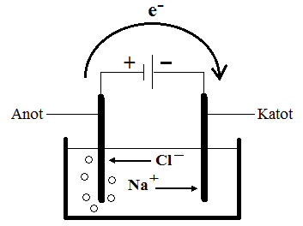

Slide 5
The electrode that is oxidized is called the anode.
The electrode that is reduced is called the cathode.
Oxidation is electron loss, and reduction is electron gain. ANION to the moving ions towards the anode, CATION to the ions moving towards the cathode.

Slide 6
Faraday’s law is divided into two basic laws
The change of an electric current or the amount of reduced and oxidized matter in the interfaces is directly proportional to the amount of electricity passing through the solution.
Quantity of matter = amount of electricity = current intensity x Time;
w = Q = I x t.
The unit of Q is Kulon, the unit of I is Amper and the unit of time (t) is
The amounts of the various substances that reduced and oxidized in the interfaces with the same amount of electricity, are proportional to equivalent weights.

