Slide 1
Ecology and Environmental Biology
Dr. Nüket BİLGEN

Slide 2
Decomposition and Nutrient Cycling
Most essential nutrients are recycled within the ecosystem.
What is the source of this essential nutrients?
Athmosphere
Soil: mineral materials stored on the immediate surface of the earth
Litter: humus leaf litter
Biomass: living organisms mainly plant tissue.

Slide 4
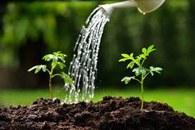
Nutrients gets into food chain
Nutrients
Nutrients

Slide 5
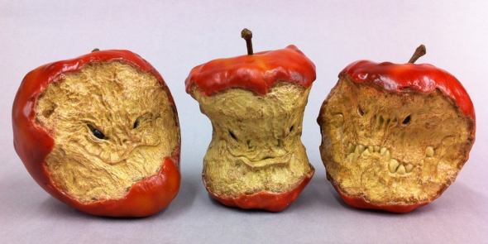
Nutrients stored in the organic compounds.
after the living tissue deterioate with age nutrients return to the soil.

Slide 6
Nutrient Cycling
Various microbial decomposers transform the organic nutrients into mineral form,
This process makes minerals available for plant uptake
Plants use this minerals forming new tissues.

Slide 7
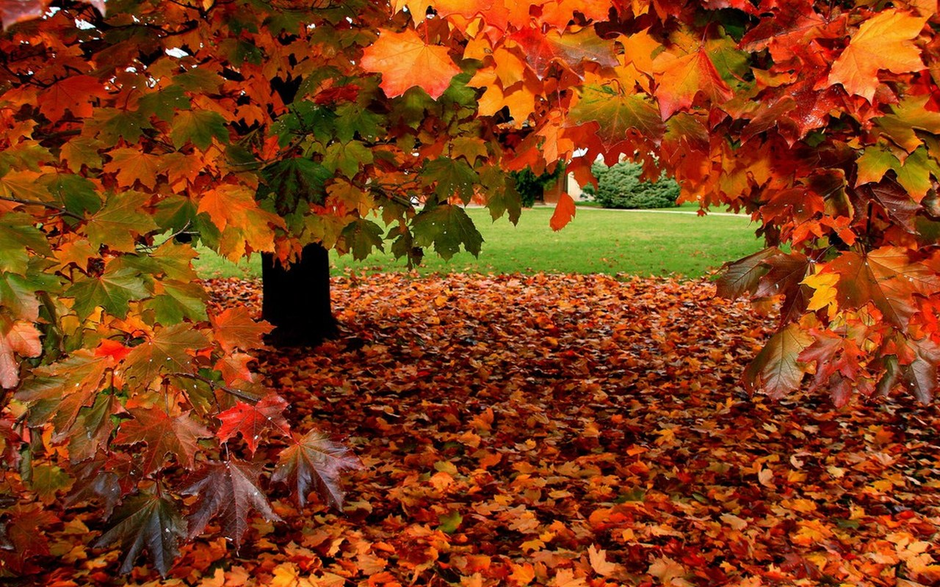
Nutrient Cycling
Plants can also benefit from processes called:
Retranslocation : minerals within the plant translocated to other parts of the plants during autumn

Slide 8
Decomposition
Decomposition?
Decomposition steps
Fragmentation
Digestion
Leaching,
Extraction
Why? Remember: Biomass is the main source of nutrients.

Slide 9
Decomposition
Invertebrate detrivores are responsible in decomposition.
4 major groups: (body width)
Microfauna- microflora (<100um) protozoa and nematods.
Mesofauna (100um-2mm) mites, potworms and spring tails
Makrofauna (2-20mm)
Megafauna (>20mm)

Slide 10
Fungi and bacteria are major decomposers of plant and animal tissue.
Megafauna (such as earthworms) have major influence on soil structure. Plants, animals remains and fecal materials used in feding.

Slide 11
Factors influencing decomposition process

Slide 12
Factors influencing decomposition process
Highest decomposition rates ocur during warm, wet conditions.
Which relating decomposition directly to climate.

Slide 13
Nutrient mineralization
Microbial decomposers breakdown chemical bounds in dead organic matter.
Organic matters become inorganic matters.
This process called nutrient mineralization.
Nutrient immobilization: organism uses some of the minerals.
Net mineralization: mineralization- immobilization

Slide 14
Rate of nutrient recycling
Nutrients cycle through the ecosystem is directly related to the rates of primary productivity (nutrient uptake) and decomposition (nutreint release)

Slide 15
Nutrient cycles
The health of our ecosystems depends on the balance of:
Carbon, Nitrogen, Phosphorous, Hydrogen and Oxygen
C N P H O
National Research Council's report on Research Pathways for the Next Decade (NRC, 1999): "Water is at the heart of both the causes and effects of climate change."

Slide 16
Water Cycles between earth and atmosphere
Water cycle is also referred as Hydrolic cycle.
the continuous cycle in which water changes from water vapor in the atmosphere to liquid water through condensation and precipitation and then back to water vapor through evaporation, transpiration, and respiration

Slide 17
https://pmm.nasa.gov/education/sites/default/files/videos/Earths_Water_Cycle_HQ.mp4

Slide 18
The Water Cycle
Water cycles between the oceans, atmosphere and land. All living organisms require water.
Precipitation and evaporation are a vital for water cycle.
Water enters the atmosphere as water vapor, a gas, when water evaporates from the ocean or other bodies of water.
Evaporation—the process by which water changes from a liquid to a gas.
Water can also enter the atmosphere by evaporating from the leaves of plants—Transpiration.

Slide 20
The Water Cycle
Precipitation--rain, snow, sleet, or hail
a. The sun heats the atmosphere.
b. Warm, moist air rises and cools.
c. Eventually, the water vapor condenses into clouds.
d. When the clouds become large enough, the water return to Earth’s surface.

Slide 21
The Carbon Cycle
Every organic molecule contains the element carbon.
carbon dioxide gas (CO₂), an important component of the atmosphere.
Carbon dioxide is taken in by plants during photosynthesis and is given off by plants and animals during cellular respiration.
Carbon cycle: Biological processes, such as photosynthesis, cellular respiration, and decomposition, take up and release carbon and oxygen.

Slide 22
The Carbon Cycle
Geochemical processes, such as erosion and volcanic activity, release carbon dioxide into the atmosphere and oceans.
Mixed biogeochemical processes, such as the burial and decomposition of dead organisms and their conversion under pressure into coal and petroleum (fossil fuels), store carbon underground.
Human activities, such as mining, cutting and burning forests, and burning fossil fuels, release carbon dioxide into the atmosphere.

Slide 23
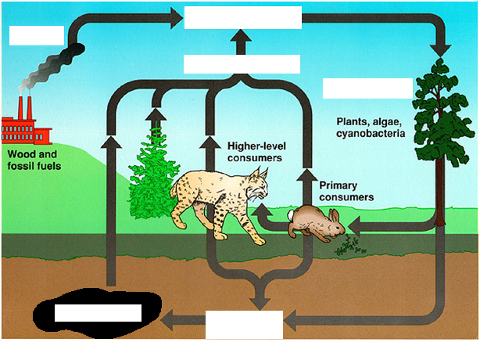
CO₂ in Atmosphere
Burning of Fossil Fuels
Cellular Respiration
Photosynthesis
Coal and Petroleum
Decomposition of dead organisms

Slide 24
Nitrogen cycle
Nitrogen is converted into multiple chemical forms as it circulates among the atmosphere, terrestrial, and marine ecosystems.
It includes both; biological and physical processes.
nitrogen cycle: fixation, ammonification, nitrification, and denitrification.

Slide 26
Nitrogen fixation
Conversion of nitrogen into nitrates and nitrites through atmospheric, industrial and biological processes is known as nitrogen fixation.
lightning strikes and bacteria
Azotobacter: Rhizobium. Symbiotic nitrogen-fixing bacteria usually live in the root nodules of legumes (such as peas, alfalfa, and locust trees).

Slide 28
Nitrogen assimilation
Plants can absorb nitrate or ammonium from the soil via their root hairs. If nitrate is absorbed, it is first reduced to nitrite ions and then ammonium ions for incorporation into amino acids, nucleic acids, and chlorophyll.
In plants that have a symbiotic relationship with rhizobia, some nitrogen is assimilated in the form of ammonium ions directly from the nodules.

Slide 29
27

Slide 30
Ammonification, mineralization
When a plant or animal dies or an animal expels waste, the initial form of nitrogen is organic.
Bacteria or fungi convert the organic nitrogen within the remains back into ammonium (NH⁺₄), a process called ammonification or mineralization.

Slide 31
31

Slide 32
Nitrification and Denitrification
Both are done by soil living bacteria.
Nitrification: conversion of ammonium to nitrate. Done by soil-living bacteria and other nitrifying bacteria.
Denitrification: reduction of nitrates back into nitrogen gas (N₂), completing the nitrogen cycle.
The denitrifying bacteria use nitrates in the soil to carry out respiration. consequently produce nitrogen gas, which is inert and unavailable to plants.

Slide 33
Lightning %5-8
how does lightning affect the nitrogen cycle?
The produced energy during lightning breaks nitrogen-nitrogen bounds and converts nitrogens to nitrogen oxides. Which are soluble in the water.
Water carry down this compound in the soil and plants can use this form.

Slide 34
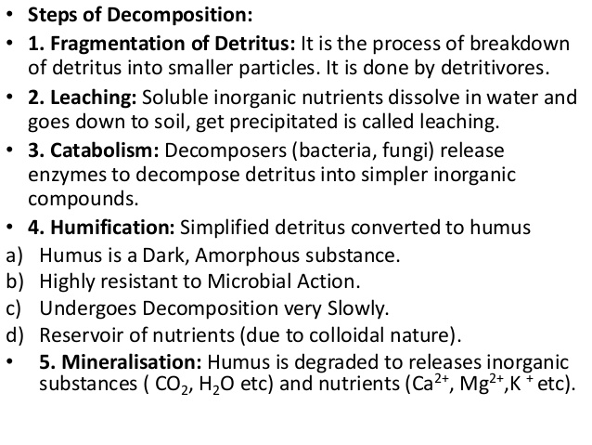

Slide 35
https://www.youtube.com/watch?v=5Fwj6TrARvo

Slide 36
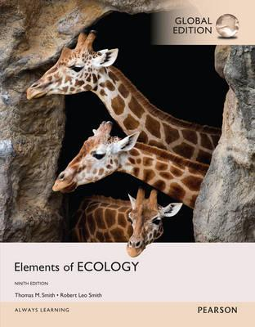
References
1- https://www.youtube.com/watch?v=ZouWWVyz9v8
2- http://www.climatedata.info/forcing/albedo/
3- http://astrocampschool.org/greenhouse-effect/
4- https://sites.google.com/a/gsbi.org/gvc1506/environment/greenhouse-effect
5- https://spaceplace.nasa.gov/seasons/en/
← Source material of this lecture
Further reading
McCarty, J. P., Wolfenbarger, L. L. and Wilson, J. A. 2017. Biological Impacts of Climate Change. eLS. 1–13.

