Slide 1
Ecology and Environmental Biology
Dr. Nüket BİLGEN

Slide 2
Population
Population: group of individuals of the same species that inhabit given area and time.
Same species→ in sexually reproducing organisms
Spatial boundary→ limitation of the place and time.

Slide 3
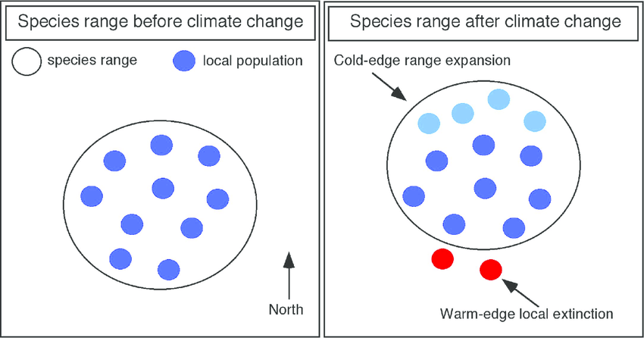
Define individual
What is an individual?
Examples?
Distribution
Distribution is based on the presence and absence of organism.
Geographic range

Slide 4
Population distribution
Influenced by;
Habitat: the natural environment of an organism; place that is natural for the life and growth of an organism.
Suitable environment, resource conditions.

Slide 5
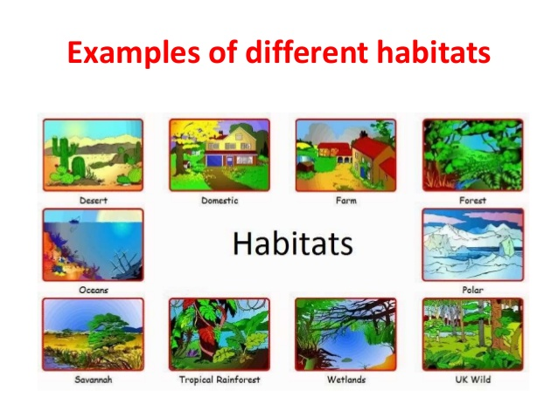
https://www.slideshare.net/bassantnour/habitat-71409435

Slide 6
Organisms can be divided in two according to their distribution
Ubiquitous: A species with a geographically widespread distribution
Endemic: distribution is restricted to certain area.

Slide 7
Endemic species of Turkey
invertebrate species in Turkey is about 19,000, of which about 4,000 species/subspecies are endemic.
vertebrate species identified to date is nearly 1,500. over 100 species are endemic, including 70 species of fish.
Anatolia is home to the Fallow Deer and the Pheasant.
https://www.iucn.org/content/biodiversity-turkey

Slide 8
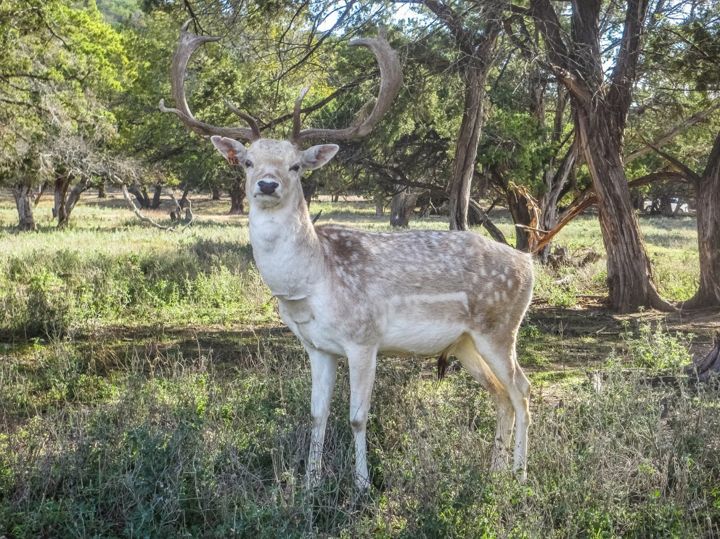
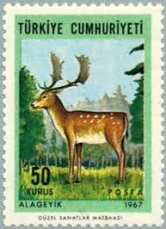
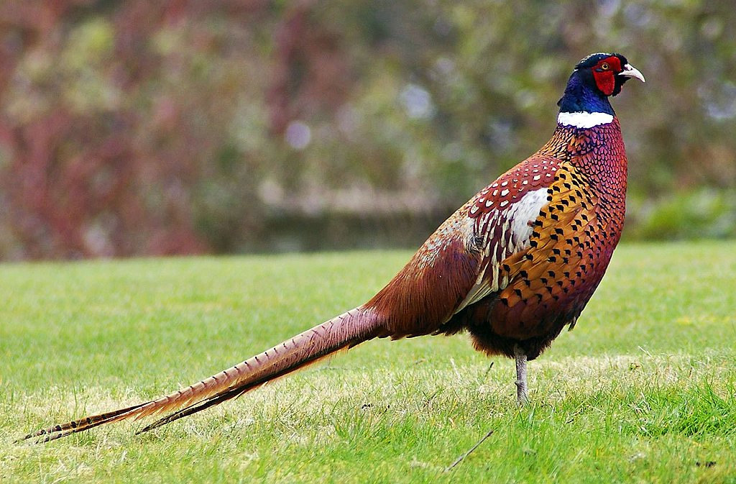
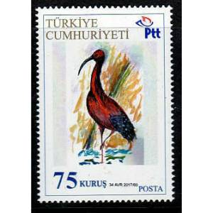

Slide 9
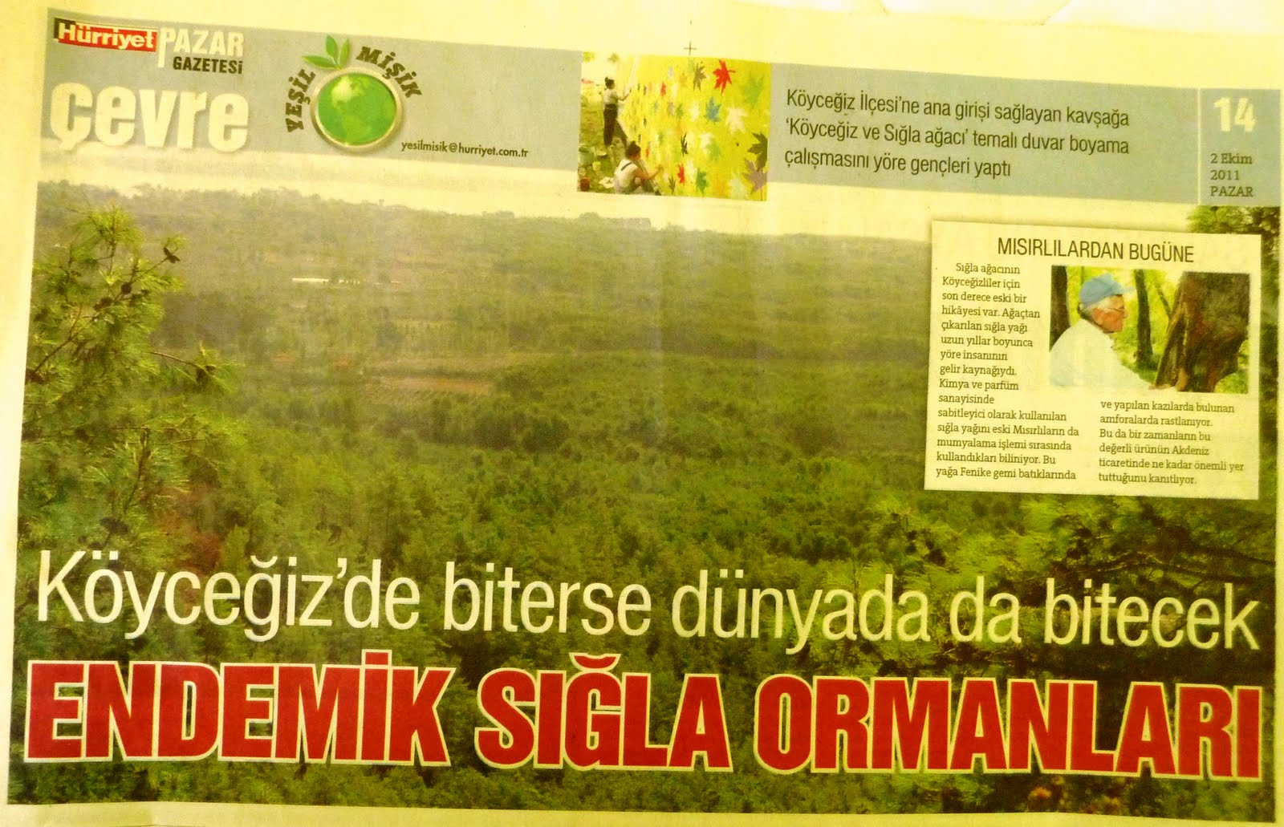
What are the factors limiting an organism’s distribution?
It is hard to define limits for organisms, but for some organisms, we can get an idea about the distribution of individuals by looking at areal photographs.

Slide 10
Species
a group of living organisms consisting of similar individuals capable of exchanging genes or interbreeding.
The species is the principal natural taxonomic unit, ranking below a genus and denoted by a Latin binomial
https://www.google.com.tr/search?q=species+definition&oq=species+definition&aqs=chrome..69i57j0l5.5077j0j7&sourceid=chrome&ie=UTF-8

Slide 11
A
B
Evolutionary
change
Evolutionary
change
Speciation:
Divergence, followed by
evolutionary change.
Divergence

Slide 12
Two types of speciation
1) Allopatric
2) Sympatric

Slide 13
1) Allopatric speciation
evolutionary change occurring in different geographic ranges.
Due to living in different geographic regions ancestral population divides;
each can undergo independent evolutionary change.
In the end this individuals can not even mate.

Slide 14
Geographic barriers
Eventhough the habitat over the mountain, sea, or lake or river is suitable for organism since the seeds can not reach over the area, than distribution is limited by geographic barrier.
Environment is a heterogene term.
Why?
Remember biotic and abiotic factors.
Temperature, humidity, soil sturucture, plants…

Slide 15
As a result of heterogene environment populations are divided into subpopulations.
Subpopulations occupying suitable habitat patches.

Slide 16
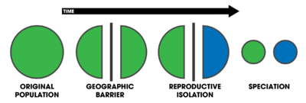
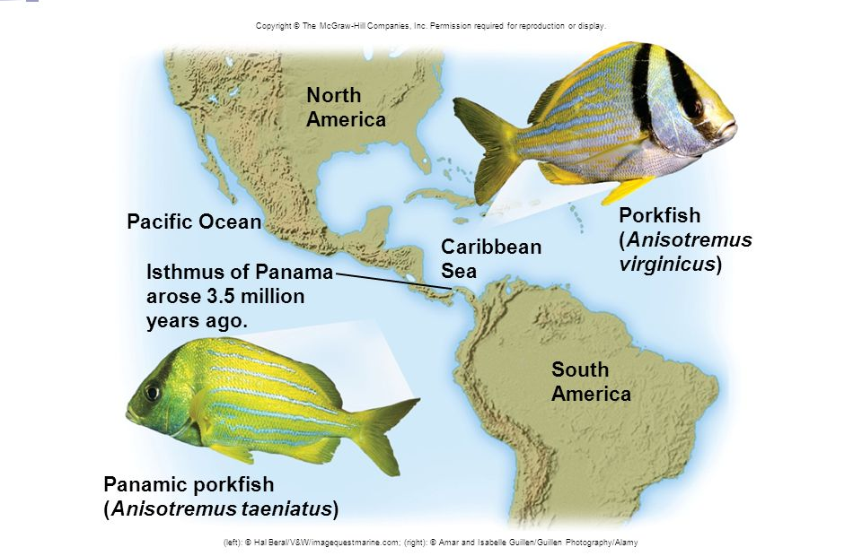
https://www.google.com.tr/search?q=Allopatric+speciation&source=lnms&tbm=isch&sa=X&ved=0ahUKEwjJ04OLjOzaAhXBJ5oKHSI0BVwQ_AUICigB&biw=1366&bih=613#imgrc=gwgCHC9nMjydTM:

Slide 17
2) Sympatric speciation
evolutionary divergence occurring in same (overlapping) geographic ranges.
Rare in nature,
but may occur by:
- Initial disruptive selection (e.g., different food sources).
- Local ecological niche specialization (e.g., races/ecotypes)

Slide 18
2) Sympatric speciation
a series of mutations may isolate a subpopulation from the parental population as interbreeding fails.
This may also occur due to interspecies hybridisation and/or chromosomal doubling/autopolyploidy.
Frogs!

Slide 19
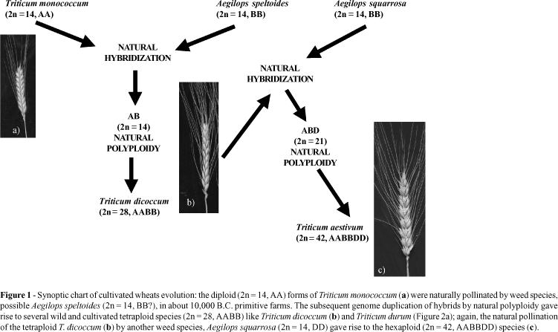
Wheats

Slide 20
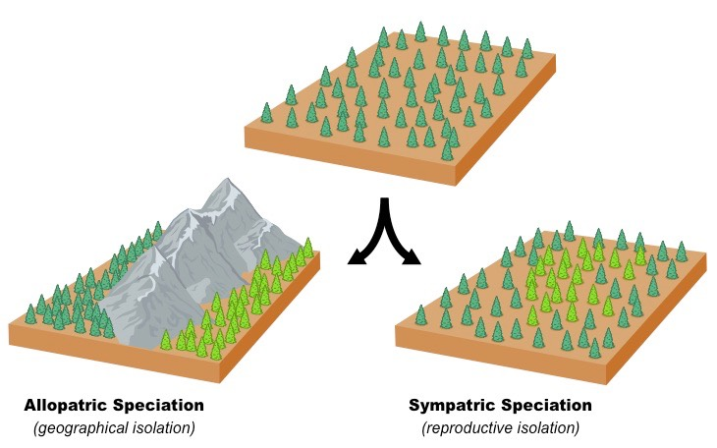
Summary

Slide 21
Reproductive Isolating Mechanisms
Geographic
  Continental Drift
  Volcanic events
  Mountain uplifting
  Changes in sea level
  Changes in climate
  Island formation

Slide 22
Reproductive Isolating Mechanisms (Genetic)
Polyploidy = evolution of chromosome number. Like in the wheat example.
that is multiple of an ancestral set.
Hybridization of 2 species followed by polyploidy ----> instant speciation.
Polyploid hybrid reproductively isolated
from both parents.

Slide 23
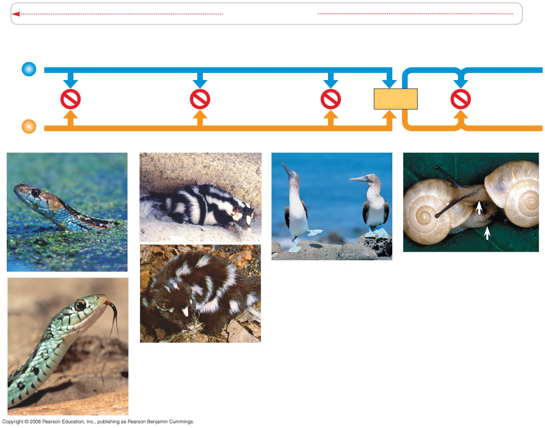
Reproductive Isolating Mechanisms (Genetic)
PRE-ZYGOTIC (pre-mating)
i) Habitat isolation - differences in habitat preference
ii) Temporal isolation - differences in timing of reproduction
garter snakes: aquatic vs. terrestrial species
spotted skunk species: mate in different seasons

Slide 24
Reproductive Isolating Mechanisms (Genetic)
PRE-ZYGOTIC (pre-mating)
iii) Behavioral (sexual) isolation - differences in behavioral responses with respect to mating
mating “dances” of birds differ among species

Slide 25
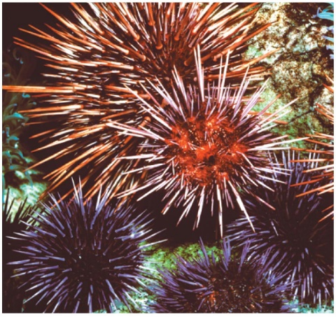
Reproductive Isolating Mechanisms (Genetic)
PRE-ZYGOTIC (post-mating)
iv) Mechanical isolation
- differences in
sex organs,
don’t “fit”
v) Gametic isolation
- sperm / egg
incompatibility
left- vs. right-handed snail species can’t mate
sperm & egg of different sea urchin species incompatible

Slide 26
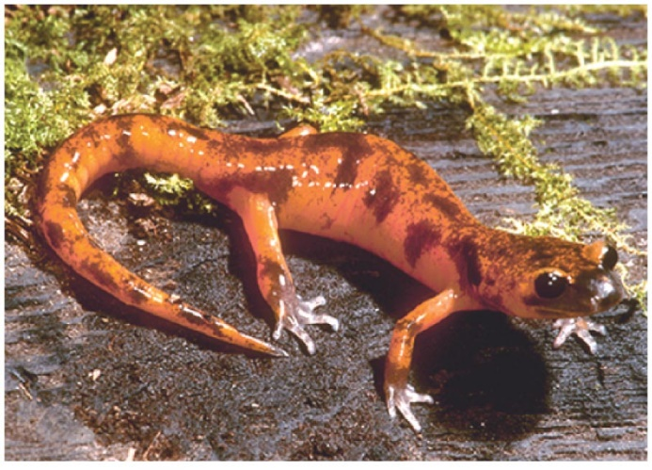
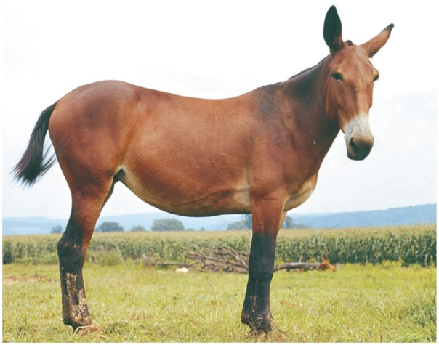
Reproductive Isolating Mechanisms (Genetic)
POST-ZYGOTIC
vi) Reduced hybrid viability
- embryo doesn’t live.
vii) Reduced hybrid fertility
- hybrids develop
but sterile.
salamander hybrids frail or don’t mature
horse + donkey → mule: sterile

Slide 27
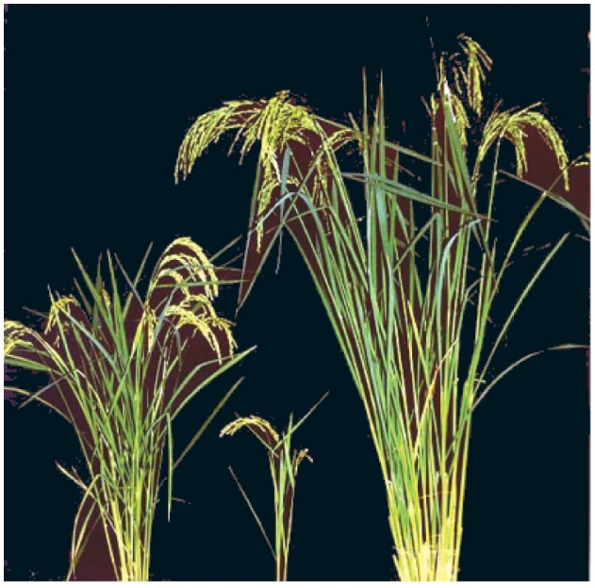
Reproductive Isolating Mechanisms (Genetic)
POST-ZYGOTIC
viii) Hybrid (F2) breakdown
- F1 fertile, but future generations
sterile or reduced fitness
hybrid rice plants small, reduced fitness

Slide 28
Time for Speciation to occur?
Varies, dependent on group. E.g.,
Spartina angelica hybrid polyploid
Ca. 20 years
Hawaiian Drosophila spp. (Fruit flies)
Average speciation time = 20,000 yrs
Platanus spp. (Sycamores)
P. orientalis & P. occidentalis separated ca. 50,000,000 years, still not genetically reproductively isolated

Slide 29
Adaptive Radiation
- spreading of populations or species
into new environments,
with adaptive evolutionary divergence.

Slide 30
Adaptive Radiation
Promoted by:
1) New and varied niches
- provide new selective pressures
2) Absence of interspecific competition
- enables species to invade niches previously occupied by others

Slide 31
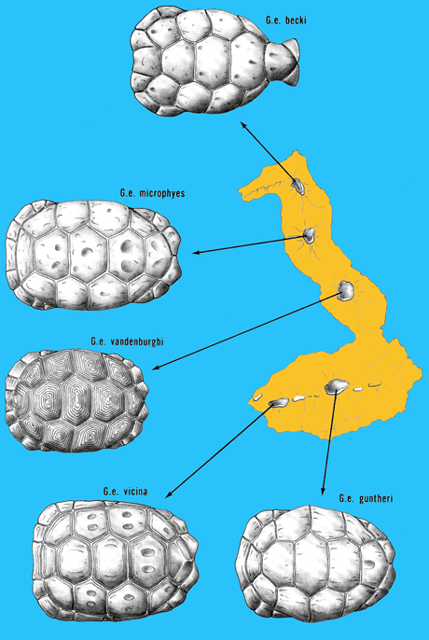
Examples of Adaptive Radiation:
Galapagos
Tortoises

Slide 32
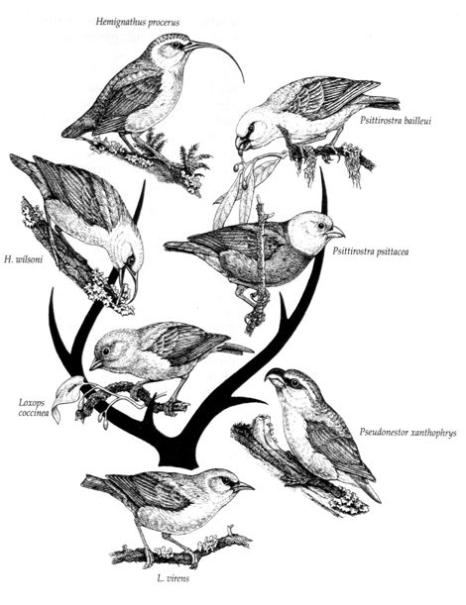
Examples of Adaptive Radiation:
“Darwin’s” Finches

Slide 33
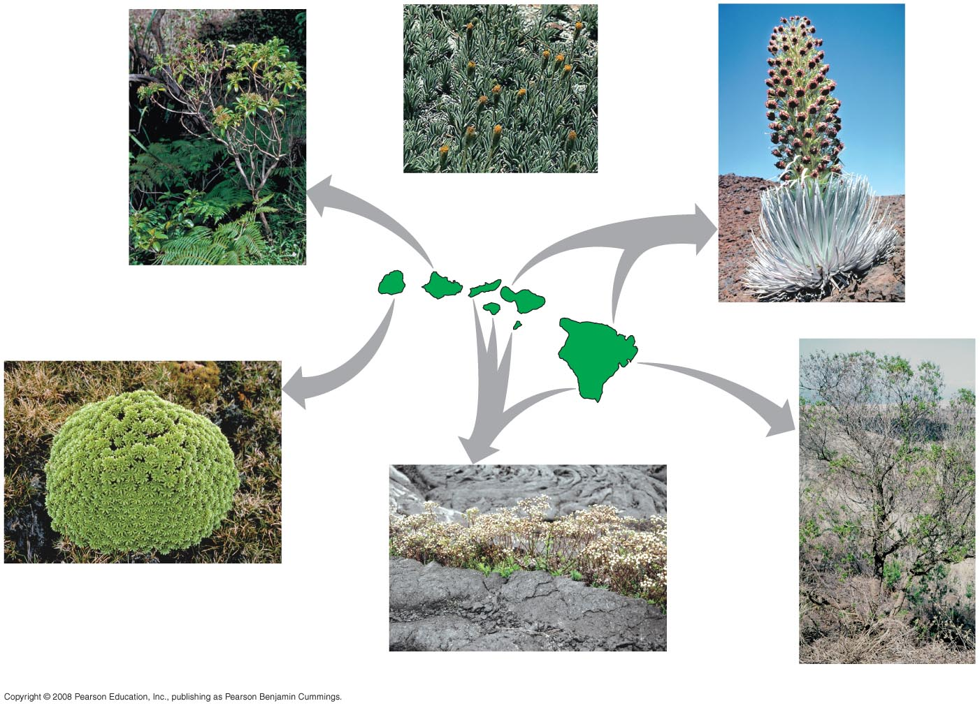
Examples of Adaptive Radiation: “Tarweeds” of Hawaiian Islands
Close North American relative,
the tarweed Carlquistia muirii
KAUAI
5.1
million
years
MOLOKAI
1.3
million
years
Dubautia laxa
MAUI
OAHU
3.7
million
years
LANAI
Argyroxiphium sandwicense
HAWAII
0.4
million
years
Dubautia waialealae
Dubautia scabra
Dubautia linearis

Slide 34
Macroevolution
= large scale evolution at & above species level
[Microevolution = small scale evolution at the population level.]

Slide 35
Tempo of Speciation
1) Gradualism (gradualistic speciation)
= gradual, step-by-step evolutionary change

Slide 36
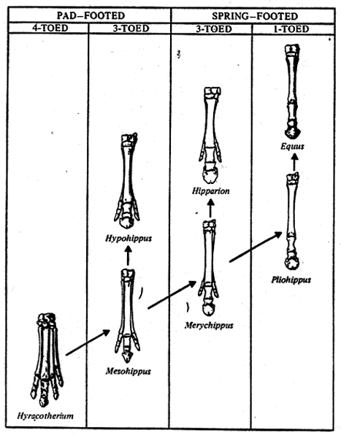
Evolution of horses

Slide 37
Species showing very little evolutionary change:
E.g.:
  Coelacanth (Latimeria) - 250 myr, rediscovered 1938
  Horseshoe crab
  Dawn-Redwood Tree (Metasequoia)
  Maidenhair Tree (Ginkgo)

Slide 38
Tempo of Speciation
2) Punctuated Equilibrium
= rapid evolutionary change during speciation
followed by relatively long periods of stasis (no change).

Slide 39
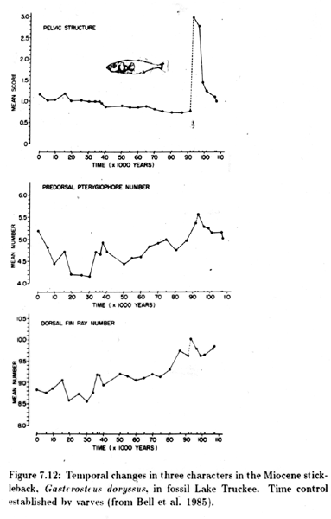
Punctuated Equilibrium:

Slide 40
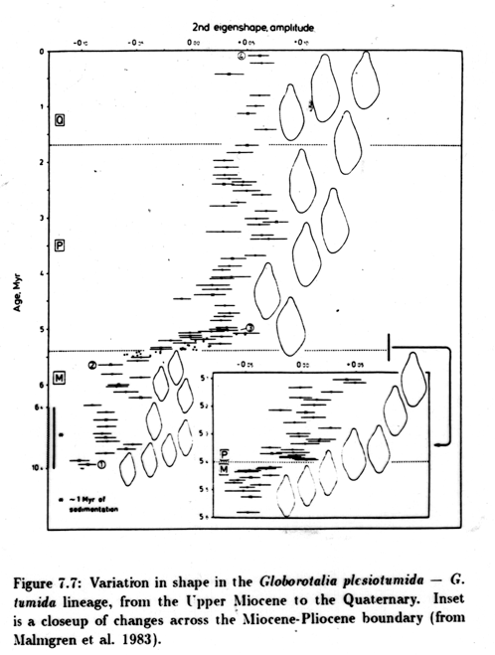
Punctuated Equilibrium:

Slide 41
How can rapid speciation (resulting in punctuated equilibrium) occur?
1) Founder principle
or population bottleneck
2) Major environmental change, new niches open up.
- both can accelerate evolutionary change

Slide 42
How can rapid speciation occur?
3) Major genetic change:

Slide 43
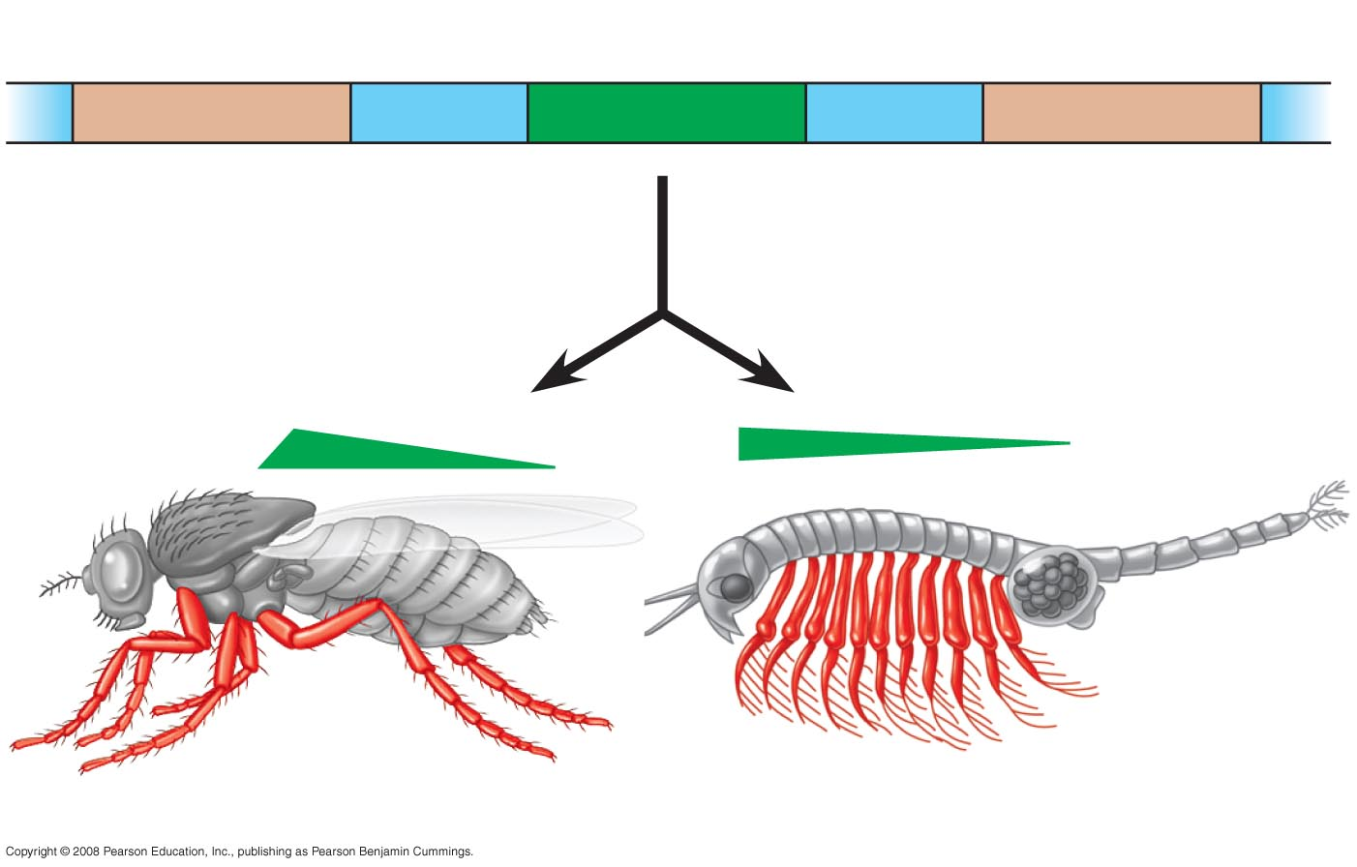
E.g., Change in a gene that regulates development (homeotic / regulatory gene)
Hox gene 6
Hox gene 7
Hox gene 8
Ubx
About 400 mya
Drosophila
Artemia

Slide 44
Heterochrony
= change in the rate or timing of development
Neotony = type of heterochrony:
decrease in rate of development

Slide 45
Many features of humans evolved by NEOTONY!
Chimp
Feature
Human
NEOT
ONY
å
ß
Developmental
T
ime

Slide 46
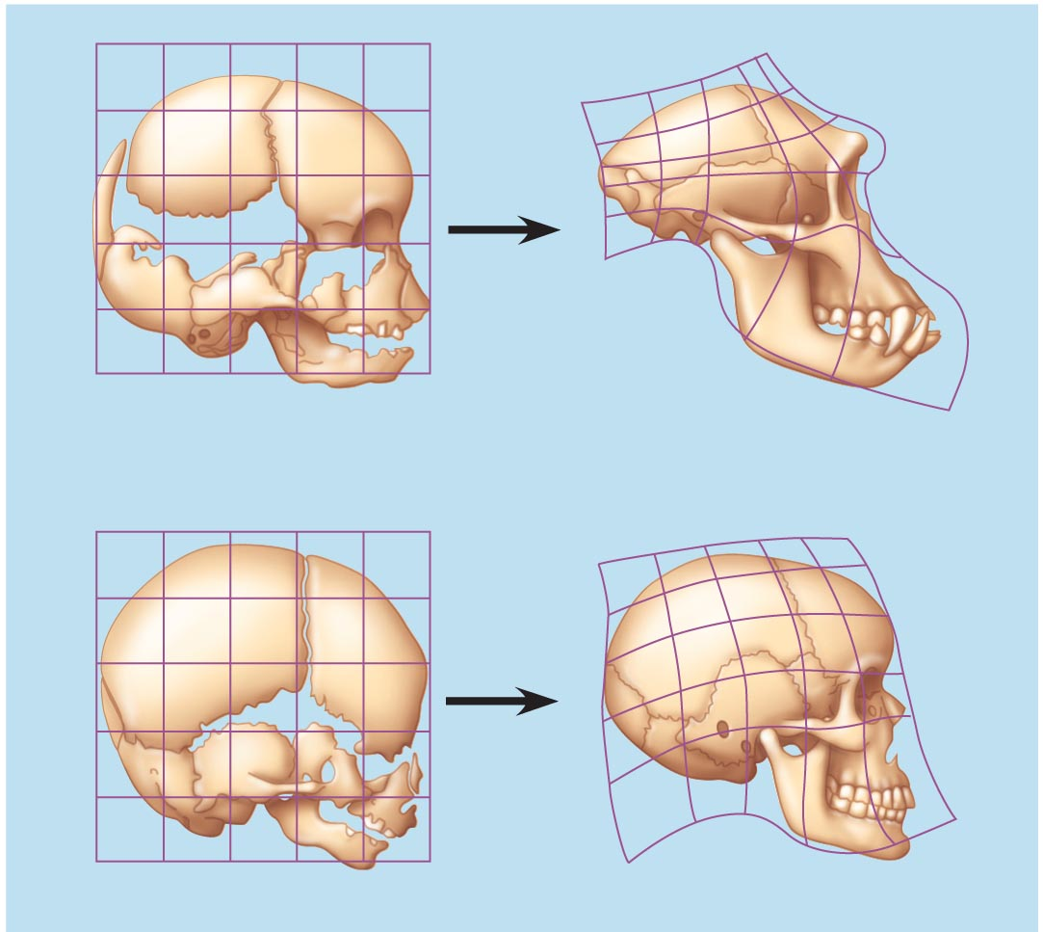
Heterochrony - NEOTONY
Chimpanzee fetus
Chimpanzee adult
Human fetus
Human adult
Mature human adult resembles fetus of both.

Slide 47
Extinction
“Opposite” of Speciation
Over 99% of all species on earth are now extinct.
E.g.,
  ammonites
  seed ferns
  dinosaurs
  Irish Elk
  dodo bird

Slide 48
Extinction is a major driving force of evolution
How?
Opens up new niches,
by removing interspecific competition.

Slide 49
Extinc species

Slide 51
Species
According to current databases and due to it differentiation, we can talk about 3 kinds of species;
Biological species,
Phylogenetic species,
Morphologic species

Slide 52
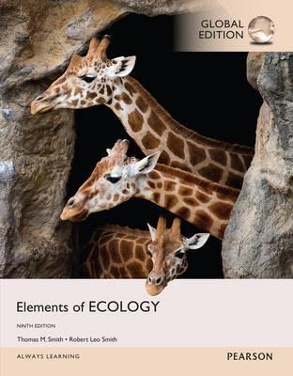
References
1- https://www.youtube.com/watch?v=ZouWWVyz9v8
2- http://www.climatedata.info/forcing/albedo/
3- http://astrocampschool.org/greenhouse-effect/
4- https://sites.google.com/a/gsbi.org/gvc1506/environment/greenhouse-effect
5- https://spaceplace.nasa.gov/seasons/en/
← Source material of this lecture
Further reading
McCarty, J. P., Wolfenbarger, L. L. and Wilson, J. A. 2017. Biological Impacts of Climate Change. eLS. 1–13.

