Slide 1
ZTM 316 Mekanizmalar
5.Hafta
Prof. Dr. Ramazan ÖZTÜRK

Slide 2
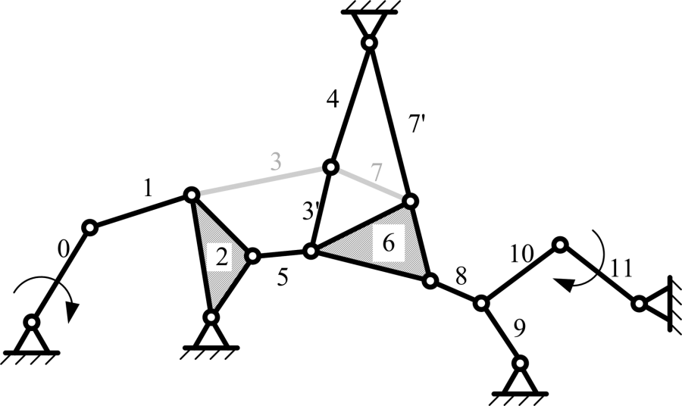
DÜZLEMSEL MEKANİZMA ÖRNEKLERİ
http://mechanismsrobotics.asmedigitalcollection.asme.org/article.aspx?articleid=2525322

Slide 3
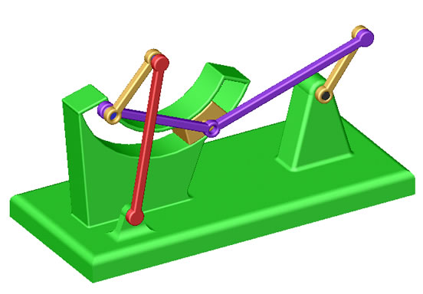
http://imalatbilgileri.blogspot.com.tr/2016/02/basit-mekanizma-ornekleri.html

Slide 4
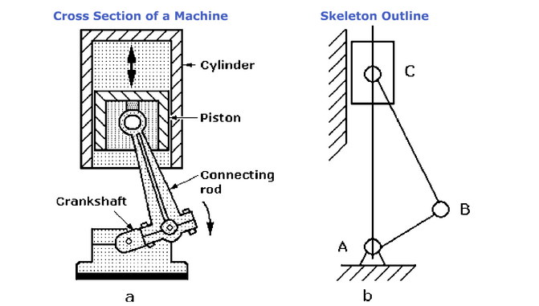
http://www.robotpark.com/academy/basics-robotic-mechanisms/

Slide 5
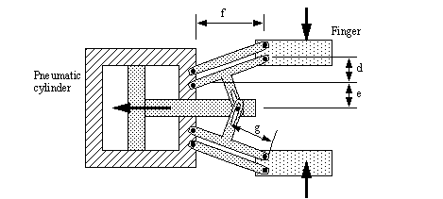
http://hughjack.com/V2/book_integration/engineeronadisk-143.html

Slide 6
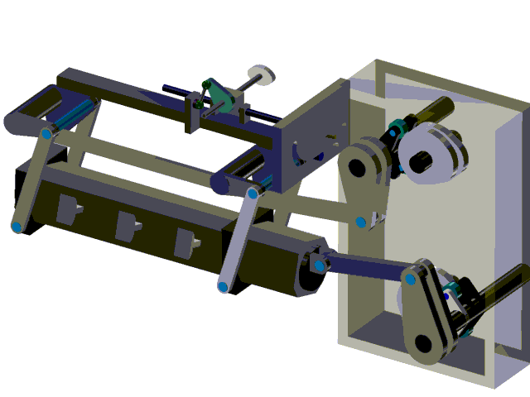
https://www.psmotion.com/mechanism-design-software/transfer-mechanism/planar-motion-transfer-mechanism

Slide 7
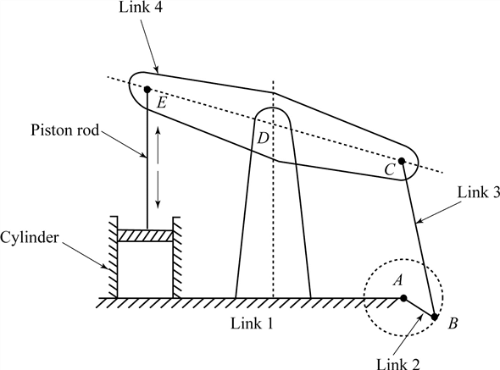
http://www.chegg.com/homework-help/theory-of-machines-and-mechanisms-4th-edition-solutions-9780195371239

Slide 8
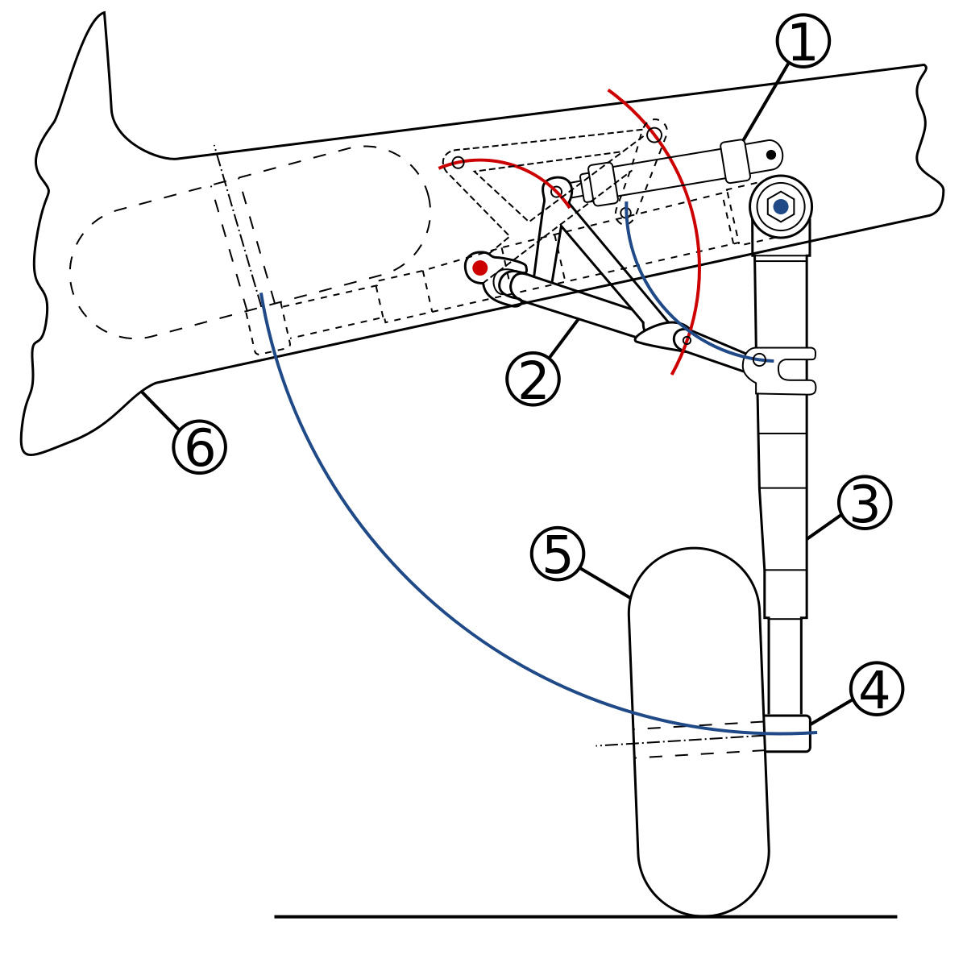
https://war.wikipedia.org/wiki/Mekanismo_(inhenyerya)

Slide 9
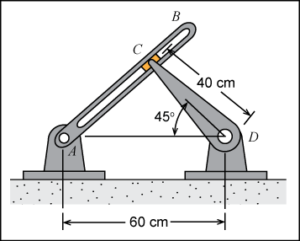
http://www.sdcpublications.com/multimedia/978-1-58503-767-4/files/krb/krb_rs_ep1.htm

Slide 10
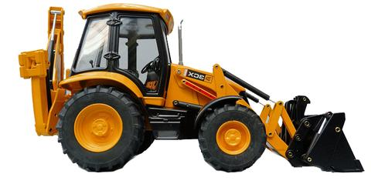
http://www.mrbillington.com/linkages.html

