Slide 1
MATTER, ELEMENTS, AND COMPOUNDS
EEE 101
Lecture Notes
Mainly from Earl Gates, Introduction to Electronics, Cengage Learning

Slide 2
MATTER
Matter is anything that occupies space and has weight.
It may be found in any one of three states: solid, liquid, or gas.
Examples of matter include the air we breathe, the water we drink, the clothing we wear, and ourselves.
Matter may be either an element or a compound.

Slide 3
ELEMENT
An element is the basic building block of nature.
It is a substance that cannot be reduced to a simpler substance by chemical means.
There are now over 100 known elements (See: Periodic Table).
Examples of elements are gold, silver, copper, and oxygen.

Slide 4
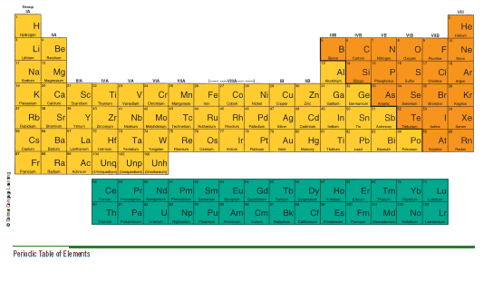
PERIODIC TABLE

Slide 5
COMPOUND
The chemical combination of two or more elements is called a compound.
A compound can be separated by chemical but not by physical means.
Examples of compounds are:
water, which consists of hydrogen and oxygen
salt, which consists of sodium and chlorine

Slide 6
MOLECULE AND ATOM
The smallest part of the compound that still retains the properties of the compound is called a molecule.
A molecule is the chemical combination of two or more atoms.
An atom is the smallest particle of an element that retains the characteristic of the element.

Slide 7
MIXTURE AND ALLOY
The physical combination of elements and compounds is called a mixture.
Examples of mixtures include:
air, which is made up of oxygen, nitrogen, carbon dioxide, and other gases
salt water, which consists of salt and water.
The physical combination of:
two or more metals, or
a metal and other material
retaining the properties of a metal is called an alloy.

Slide 8
A CLOSER LOOK AT ATOMS - 1
As previously stated, an atom is the smallest particle of an element.
Atoms of different elements differ from each other. If there are over 100 known elements, then there are over 100 known atoms.
Every atom has a nucleus.
The nucleus is located at the center of the atom.

Slide 9
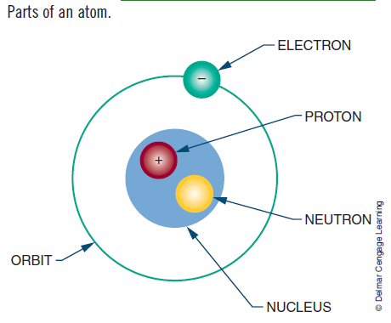
A CLOSER LOOK AT ATOMS - 2
The nucleus contains:
positively charged particles (called protons)
uncharged particles (called neutrons)
Negatively charged particles (called electrons) orbit around the nucleus
QUESTIONS:
- Do an atom really look like this?
- Have you ever thought about the relative sizes of these?

Slide 10
A CLOSER LOOK AT ATOMS - 3
“The number of protons” in the nucleus of the atom is called the element’s atomic number.
Atomic numbers distinguish one element from another.
Each element also has an atomic weight. The atomic weight is the “mass of the atom”. It is determined by the total number of protons and neutrons in the nucleus.
Electrons do not contribute to the total mass of the atom; an electron’s mass is only 1/1845 that of a proton and is not significant enough to consider.

Slide 11
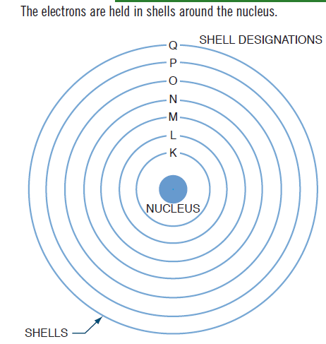
A CLOSER LOOK AT ATOMS - 4
The electrons orbit in concentric circles about the nucleus. Each orbit is called a shell.
These shells are filled in sequence; K is filled first, then L, M, N, and so on.

Slide 12
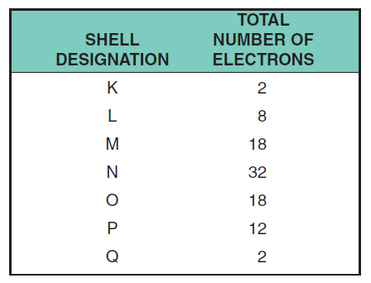
A CLOSER LOOK AT ATOMS - 5
The maximum number of electrons that each shell can accommodate is shown below:

Slide 13
VALENCE
“The outer shell” is called the valence shell.
“The electrons at the valence shell” are called the valence electrons.
“The number of electrons at the valence shell” is called valence.
The farther the valence shell is from the nucleus, the less attraction the nucleus has on each valence electron.
Thus the potential for the atom to gain or lose electrons increases if the valence shell is not full and is located far enough away from the nucleus.

Slide 14
CONDUCTIVITY
Conductivity of an atom depends on its valence band.
The greater the number of electrons in the valence shell, the less it conducts.
For example, an atom having seven electrons in the valence shell is less conductive than an atom having three electrons in the valence shell.

Slide 15
CONDUCTORS - 1
Electrons in the valence shell can gain energy.
If these electrons gain enough energy from an external force, they can leave the atom and become free electrons, moving randomly from atom to atom.
“Materials that contain a large number of free electrons” are called conductors.

Slide 16
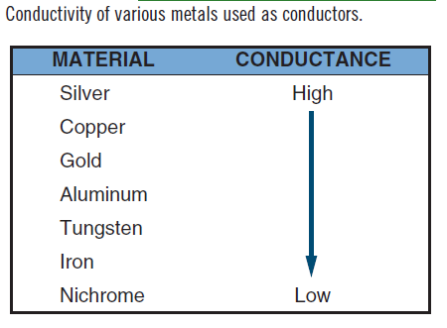
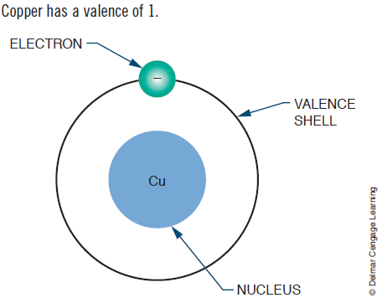
CONDUCTORS - 2
The table compares the conductivity of various metals used as conductors.
On the chart, silver, copper, and gold have a valence of 1.
However, silver is the best conductor because its free electron is more loosely bonded.

Slide 17
INSULATORS - 1
Insulators, the opposite of conductors, prevent the flow of electricity.
Insulators are stabilized by absorbing valence electrons from other atoms to fill their valence shells, thus eliminating free electrons.

Slide 18
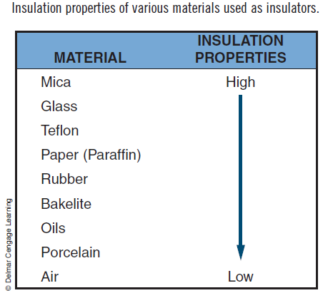
INSULATORS - 2
Materials classified as insulators are compared in the Table.
Mica is the best insulator because it has the fewest free electrons in its valence shell.
A perfect insulator will have atoms with full valence shells. This means it cannot gain electrons.

Slide 19
SEMICONDUCTORS
Halfway between conductors and insulators are semiconductors.
Semiconductors are neither good conductors nor good insulators but are important because they can be altered to function as conductors or insulators.
Silicon and germanium are two semiconductor materials.
They play a quite important role in electronic devices!...

Slide 20
IONS / IONIZATION
“An atom that has the same number of electrons and protons” is said to be electrically balanced.
“A balanced atom that receives one or more electrons” is no longer balanced. It is said to be negatively charged and is called a negative ion.
“A balanced atom that loses one or more electrons” is said to be positively charged and is called a positive ion.
“The process of gaining or losing electrons” is called ionization.
Ionization is significant in current flow.

Slide 21
Homework #1
Wearable electronic devices are quite popular nowadays; and hence, “wearable antenna technology” has become quite critical.
Assume that you are going to design a wearable antenna; and you have to choose an appropriate conducting material.
Considering several criteria (conductivity; price; elasticity; density or weight; endurance to oxidation and corrosion; toxicity; suitability for embedding into textile), choose an appropriate conducting material.
Hint: Alternatives might be platinum, gold, silver, copper, aluminum, chrome, nickel, carbon fiber, berilium, etc.

Slide 22
Scilab Assignment #2
Create a 3x3 matrix (the first matrix)
Compute the following:
The inverse of this matrix
The transpose of this matrix
The determinant of this matrix
The rank of this matrix
Create a 4x3 matrix (the second matrix)
Try to compute the following:
The inverse of this matrix
The transpose of this matrix
The determinant of this matrix
The rank of this matrix

