Slide 1

BÖLÜM 2
SU SAFLAŞTIRMA, ÇEVRE KONTROL

Slide 2
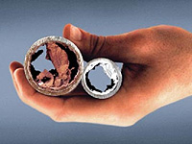
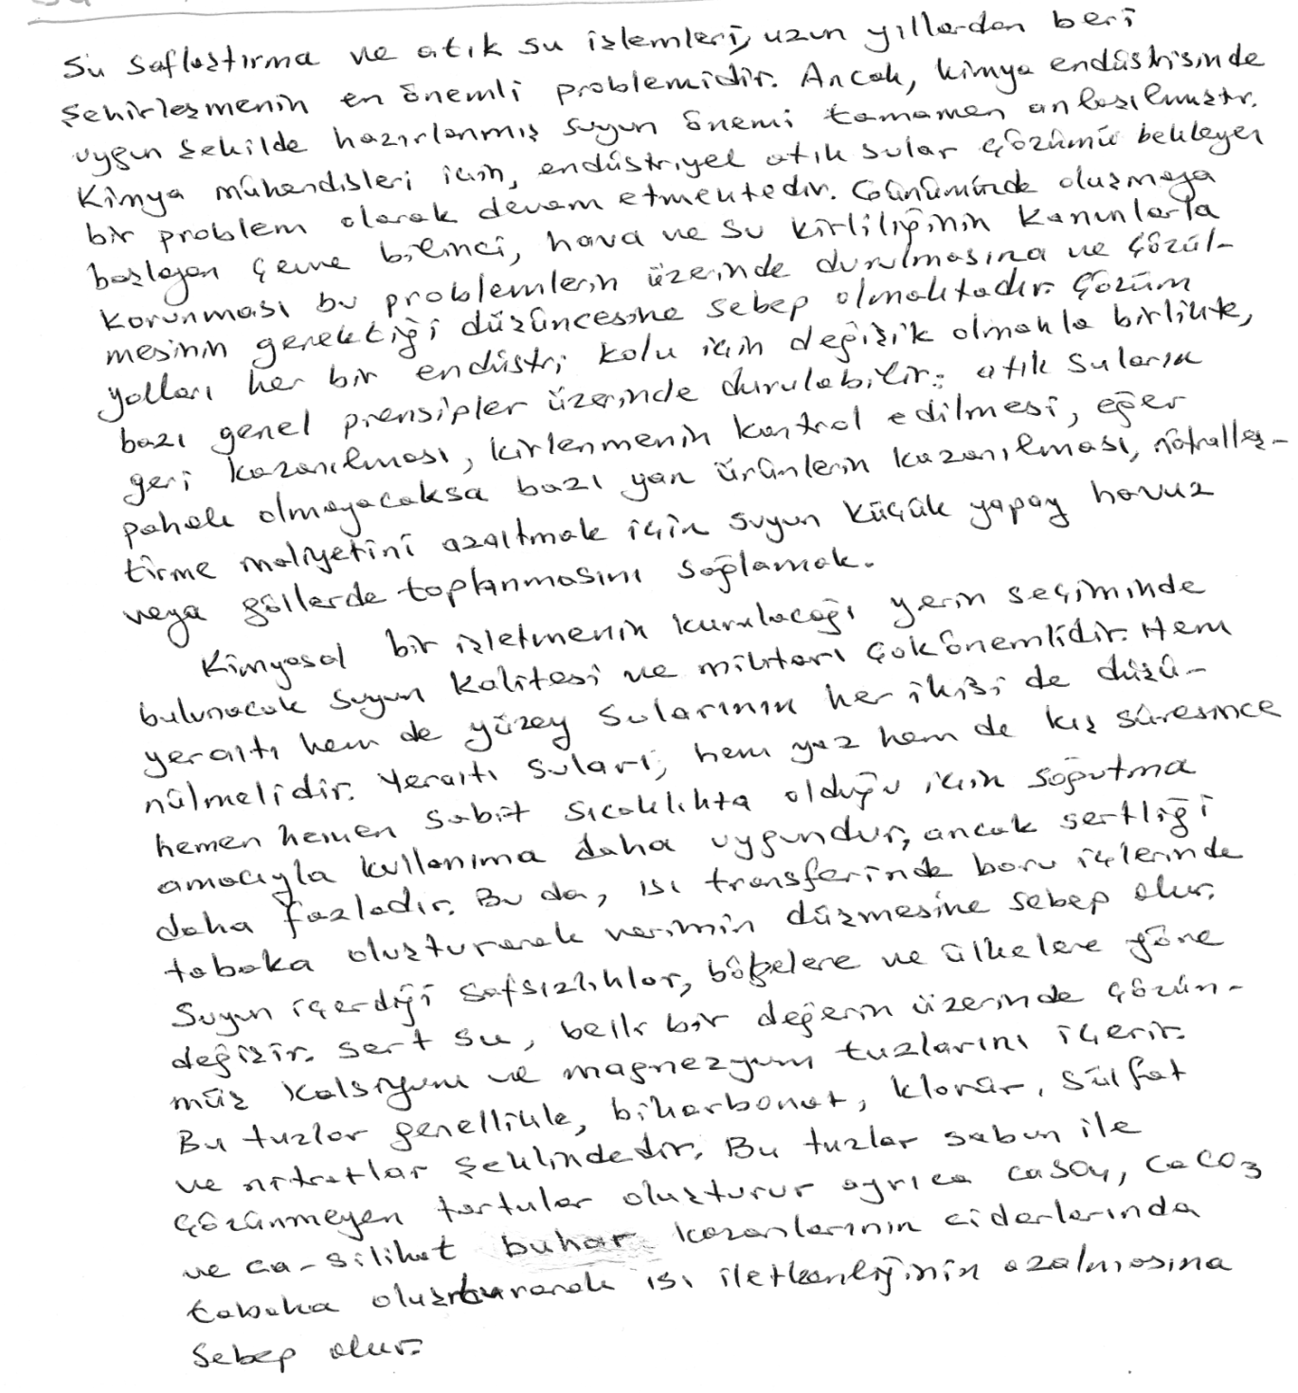

Slide 3
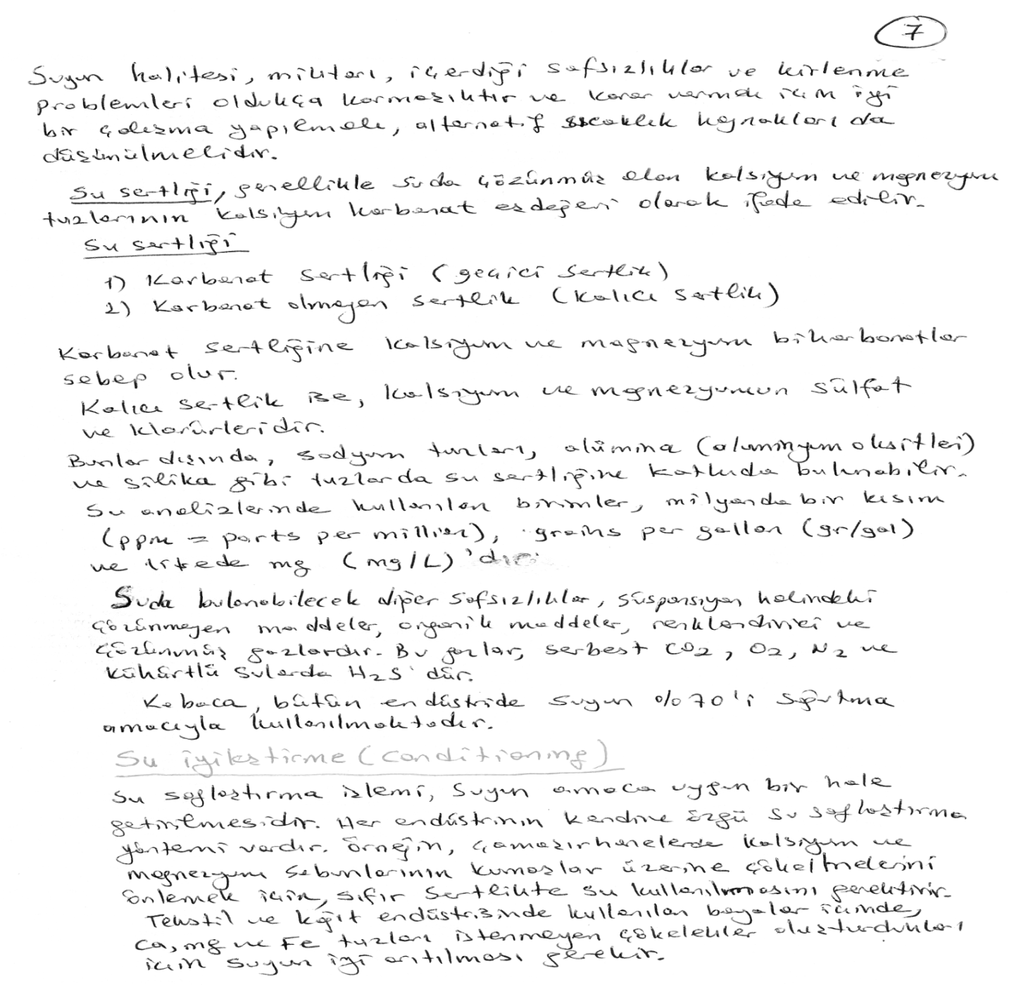

Slide 4
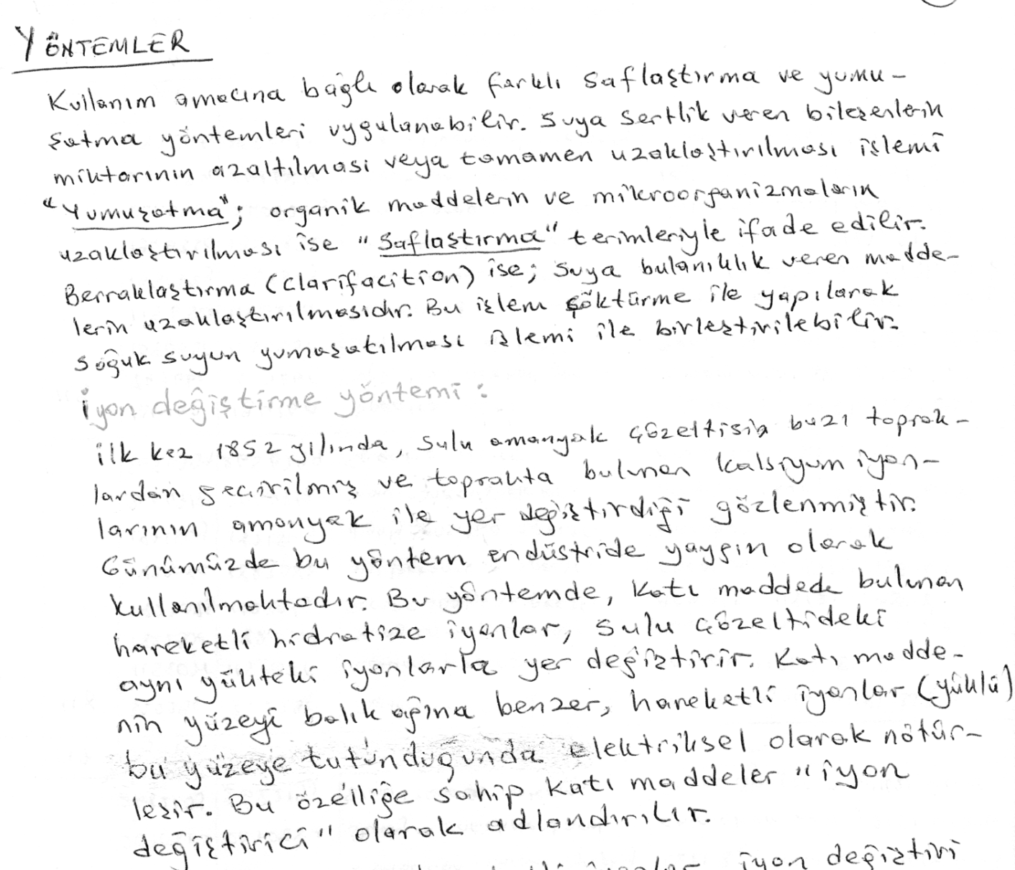
İyon değiştiricinin sabit negatif ucuna bağlı sabit pozitif grubun, çözeltideki pozitif grupla yer değiştirmesi ile katyon değişimi olur. Bu tür reçineler “katyon değiştirici reçine” olarak tanımlanır. Anyon değişiminde bunun tam tersi olur.

Slide 7
The Process of Ion-exchange
In the context of water purification, ion-exchange is a rapid and reversible process in which impurity ions present in the water are replaced by ions released by an ion-exchange resin. The impurity ions are taken up by the resin, which must be periodically regenerated to restore it to the original ionic form. (An ion is an atom or group of atoms with an electric charge. Positively-charged ions are called cations and are usually metals; negatively-charged ions are called anions and are usually non-metals).
The following ions are widely found in raw waters:
Cations | Anions
Calcium (Ca²⁺) | Chloride (Cl⁻)
Magnesium (Mg²⁺) | Bicarbonate (HCO3⁻)
Sodium (Na⁺) | Nitrate (NO3⁻)
Potassium (K⁺) | Carbonate (CO3²⁻)
Iron (Fe²⁺) | Sulfate (SO4²⁻)

Slide 8
Ion Exchange Resins
There are two basic types of resin - cation-exchange and anion-exchange resins. Cation exchange resins will release Hydrogen (H+) ions or other positively charged ions in exchange for impurity cations present in the water. Anion exchange resins will release hydroxyl (OH-) ions or other negatively charged ions in exchange for impurity anions present in the water
Today’s modern ion-exchange resins are prepared from synthetic polymers such as styrenedivinylbenzene copolymers which have either been sulphonated to form strongly acidic cation-exchangers or aminated to form strongly basic or weakly basic anion-exchangers

Slide 9
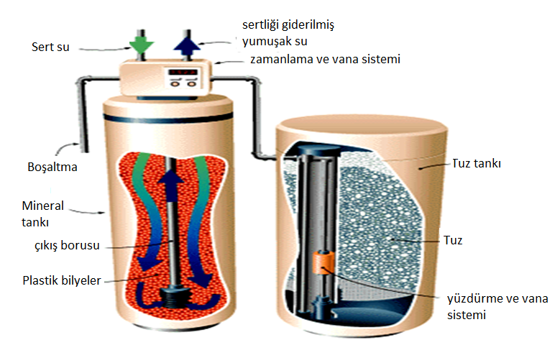
Water passing through the mineral tank loses positively charged calcium and magnesium ions to negatively charged plastic beads. The brine tank holds a salt solution that flushes the mineral tank, replacing calcium and magnesium ions with sodium. A meter at the top of the mineral tank regulates recharging cycles. The valve assembly routes water flow for each phase of the regeneration cycle.

Slide 10
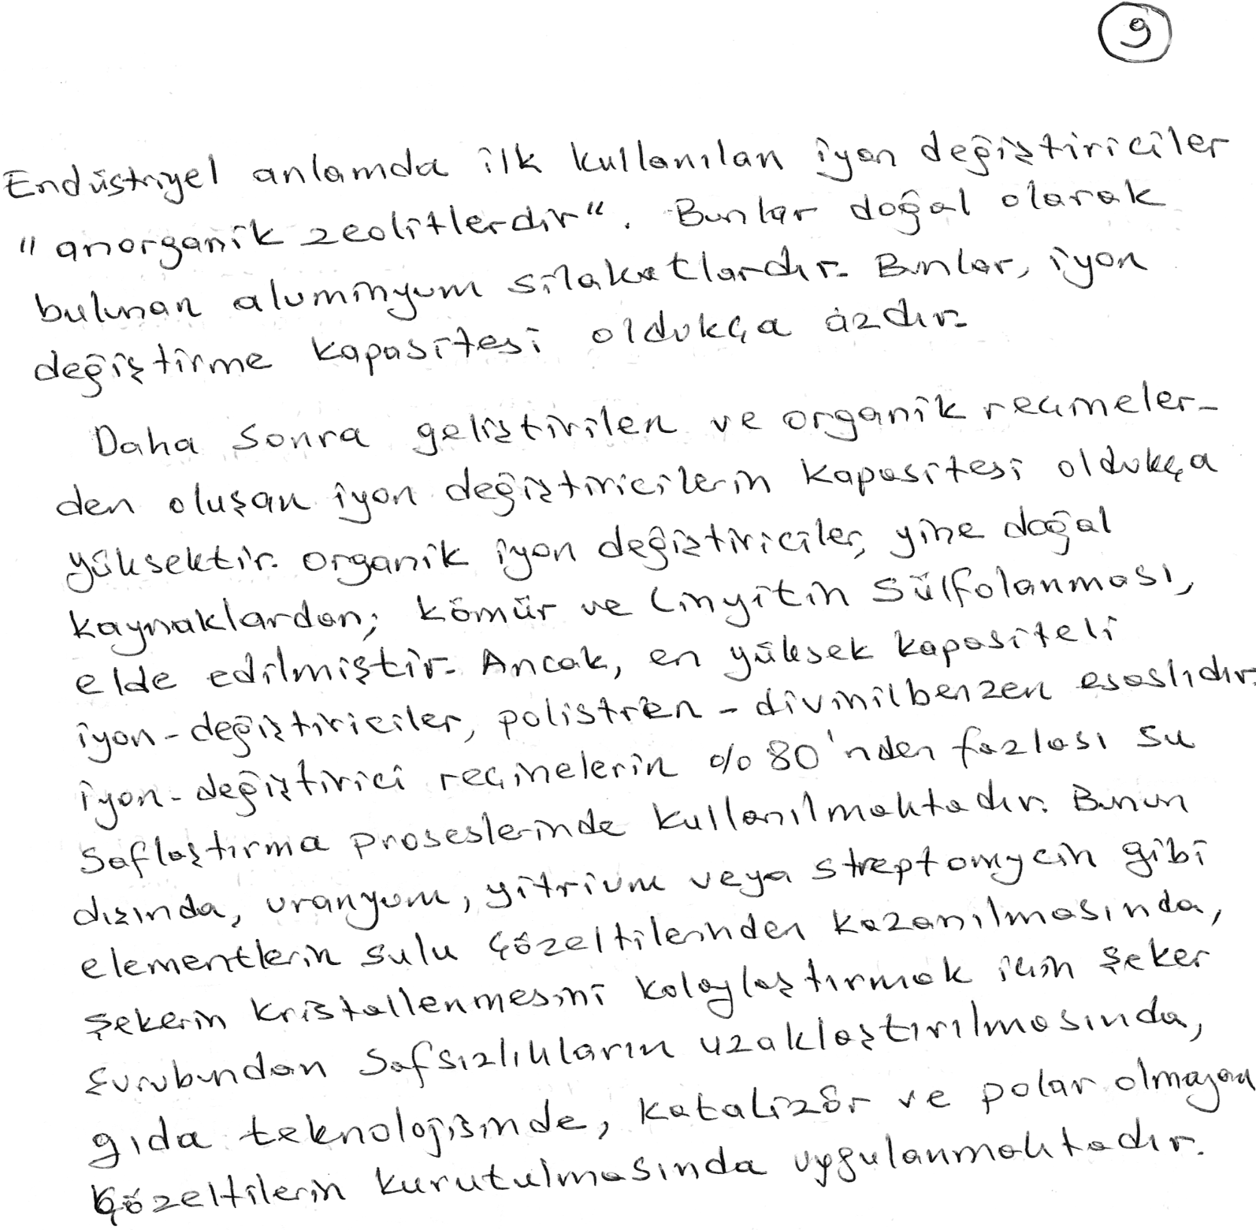

Slide 11
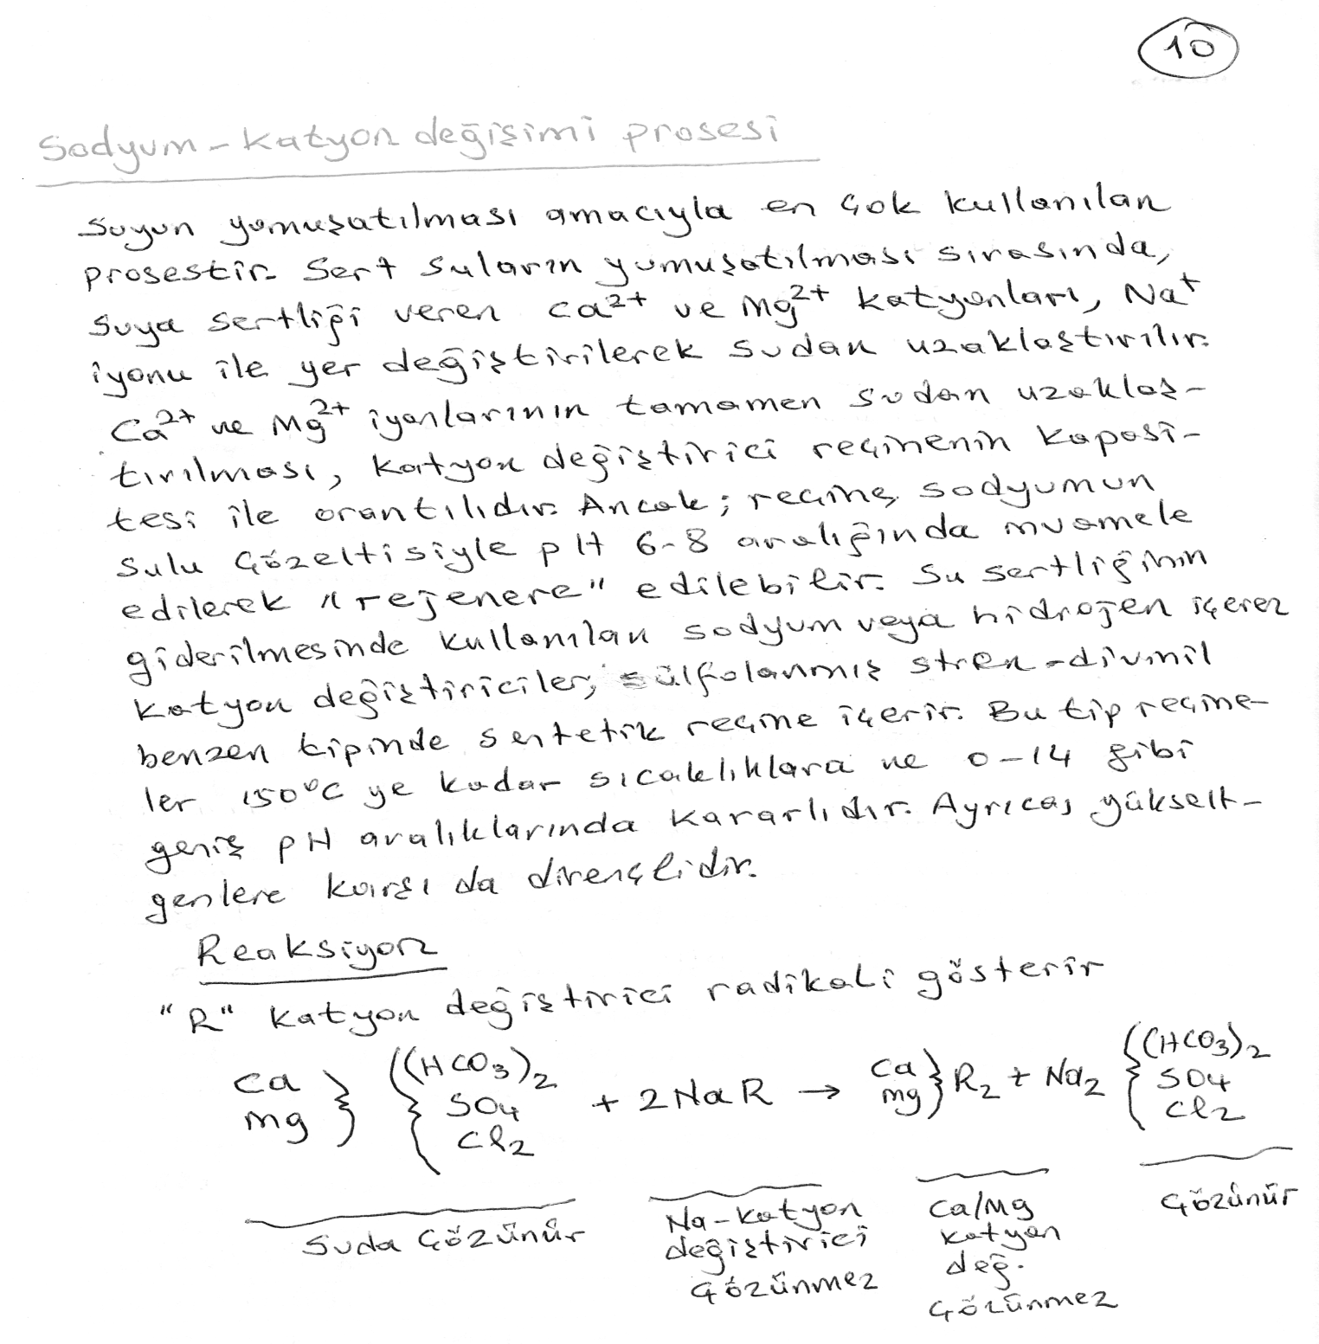

Slide 12
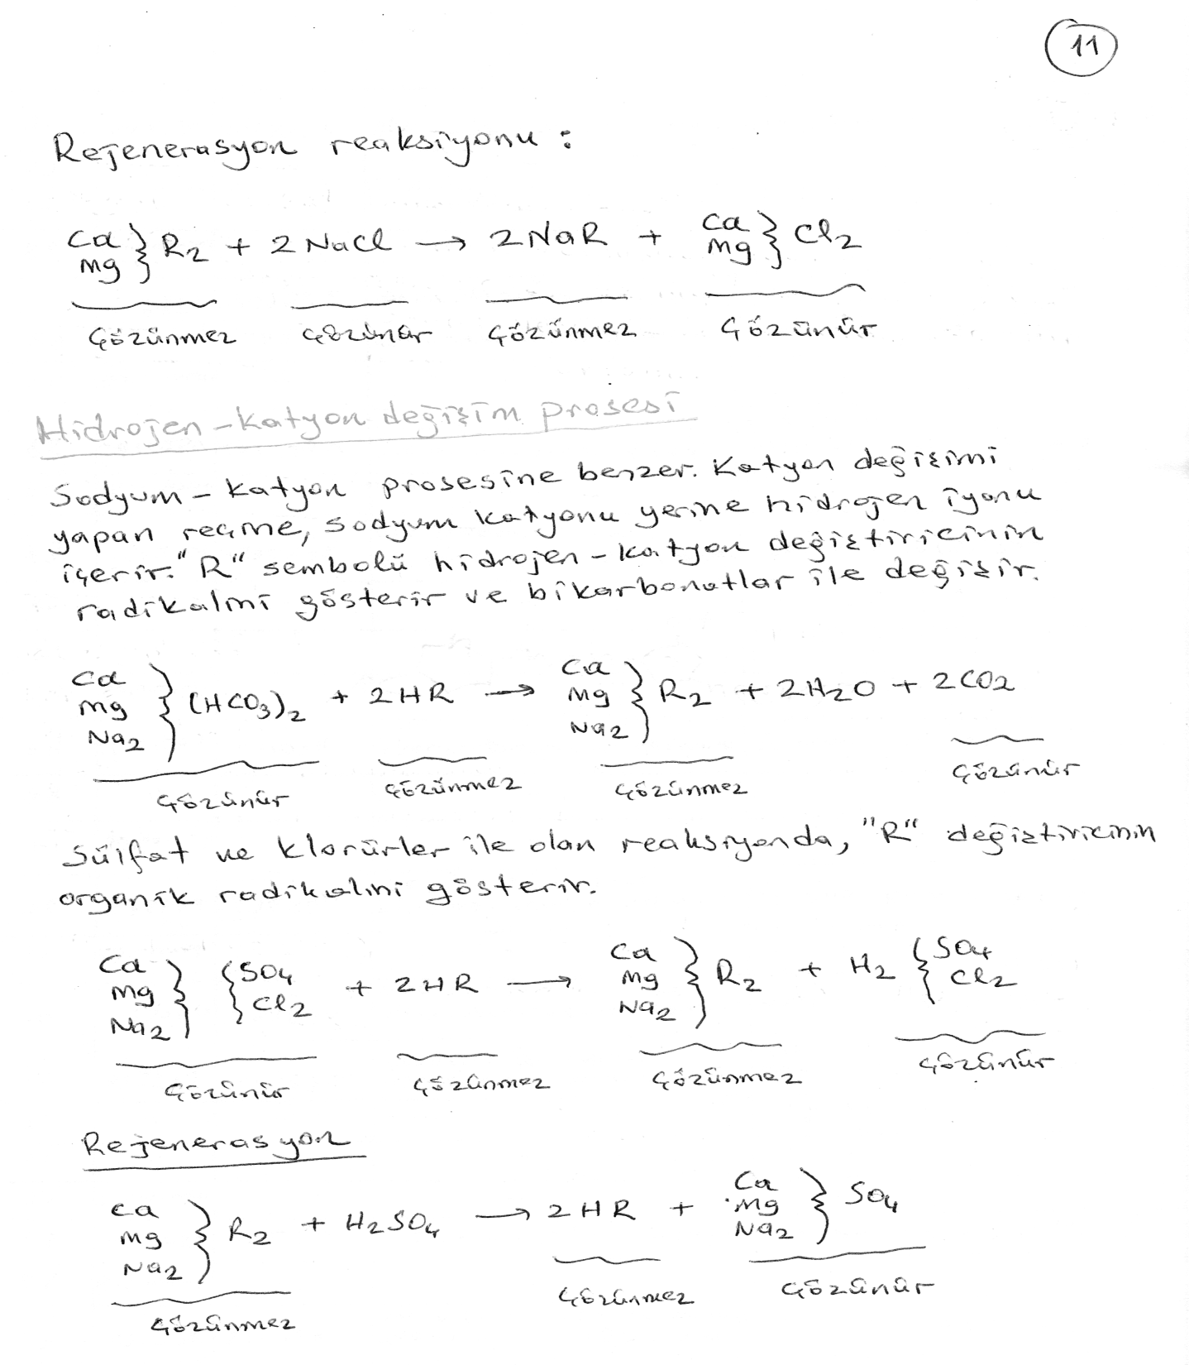

Slide 13
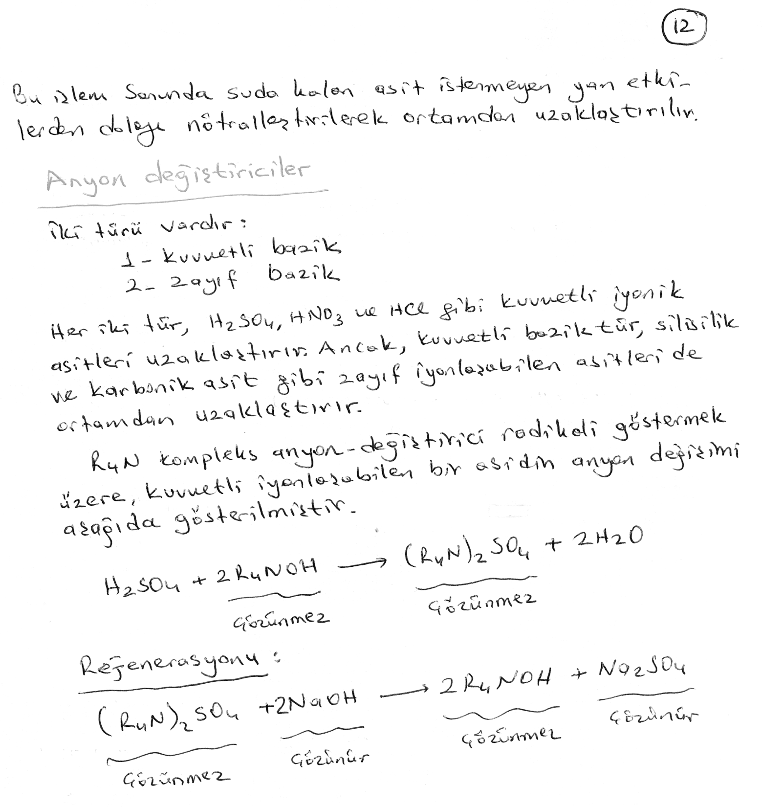

Slide 14
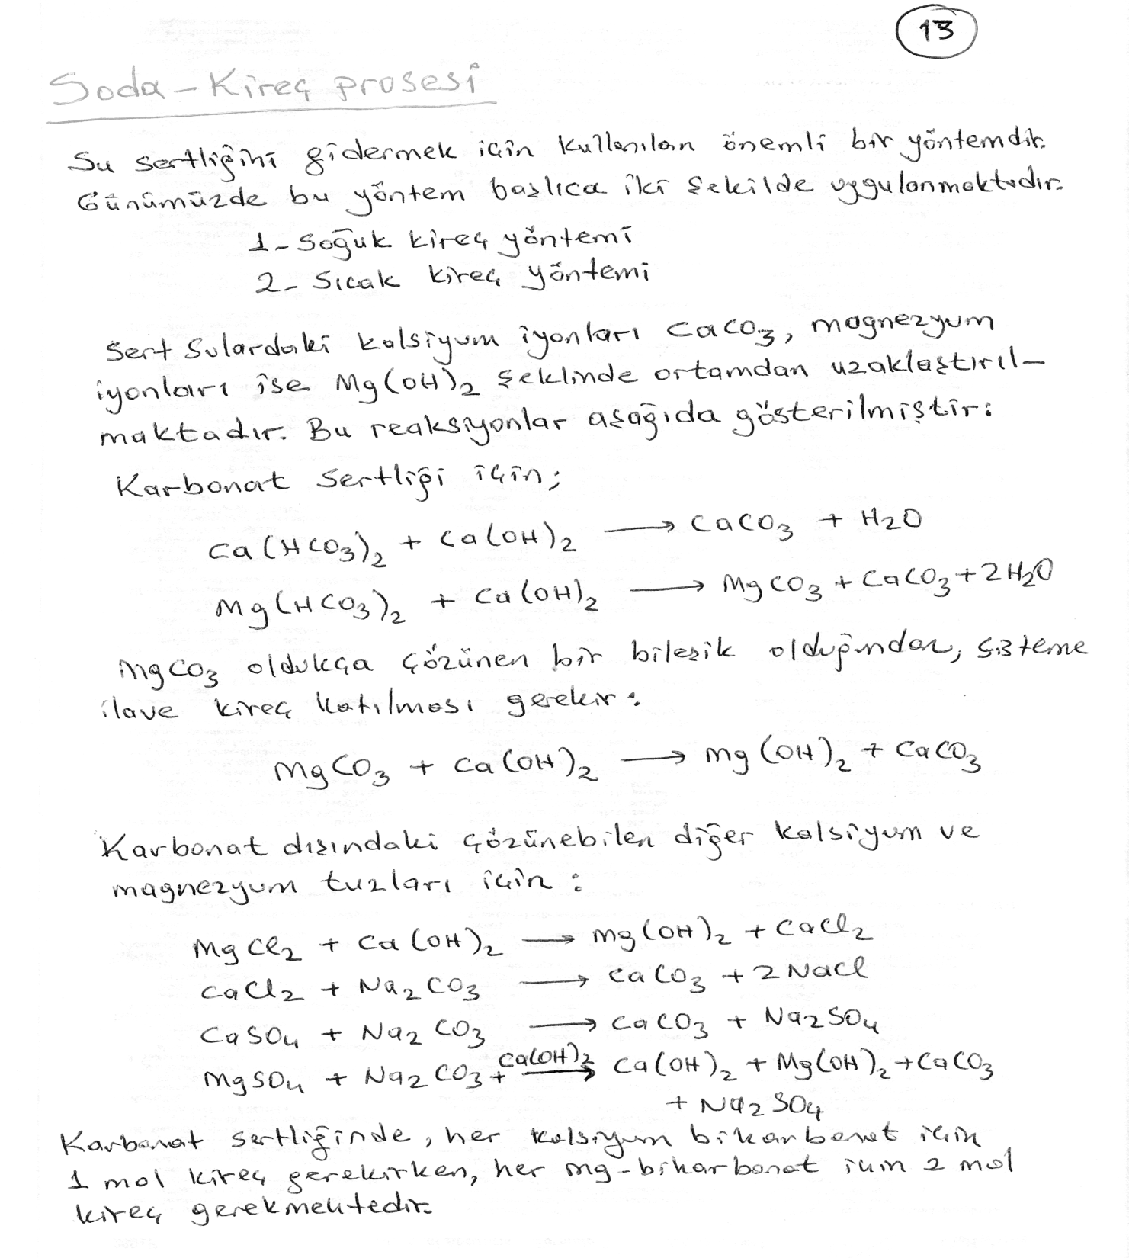

Slide 15
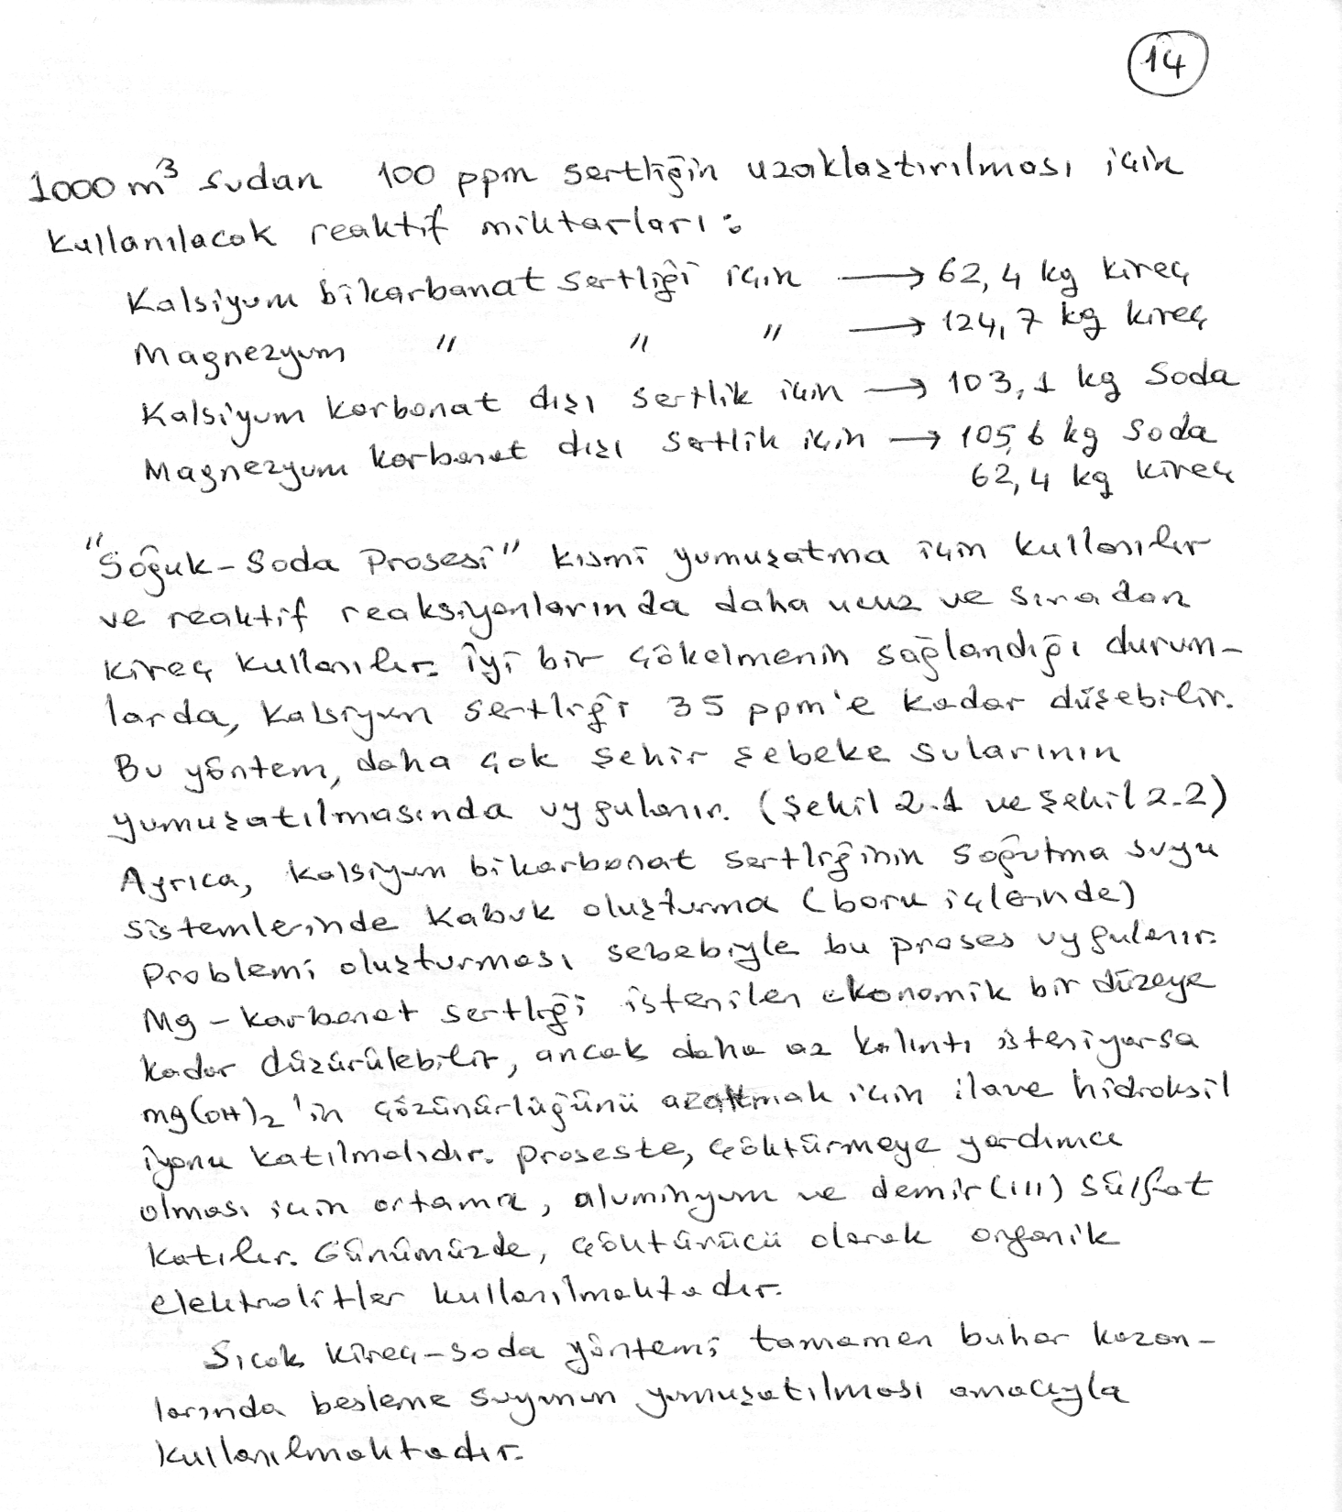

Slide 16
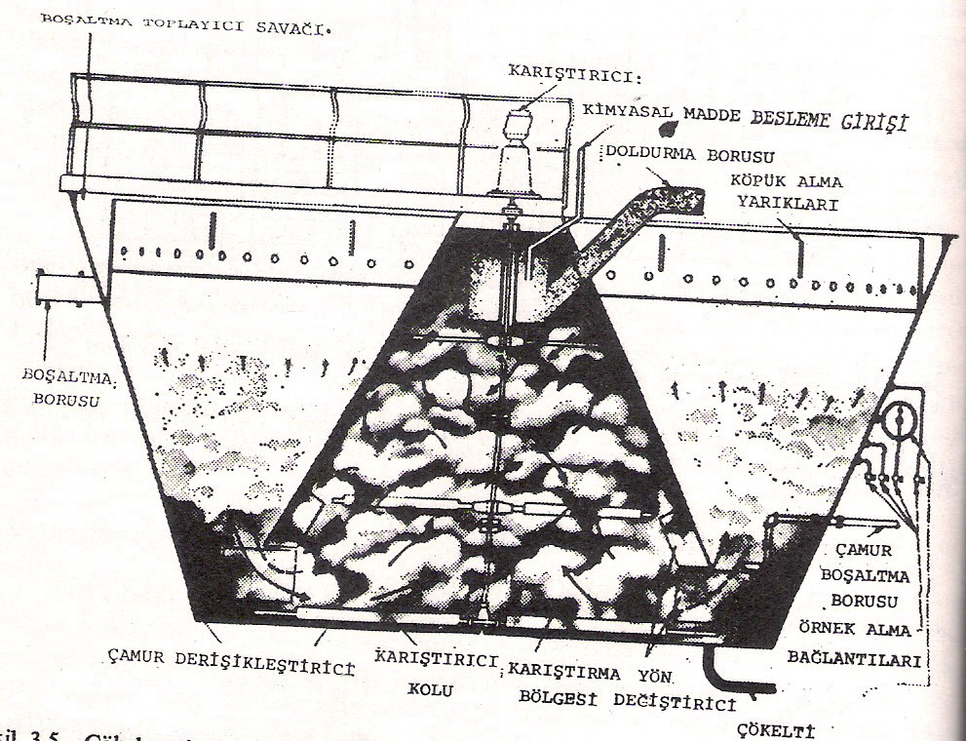
Şekil 2.1. soğuk soda-kireç prosesisyle suyun kısmi yumuşatılması

Slide 17
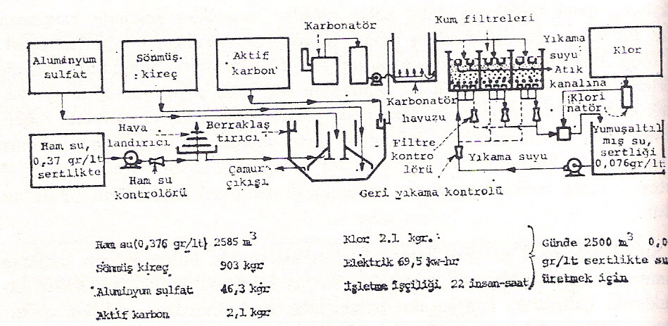
Şekil 2.2. Şehir şebekesi suyunun saflaştırılmasını gösteren akım diyagramı

Slide 18
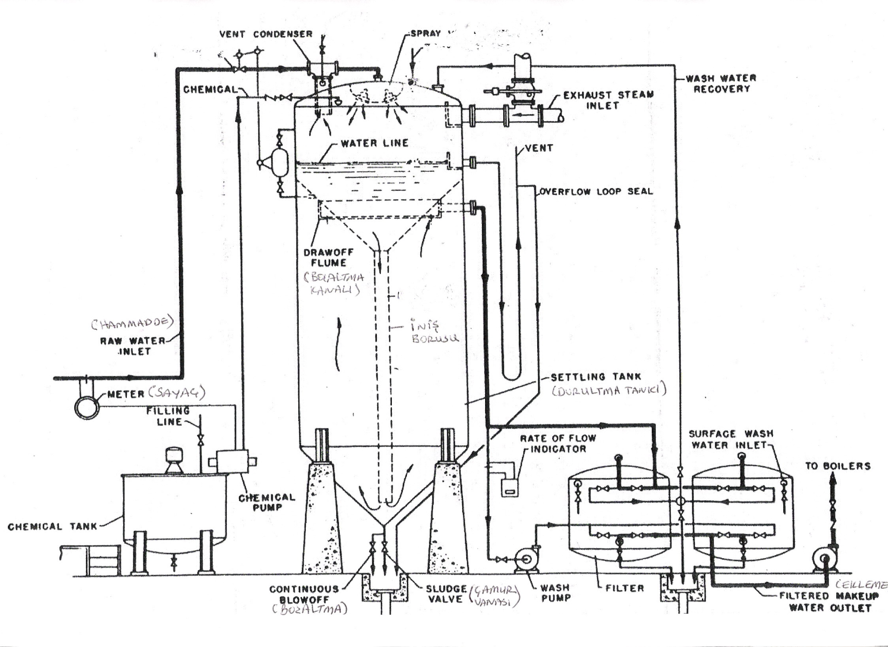
Şekil 2.3. Sıcak soda-kireç prosesisyle suyun yumuşatılması prosesi

Slide 19
