Slide 1
BÖLÜM 10
KLOR ALKALİ ENDÜSTRİLERİ
Soda Külü, Kostik Soda, Klor

Slide 2
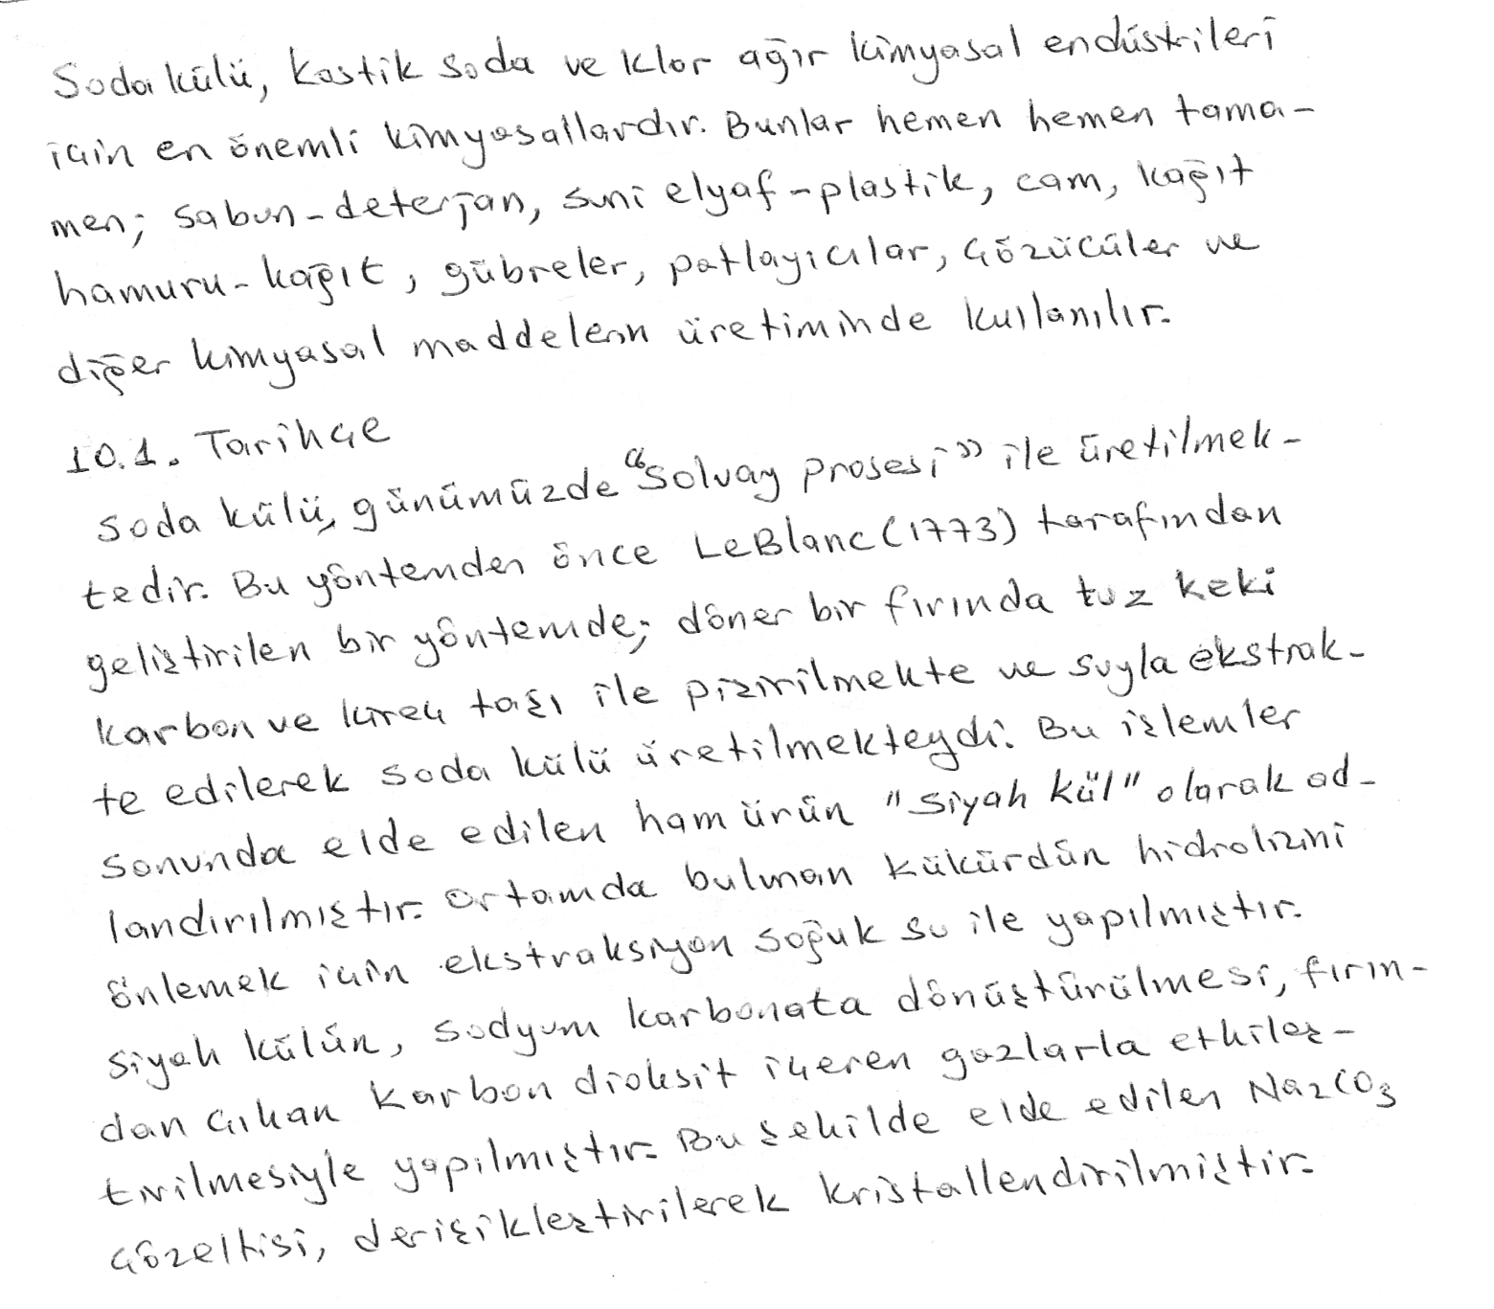

Slide 3
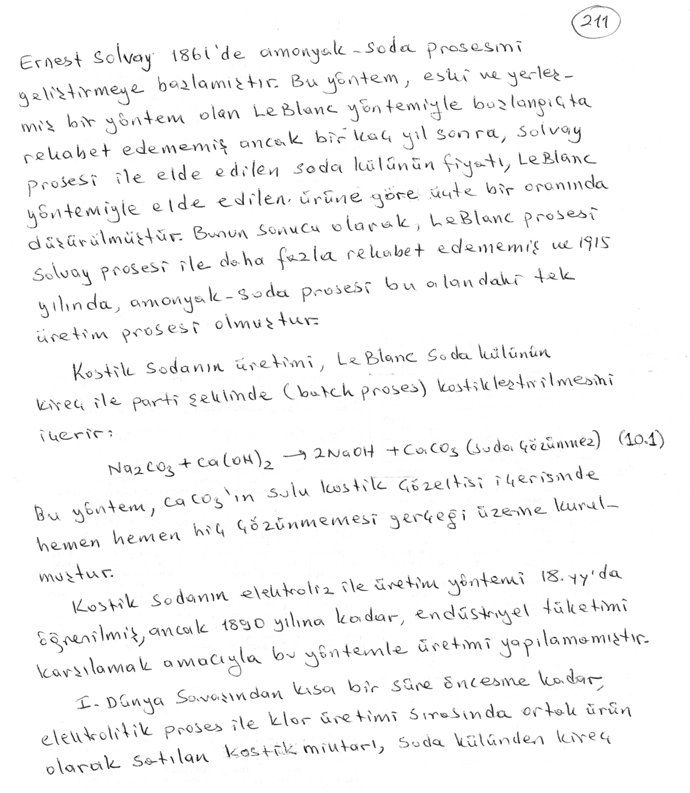

Slide 4
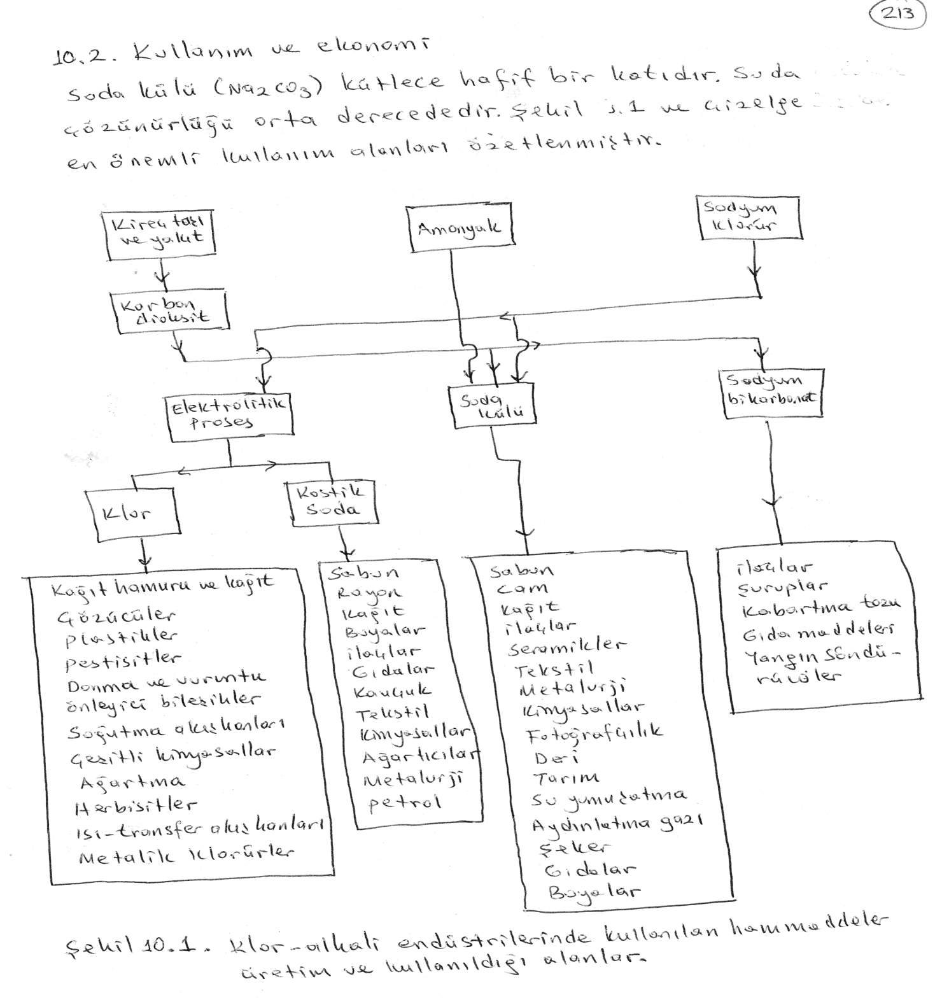

Slide 5
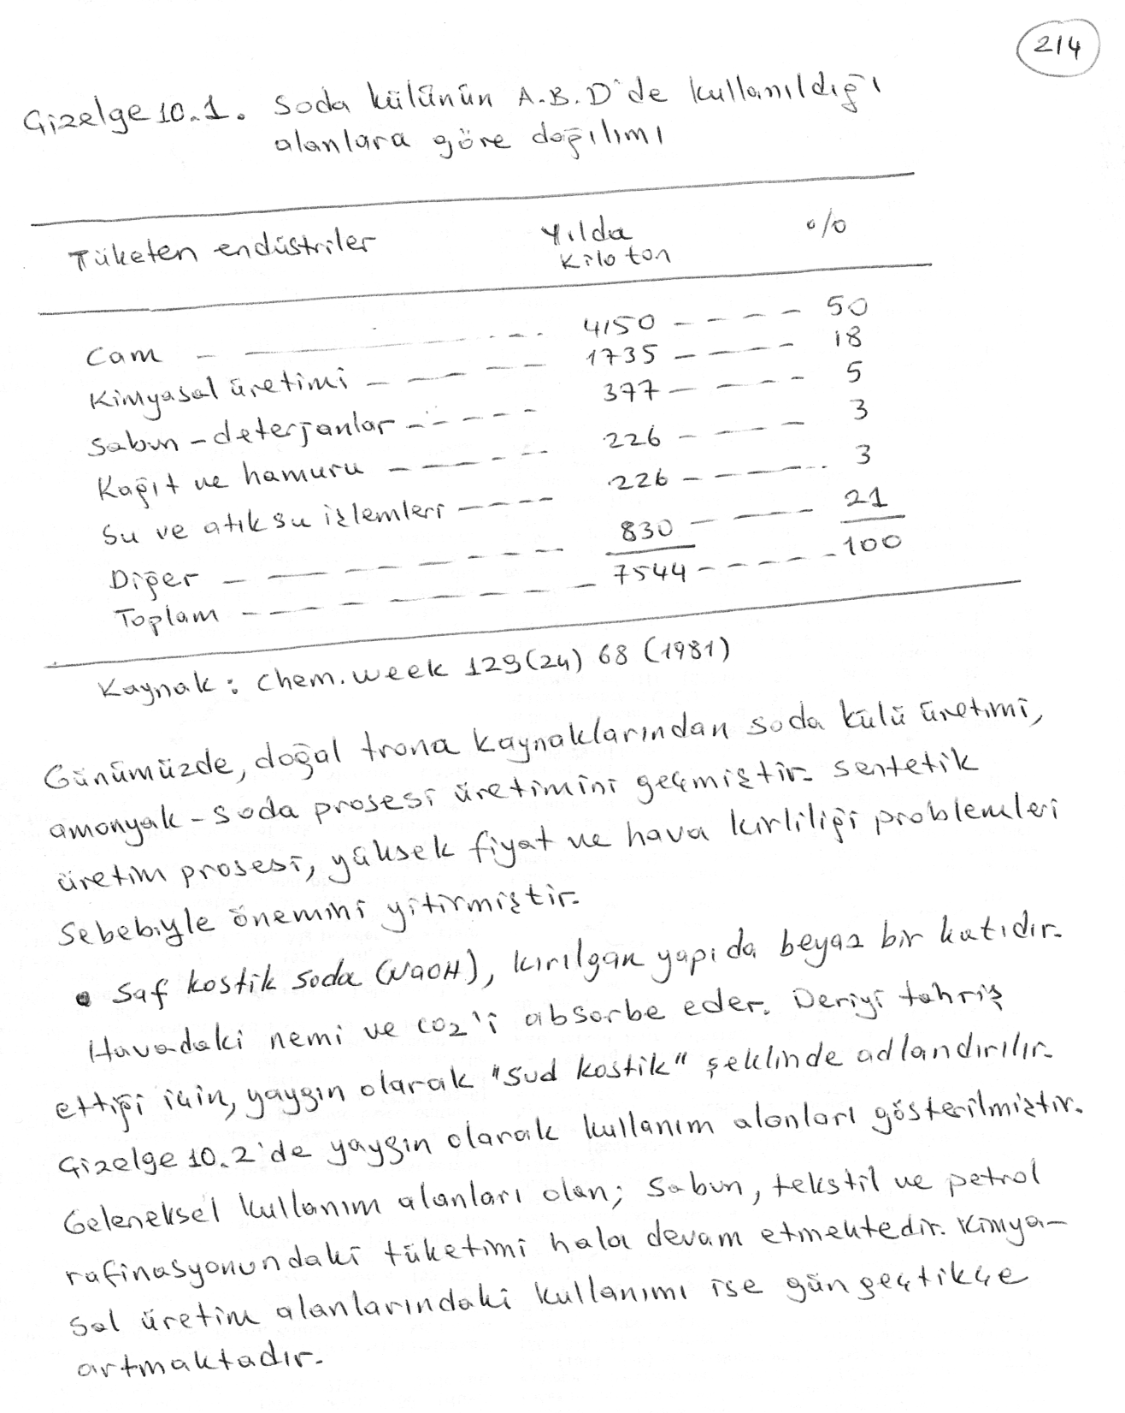

Slide 6
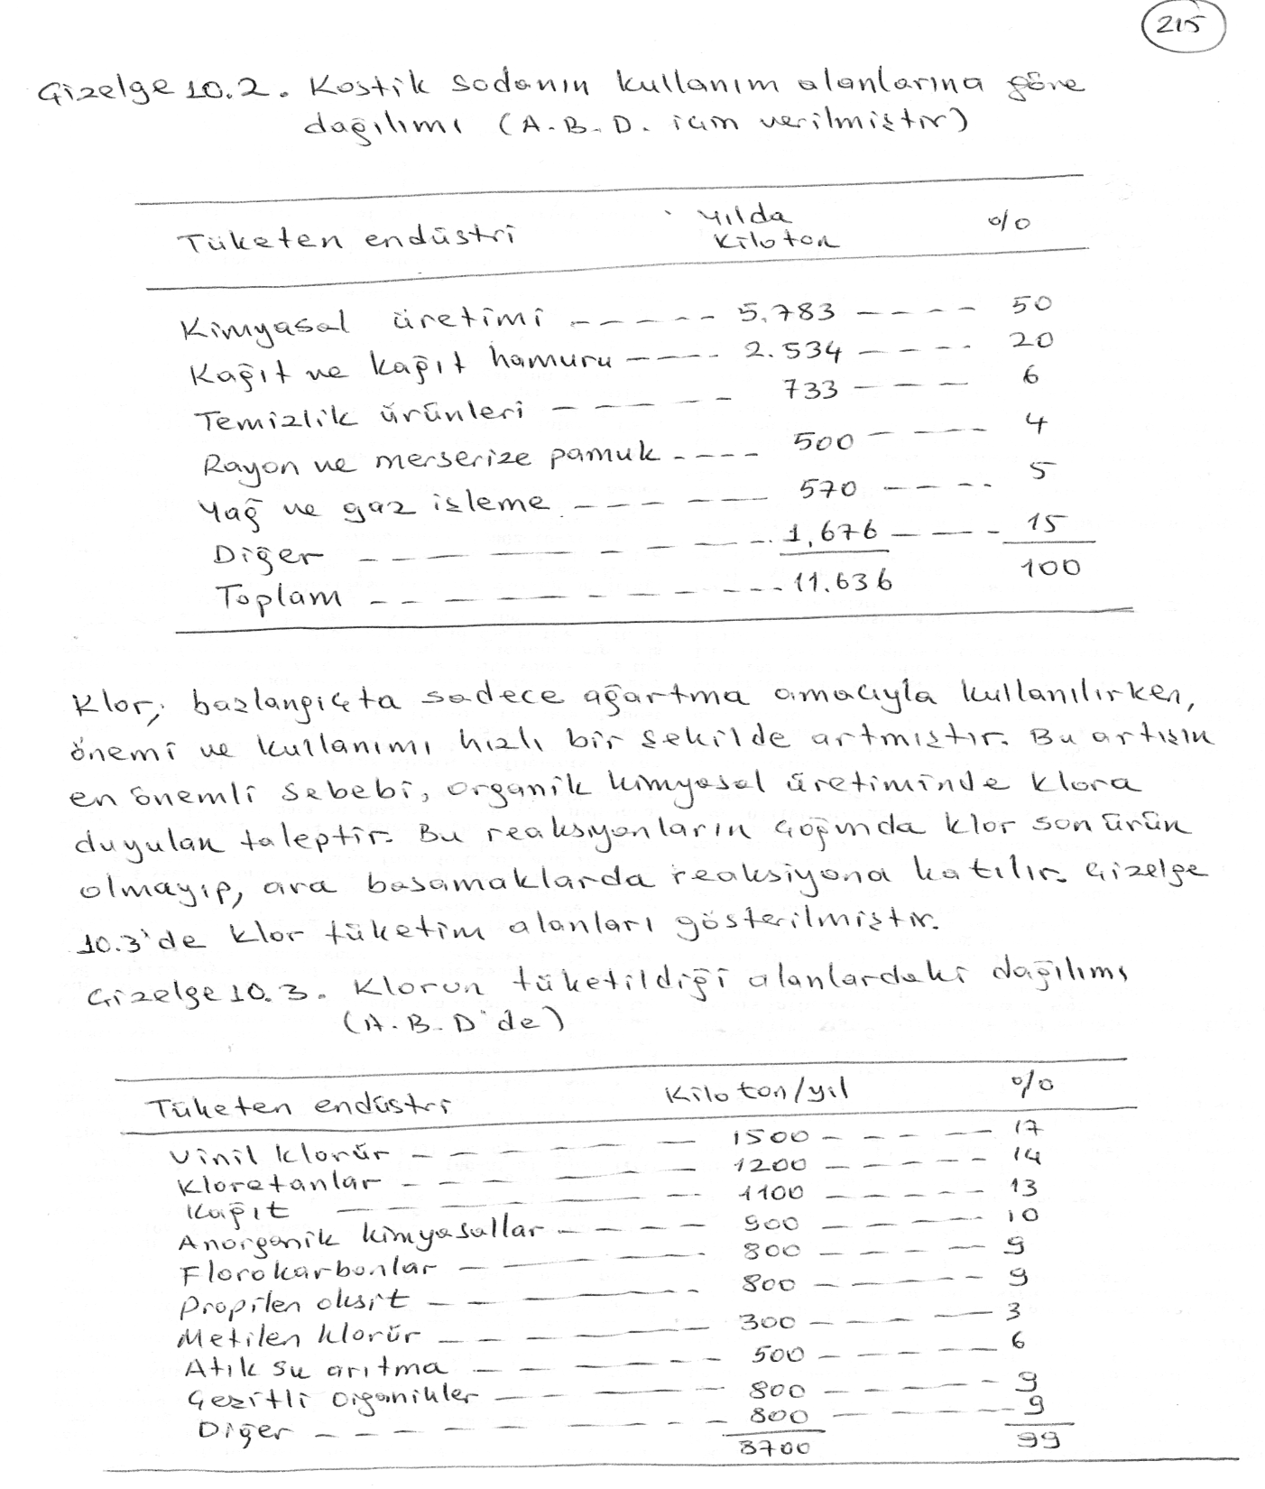

Slide 7
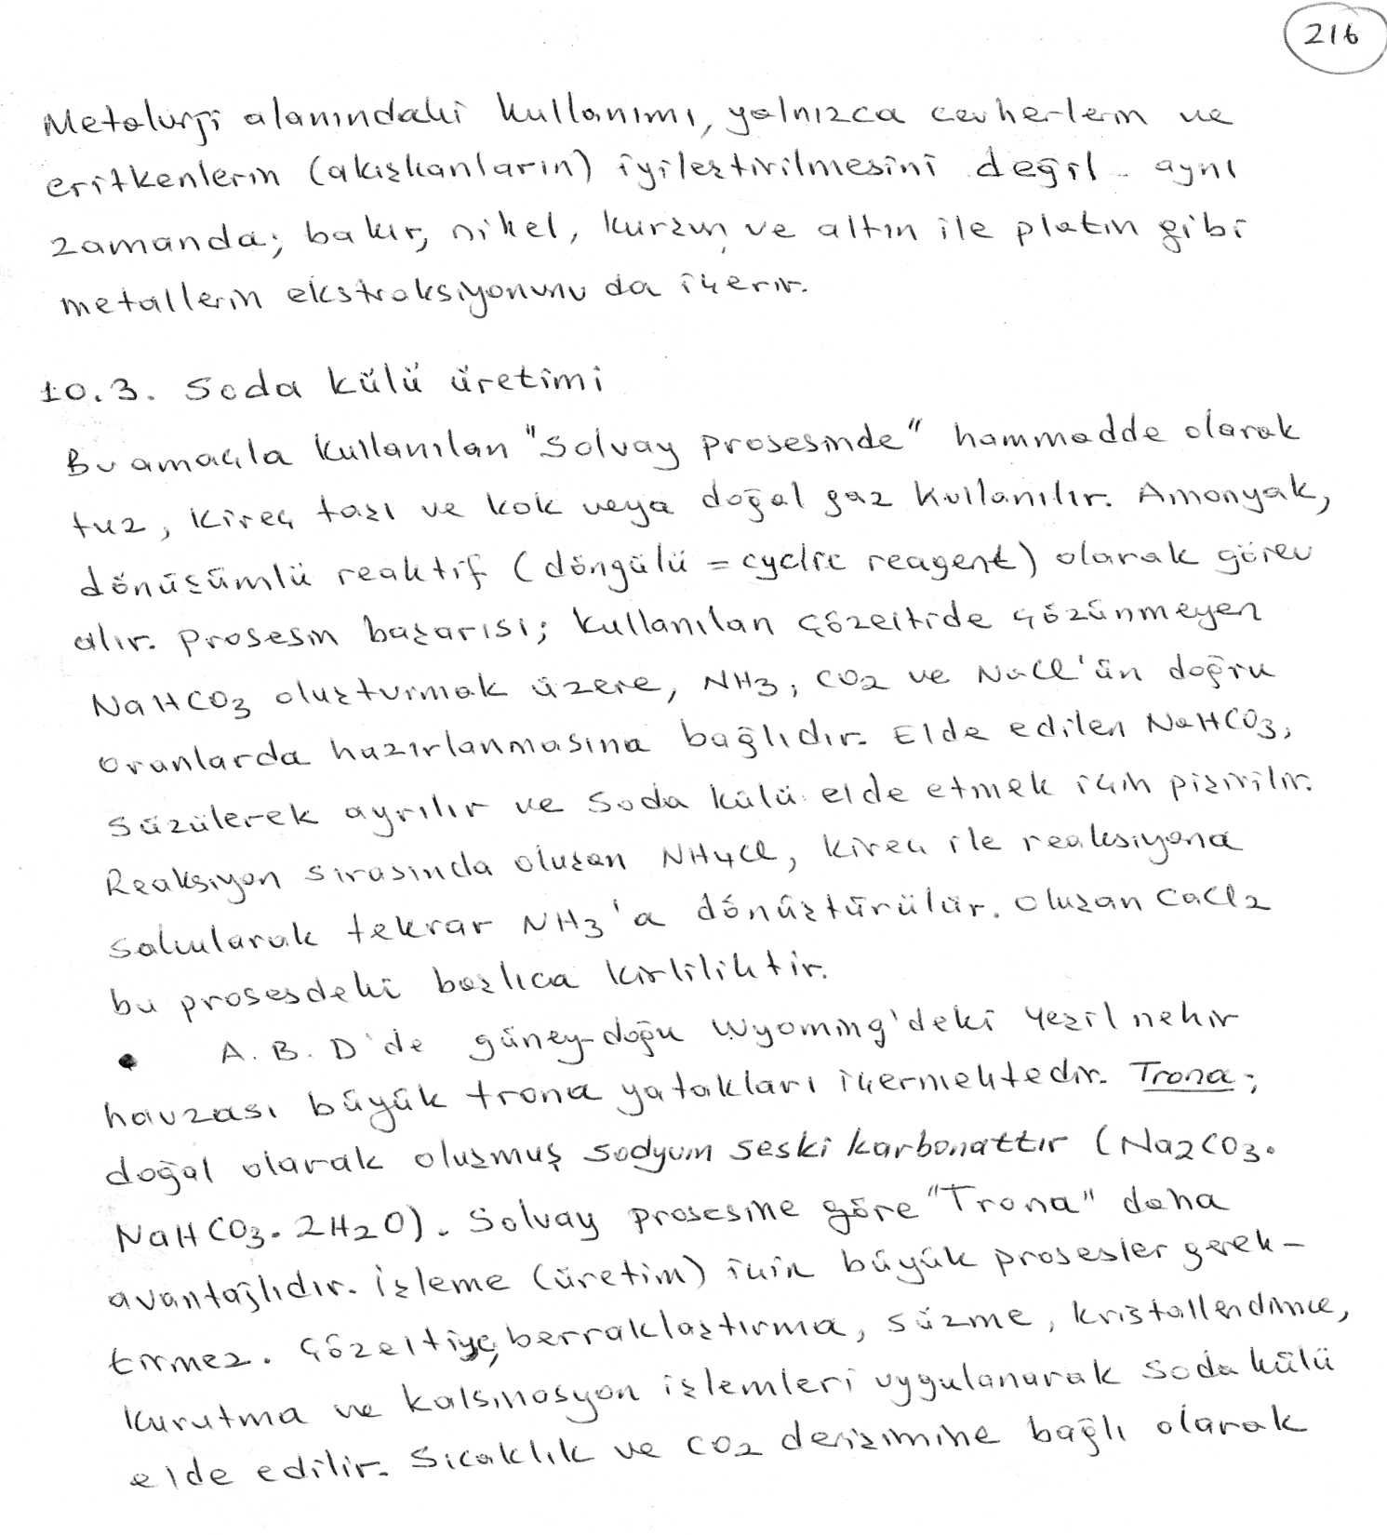
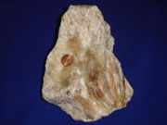
Trona

Slide 8
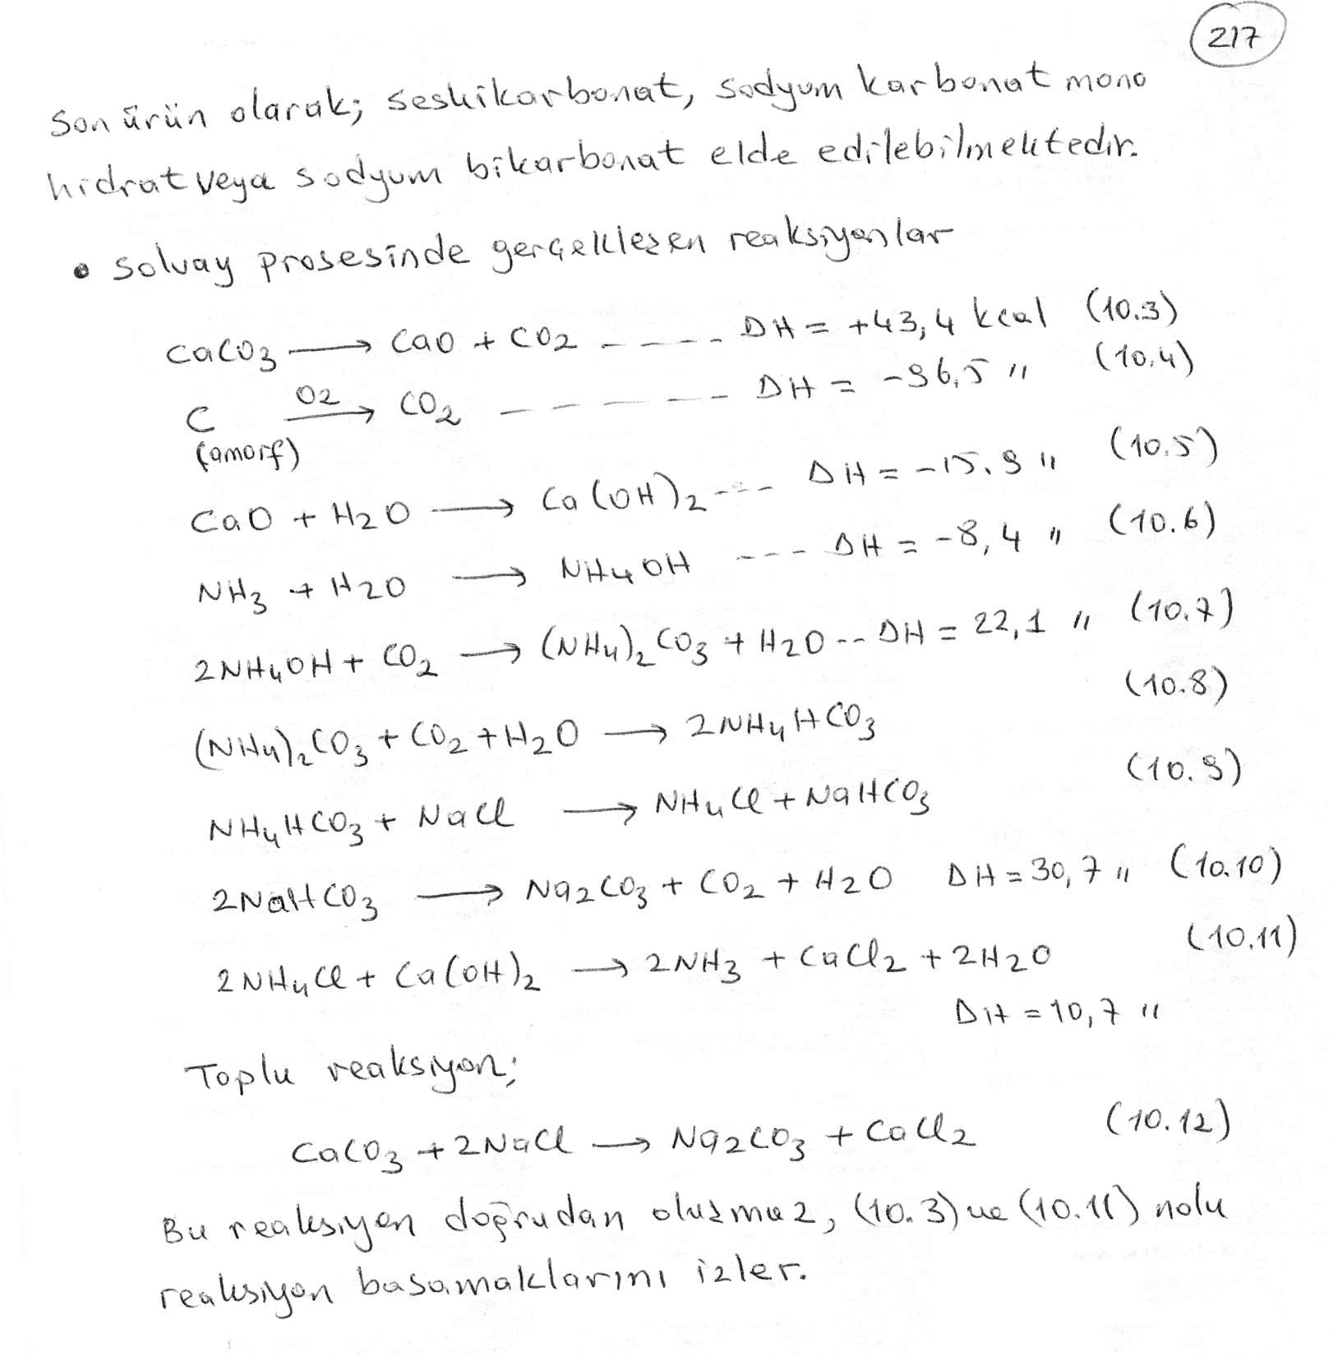

Slide 9
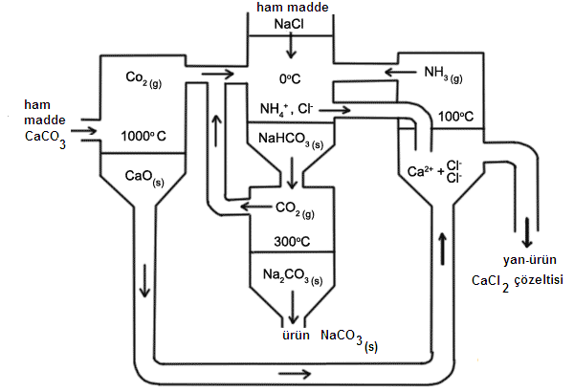
Şekil 10.2. Solvay Prosesi akım diyagramı

Slide 10
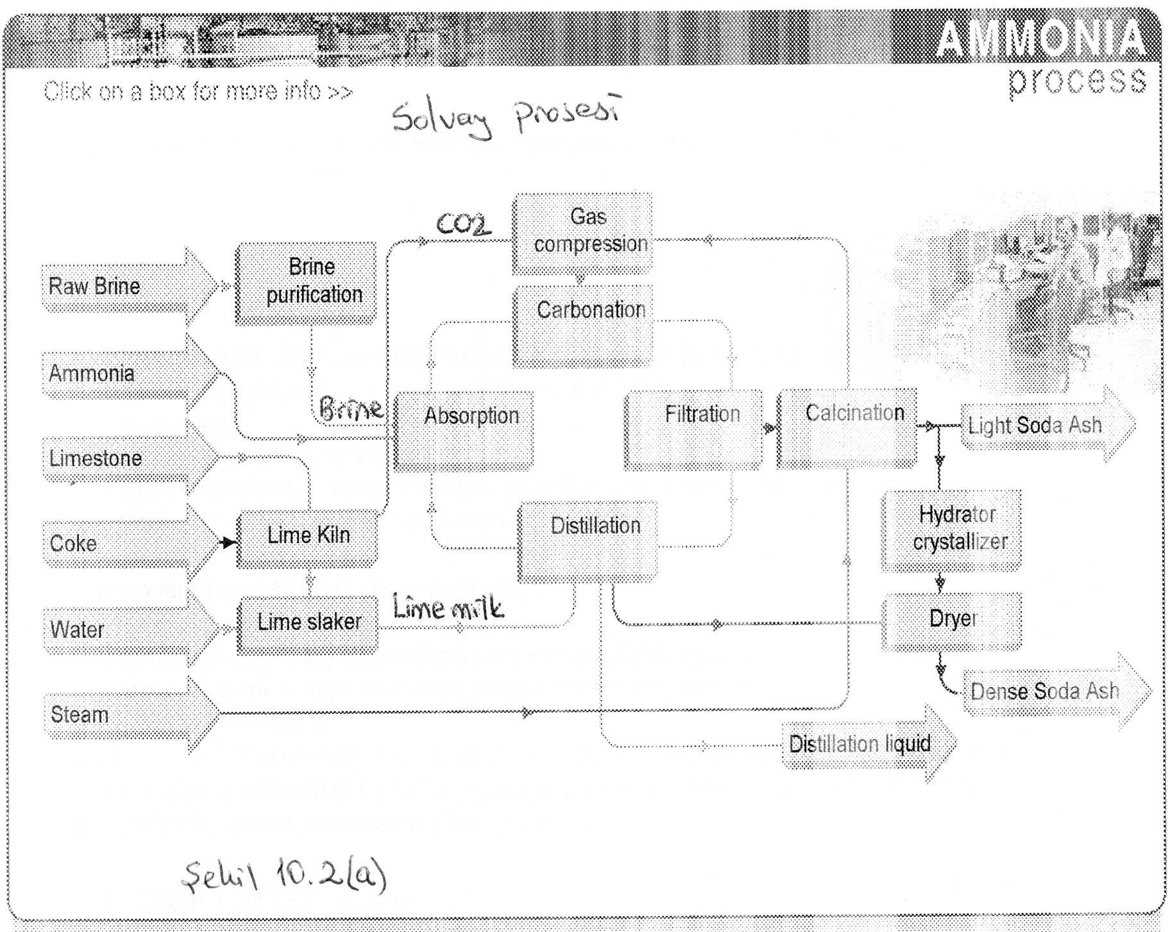

Slide 11
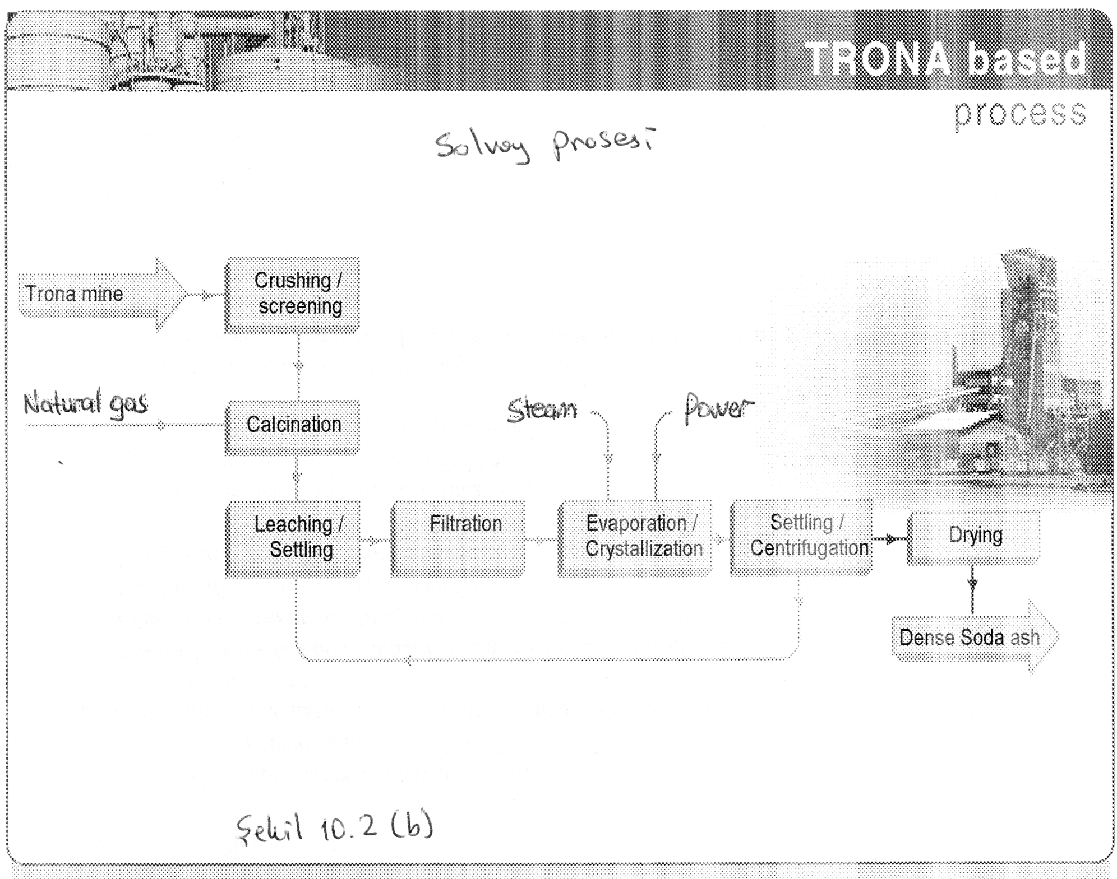

Slide 12
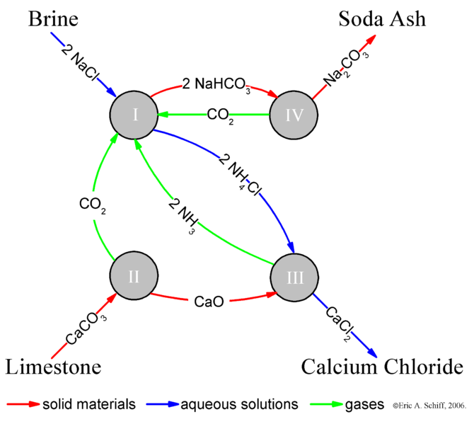
Solvay Prosesi özet
NaCl + CO₂ + NH₃ + H₂O → NaHCO₃ + NH₄Cl (I)
CaCO₃ → CO₂ + CaO (II)
2 NH₄Cl + CaO → 2 NH₃ + CaCl₂ + H₂O (III)
2 NaHCO₃ → Na₂CO₃ + H₂O + CO₂ (IV)

Slide 13
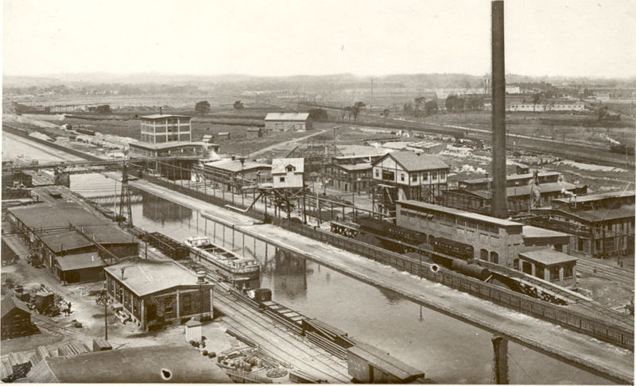
Soda külü üretim tesisi U.S/New york

Slide 14
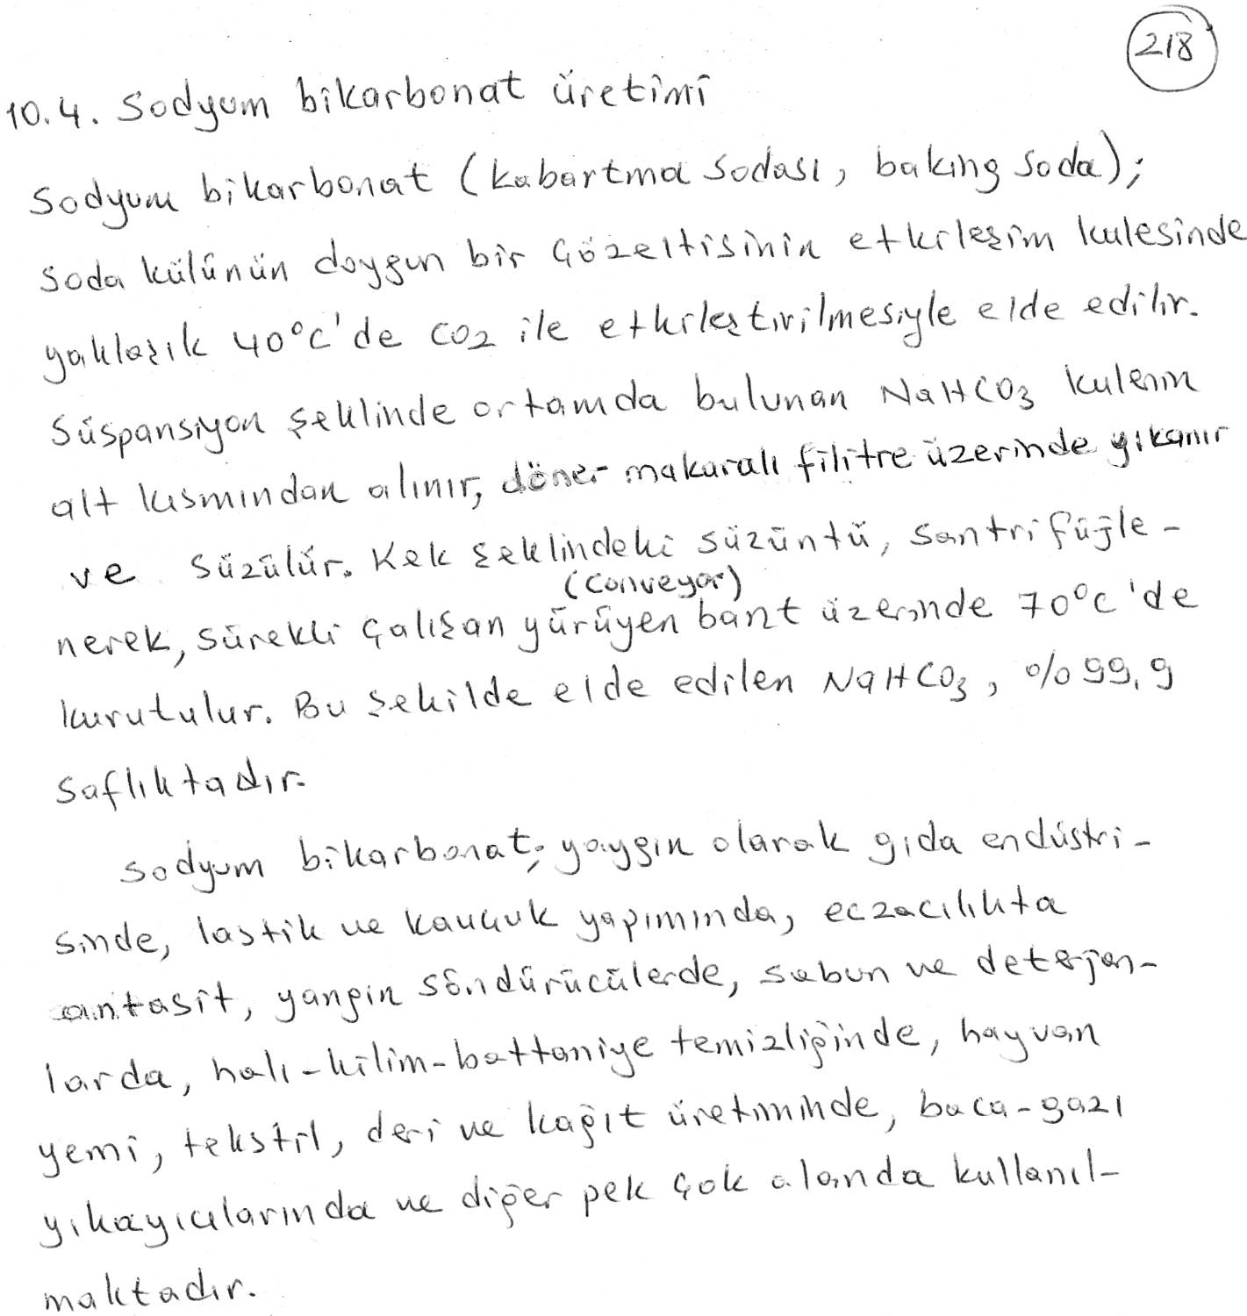
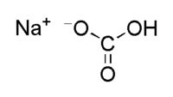

Slide 15
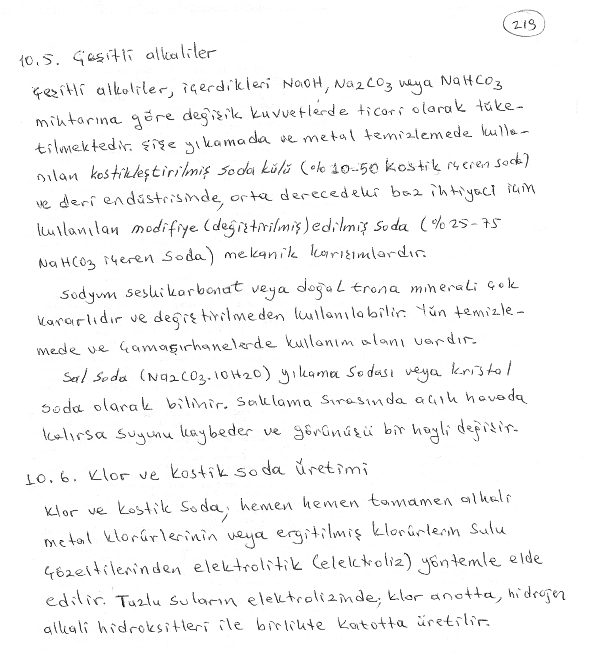

Slide 16
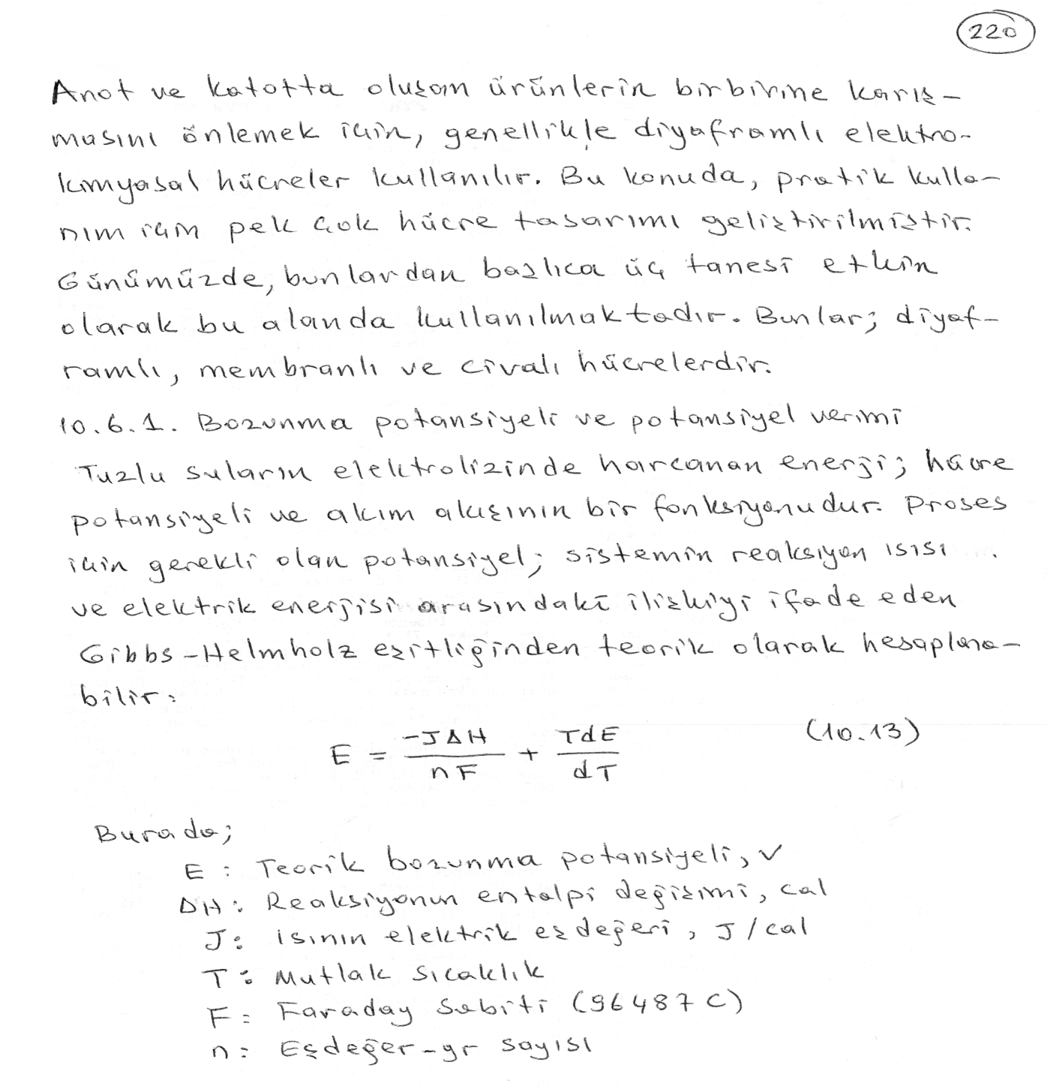

Slide 17
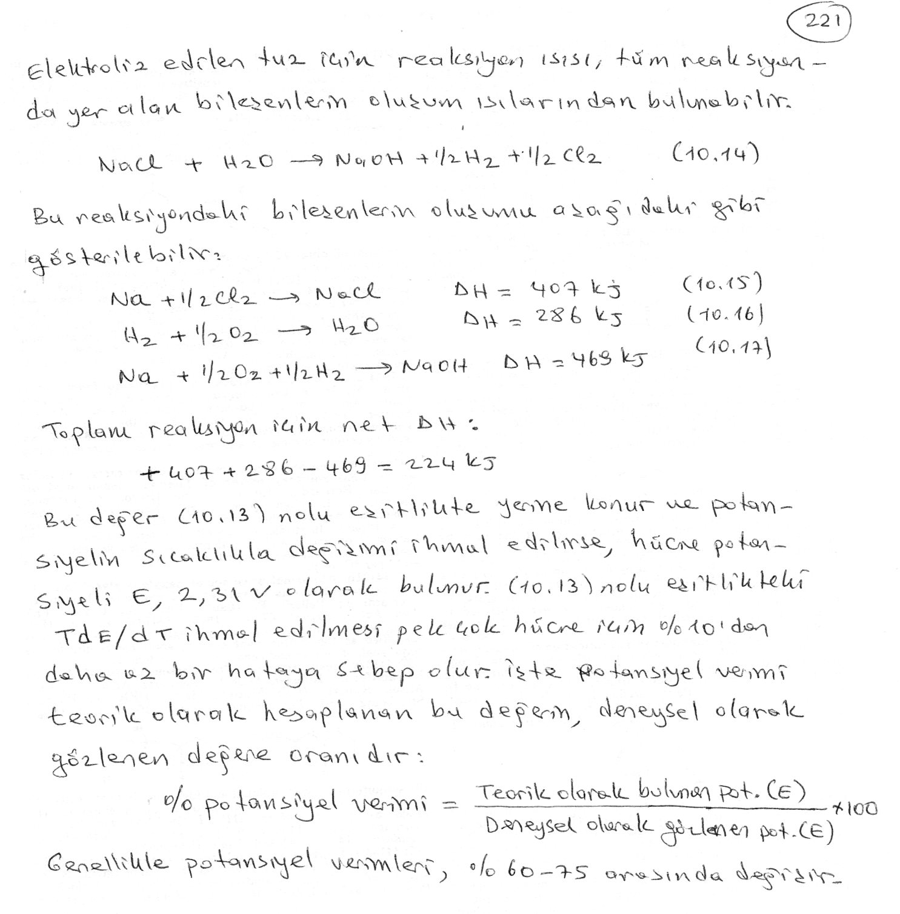

Slide 18
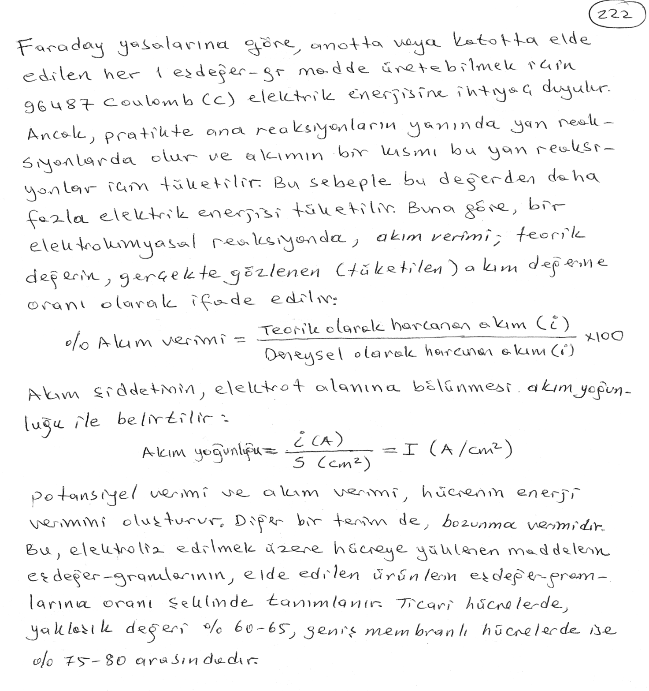

Slide 19
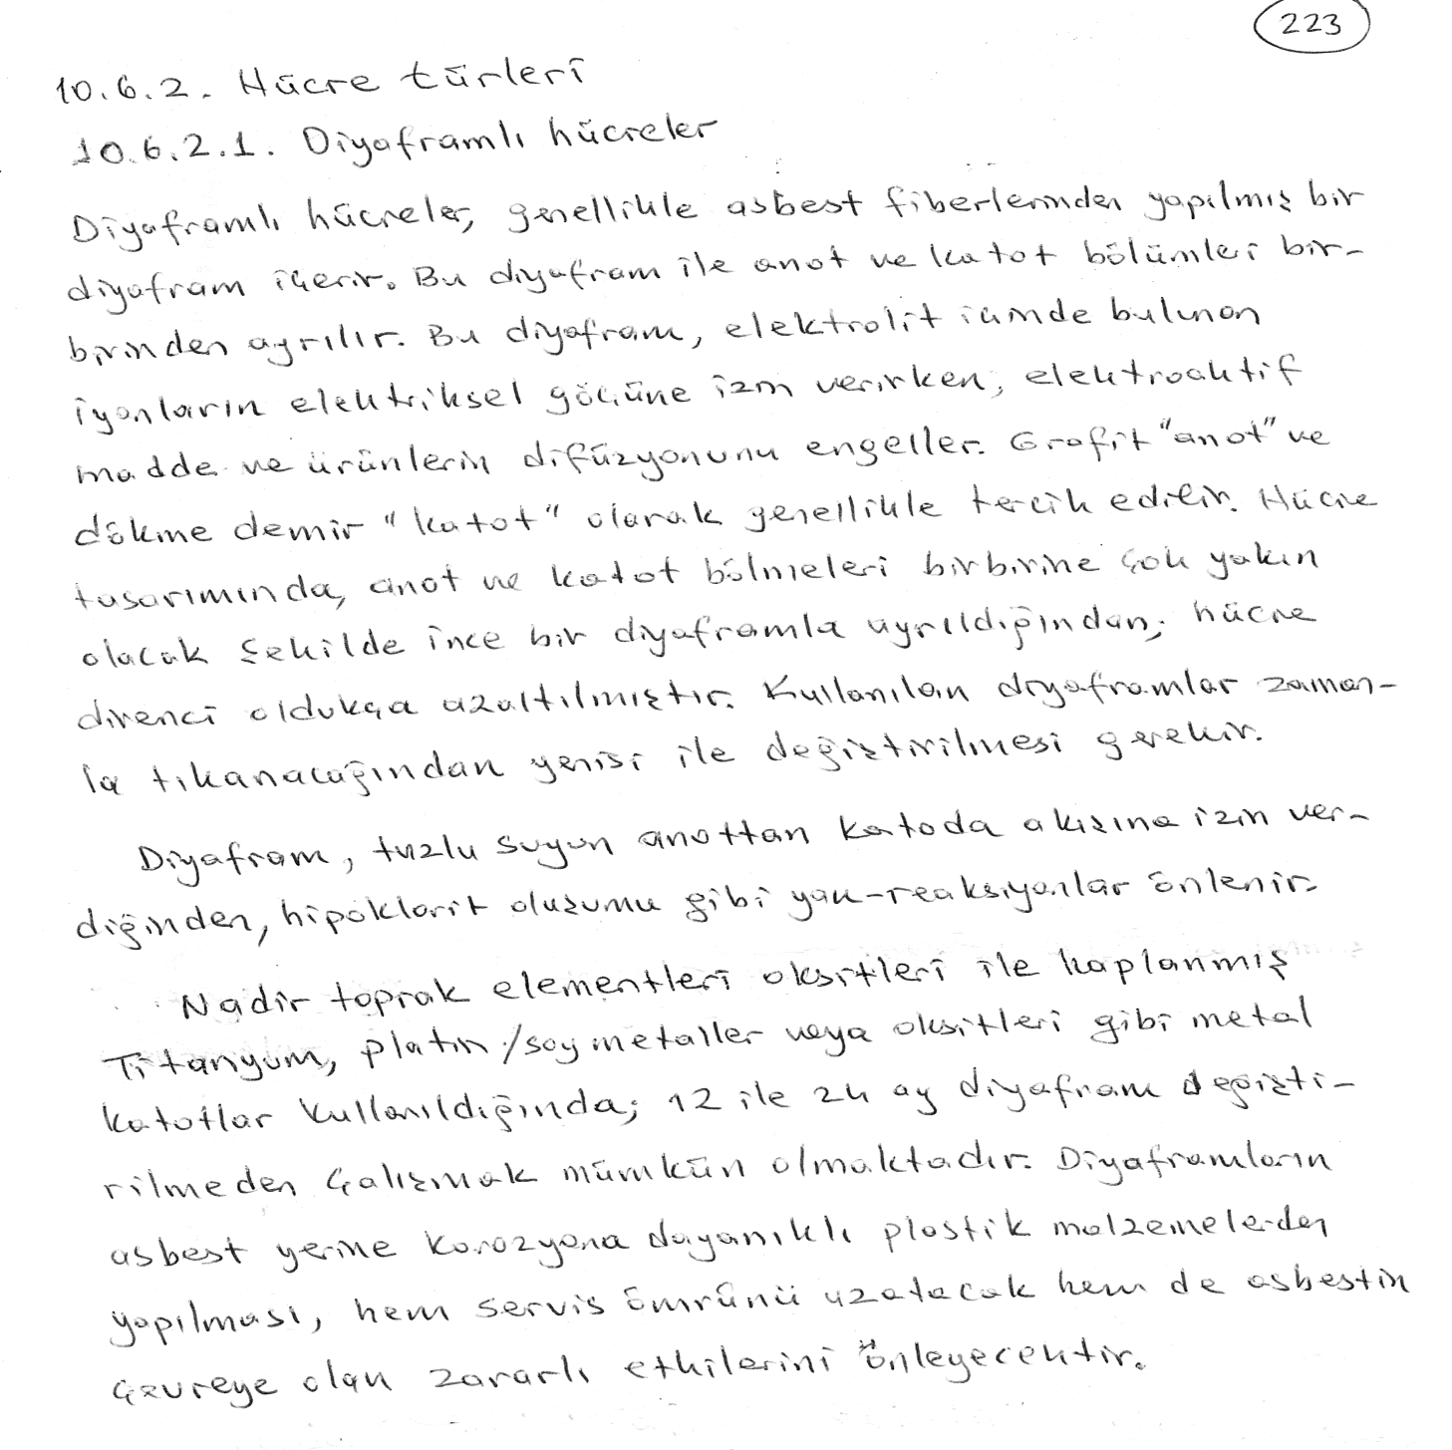

Slide 20
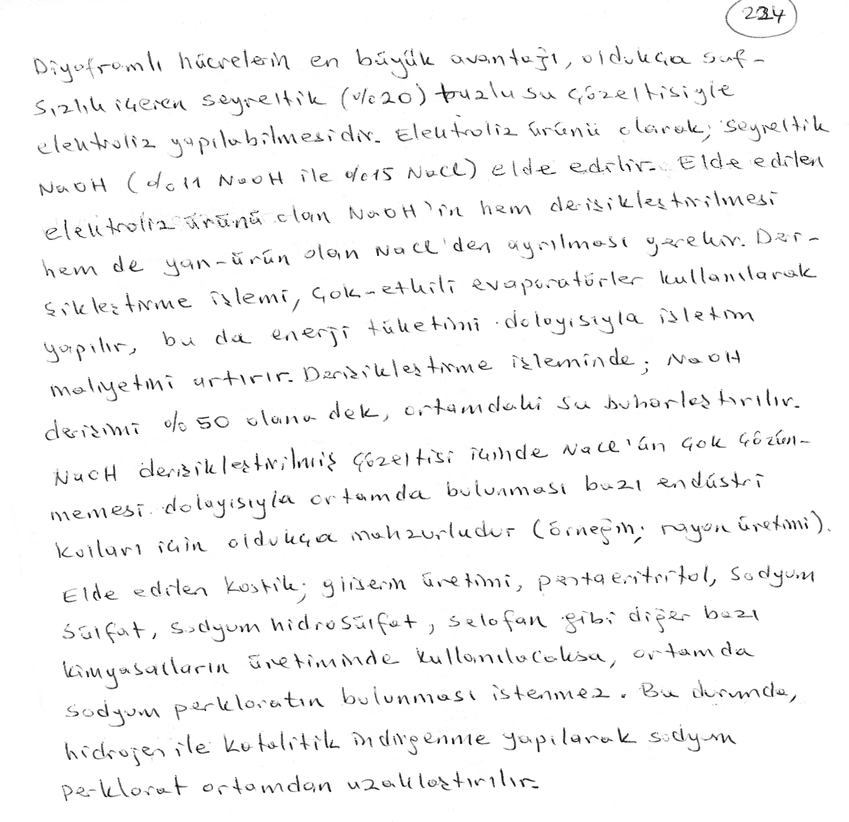

Slide 22
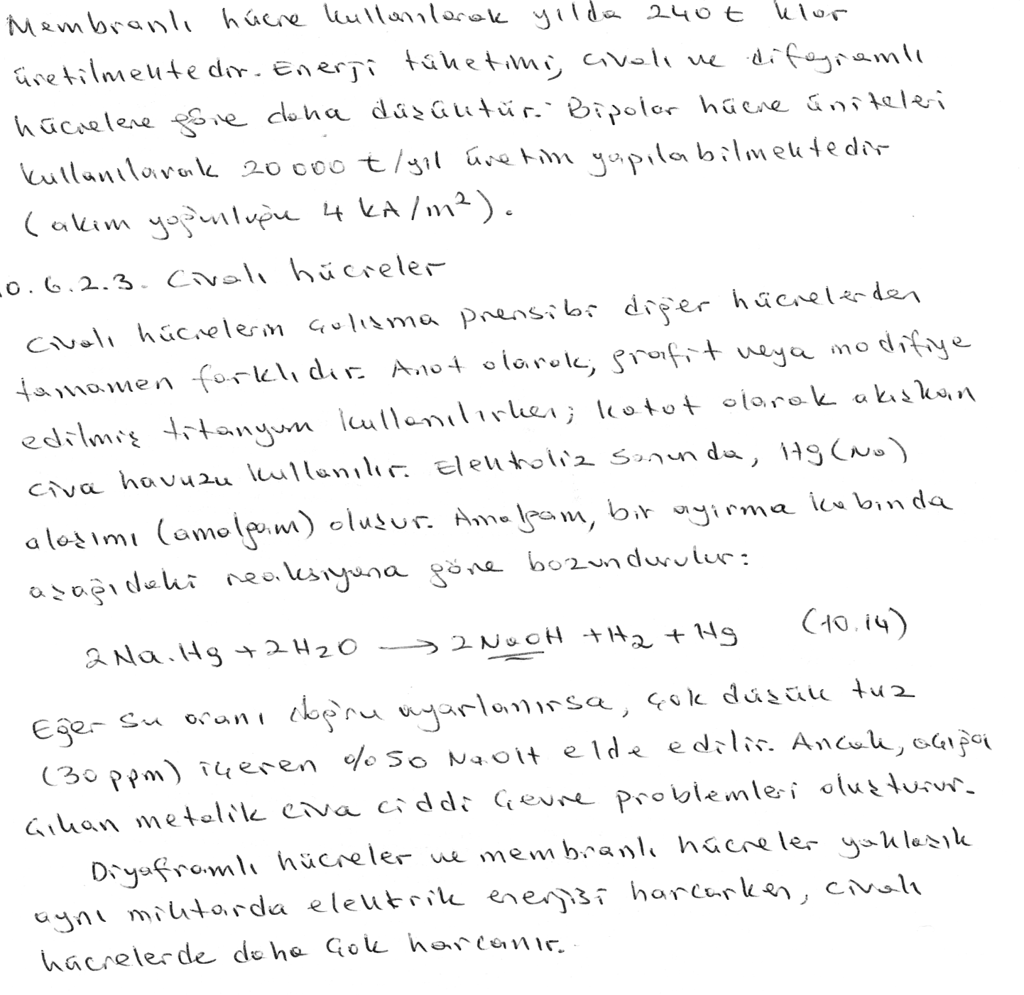

Slide 23
Chloralkali electrolysis is a technique for the industrial production of chlorine and the alkali known as caustic soda (sodium hydroxide) from brine, a solution of common table salt (sodium chloride) in water. Three processes are in use: the diaphragm-cell process, the membrane-cell process, and the mercury-cell process. In the diaphragm-cell process, a porous diaphragm divides the electrolytic cell, which contains brine, into an anode compartment and a cathode compartment. When an electric current passes through the brine, the salt’s chlorine ions and sodium ions move to the electrodes. Chlorine gas is produced at the anode, and sodium ions at the cathode react with the water, forming caustic soda. Some salt remains in the solution with the caustic soda and can be removed at a later stage. In the membrane-cell process, the compartments are separated by a membrane rather than a diaphragm. Brine is pumped into the anode compartment, and only sodium ions pass into the cathode compartment, which contains pure water. Thus, the caustic soda produced has very little salt contamination. In the mercury-cell process, mercury, which flows along the bottom of the electrolytic cell, serves as the cathode. When an electric current passes through the brine, chlorine is produced at the anode and sodium dissolves in the mercury, forming an amalgam of sodium and mercury. The amalgam is then poured into a separate vessel, where it decomposes into sodium and mercury. The sodium reacts with water in the vessel, producing the purest caustic soda, while the mercury returns to the electrolytic cell.

Slide 24
Chlor-Alkali Membrane Cell Process
Caustic soda (NaOH) and chlorine are produced by the electrolysis of an aqueous solution of sodium chloride (brine). Previous technologies used in the chlor-alkali process included the use of mercury and diaphragm cells. Due to pollution concerns, the mercury cell technology has nearly been displaced as there are less than 10 of these plants operating in the U.S. Diaphragm cell technology is still in use, but newer plants are turning to a newer technology because the older diaphragm cells utilitze asbestos in the cells. The increased economics of the new membrane process are also a deciding factor.
.
The newest chlor-alkali processes rely on an ion-exchange membrane to separate the sodium and chloride ions of the sodium chloride. The ion-exchange membranes typically fluoropolymer based and can contain sulfonic acid groups. Figure 1 represents a condensed overview of a membrane cell process

Slide 25
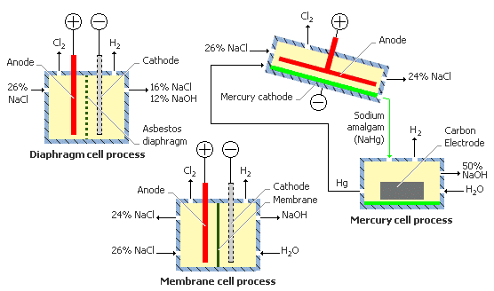
Chloralkali Electrolysis

Slide 26
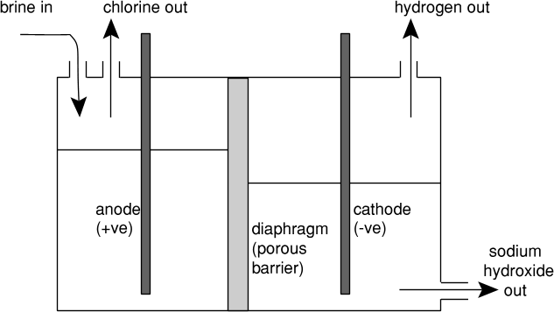

Slide 27
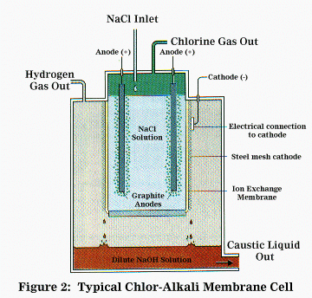
2 NaCl (aq) + 2 H₂O (l) ---> H₂ (g) + Cl₂ (g) + 2 NaOH (aq)
anode compartment
2Cl – à Cl₂ + 2e – or
Cl – à ½ Cl₂ + e –
cathode compartment
2H₂O + 2e – à H₂ + 2 OH – or
2H+ + 2e – à H₂

Slide 28
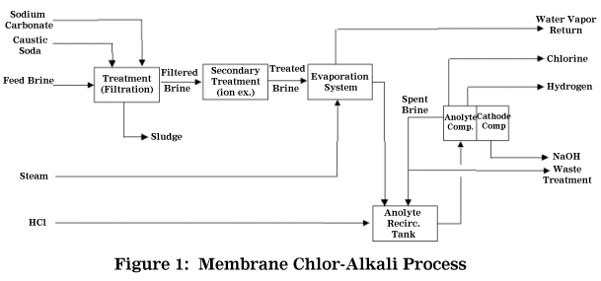

Slide 29
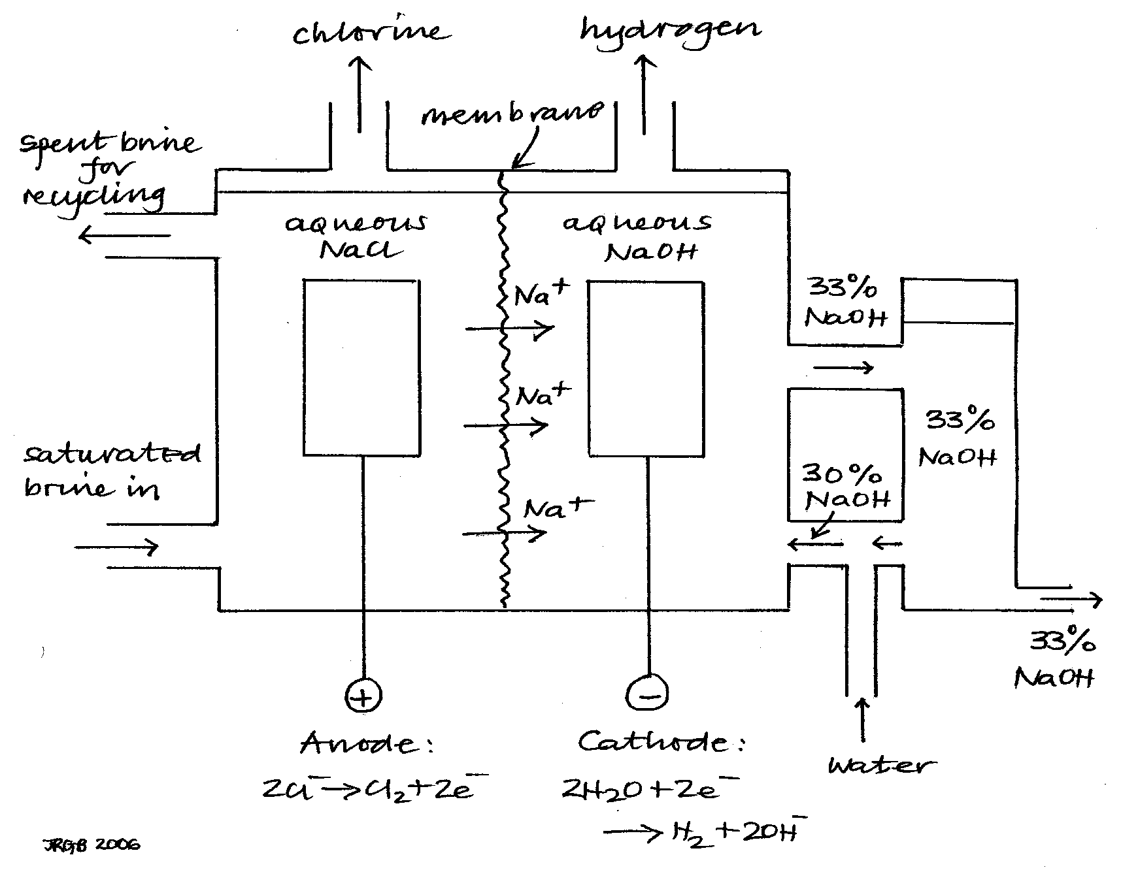
Membranlı hücre

Slide 30
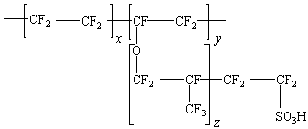
PTFE called Naflion (a du Pont polymer), the structure being given below.

Slide 31
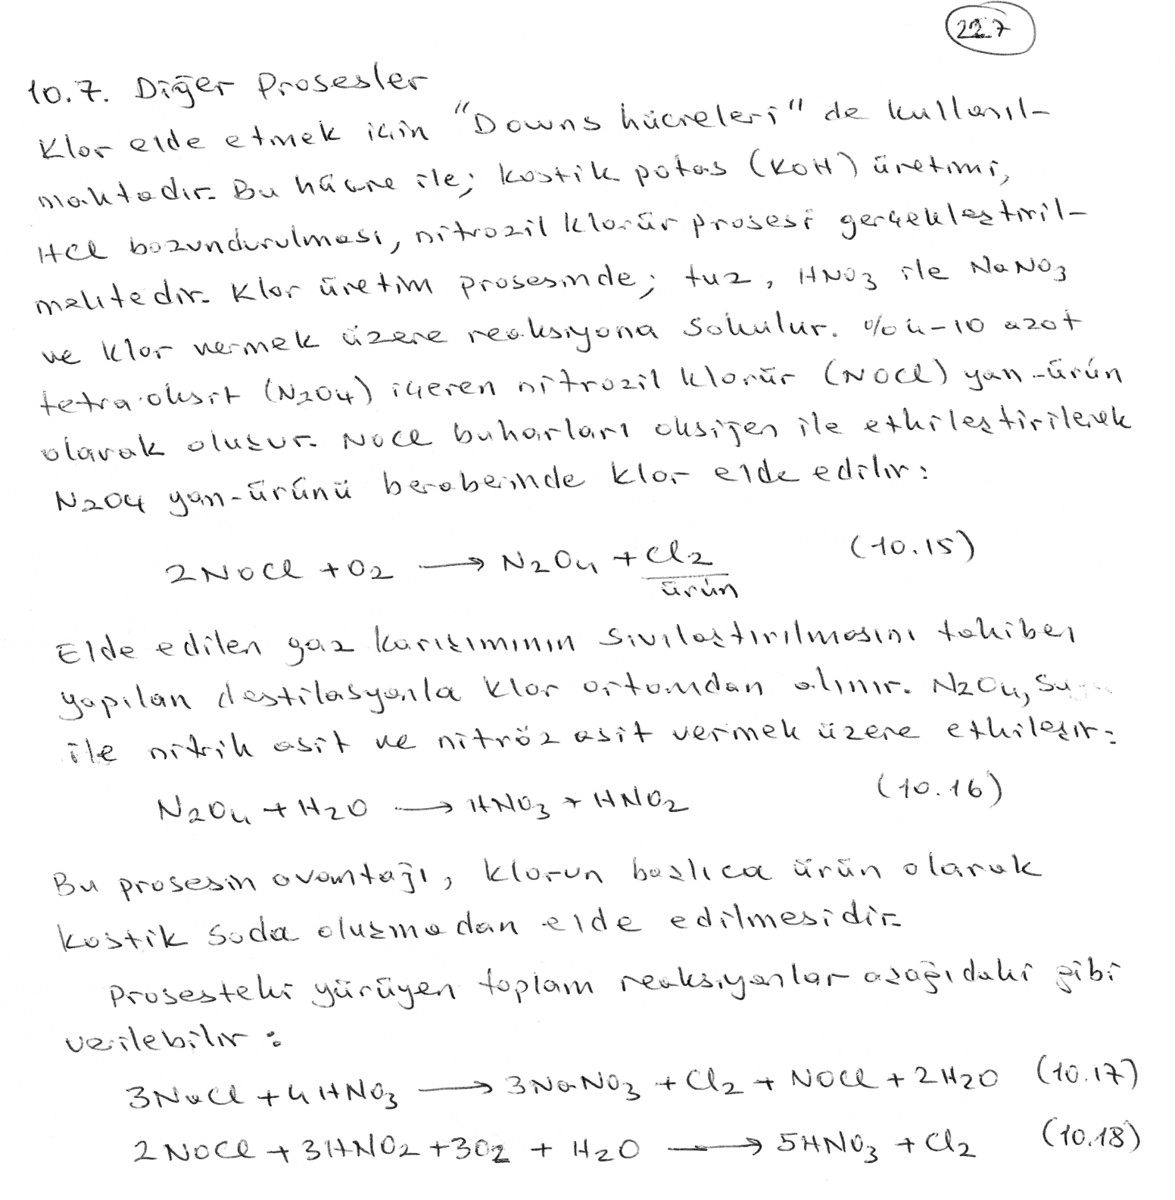

Slide 32
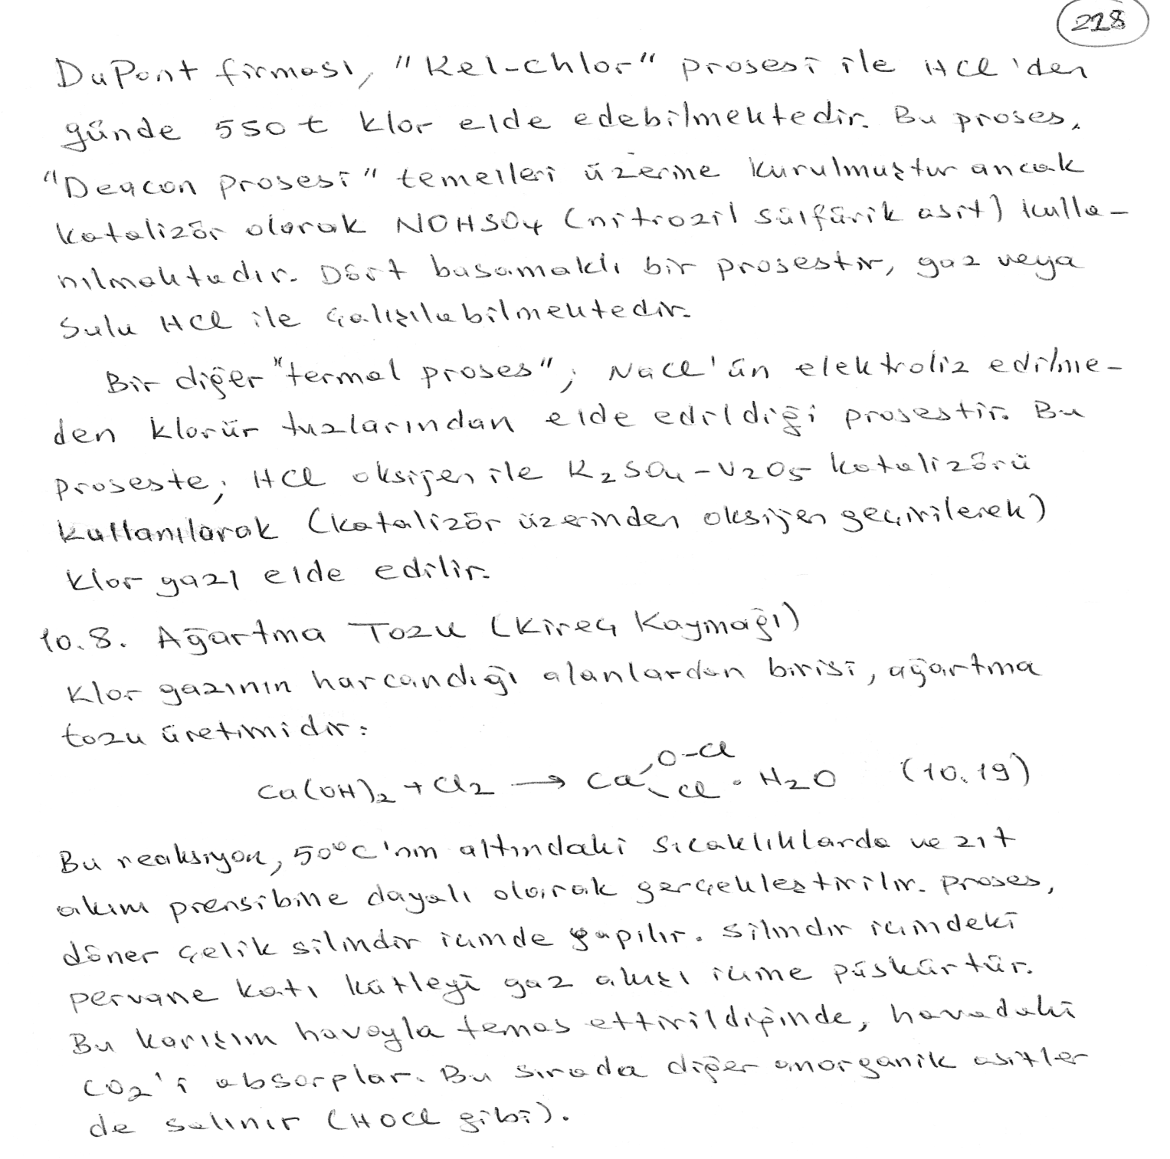

Slide 33
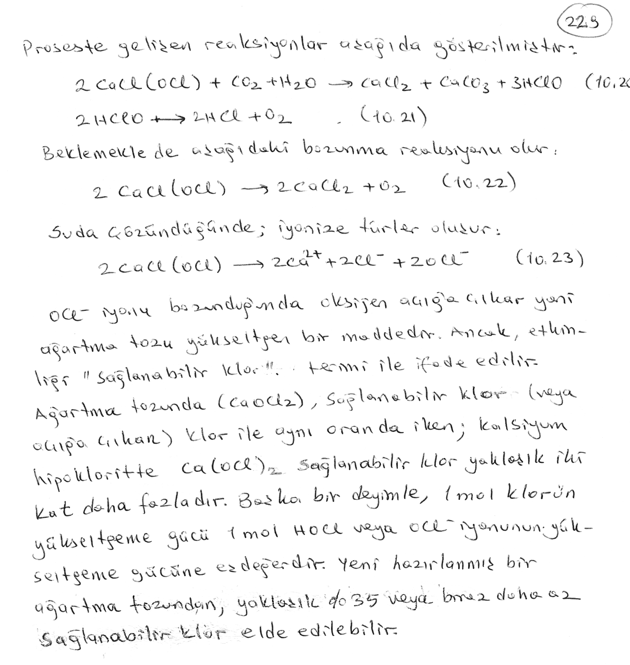

Slide 34
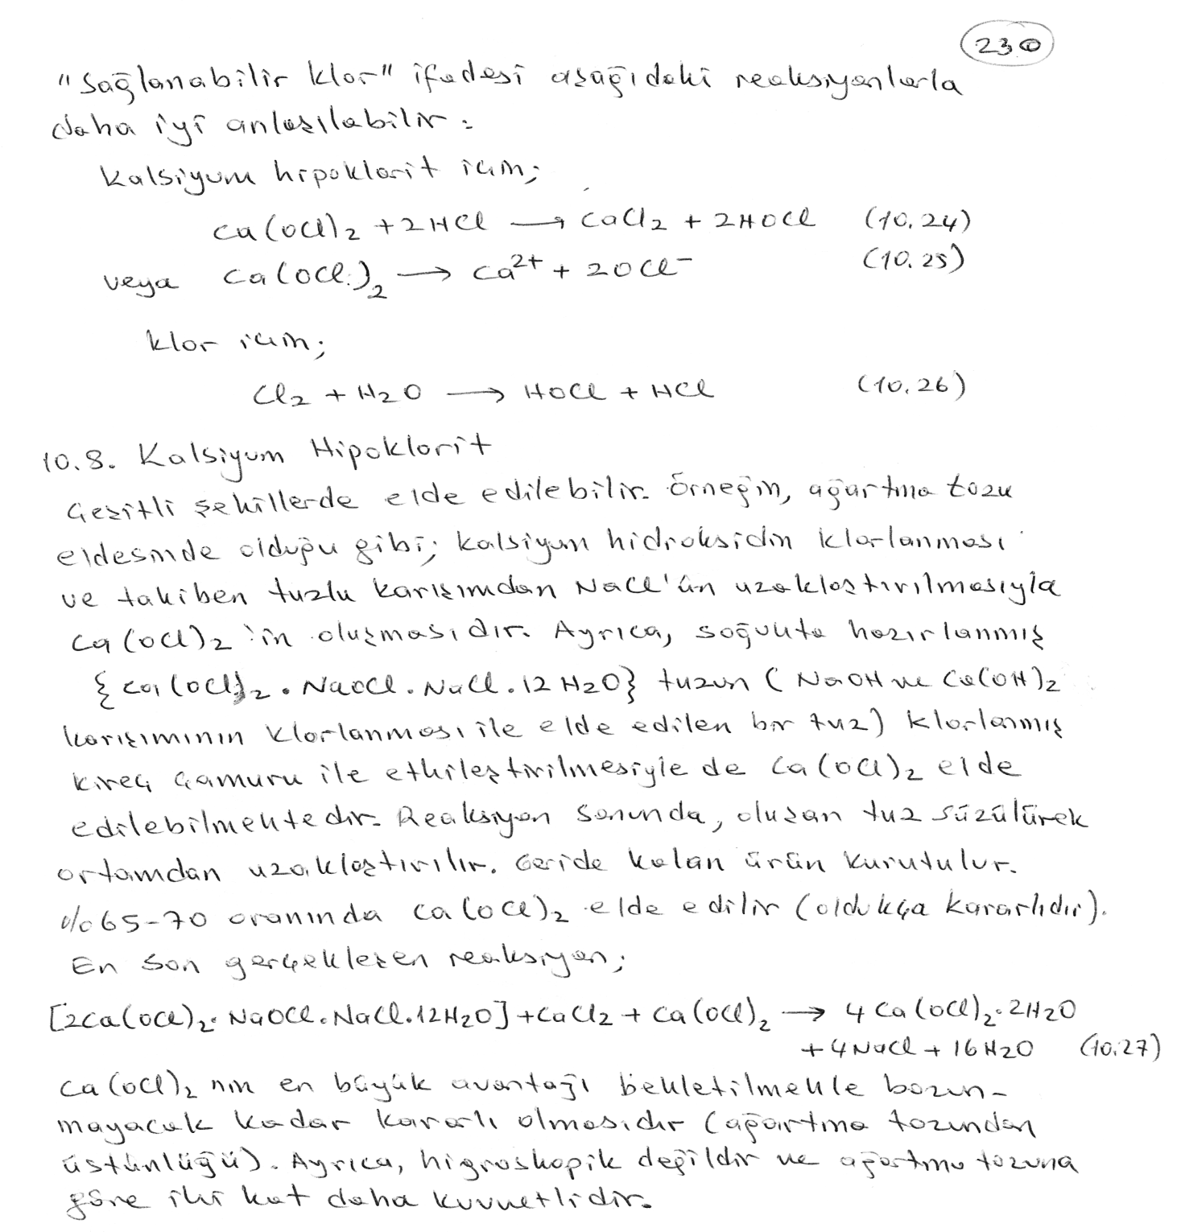

Slide 35
bleaching powder
bleaching powder, white or nearly white powder that is usually a mixture of calcium chloride hypochlorite, CaCl(OCl); calcium hypochlorite, Ca(OCl)₂; and calcium chloride, CaCl₂. Sometimes called chloride of lime, it can be prepared by reacting calcium hydroxide or slaked lime, Ca(OH)₂, with chlorine gas, Cl_{2.} It is used as a strong bleaching agent, as a disinfectant, and in making Javelle water. Bleaching powder was first produced in 1799 by Charles Tennant in Glasgow, Scotland.

Slide 36
Javelle water
Javelle water or Javel water (both: zhuvel') [key], Fr. eau de Javelle, aqueous solution of sodium or potassium hypochlorite. It was originally made near the French town of Javelle (now part of Paris) and was the first chemical bleach, a use first demonstrated by C. L. Berthollet in 1785. It was produced by passing chlorine gas through a water solution of potash (potassium carbonate). After the invention of bleaching powder Javelle water was sometimes produced by reacting the bleaching powder with potash or soda ash (sodium carbonate). Now usually sodium hypochlorite solution, it is used in bleaching and as a disinfectant.

Slide 37
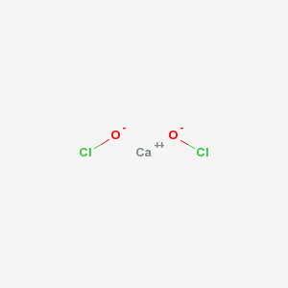
IUPAC Name | calcium dihypochlorite
CAS Number | 8031-48-9
Chemical Formula | CaCl₂O₂
Calcium hypochloride; Hypochlorous Acid, Calcium Salt; Losantin; Hy-Chlor; Chlorinated lime; Lime chloride; Chloride of lime; Calcium oxychloride; Calciumhypochlorit (German); Hipoclorito de calcio (Spanish); Hypochlorite de calcium (French

Slide 38
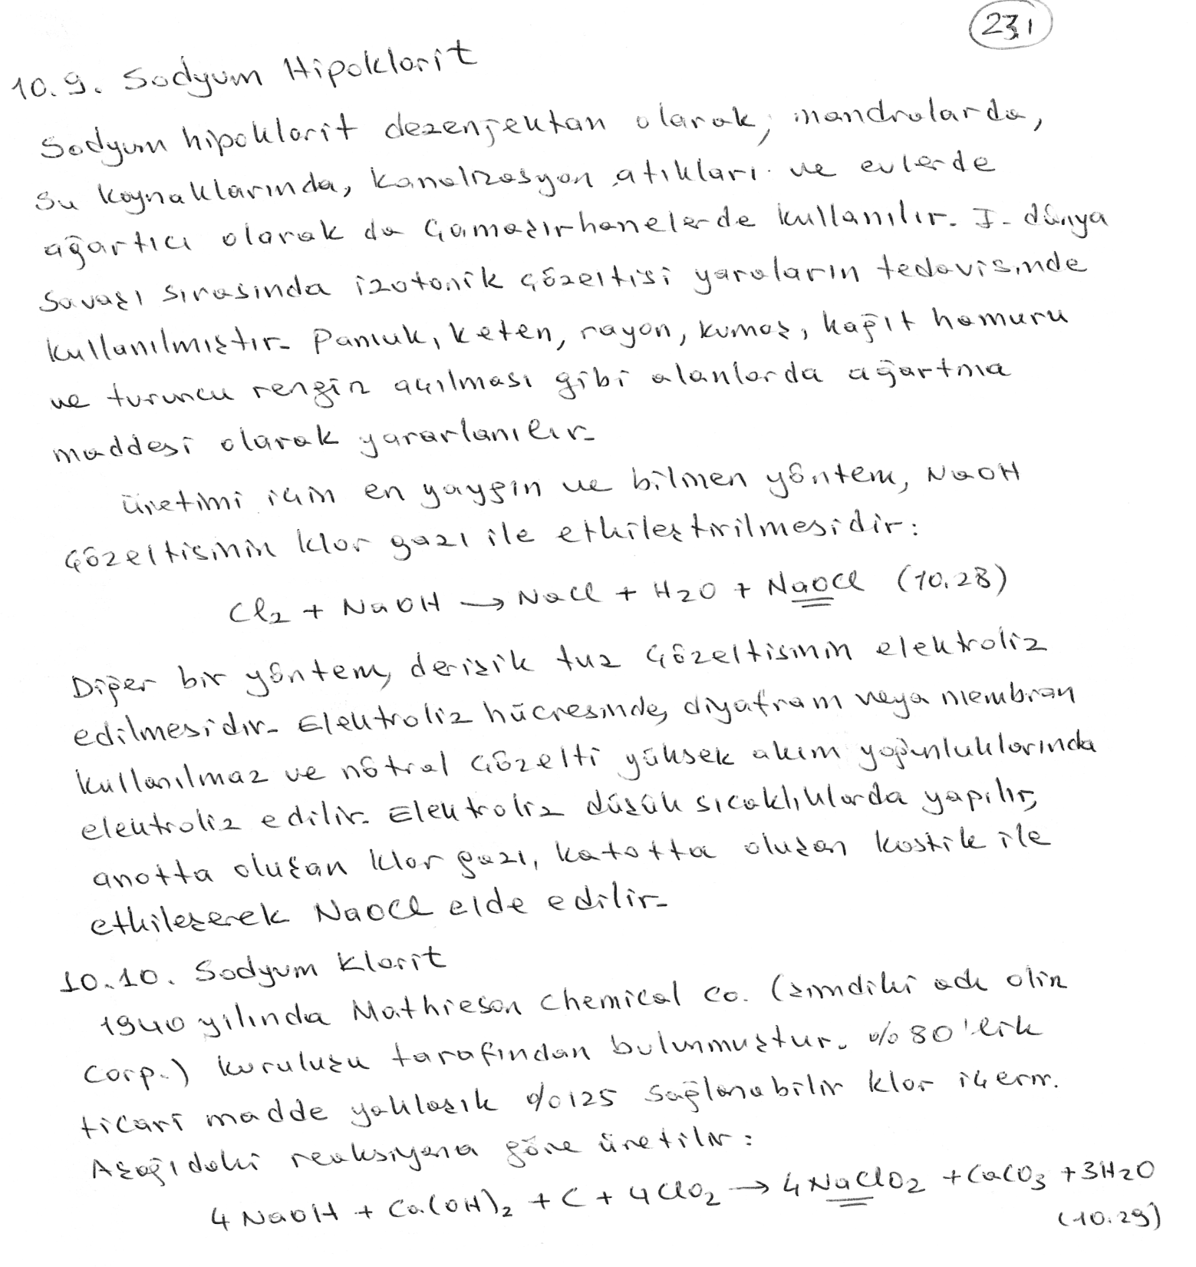

Slide 39
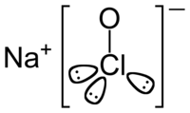
Sodium hypochlorite is a chemical compound with the formula NaClO. A solution of sodium hypochlorite is frequently used as a disinfectant and as a bleaching agent; indeed, often it is simply called "bleach", though other chemicals are sometimes given that name as well.
Sodium hypochlorite may be prepared by absorbing chlorine gas in cold sodium hydroxide solution:
2NaOH + Cl₂ → NaCl + NaClO + H₂O
Sodium hydroxide and chlorine are commercially produced by the chloralkali process, and there is no need to isolate them to prepare sodium hypochlorite. Hence NaClO is prepared industrially by the electrolysis of sodium chloride solution without any separation between the anode and the cathode. The solution must be kept below 40 °C (by cooling coils) to prevent the formation of sodium chlorate

Slide 40
